Slide 1
Marijuana: Implications for Society
Kevin A. Sabet, Ph.D.
Co-Founder, Project SAM (Smart Approaches to Marijuana)
Asst. Professor, UF College of Medicine
www.kevinsabet.com
www.learnaboutsam.org

Slide 2
Marijuana
The number and percentage of persons aged 12 or older who were current marijuana users in 2011 were 18.1 million or 7% - similar to 2009 and 2010 rates, but higher than those in 2002 through 2008.
From the late 1990s until the mid-2000s marijuana use by adolescents (8th – 12th graders) declined, however they started to rise again in 2006.
In 2012, 22.9% of 12th graders used marijuana in the past month – an increase from 18.8% in 2007.

Slide 3
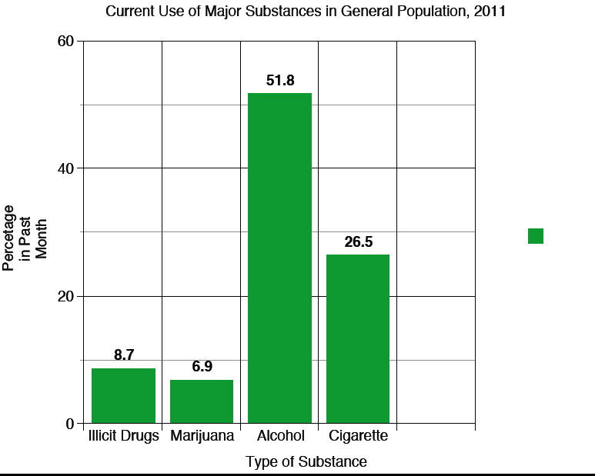
Major Substances in General Population, 2011

Slide 4
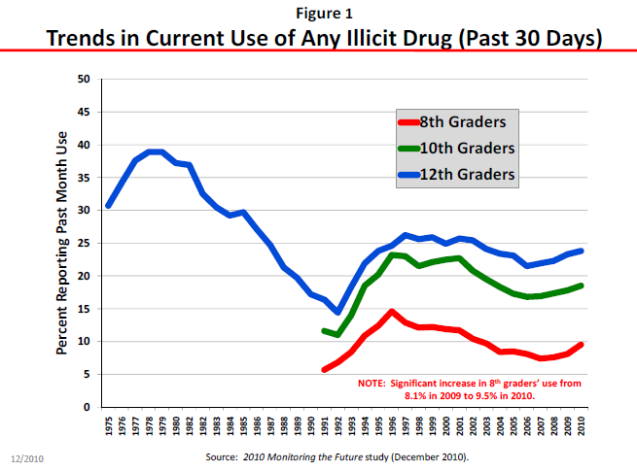

Slide 5
Alcohol & Tobacco Money Makers or Dollar Drainers
Alcohol
T obacco
$185
bil.
$200
bil.
Costs
$14 bil.
$25 bil.
Revenues
Kevin A. Sabet, Ph.D., www.kevinsabet.com

Slide 6
Marijuana’s Health Effects
Most people who use marijuana once
will stop, and not become addicted.
1 in 6 kids who try marijuana
will become addicted.
For people who keep smoking marijuana, the health harms
are underappreciated and costly.

Slide 7
Potency: Increased THC Content
in Seized Marijuana
PERCENT THC FROM 1983 TO 2009
10%
9%
8%
7%
6%
5%
4%
3%
2%
1%
0
’85
’90
’95
’00
‘05
Sources: The University of Mississippi Potency Monitoring Project
Kevin A. Sabet, Ph.D., www.kevinsabet.com

Slide 8
282
Heroin
351
Stimulants
358
Hallucinogens
175
Inhalants
Dependence on or
Abuse of Specific Illicit
Drugs
Persons 12 or Older, 2008
451
Tranquilizers
126
Sedatives
1,411
Cocaine
4,199
Marijuana
1,716
Pain Relievers
Substance Abuse and Mental Health Services Administration. (2009). O$ce of Applied Studies. Treatment Episode Data Set (TEDS): 2009 Discharges from Substance Abuse Treatment Services, DASIS.

Slide 9
Long Term Effects of Marijuana
ESTIMATED PREVALENCE OF DEPENDENCE AMONG USERS
32
23
17
15
11
9
8
5
Tobacco
Alcohol Marijuana Cocaine Stimulant Analgesics Psychedelics
Source: Wagner, F.A. & Anthony, J.C. From first drug use to drug dependence; developmental periods of risk for dependence upon cannabis, cocaine, and alcohol. Neuropsychopharmacology 26, 479-488 (2002).
Heroin

Slide 10
Increased Marijuana Treatment Admissions 1993 and 2007
PERCENT OF ADMISSIONS
60%
1993 2007
50%
40%
30%
20%
10%
0
Alcohol
Cocaine
Heroin
Marijuana
Source: Treatment Episode Data Set, US Health and Human Services, 1993 & 2007
Kevin A. Sabet, Ph.D., www.kevinsabet.com

Slide 11
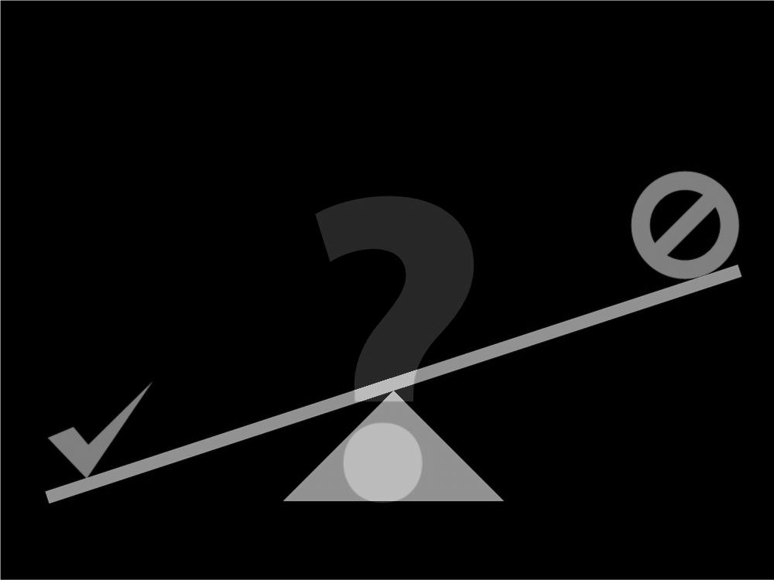
All or nothing?
Legalization vs. Incarceration-Only

Slide 12
Marijuana and Kids
The adolescent brain is especially susceptible to marijuana use.
That means that when kids use, they have a greater chance of addiction since their brains are being primed.
If used regularly before 18, new research shows that IQ drops by 8 points at age 38, even when that person has stopped.

Slide 13
Chair, Patrick J. Kennedy
Launched January 10th, Denver
Over 5,000 press mentions
Public Health Board of Trustees

Slide 14
To inform public policy with the science of today’s marijuana.
To have honest conversation about reducing the unintended consequences of current marijuana policies, such as lifelong stigma due to arrest.
To prevent the establishment of Big Marijuana that would market marijuana to children — and to prevent Big Tobacco from taking over Big Marijuana. Those are the very likely results of legalization.
To promote research of marijuana’s medical properties and produce pharmacy-attainable medications.

Slide 15
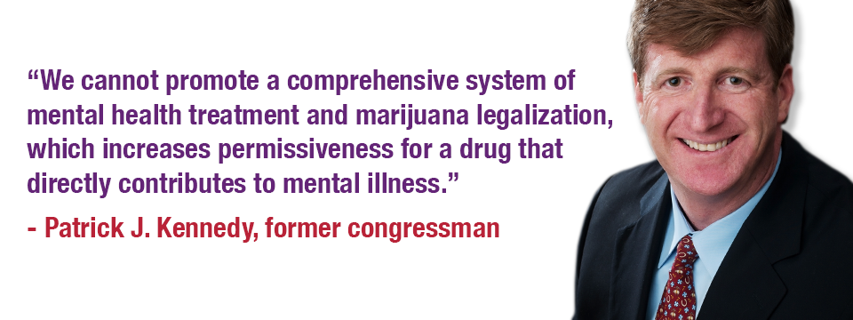

Slide 16
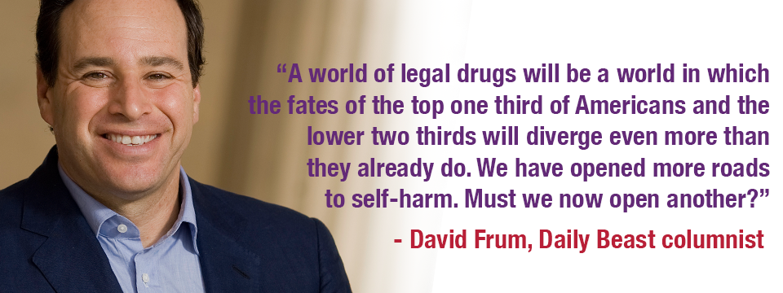

Slide 17
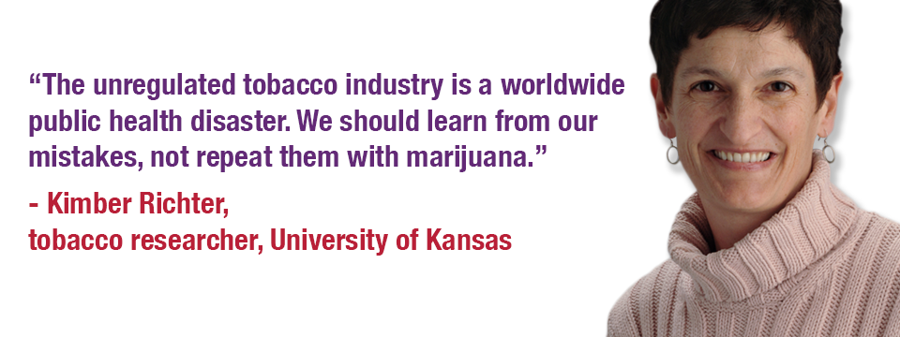

Slide 18
One Week Later: Results
Over 5,000 media hits
Hundreds of supporting emails
Numerous endorsements
Political interest
Financial donations
Website with information and cites
Social Media: Twitter, Facebook

Slide 19
Future
Nationwide infrastructure to support local partners in getting this message out
CADCA, NNOAC, California, Colorado, Ohio, Michigan, Oregon, Washington, Rhode Island, Massachusetts

Slide 20
“If Only We Treated It Like Alcohol…”
2.7 million
Arrests for alcohol-related crimes in 2008
847,000
Marijuana-related arrests in 2008
(Does NOT include violence;
Includes violations of liquor laws and driving under the influence)
Kevin A. Sabet, Ph.D., www.kevinsabet.com

Slide 21
Effect of Legalization on
Price & Consumption
RAND: Price Will Drop
More Than 80%
Consumption Will Increase
Tax evasion a major concern

Slide 22
What incentives do legal corporations have to keep price low and consumption high?
Alcohol:
“Drink Responsibly”
and Tax Low

Slide 23
Legalization:
Experience Elsewhere?
No modern nation has tried legalization, though most Western countries do not imprison people for simple marijuana possession.
The Netherlands, Portugal, Italy use rates lower for some drugs since 10 years ago; higher for others.
The Dutch experienced a three-fold increase in marijuana use among young adults after commercialization expanded.

Slide 26
Underground Markets
and Crime
RAND: Mexican Drug Trafficking Organizations (DTOs) earn 15-25% of revenue from marijuana.
It is highly likely that legalization
would not eliminate black markets for drugs.
State Legalization: 2-4% impact on DTO revenues (California)
Most legalization proposals call for taxes on drugs, which increases likelihood that markets will remain endemic.
TCOs involved in numerous illegal trades

Slide 27
Taxes Necessary to Prevent a Price Collapse Are Enormous (Caulkins)
Excise taxes create gray markets
Most relevant metrics are
Price per unit weight
Price per unit volume
Canada tried but had to repeal ~300% excise taxes on tobacco

Slide 28
Medical Marijuana

Slide 29
Bypassing the FDA Process
Before FDA approves a drug as medicine, testing is done to:
Determine the benefits and risks of the drug
Determine how it may interact with other drugs
Assure standardization of the drug
Determine the appropriate dosage levels
Identify and monitor side effects
Identify safe drug
administration

Slide 30
Compassionate care or
increased access to marijuana?
>80%
Most card holders in CA and CO are white men between the ages of 17 and 35
No history of chronic illness
History of Alcohol and Drug Use

Slide 31
That doesn’t mean that components
in marijuana do not have medical properties.
These are being scientifically developed.

Slide 32
Compassionate care increased access to marijuana?
<5%
Only 10% of card holders are cancer, HIV/AIDS, or glaucoma patients
90% are registered for ailments such as headaches and athlete’s foot

Slide 33
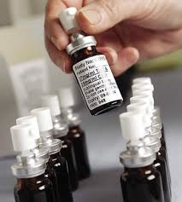
Cannabis-Based Medicines
Sativex is in the process of being studied
Approved in Canada and across Europe
Administered via an oral spray
Research on the efficacy of cannabinoids is not focused on raw/crude marijuana, but in the individual components that may have medical use.

Slide 34
Let’s Not Go Back Here
The Liggett Group: “If you are really and truly not going to sell [cigarettes] to children, you are going to be out of business in 30 years.”
R. J. Reynolds: “Realistically, if our company is to survive and prosper, over the long term we must get our share of the youth market.”

Slide 35
Lorillard: “The base of our business is the high school student.”
Phillip Morris: “Today's teenager is tomorrow's potential regular customer… Because of our high share of the market among the youngest smokers, Philip Morris will suffer more than the other companies from the decline in the number of teenage smokers.”

Slide 36
There are alternatives…
Smart
International
Prevention
Treatment
Recovery
Enforcement
Efforts

Slide 37
Thank You!
Questions?
Email
kevinsabet@gmail.com

