Slide 1
Marijuana Legalization Issues: Where Can We Go?
A Roadmap for Public Health Success and an Appeal for a Smart Approach
Dr. Kevin A. Sabet
Co-Founder, Project SAM (Smart Approaches to Marijuana)
Assistant Professor, University of Florida
Director, Drug Policy Institute
President, Policy Solutions Lab

Slide 2
Why Are We Having This Discussion?

Slide 3
Because Legalization Proponents Have Been Brilliant… …And We Have Not Been!

Slide 4
They have framed the debate this way:

Slide 5
All or nothing: Legalization vs. Prohibition

Slide 6
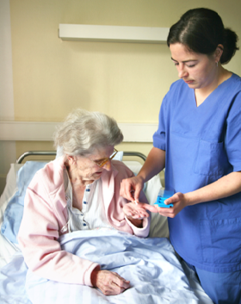

Slide 7
Legalization is now a reality.
And it is gaining support every year.

Slide 8
Support for Marijuana Legalization Has Reached Unprecedented Levels
Sources: Gallup http://bit.ly/olrSEQ and GSS

Slide 9
In one mathematical model, legalization reaches 70% support in 5 years…

Slide 10
Factors Leading to Increase
Outspent
Messenger problem
(generational familiarity)
Seen and framed as
sensible alternative

Slide 11
We Are Often on the Defensive
We have not admitted where we have drug policy challenges.
Nontraditional groups have rejected our message.
Our message has become stale: “Party of No”.

Slide 12
We Risk Losing Key Groups Traditionally Against Legalization
…Blacks and Hispanics
…women/soccer moms
…new immigrants
…Independents and Moderate Democrats
…Republicans

Slide 13
In Washington State, 47% of the counties that voted for Obama in the presidential election also voted AGAINST Legalization
But only 57% that voted for Romney also voted against Initiative 502.
In CO, 76% of those under the age of 35 and 49% of >55 supported legalization.
In CO, we lost low-income voters for the first time. (65% of <$50,000 earners)
In CO, we lost a whopping 74% of those who ID as independents

Slide 14
This is very different than what happened just 2 years ago in CA
Swing Voters
Overall
Notes:
Preliminary Evaluation of Marginal Differences Between Opposition for Prop 19 and Opposition for General Legalization by Demographic
“California voters put up the largest number ever recorded for a legalization referendum, in a year when conservatives took back the House and typically lower mid-term election turnout patterns held. Given the high level of support for legalization in this survey, and the unusual circumstances of this election year, it is very unlikely that Prop 19 was the final word on this issue” Source: Greenberg Quinlan Rosner, 2010

Slide 15
How Can We Turn This Around?

Slide 16
We Need To Recapture
The Middle Ground
The Message That Emphasizes Health
Moms, Dads, Minorities, Independents
Young People

Slide 17
When presented with “regulation” and a “new approach” in the form of legalization, more and more groups are choosing that over the “old way” of “prohibition” – which is associated with a “moralistic” drug policy grounded in fear and
“Reefer Madness”

Slide 18
This is a MIScharacterization of our view
BUT THAT DOESN’T MATTER ANYMORE
Just like it doesn’t matter that no one actually serves prison time for pot…
“PERCEPTION IS REALITY”

Slide 19
We Need To Live with the
“Hand We Are Dealt”
(even if they are myths)
“Jails are full of MJ users”
“Addiction is a health issue”
“Treatment is best/can do no harm”
“We need to try something new”
“Marijuana has been demonized”
“The Drug War Hurts Minorities”
“The Drug War is a Failure”

Slide 20
We Need a REBRANDING
A “SMART APPROACH”
Not about legalization vs. incarceration
We can be against legalization
but also for health, education, and common-sense
We can be against discriminatory laws and practices too.
RECLAIM “REFORM!”

Slide 21
This is a about creating a PERMISSION STRUCTURE for others to support us.
Medical MJ gave people “permission” to support legalization
We need to give people “permission” to oppose it.

Slide 22
Let’s Widen Our Tent
Example: MSNBC Show,
“Up with Chris Hayes” with Soros Fellow, Newsweek Journalist, and NAACP Senior Staff Member

Slide 23
Chair, Patrick J. Kennedy
Launched January 10th, Denver
Over 5,000 press mentions
Public Health Board of Trustees

Slide 24
To inform public policy with the science of today’s marijuana.
To have honest conversation about reducing the unintended consequences of current marijuana policies, such as lifelong stigma due to arrest.
To prevent the establishment of Big Marijuana that would market marijuana to children — and to prevent Big Tobacco from taking over Big Marijuana. Those are the very likely results of legalization.
To promote research on marijuana in order to obtain FDA-approved, pharmacy-dispensed, cannabis-based medications."

Slide 25
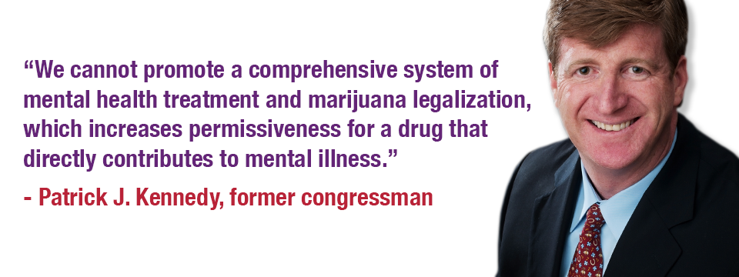

Slide 26
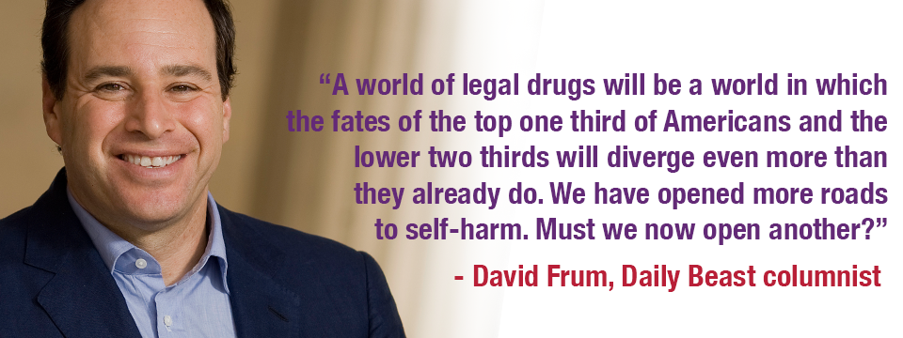

Slide 27
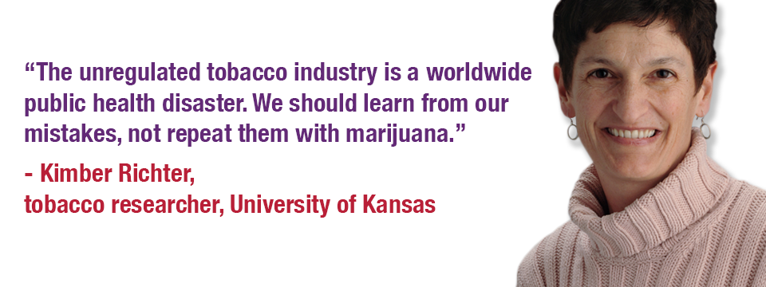

Slide 28
One Week Later: Results
Over 5,000 media hits
Hundreds of supporting emails
Numerous endorsements
Political interest
Financial donations
Website with information and cites
Social Media: Twitter, Facebook

Slide 29
Future
Nationwide infrastructure to support local partners in getting this message out
CADCA, NNOAC, California, Colorado, Ohio, Michigan, Oregon, Washington, Rhode Island, Massachusetts

Slide 30
Going Through the Arguments

Slide 31
Current Use of Major Substances
in the General Population, 2009
Past Month Use (Ages 12 or Older)
60
51.9
50
40
30
23.3
20
10
6.6
0
Marijuana
Cigarettes
Alcohol
Source: SAMHSA,
2009 National Survey on Drug Use and Health
(September 2010).

Slide 32
Alcohol & Tobacco Money Makers or Dollar Drainers
Alcohol
T obacco
$185
bil.
$200
bil.
Costs
$14 bil.
$25 bil.
Revenues
Kevin A. Sabet, Ph.D., www.kevinsabet.com

Slide 33
“If Only We Treated It Like Alcohol…”
2.7 million
Arrests for alcohol-related crimes in 2008
847,000
Marijuana-related arrests in 2008
(Does NOT include violence;
Includes violations of liquor laws and driving under the influence)
Kevin A. Sabet, Ph.D., www.kevinsabet.com

Slide 34
Effect of Legalization on
Price & Consumption
RAND: Price Will Drop
More Than 80%
Consumption Will Increase
Tax evasion a major concern

Slide 35
What incentives do legal corporations have to keep price low and consumption high?
Alcohol:
“Drink Responsibly”
and Tax Low

Slide 36
Legalization:
Experience Elsewhere?
No modern nation has tried legalization, though most Western countries do not imprison people for simple marijuana possession.
The Netherlands, Portugal, Italy use rates lower for some drugs since 10 years ago; higher for others.
The Dutch experienced a three-fold increase in marijuana use among young adults after commercialization expanded.

Slide 39
Underground Markets
and Crime
RAND: Mexican DTOs earn
15-25% of revenue from marijuana.
It is highly likely that legalization
would not eliminate black markets for drugs.
State Legalization: 2-4% impact on DTO revenues (California)
Most legalization proposals call for taxes on drugs, which increases likelihood that markets will remain endemic.
TCOs involved in numerous illegal trades

Slide 40
Taxes Necessary to Prevent a Price Collapse Are Enormous (Caulkins)
Excise taxes create gray markets
Most relevant metrics are
Price per unit weight
Price per unit volume
Canada tried but had to repeal ~300% excise taxes on tobacco

Slide 41
Marijuana’s Health Effects
Most people who use marijuana once
will stop, and not become addicted.
1 in 6 kids who try marijuana
will become addicted.
For people who keep smoking marijuana, the health harms
are underappreciated and costly.

Slide 42
Potency: Increased THC Content
in Seized Marijuana
PERCENT THC FROM 1983 TO 2009
10%
9%
8%
7%
6%
5%
4%
3%
2%
1%
0
’85
’90
’95
’00
’05
Sources: The University of Mississippi Potency Monitoring Project
Kevin A. Sabet, Ph.D., www.kevinsabet.com

Slide 43
Long Term Effects of Marijuana
32
ESTIMATED PREVALENCE OF DEPENDENCE AMONG USERS
23
17
15
11
9
8
5
Tobacco
Alcohol Marijuana Cocaine Stimulant Analgesics Psychedelics
Source: Wagner, F.A. & Anthony, J.C. From first drug use to drug dependence; developmental periods of risk for dependence upon cannabis, cocaine, and alcohol. Neuropsychopharmacology 26, 479-488 (2002).
Heroin

Slide 44
282
Heroin
351
Stimulants
358
Hallucinogens
175
Inhalants
Dependence on or
Abuse of Specific Illicit
Drugs
Persons 12 or Older, 2008
451
Tranquilizers
126
Sedatives
1,411
Cocaine
4,199
Marijuana
1,716
Pain Relievers
Substance Abuse and Mental Health Services Administration. (2009). O$ce of Applied Studies. Treatment Episode Data Set (TEDS): 2009 Discharges from Substance Abuse Treatment Services, DASIS.

Slide 45
Increased Marijuana Treatment Admissions 1993 and 2007
PERCENT OF ADMISSIONS
60%
1993 2007
50%
40%
30%
20%
10%
0
Alcohol
Cocaine
Heroin
Marijuana
Source: Treatment Episode Data Set, US Health and Human Services, 1993 & 2007
Kevin A. Sabet, Ph.D., www.kevinsabet.com

Slide 46
Marijuana and Kids
The adolescent brain is especially susceptible to marijuana use.
That means that when kids use, they have a greater chance of addiction since their brains are being primed.
If used regularly before 18, new research shows that IQ drops by 8 points at age 38, even when that person has stopped.

Slide 47
Medical Marijuana

Slide 48
Bypassing the FDA Process
Before FDA approves a drug as medicine, testing is done to:
Determine the benefits and risks of the drug
Determine how it may interact with other drugs
Assure standardization of the drug
Determine the appropriate dosage levels
Identify and monitor side effects
Identify safe drug
administration

Slide 49
Compassionate care increased access to marijuana?
<5%
Only 10% of card holders are cancer, HIV/AIDS, or glaucoma patients
90% are registered for ailments such as headaches and athlete’s foot

Slide 50
Compassionate care or
increased access to marijuana?
>80%
Most card holders in CA and CO are white men between the ages of 17 and 35
No history of chronic illness
History of Alcohol and Drug Use

Slide 51
That doesn’t mean that components
in marijuana do not have medical properties.
These are being scientifically developed.

Slide 52
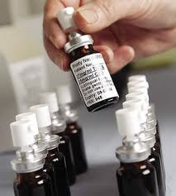
Cannabis-Based Medicines
Sativex is in the process of being studied
Approved in Canada and across Europe
Administered via an oral spray
Research on the efficacy of cannabinoids is not focused on raw/crude marijuana, but in the individual components that may have medical use.

Slide 53
Let’s Not Go Back Here
The Liggett Group: “If you are really and truly not going to sell [cigarettes] to children, you are going to be out of business in 30 years.”
R. J. Reynolds: “Realistically, if our company is to survive and prosper, over the long term we must get our share of the youth market.”

Slide 54
Lorillard: “The base of our business is the high school student.”
Phillip Morris: “Today's teenager is tomorrow's potential regular customer… Because of our high share of the market among the youngest smokers, Philip Morris will suffer more than the other companies from the decline in the number of teenage smokers.”

Slide 55
We Need to Remember
We are right.
We have the science on our side.
We need to stay strategic in our messaging.
We need to regain the middle in order to win the day.

Slide 56
Thank you!
kevinsabet@gmail.com
www.learnaboutsam.org
www.kevinsabet.com

