Slide 1
Marijuana – Medicine, or Just Another Buzz?
Stuart Gitlow MD MPH MBA, DFAPA
President
American Society of Addiction Medicine
Executive Director
Annenberg Physician Training Program in Addictive Disease

Slide 2
Faculty Disclosure
Stuart Gitlow MD MPH MBA serves as President of the American Society of Addiction Medicine. He is a solo practitioner specializing in addictive disease.

Slide 3
Study Question
John has cancer and will die in precisely 12 months.
A drug is available to treat John
    50% of the time, the drug leads to complete cure if given at this stage in the disease
    50% of the time, the drug causes death in one week
    On what basis should the decision be made as to whether John will take the drug?
    Who should make the decision?

Slide 4
Given a disease, will a given treatment resolve the disease?

Slide 5
Will treatment itself cause other difficulties to arise?

Slide 6
Will treatment itself cause other difficulties to arise?

Slide 7
Is an alternative and superior treatment available?

Slide 8
What are the risks to the public v. gains to the individual?

Slide 9
Study Question 2
John has cancer and will die in precisely 12 months. He has marked impairment, is debilitated, and uncomfortable. He is entirely unproductive and miserable.
Wouldn’t ANY potential cure be worth trying? John can’t get any worse, can he?
Or is it possible he could be worse and simply not know it?

Slide 10
Study Problems
If I study alcoholism and my outcome measure is quantity of alcohol imbibed, then my study protocols described here would be successful interventions:
    Hit the patient on the head with a hammer repeatedly.
    Place the patient in a small room and lock him in.
    A single outcome measure does not necessarily demonstrate success even when the outcome measure is an intuitive one.

Slide 11
Study Problems
Subjective outcome measures also don’t work. If I give methadone to a TB patient, is that useful?
    They feel much better.
    Was the intervention useful?

Slide 12
Study Considerations
Subjective improvement might present in the face of a worsening overall condition
Intervention might have side effects that are more impairing than the original condition
Long-term use of the intervention might lead to worse difficulty than the original target condition
Do alternative treatments exist that are superior for the condition, even if subjectively less desirable?
Can a component of the drug be synthesized, relieving the need to take other components?
Risk to population vs Benefit to individual

Slide 13
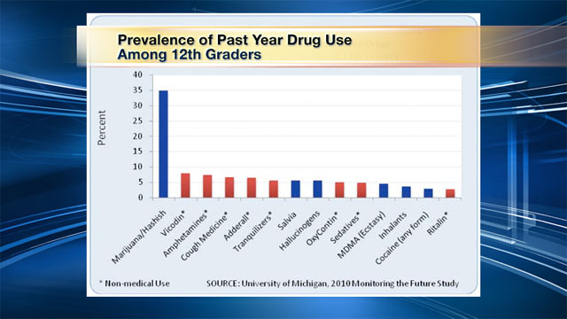
Prevalence of past year drug use among 12th graders

Slide 14
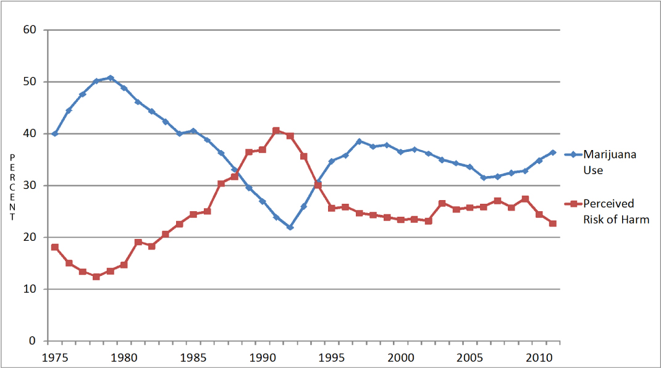
Marijuana use among 12th graders – University of Michigan Study

Slide 15
Marijuana
Marijuana is a plant.
It contains over 400 components, many more when combusted.
Among these components are 60+ cannabinoids, a fraction of the products of combusted marijuana.
Over the last 35 years, there have been fewer than 20 small randomized controlled trials, each of short duration, with a grand total of approximately 300 subjects.
Marijuana is a crude delivery system that delivers known toxins and carcinogens while delivering potentially useful cannabinoids.

Slide 16
Evidence is present to support research in:
HIV patients with cachexia, neuropathy, or chronic pain.
Chemotherapy patients who obtain insufficient relief from anti-emetics
Anti-emetic effect in opioid-based treatment of post-op, traumatic, or cancer pain
Patients with spinal cord injury or neuropathic pain syndromes
Other patients with chronic pain syndromes

Slide 17
The purpose of clinical trials
To determine if the development of non-smoked cannabinoid rapid-delivery systems has significant benefit without significant risk.

Slide 18
California
    Approved Conditions: AIDS, anorexia, arthritis, cachexia, cancer, chronic pain, glaucoma, migraine, persistent muscle spasms, seizures, severe nausea, or other chronic or persistent medical symptoms.
    Allowed Possession: 8 ounces
    Fee: $66, unless on Medicaid, then $33.
    Note that a typical 1/8th ounce bag of marijuana costs about $50 on the street.
    Also note that one ounce of marijuana can be used to make approximately 50 joints.

Slide 19
Connecticut
    Approved Conditions: Cancer, glaucoma, HIV, Parkinson’s, MS, spinal damage, Crohn’s, PTSD.
    Allowed Possession: An amount necessary to ensure uninterrupted availability for a period of one month.
    Fee: Not yet established

Slide 20
Rhode Island
    Approved Conditions: Cancer, glaucoma, +HIV, Hepatitis C, or any cachexia, severe chronic pain, severe nausea, seizures, severe muscle spasms, Alzheimer’s disease-related agitation.
    Allowed Possession: 2.5 ounces
    Fee: $75, unless you are on Medicaid or SSI, in which case the fee is $10.

Slide 21
Washington (state)
    Allowed Possession: 24 ounces (enough for 1200 joints)

Slide 22
Federal Law
Schedule I Definition:
    High potential for abuse
    No currently accepted medical use in treatment
    Lack of accepted safety for use under medical supervision
    Advocates first attempted to have marijuana removed from Schedule I in 1972.
    This led to a five part test to determine whether a drug has a currently accepted medical use

Slide 23
Is there a currently accepted medical use?
The drug’s chemistry is known and reproducible
There must be adequate safety studies
There must be adequate and well-controlled studies proving efficacy
The drug must be accepted by qualified experts
Scientific evidence must be widely available

Slide 24
Studies on Smoked Marijuana
Cancer chemotherapy – 3 randomized double blind controlled trials involving 43 patients revealed a modest antiemetic effect. No studies against contemporary antiemetics (which are superior to those available at the time of the study).
Appetite stimulation – 3 trials involving 97 HIV patients revealed no difference between oral cannabinoids and smoked marijuana in efficacy.

Slide 25
Studies on Smoked Marijuana
Pain Management – 2 trials involving 89 patients with varying results due to subjective reporting issues. Of note, 27% of HIV patients use marijuana to relieve pain, but nearly half of these users report memory deterioration.
Glaucoma – One randomized double-blind placebo controlled trial with 18 patients revealed a brief reduction in intraocular pressure secondary to marijuana use.

Slide 26
Adverse Effects of Smoked Marijuana
There have been only short-term controlled trials. Adverse reactions observed in short-term randomized placebo-controlled trials are largely mild without substantial impairment.
Note that this would be true for smoked tobacco as well.
This has led to the frequent statement by marijuana advocates that marijuana use has not led to any deaths.
Neuropsychological deficits are consistently observed in frequent users of marijuana.
In a minority, marijuana use can lead to anxiety, panic, confusion, paranoia, and frank psychosis such as delusions and hallucinations.

Slide 27
Adverse Effects of Smoked Marijuana
Marijuana use is the most common drug involved in drugged driving. It doubles the risk of a crash and increases the risk of crash injuries.
    A study of seriously injured drivers in Maryland showed that 26.9% were positive for marijuana.
7 cohort studies have shown a 40% increased risk of psychosis in marijuana users when compared to nonusers. Cannabis use by age 18 leads to a 6-fold increase in risk of schizophrenia later in life (Andréasson).
    There is a dose-response effect, with risk increasing 50-200% in those who use marijuana frequently

Slide 28
AMA Recommendations (2009 – CSAPH)
1) Adequate and well-controlled studies of marijuana and related cannabinoids should be conducted.
2) Noting that Schedule I listing causes difficulty in research, facilitation of clinical R&D should be implemented.
3) The AMA urged the NIH to implement appropriate research protocols, funding allotments, and availability of study-grade marijuana
4) Discussion of marijuana by the physician should not subject the physician or patient to criminal sanctions

Slide 29
ANA Recommendations (2008)
1) Confirm the therapeutic efficacy of medical marijuana
2) Reclassify marijuana into a schedule other than Schedule I
3) Exempt from prosecution, liability, or sanction those who prescribe, dispense, or administer medical marijuana in accordance with state law
4) Protect patients using medical marijuana from criminal or civil penalties
5) Educate clinicians regarding appropriate use of marijuana

Slide 30
ASAM Recommendations (2010)
1) Marijuana must be subject to the same standards applicable to prescription medication
2) Clinicians should not provide patient access to marijuana until appropriate FDA approval is present
3) Smoking is inherently unsafe
4) Discourages state interference in the federal medication approval process
5) Rejects state legislative process as a means for which individuals without appropriate qualifications make determinations about medication
6) Physicians ignoring (2) should have a true patient-physician relationship and conduct themselves accordingly.

Slide 31
ASAM Recommendations (2010)
7) Ensure that recommendations for marijuana are not a large or exclusive aspect of the physician’s practice
8) No recommendation be given unless the physician has information regarding composition and dose
9) Any physician discussing marijuana with patients should have adequate training in identifying addictive illness.

Slide 32
ASAM Recommendations (2012)
1) Physicians lead efforts to oppose legislative initiatives that would result in legalization of marijuana production, distribution, marketing, possession, and use by the general public.
2) All physicians should incorporate screening and treatment for risky substance use into their routine.
3) Inform the public that marijuana available today is of far higher potency than that which was available in the 1960s. Further inform the public about potential development and progression of psychotic conditions related to use of high-potency marijuana among adolescents.

Slide 33
ASAM Recommendations (2012)
4) Carefully monitored addiction treatment be provided to those with marijuana use disorders.
5) Study drugged driving associated with marijuana use and recommend consequences of drugged driving be comparable to those of drunk driving.
6) Promote systems such as Drug Courts.

Slide 34
APA Guidance (2012)
By sanctioning patients’ consumption, psychiatrists may contribute to the adverse community impact of the culture surrounding marijuana dispensaries, including criminal behavior.
They advise that physicians assume their role of educating patients about risks and benefits, particularly when responding to requests for a nonbeneficial treatment.

Slide 35
There is no such thing as Medical Marijuana - currently
Currently available marijuana lacks quality control and standardization, can be contaminated with pesticides and microbes, and does not assure patients of a reliable and reproducible dose.
There is a paucity of evidence-based high-quality data.
Guidelines for physicians indicate that physicians should not advise patients to seek treatments about which the physician has inadequate information regarding composition, dose, side effects, or appropriate therapeutic targets or patient populations.
No mechanism exists for collecting data on efficacy or adverse events.

Slide 36
Professional Liability
Professional liability coverage may not extend to harm resulting from patient’s use of marijuana upon the physician’s recommendation.
Failure to conduct a physical exam, medical history, or provide appropriate medication may result in unprofessional conduct, sanctions, license suspension, license revocation.

Slide 37
Societal Costs
Alcohol has US tax revenue of $14B
Alcohol has annual social costs of $185-235B
Tobacco has US tax revenue of $25B
Tobacco’s costs are approximately $200B
Revenues from taxes on alcohol and tobacco do not approach the costs of prevention/treatment. How would this work with marijuana?

Slide 38
Conclusions
1) Marijuana is not an acceptable medical product
2) Scientific approval is not yet supportable and synthesized, purified, medication-grade prescriptions are not available
3) Malpractice/liability issues are high for clinicians recommending use of a drug with unknown content at an unknown dose in a manner that does not reflect any medical guidelines. Responsibility for any resulting accident or injury would rest with the clinician
4) Clinicians should assist at the legislative level by educating legislators as to the state of the art, and encouraging appropriate study of cannabinoids so that medication can be utilized if found to be appropriate

