Slide 1
Colorado: Costing Employers
An Update on Workplace Realities
in the Era of Legalized Marijuana
Jo McGuire
jo@jomcguire.org
Five Minutes of Courage
www.jomcguire.org

Slide 2
Amendment 64 Employer Clause
“Nothing in this section is intended to require an employer to permit or accommodate the use, consumption, possession, transfer, display, transportation, sale or growing of marijuana in the workplace or to affect the ability of employers to have policies restricting the use of marijuana by employees.”
Notes:
Amendment 64 is very clear in that employers must not be forced to tolerate or accommodate the effects of marijuana in the workplace. This is duplicated in Colorado State Law in several areas concerning workplace safety.
Every HR person should ask themselves – which position in our company can afford impaired workers? The answer to that should be “none”.

Slide 3
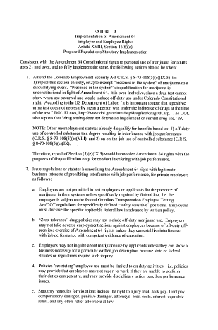
“Every existing Colorado law that is not compliant with Amendment 64 should be changed …. because an employee’s Constitutional Right to use marijuana supersedes an employer’s right to drug test.”
– Kimberlie Ryan, Atty
Notes:
Amendment 64 is very clear in that employers must not be forced to tolerate or accommodate the effects of marijuana in the workplace. This is duplicated in Colorado State Law in several areas concerning workplace safety.
Every HR person should ask themselves – which position in our company can afford impaired workers? The answer to that should be “none”.

Slide 4
Quest Diagnostics Drug Test Index™
http://www.questdiagnostics.com/home/physicians/health-trends/drug-testing
Notes:
Quest Diagnostics’ Drug Testing Index showed that in 2013, positive results for marijuana increased 6.2%. Marijuana positivity rates were dramatically higher in the two states with legal recreational marijuana: marijuana positivity rates increased 20% in Colorado and increased 23% in Washington. Quest Diagnostics Drug Testing Index. (2014, September 11). Workforce drug test positivity rate increases for the first time in 10 years, driven by marijuana and amphetamines, finds Quest Diagnostics Drug Testing IndexTM analysis of employment drug tests. Madison, NJ: Quest Diagnostics. Available: http://www.questdiagnostics.com/home/physicians/health-trends/drug-testing

Slide 5
Job Applicants at CO Electric Company
February 2015
12 applicants in the pre-employment process
Mobile drug test collector arrives
9 applicants walk-out
3 complete pre-employment drug screen
2 pass the drug screen
1 fails (THC positive)
vs

Slide 6
Looking Outside the State for Qualified Employees
“
Jim Johnson said his company has encountered so many job candidates who have failed pre-employment drug tests because of their THC use … it is actively recruiting construction workers from other states.
”
GE Johnson
http://gazette.com/drug-use-a-problem-for-employers/article/1548427

Slide 7
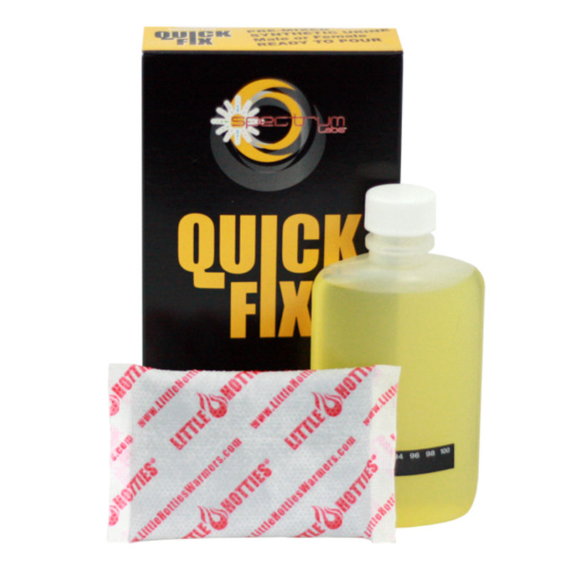
“In February,” Leona Willener said, “more than half the applicants who came to her company looking for work failed the required drug tests because of THC use … 1 in 3 attempted to cheat the test.”
“
”
Colorado Staffing Agency
http://gazette.com/drug-use-a-problem-for-employers/article/1548427

Slide 8
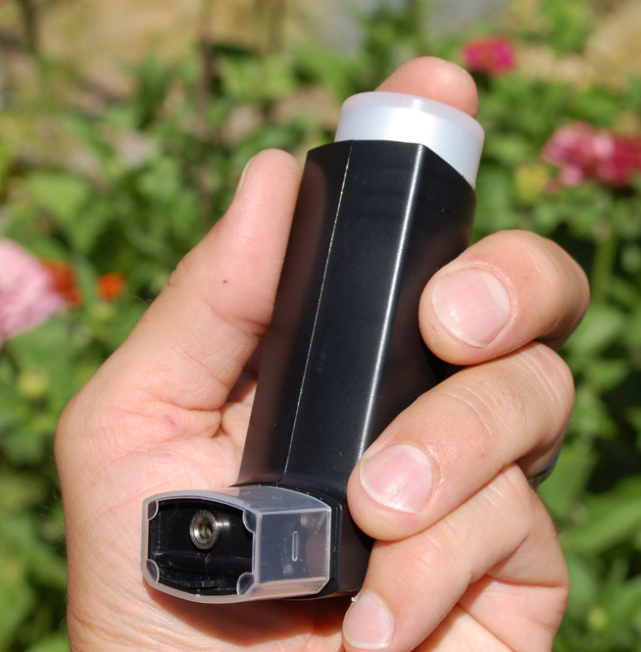
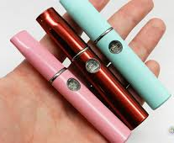
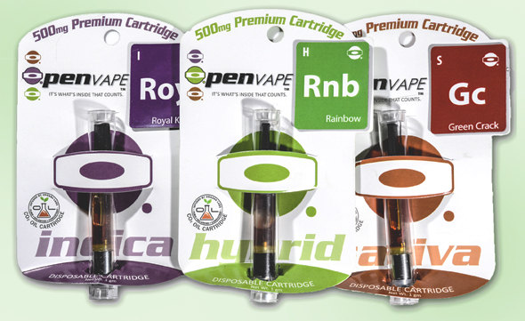
EMPLOYER CHALLENGES
Notes:
The introduction of vaporizers to the marijuana market has allowed a revolution of new thinking in public consumption. The sophisticated products allow employees, students and people in the general public to consume concentrated hash oil virtually without notice. There is little to no obvious odor depending upon the sophistication of the product. Some companies are considering policies that are consistent with non-smoking on company property, however it is the impairment that must be considered thoughtfully when determining how to handle these products and their usage by employees.

Slide 9
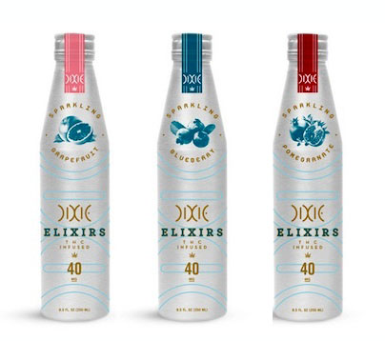
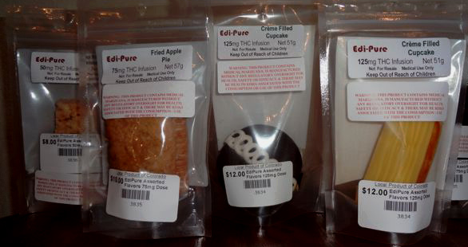
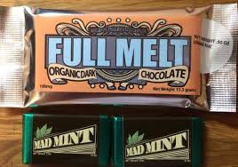
EMPLOYER CHALLENGES
Notes:
Edibles come in an unlimited array of options that mirror foods you would see people eat every day without question.
Serving suggestions are not standardized, nor are there parameters for determining warning labels, etc.
Potency is highly variable.
Employers would have no way of knowing if an employer were to consume edibles during work hours, except for signs and symptoms of impairment which can take a little longer to manifest through the digestion system.

Slide 10
Employer’s Rights
Colorado Employment Law repeatedly requires, endorses & allows for “presence in system” testing
Colorado State Unemployment Law
Worker’s Compensation Act
Medical Marijuana Act
Employers in other states should check their state laws
Notes:
Colorado law repeatedly states that substances “present in the system” qualify for positive drug tests. While marijuana proponents decry this as unfair because it may not necessarily mean “impairment” at the time of the test – remember 3 important issues:
Presence in system testing is the only scientific method currently available. Also – every other drug test result is ALSO presence-in-system testing.
Aside from pre-employment testing – you are also using signs and symptoms of impairment and/or drug use violating safe and drug free workplaces to make your determination
In Colorado – the unsafe behaviors of an employee alone are enough to take action. While confirmatory testing is helpful – you are not bound to a decision solely based on a drug test result. Make sure your policy is very clear that erratic/unsafe behaviors are actionable.
Colorado Unemployment Law:
http://www.colorado.gov/cs/Satellite?blobcol=urldata&blobheader=application%2Fpdf&blobkey=id&blobtable=MungoBlobs&blobwhere=1251874262653&ssbinary=true
Colorado Worker’s Compensation Act:
http://www.colorado.gov/cs/Satellite?blobcol=urldata&blobheader=application%2Fpdf&blobkey=id&blobtable=MungoBlobs&blobwhere=1251874262653&ssbinary=true
Medical Marijuana Act: http://www.colorado.gov/cs/Colorado+Constitution+Article+XVIII.pdf

Slide 11
Employer’s Rights
Have a sound drug policy in place
Zero-tolerance of impairment is absolutely allowable & enforceable
Communicate expectations/outcomes with all employees
Keep signature pages for documentation
Consistently enforce policies with clarity
No “case-by-case” basis
Notes:
Have a sound drug policy in place – check resources for good policies and have yours reviewed by an attorney WHO IS FAMILIAR with drug/alcohol policies and testing. (Just because they practice law – does not mean they know this area well)
Zero-tolerance is absolutely allowable and enforceable and is indeed the BEST practice. Attempting “case-by-case” basis is shaky ground.
Communicate the policy with all staff & employees – Either one-on-one in orientation or in mandatory all-staff training. Do not neglect to prove this has been communicated and the employee is aware.
Keep signature pages in each employee file for proof – or have a classroom/training sign-in sheet proving that the employee attended training.

Slide 12
Employer’s Rights
Pre-Employment, Post-Accident, Random & Reasonable-Cause testing are all permissible and encouraged
All supervisors should be trained in detecting signs & symptoms
Never call a Reasonable Cause test a “random”
Notes:
Pre-employment testing should be a MUST in your company. Never make a job offer without it. In 2 Colorado cases, offers were extended prior to drug test results with no contingency clause and the employee was able to successfully sue for unemployment benefits.
Post-accident testing should be a mandatory company policy with terms and parameters clearly identified. This prevents company liability should an employee cause harm or damage while impaired. It can also alleviate the amount of disability pay-outs if the employee is found at fault due to drug or alcohol impairment. A federal report on Workplace Drug-Testing by SAMHSA, states that that employees using marijuana cause 55% more accidents than those who do not and positive drug tests showing THC in the employee’s system verifies 85% more on-the-job injuries by marijuana users.
Random testing is highly recommended and the benefits far outweigh the minimal costs. Employees who use marijuana regularly have increased absenteeism, higher instances of workplace theft and loss of work productivity as additional costs to the employer. In the U.S. employee drug use costs employers over $81 billion per year in lost revenues. (SAMHSA)
Reasonable Cause testing should not be confused with random drug testing. In order to call a test “random” you must be able to prove the absolute scientific randomness of the individual being chosen for the test. So call it what it is: Reasonable Cause or Reasonable Suspicion and document it as such. Know the signs and symptoms and make sure all HR personnel and supervisory staff are also trained to detect signs of impairment.

Slide 13
Employer Responsibilities
Safe and Drug-Free Workplace
Protect employees, customers,
work-environment and the public
Get involved in Protecting Employer’s Rights
Notes:
Know cut-off levels and what they mean
Know impairment information - DUID
Employers need to stop warning in advance for “clean” testing
Know what to look for in a policy
Know about presence in system
Know the latest in testing methods

Slide 14
Colorado: Costing Employers
An Update on Workplace Realities
in the Era of Legalized Marijuana
Jo McGuire
jo@jomcguire.org
Five Minutes of Courage
www.jomcguire.org

Slide 15
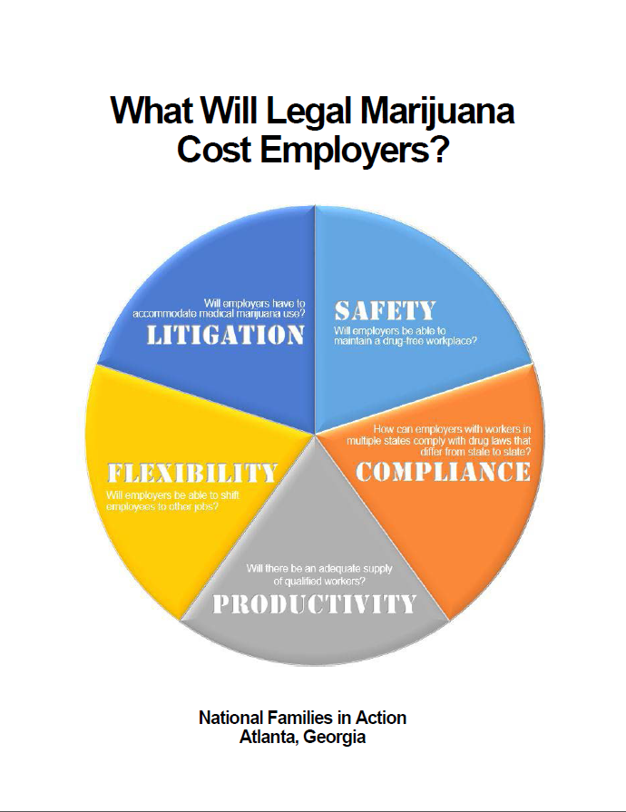

Slide 16
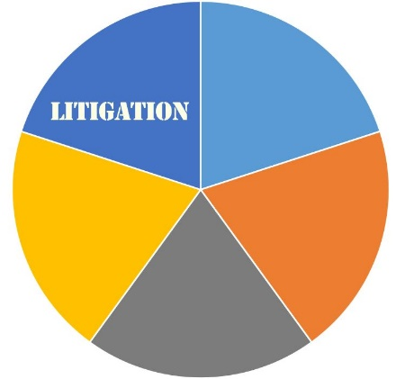
Employers’ litigation costs will
rise as case law is established
Current questions being litigated:
Can employers fire an employee for engaging in legal activities off the clock?
Does firing an employee who tests positive for marijuana violate anti-discrimination laws?
Are employees who use marijuana off the clock impaired when they come to work?
Must employers cover medical marijuana costs for employees injured on the job?
Must employers pay unemployment compensation to employees fired for failing a drug test?

Slide 17
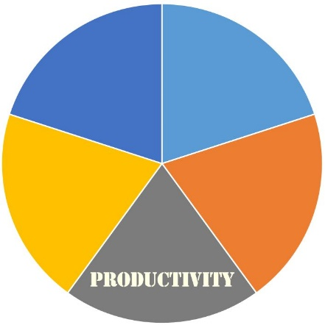
Will there be an adequate supply of qualified workers?
Potential Consequences
Fewer job applicants able to pass a pre-employment drug test
Reduced motivation among mj using employees
Increased accidents, injuries, absenteeism
Increased addiction
Impact on brain development, memory, lowered IQ means diminished ability to learn
Increased liability and health insurance costs

Slide 18
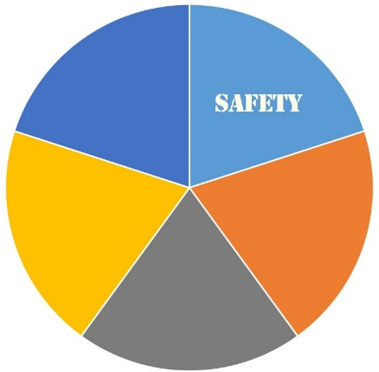
Workplace safety threatened
Relevant issues
Will employers be able to maintain a drug-free workplace?
How can employers ensure safety if they must show impairment rather than the presence of marijuana in the body?
Must employers required by DOT to drug-test workers in safety-sensitive jobs exempt those using medical marijuana?
Legalization advocates challenge drug-free workplace programs

Slide 19
Workplace flexibility imperiled
Potential loss of flexibility
Will employers be able to shift employees to different jobs in the company?
Will employees still be able to work from home?

Slide 20
How can employers with employees in multiple states comply with marijuana laws that differ from state to state – and with federal law?
To what lengths do employers have to go to comply with marijuana-friendly laws vis-à-vis their employees?
Must employers allow employees to use medical marijauna on the job?
If employers with federal contracts do business in legal marijauna states, how can they comply with federal mandates to maintain drug-free workplaces?

Slide 21
