Slide 1
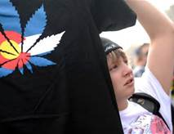
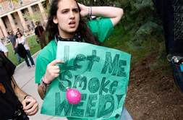
Marijuana in the 21st Century
The reality from Colorado post A64

Slide 2
CeDAR
Residential, Outpatient and Extended Care for adult CD patients at the University of Colorado Hospital
Specialize in the treatment of co-occurring disorders
Nationally recognized as a thought leader in the field

Slide 4
Todays Agenda
What’s going on in Colorado?
Trends
Concentrates
Edibles
Vape
What can you do?

Slide 5
This is about commercialization.

Slide 6
A few things we will NOT be covering:
Casual adult use
Medical implications past my pay grade

Slide 7
THC:
Psychoactive Ingredient

Slide 8
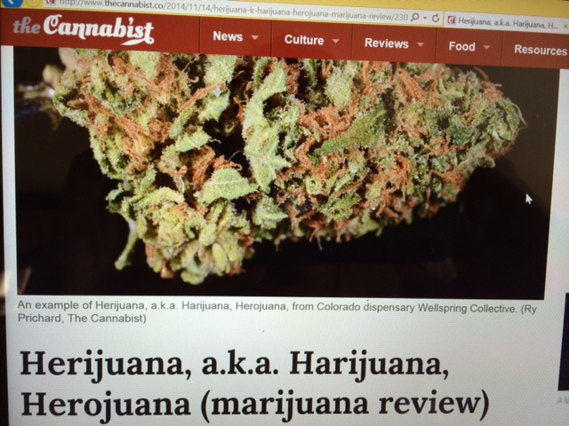
Potency - last 5 years in CO
Notes:
High times said it is impossible to get more than 30% THC inside of a plant – in Dec 2014 they tested 36%
“herowana”

Slide 9
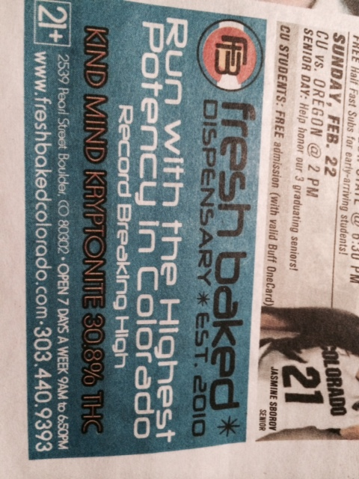

Slide 10
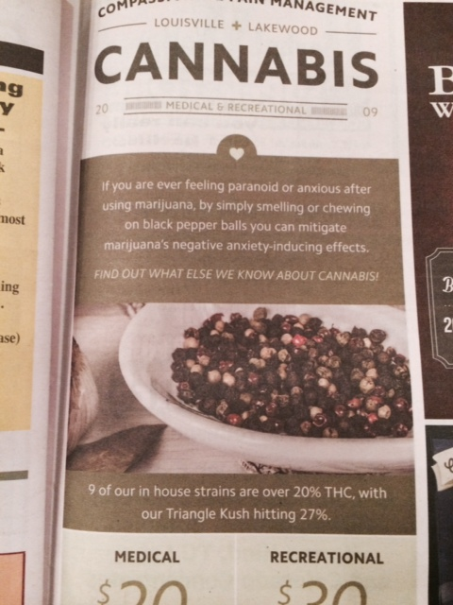

Slide 11
Why should we care about high potency? Lancet Study
Daily use sees an increase in psychosis of 5x
Weekend use sees an increase 3x
24% of psychosis cases in the study group caused by weed alone

Slide 12
What little data we have doesn’t look good
Notes:
Public consumption 184/889, Summons 118/154, DUID 78/101
* Anthony Cotton Denver Post 12/29/14

Slide 13
Volume of marijuana in CO skyrocketing

Slide 14
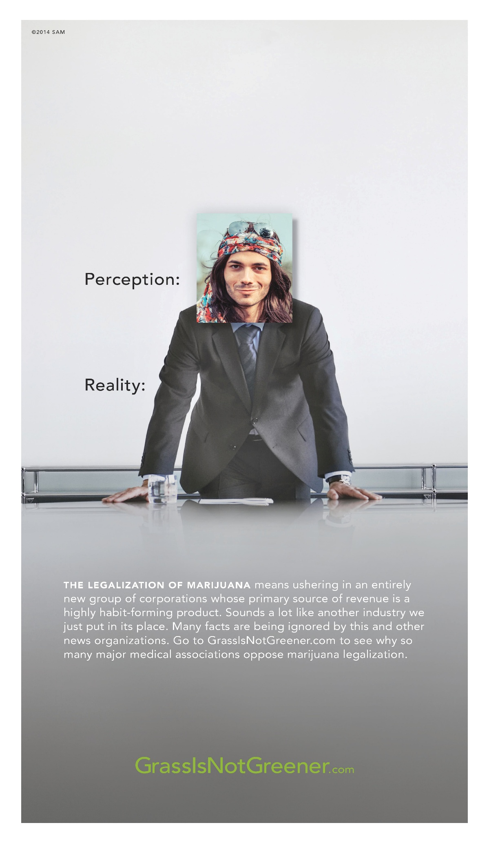
“We see the inevitability of large, well-run companies to sell cannabis, that train left the station a long time ago.”
- Brendan Kennedy CEO of Privateer Holding
“Beer, wine and tobacco people—I’ve met with them all,” said Allen St. Pierre, the executive director of NORML, St. Pierre hopes to create a “Dionysus lobby,” built on the shared interests of alcohol, tobacco and pot. All three industries want low taxes, the right to advertise freely, and the ability to make convenient sales, he said.

Slide 15
Here’s what we’re dealing with

Slide 16
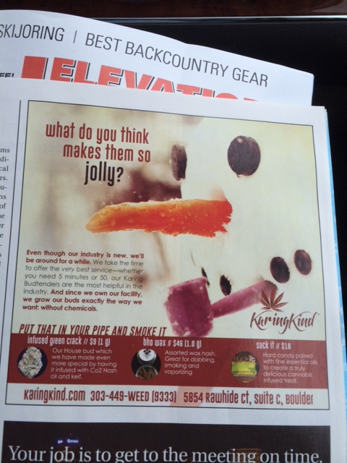
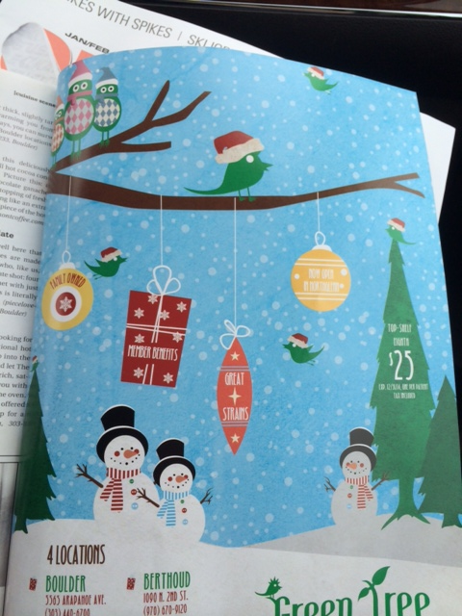

Slide 17
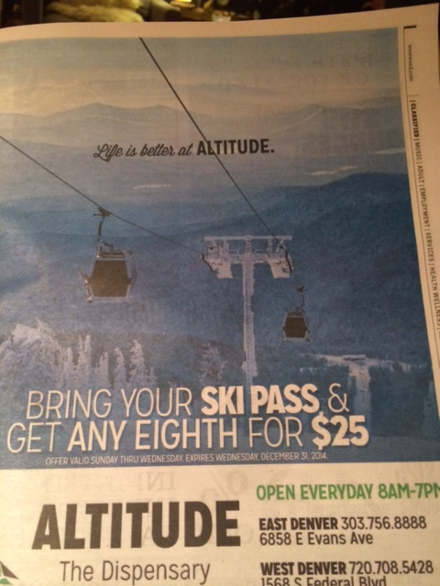

Slide 19
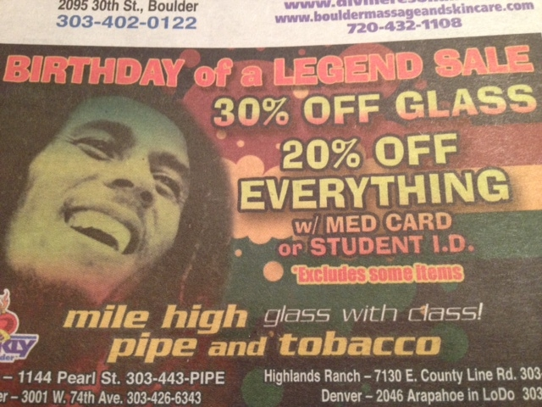
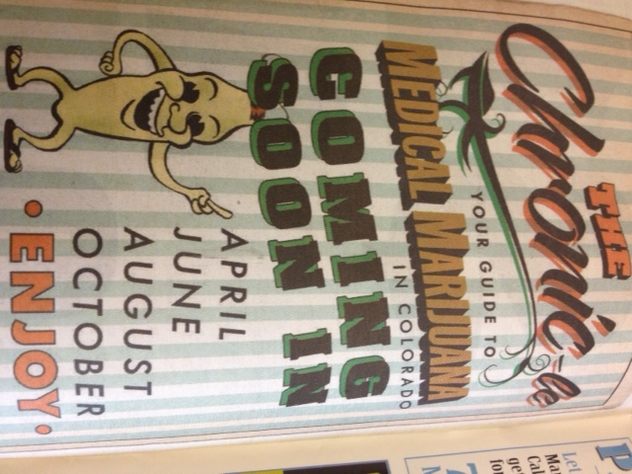
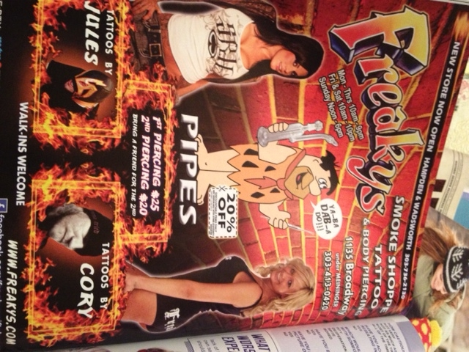

Slide 20
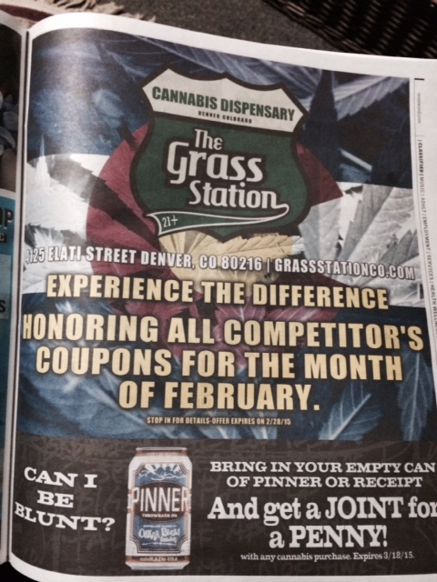
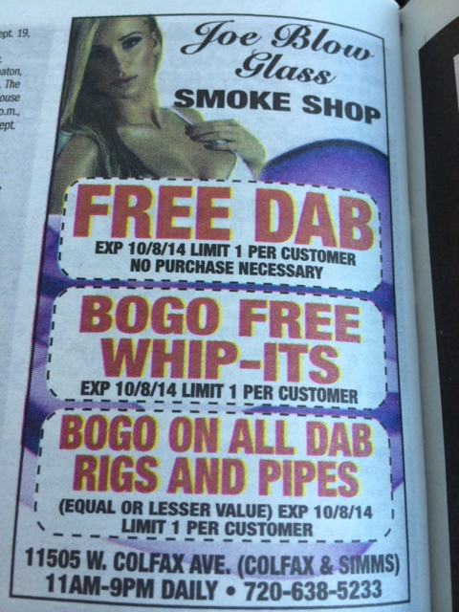

Slide 21
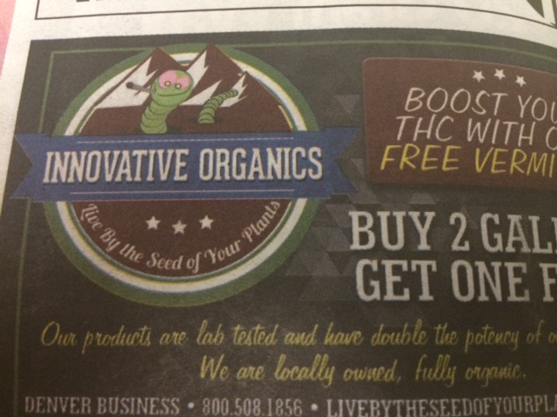

Slide 22
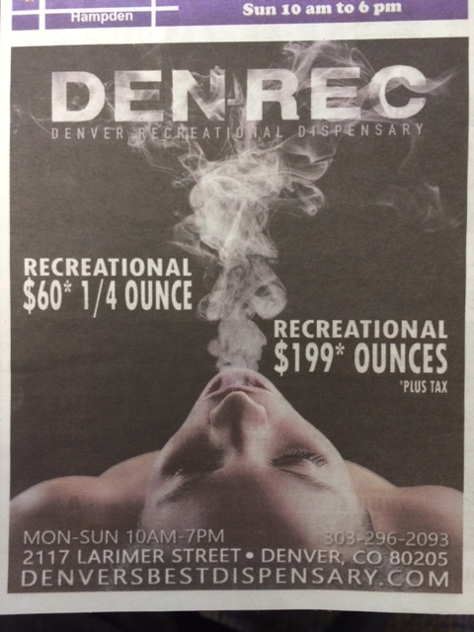

Slide 23
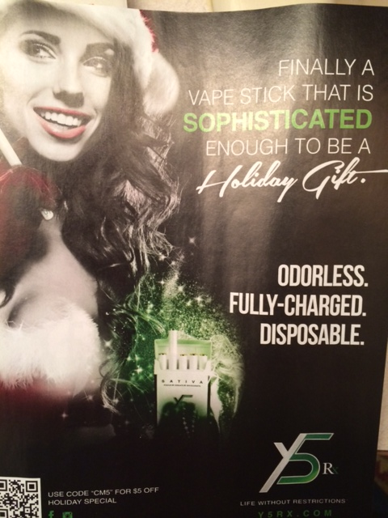

Slide 24
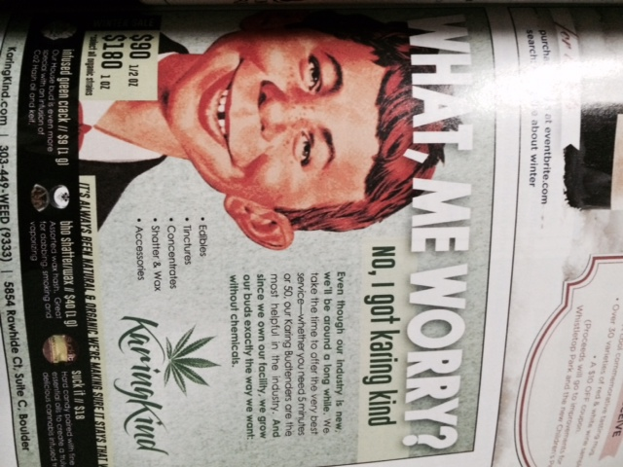

Slide 25
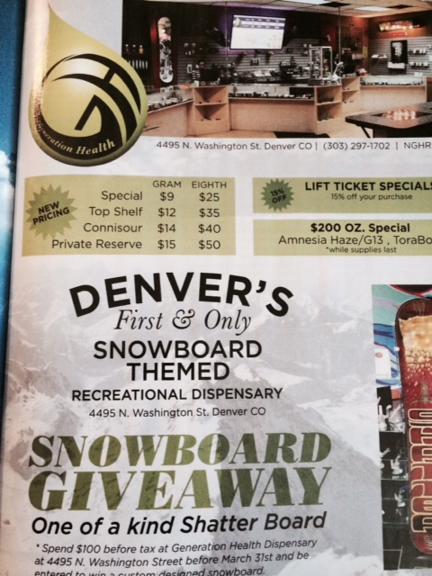

Slide 26
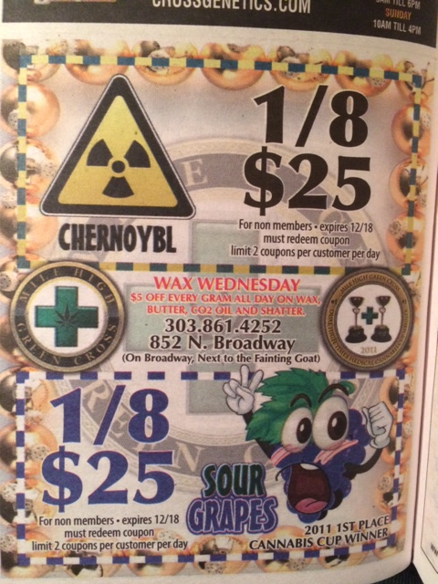

Slide 27
Trending…
Concentrates!
Edibles!!
Vape!!!

Slide 28
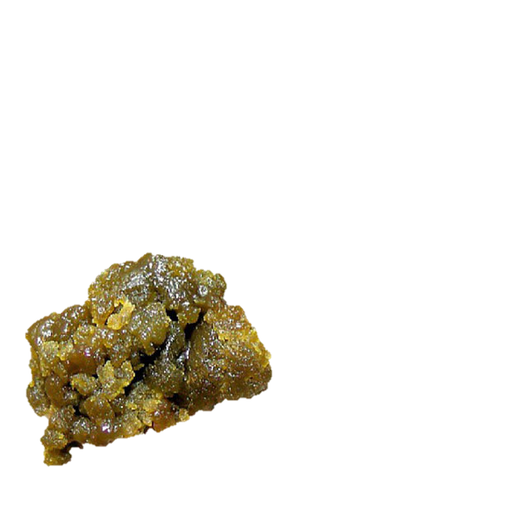
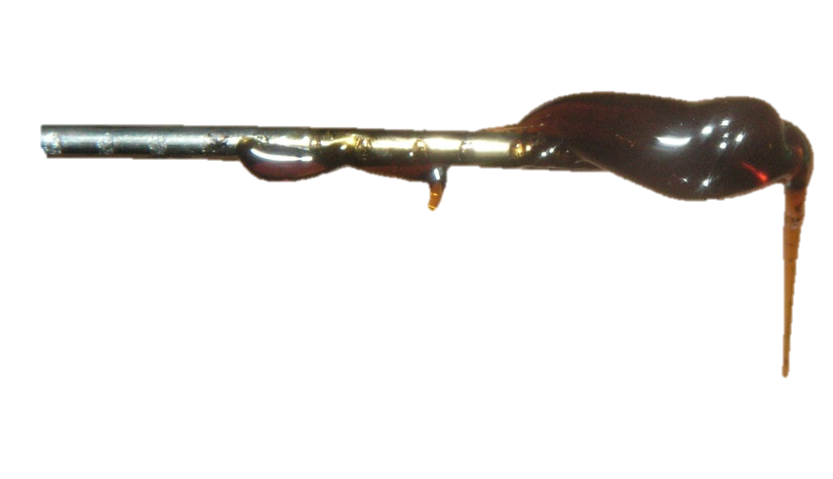
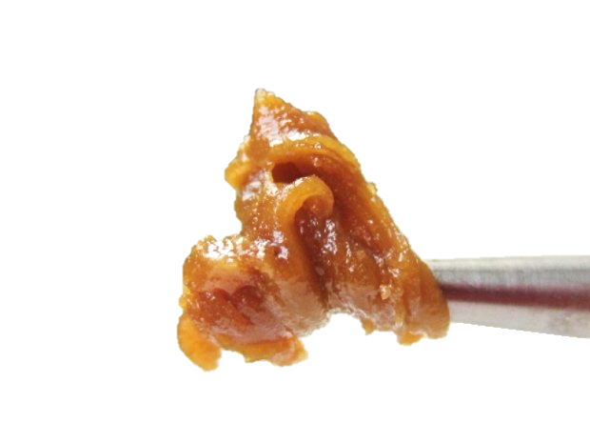
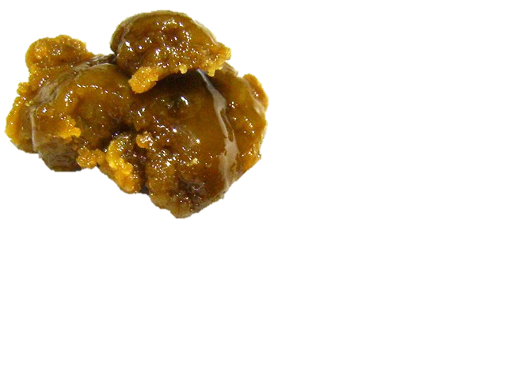
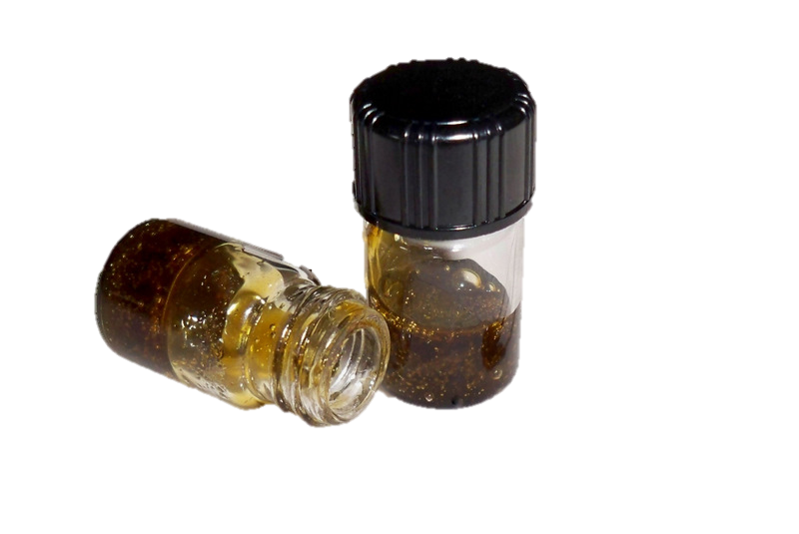
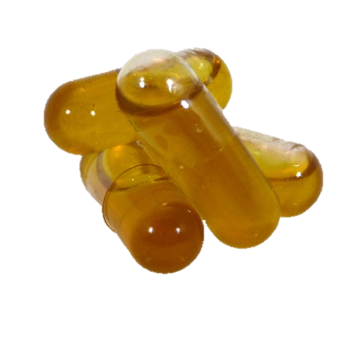
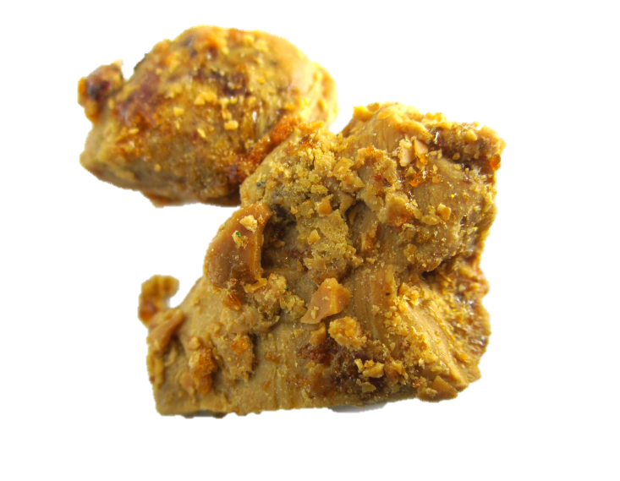
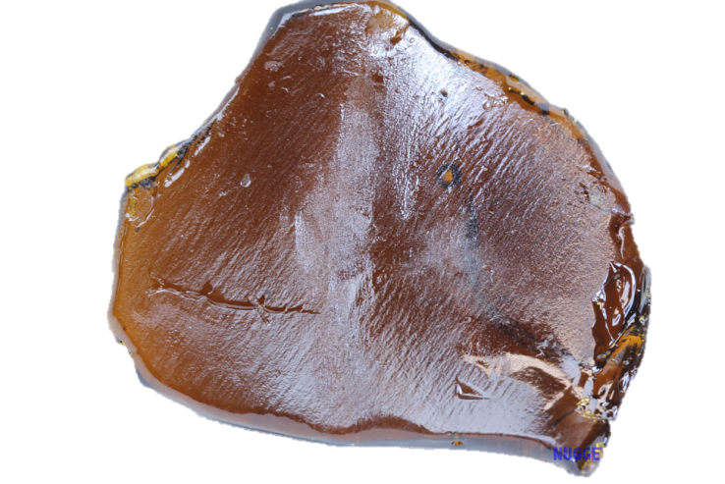
“But it’s just a plant…” (80-90% THC) Concentrates
“Green Crack” wax
“Ear Wax”
Butane Hash Oil (BHO)
“Shatter”
“Budder”
Hash Oil Capsules

Slide 31
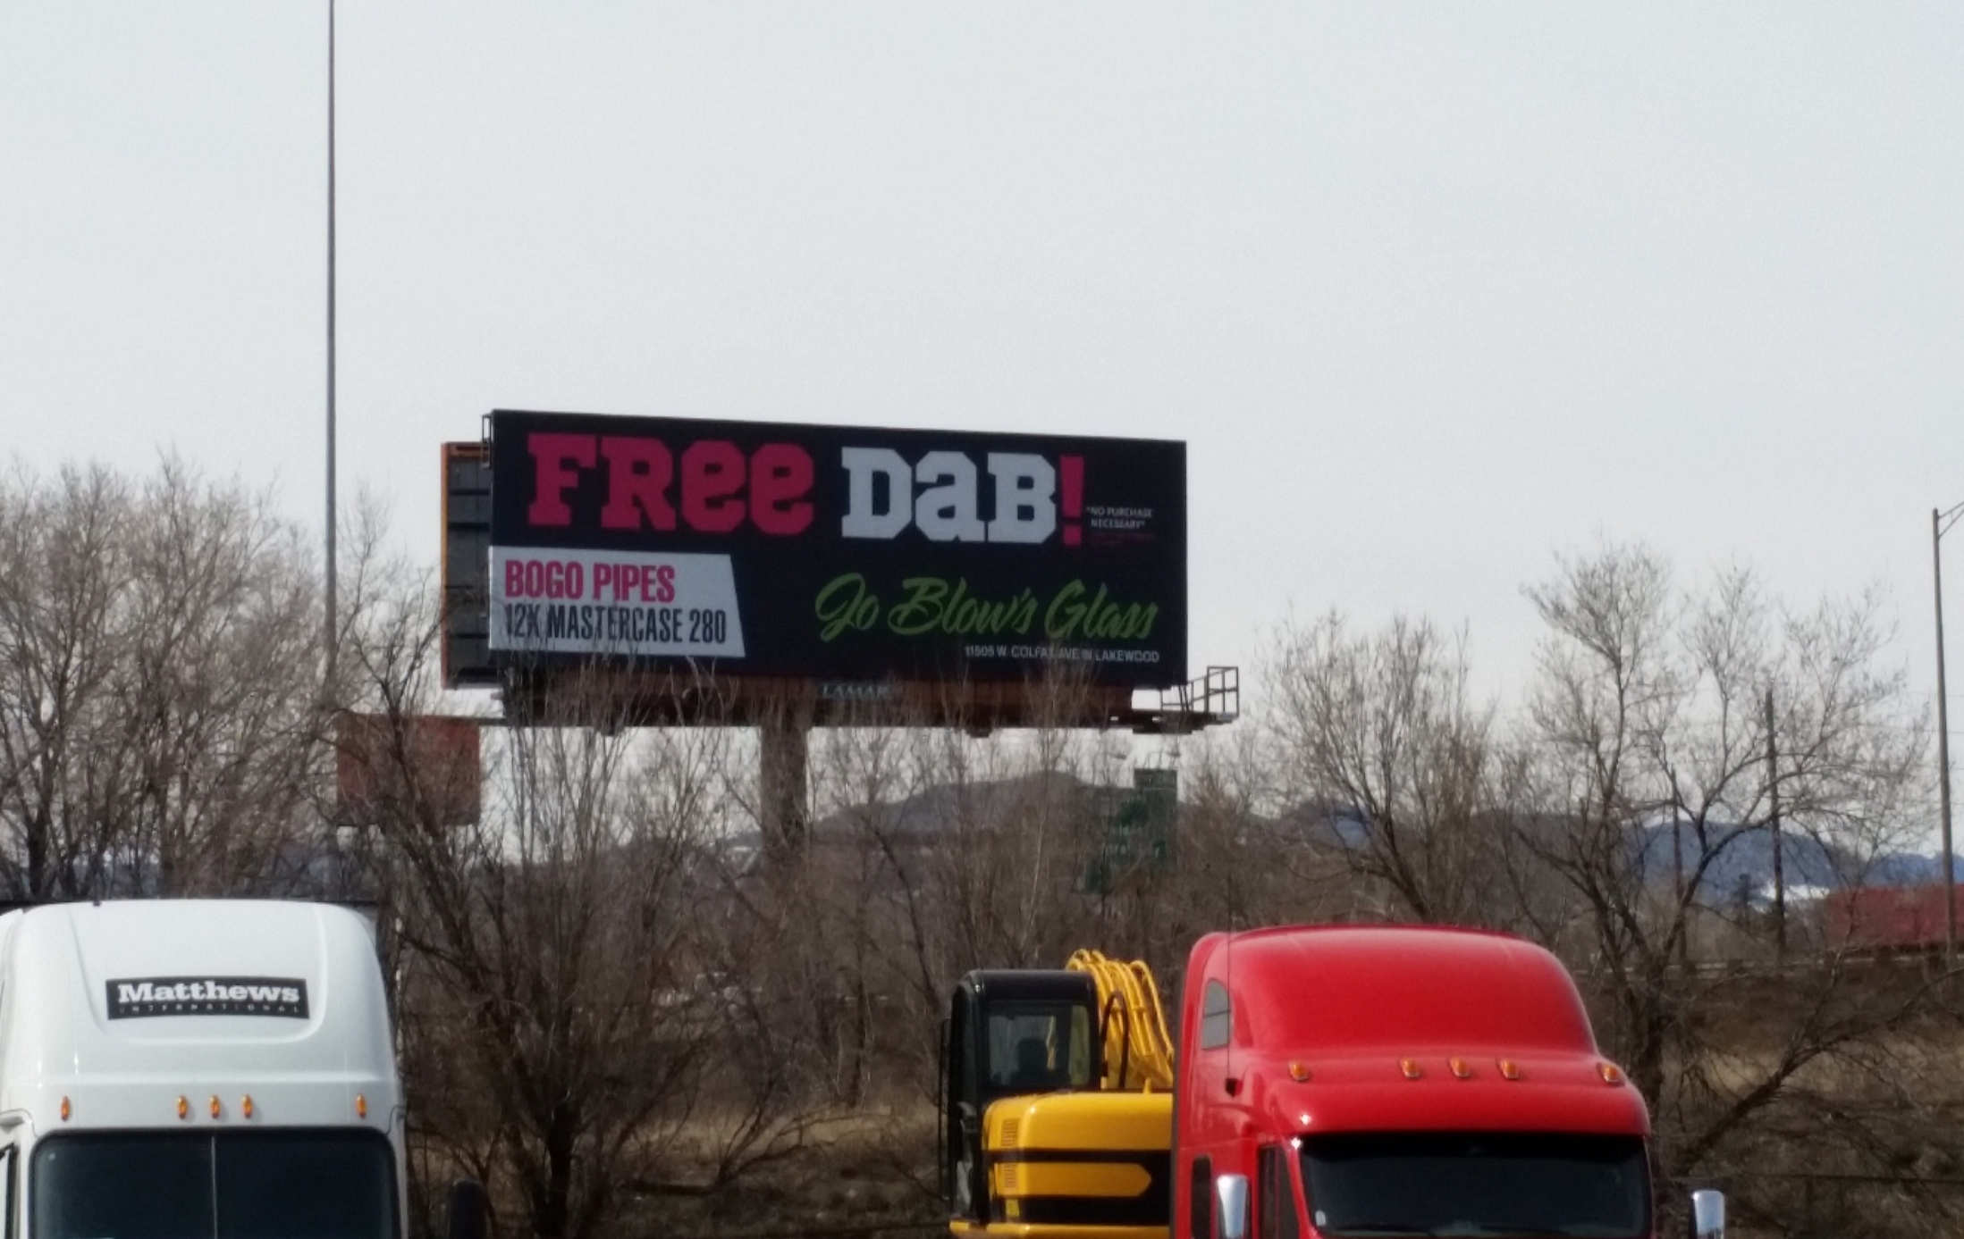

Slide 32
Edibles

Slide 33
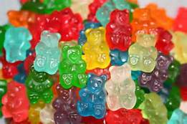
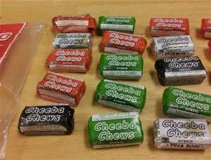
In a report published in the Journal of the American Medical Association last month, Andrew Monte, MD; Richard Zane, MD; and Kennon Heard, MD, pointed to edible marijuana as the culprit behind the most troubling cases arriving at the UCH and Children’s Hospital Colorado emergency departments, including severe burns and cycling vomiting syndrome.

Slide 35
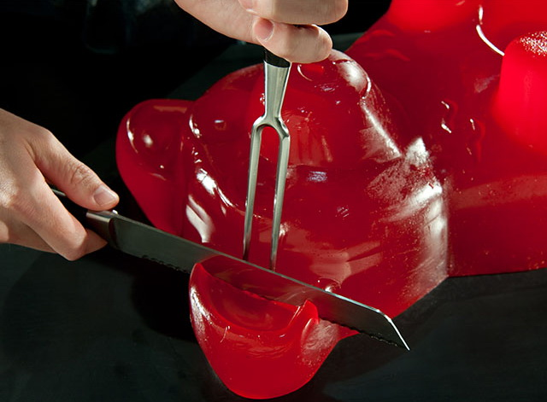
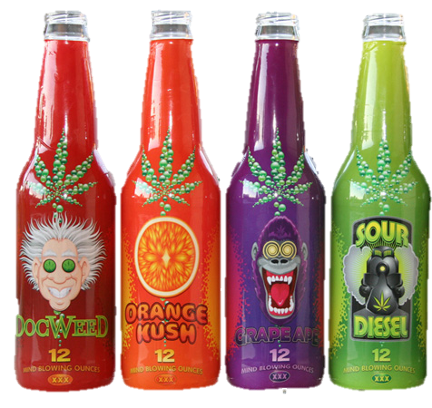
How many servings?
10 mg is a legal dose
Packaging is not regulated
Notes:
Gummy Bears – 4 servings
Brownies – 8 servings
Izzy - 10 servings
Marijuana edibles are the perfect medicine for medical marijuana patients. They are easy to consume, transport, and their effects last much longer than smoking medical marijuana.
YiLo’s marijuana edibles, made by Natural Relief Clinic dispensary (DBA Green Farmacy), are made with high-quality medical marijuana and come in three consistent strengths: 60mg, 120mg, or 180mg.
The YiLo Gummy Bear edibles taste just like regular gummy bears. Each package comes with six gummy bears. Therefore, a 60mg bag of YiLo Gummy Bear edibles would contain six 10mg gummy bears.
The Product Review Team at AZmarijuana.com tested YiLo Gummy Bears. We found that they are all delicious and very potent. Some of us medicated with only 5mg for the day, while others needed 60mg. These marijuana edibles began working within 20-60 minutes, usually dependent upon whether food was already in the stomach or not.
The effects from the edibles were always the same: calm mind, relaxed body, reduced pain, and happiness. The YiLo edibles have lasting effects which range from 3 – 6 hours; whereas smoking medical marijuana usually provides relief for only 1 – 3 hours.
an edible high taking up to 90 minutes to hit and lasting much longer than a smoking high. Edibles typically give three to four hours of peak stonedness, compared to an hour or two from smoking. If you're looking for a quick-hitting high that's gone in a couple hours, stick with smoking.
Awareness that marijuana infused products can take anywhere from 30 minutes to 2 hours to take effect

Slide 36
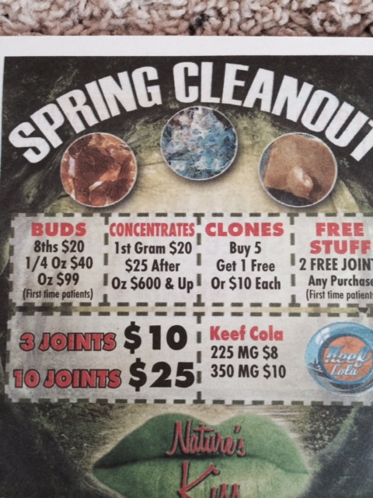

Slide 37
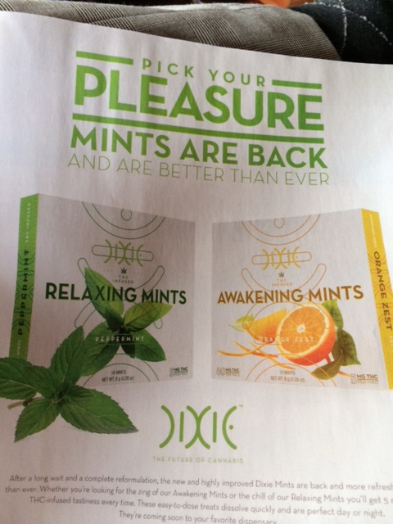

Slide 38
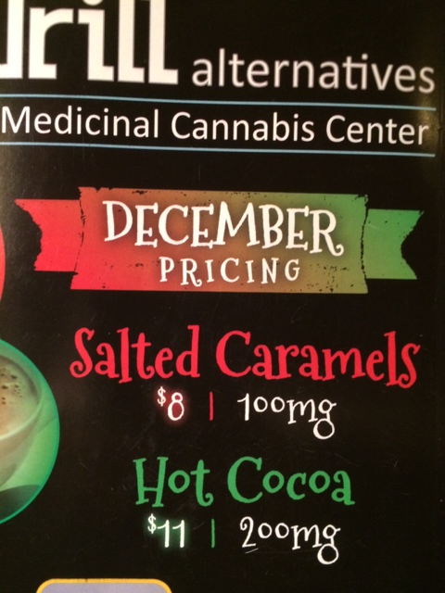

Slide 39
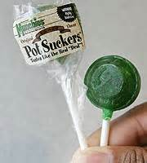
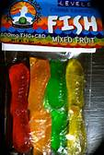
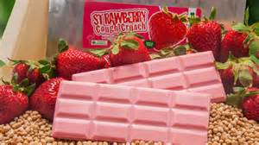
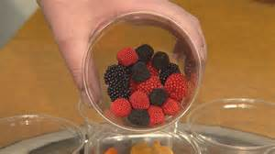

Slide 40
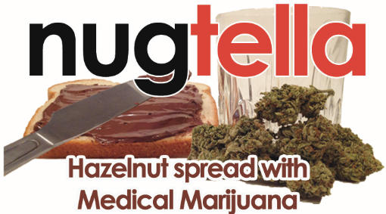
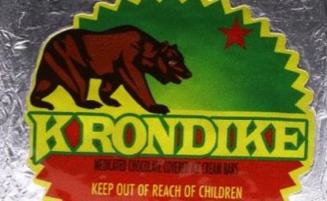
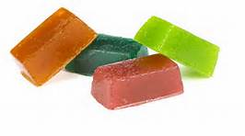
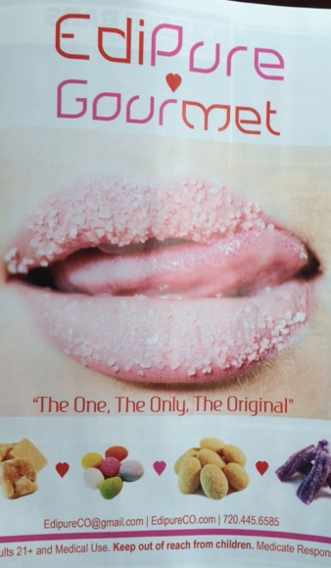
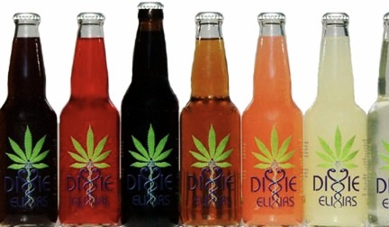
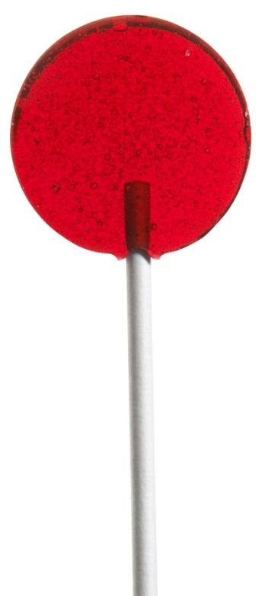

Slide 41
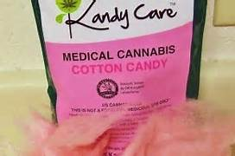
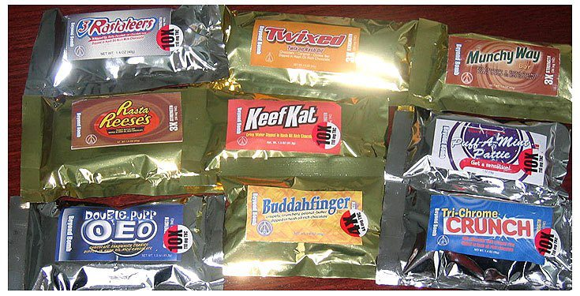

Slide 42
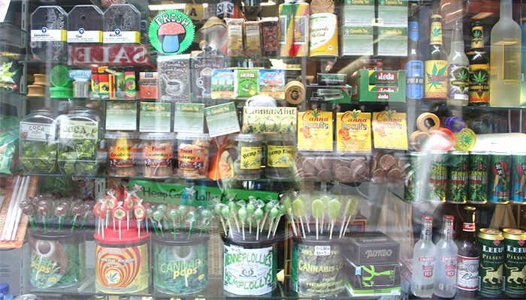
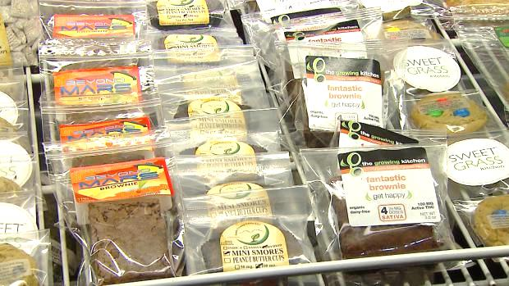
Cannabis Candy Store

Slide 43
Why were they “GONE?”

Slide 45
Vaping
Concentrates
oils
flowers

Slide 46
Increasingly popular and accessible

Slide 57
Treatment/Prevention
The best treatment is still prevention
Normalizing sobriety is key
Pushing back in a way that will resonate with the culture they are in
Family and social groups
MUST BE RELEVANT!

Slide 59
www.learnaboutsam.org
www.legalizationviolations.com
www.cedarcolorado.org

