Slide 1
The Link Between
Mental Illness and Marijuana
Patrick J. Kennedy
Dr. Christian Thurstone
Kevin A. Sabet, Ph.D.
Carmen Fernandez
Project SAM (Smart Approaches to Marijuana)
www.learnaboutsam.org

Slide 2
Outline
Link between marijuana and mental illness
Some early findings from Colorado
What is SAM and why do we care about this issue?
An appeal for action

Slide 3
Patrick J. Kennedy
Former Congressman;
Lead Sponsor,
Mental Health Parity & Addiction Equity Act.
Co-Founder, Project SAM

Slide 4
The Link Between Marijuana & Mental Illness
Since 2002, almost a dozen studies have shown that regular use of marijuana carries a significant increased risk of developing psychotic illnesses like schizophrenia.
Higher risk for:
Those with a family history of the disorders
Those with a psychosis-prone personality
Those who start using in early adolescence.
Risks increase with potency and frequency of use.

Slide 5
Psychoactive Ingredient

Slide 6
An early finding: The Link Between Marijuana & Mental Illness
1987 study from Sweden published in the British journal Lancet.
Researchers did a 15-year examination of 45,570 military conscripts and found that those who had used marijuana on more than 50 occasions had a six-fold risk for developing schizophrenia relative to non-users

Slide 7
Lancet medical journal: 2007, The survey authors concluded: “The evidence is consistent with the view that cannabis increases [the] risk of psychotic outcomes.”
Meta-analysis was conducted by Australian researchers in 2011 for the Archives of General Psychiatry
used 83 studies to assess the impact of marijuana use on the early onset of psychotic illness.
The findings were clear and consistent: “The results of meta-analysis provide evidence for a relationship between cannabis use and earlier onset of psychotic illness…[The] results suggest the need for renewed warnings about the potentially harmful effects of cannabis.”

Slide 8
2013: Researchers analyzed data from interviews with more than 43,000 respondents over the age of 18 from the National Epidemiologic Survey on Alcohol and Related Conditions.
Study published in the journal Comprehensive Psychiatry, researchers at Toronto’s Centre for Addiction and Mental Health (CAMH) found that people with mental illness are seven times more likely to use marijuana weekly than people without a mental illness.
Rates elevators for:
Bipolar disorder
Other substance abuse disorders.

Slide 9
The mechanism of the connection
Does marijuana use come first, or does mental illness come first?

Slide 10
Answer: Yes to both!
Regardless of the mechanism, it is clear that marijuana is harmful to mental health.

Slide 11
Why do we care?

Slide 12
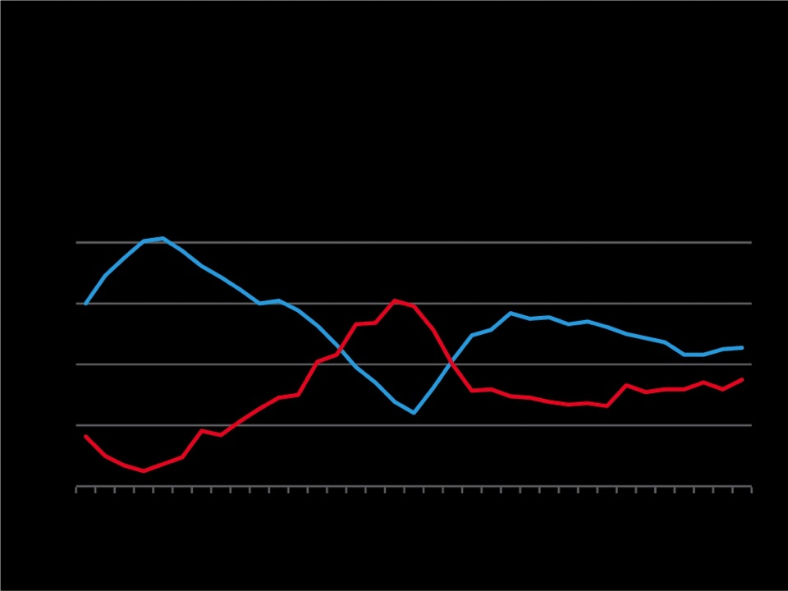
Changes in Perceptions Lead to Changes in Reality
MARIJUANA USE AND PERCEIVED RISK AMONG 12TH GRADERS, 1975 TO 2009
50%
Past Year Use
40%
30%
Perceived Risk
20%
10%
’75
’80
’85
’90
’95
’00
’05
Source: The Monitoring the Future study, the University of Michigan

Slide 13
Let’s Not Repeat Mistakes of Alcohol & Tobacco
Use levels for alcohol and tobacco are much higher than marijuana
Industries promote addiction and target kids

Slide 14
What incentives do legal corporations have to keep price low and consumption high?
“Enjoy Responsibly”
Taxes today for alcohol are 1/5 of what they were during the Korean War (adj for inflation)

Slide 15
Alcohol & Tobacco Money Makers or Dollar Drainers
Alcohol Costs
T obacco Costs
$185
billion
$200
billion
Costs
$14 billion
$25 billion
Revenues
Revenues

Slide 16
“If Only We Treated It Like Alcohol…”
ALCOHOL ARRESTS
MARIJUANA
ARRESTS
2.7 million
Yearly
847,000
Yearly
(Does NOT include violence;
Includes violations of liquor laws and driving under the influence)

Slide 17
Can we trust companies and
Big Corporations not to target youth and the vulnerable?

Slide 18
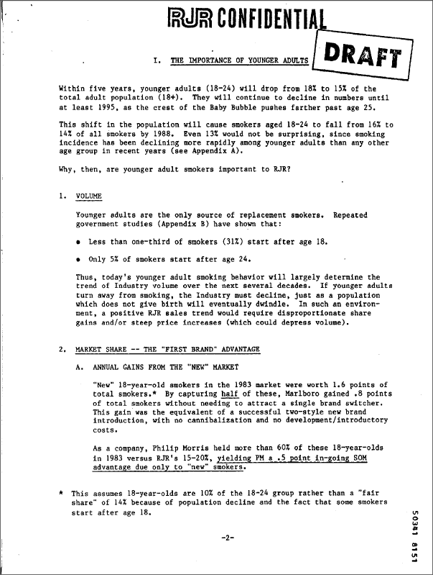
RJ Reynolds (1984 est.)
http://legacy.library.ucsf.edu/tid/eyn18c00

Slide 19
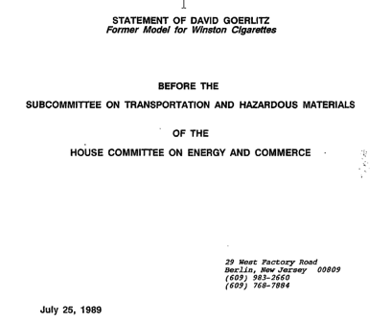
Tobacco Institute (1989)
http://legacy.library.ucsf.edu/tid/pvt37b00

Slide 20
RJ Reynolds (1973)
http://legacy.library.ucsf.edu/tid/mqu46b00

Slide 21
Brown & Williamson (1972)
http://legacy.library.ucsf.edu/tid/wwq54a99

Slide 22
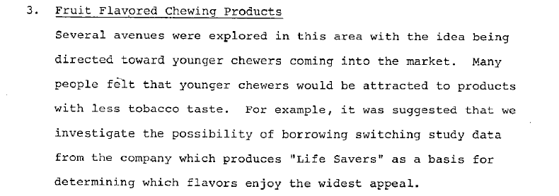
Lorillard (1979)
http://legacy.library.ucsf.edu/tid/sdw88c00

Slide 23
“The use of marijuana ... has important implications for the tobacco industry in terms of an alternative product line. (We) have the land to grow it, the machines to roll it and package it, the distribution to market it. In fact, some firms have registered trademarks, which are taken directly from marijuana street jargon. These trade names are used currently on little-known legal products, but could be switched if and when marijuana is legalized. Estimates indicate that the market in legalized marijuana might be as high as $10 billion annually.” From a report commissioned by cigarette manufacturer Brown and Williamson (now merged with R.J. Reynolds) in the 1970s.

Slide 24
Christian Thurstone, MD
Medical Director, adolescent substance abuse treatment program, Denver Health

Slide 25
Will Big Marijuana become the new Big Tobacco?
Lessons from Colorado

Slide 26
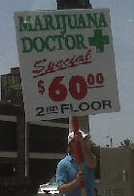
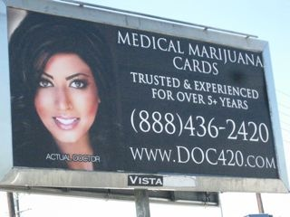

Slide 27
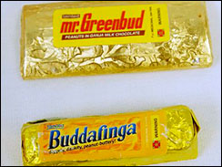
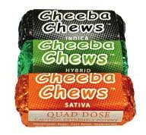
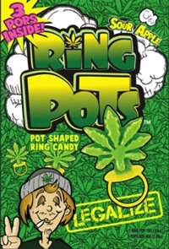
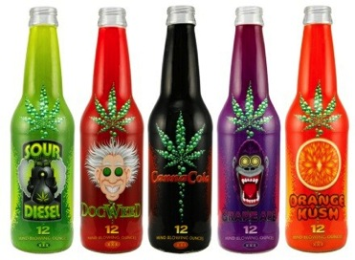
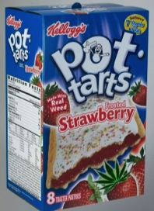
Marketing to Children

Slide 28
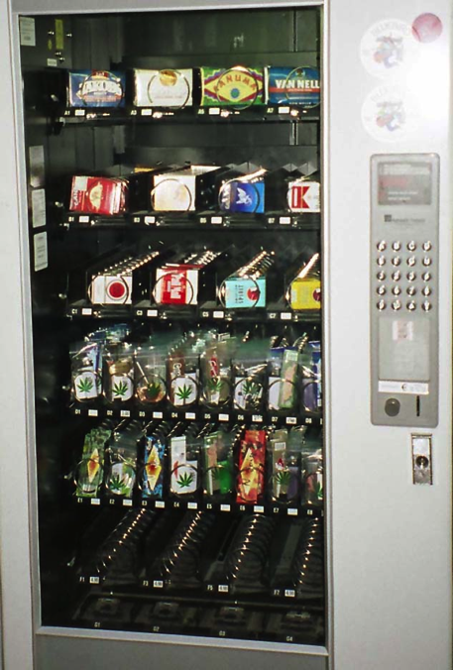

Slide 29
Past month prevalence of marijuana use –
12+ yrs
12.2
9.62
7.88
6.0
6.6
6.1
29
Source: National Survey on Drug Use and Health
Notes:
29

Slide 30
Number substance treatment admissions for marijuana - Denver metro
Med. MJ Dispensaries/Commercializaition
Colorado
#
Denver
Source: Drug/Alcohol Coordinated Data System

Slide 31
Blood tests for DUID positive for THC - Colorado
#
31
Source: Colorado Department of Public Health and the Environment
Notes:
31

Slide 32
CO Traffic Fatalities with a THC+ driver
#
Med. MJ Dispensaries/Commercializaition

Slide 33
Use of “regulated” marijuana by Denver teens
%
%
%
%
Substance treatment = 74% YES
Primary Care=
72% NO
Source: Salomonse-Sautel et al. (2012), JAACAP 51:694-702; Thurstone et al., under review
33
Notes:
33

Slide 34
Average urine drug screen results
Ng/ml
34
Source: Thurstone et al., in preparation
Notes:
34

Slide 35
Drug-Related Suspensions/Expulsions - Colorado
Med. MJ Dispensaries/Commercializaition
#
35
Source: Colorado Department of Education
Notes:
35

Slide 36
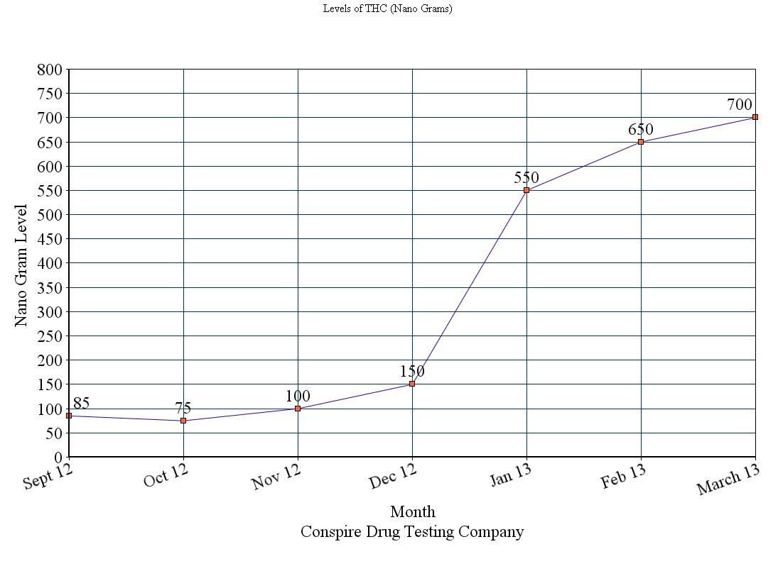
Colorado: Drug Testing Company Sees Spike in Children Using Marijuana
Levels of THC (Nano Grams) after passage of Amendment 64:
High School Student: “I’ve seen a lot more people just walking down the street smoking (joints)…it has kind of gotten out of hand.”
Passage of Legalization

Slide 37
Marijuana and Kids
The adolescent brain is especially susceptible to marijuana use.
That means that when kids use, they have a greater chance of
addiction since their brains
are being primed.

Slide 38
Marijuana, Mental Health, and Kids
adolescents who use marijuana have a 2-4 fold increase risk of developing psychosis and this risk is dose-dependent (Hall and Degenhardt, 2009)
adolescents who use marijuana heavily have up to an 8-point drop in IQ and this risk is also dose-dependent (Meier et al., 2012)
marijuana, especially high potency marijuana, may cause acute anxiety attacks and psychosis (Hall and Degenhardt, 2009). MJ accounted for 461,028 ED visits in 2012 (DAWN, 2013). Symptoms of withdrawal include anxiety and depression (Budney et al., 2002).
Controlling for other possible confounds, those who use marijuana are twice as likely to have had a suicide attempt requiring hospitalization (Hall and Degenhardt, 2009).
Marijuana withdrawal causes a doubling in aggressive episodes compared to controls (Kouri et al., 1999; Smith et al., 2013).

Slide 39
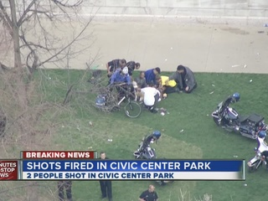
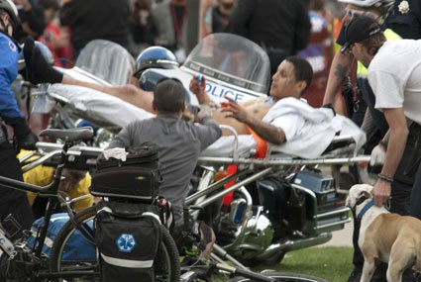
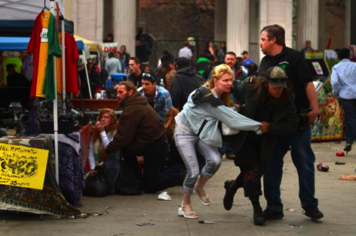
Is this our model?

Slide 40
Responsible Regulations?
Heavily influenced by CO’s massive medical marijuana industry
Allowing character packaging, edibles, candies
Can grow much more than you sell
Advertising allowed in “Adult Periodicals”

Slide 41
Kevin A. Sabet, Ph.D.
Director, Project SAM;
Asst. Professor & Drug Policy Institute Director, University of Florida. Former Obama Administration Drug Advisor

Slide 42
So what are our choices for marijuana policy?

Slide 43
All or nothing: Legalization vs. Prohibition

Slide 44
Current Debate
Debate focuses on gains, not potential drawbacks, of legalization.
One major potential drawback is increased use among young people

Slide 45
We Need
A “SMART APPROACH”
Not about legalization vs. incarceration
We can be against legalization
but also for health, education, and common-sense

Slide 46
Chair, Patrick J. Kennedy
Launched January 10th, Denver
Over 5,000 press mentions
Public Health Board of Trustees
Local Affiliates in CA, MA, VT, HI, and more in 2013

Slide 47
To inform public policy with the science of today’s marijuana.
To have honest conversations about reducing the unintended consequences of current marijuana policies, such as lifelong stigma due to arrest.
To prevent the establishment of Big Marijuana that would market marijuana to children — and to prevent Big Tobacco from taking over Big Marijuana. Those are the very likely results of legalization.
To promote research of marijuana’s medical properties and produce pharmacy-attainable medications.

Slide 48
Current Situation
Less than 3% of state “medical marijuana” users have cancer, HIV, or glaucoma.
Could exacerbate symptoms (American Glaucoma Society)
Vast majority are white males in 30s and 40s with self-diagnosed pain.
Vast majority of cancer doctors and other physicians do not recommend smoking or ingesting marijuana.

Slide 49
Current Situation
Relative to areas without them, areas with medical marijuana “dispensaries” connected to crime, youth access, and increased abuse.
Voting on medicine? Bypassing scientific, FDA process, in favor of larger political and legalization agendas.
Most major medical groups oppose state-based smoked marijuana as medicine (eg AMA, ACS).

Slide 50
This doesn’t mean that components
in marijuana do not have medical properties.
These are being scientifically developed.
However, the process should be improved.

Slide 51
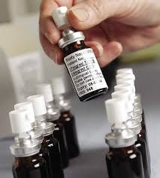
Cannabis-Based Medicines
Research on the efficacy of cannabinoids is not focused on raw/crude marijuana, but in the individual components that may have medical use.
Sativex is in the process of being studied
Approved in Canada and across Europe
Administered via an oral mouth spray, THC:CBD - 1:1

Slide 52
We don’t smoke opium to benefit from morphine.
So we don’t need to smoke marijuana to receive its potential benefits.

Slide 53
We need to decrease access and availability.
So, a smart approach might look like this:
Increased community-based prevention through community coalitions to empower schools, parents, physicians and other health care professionals to prevent marijuana use among youth
Increased screening and brief interventions in health care settings
Increased access to treatment
Increased access to recovery-oriented services
Greater number of drug treatment courts and HOPE Probation programs

Slide 54
Carmen Fernández Cáceres
Director-General
Centros de Integración Juvenil, A.C. (CIJ)

Slide 55
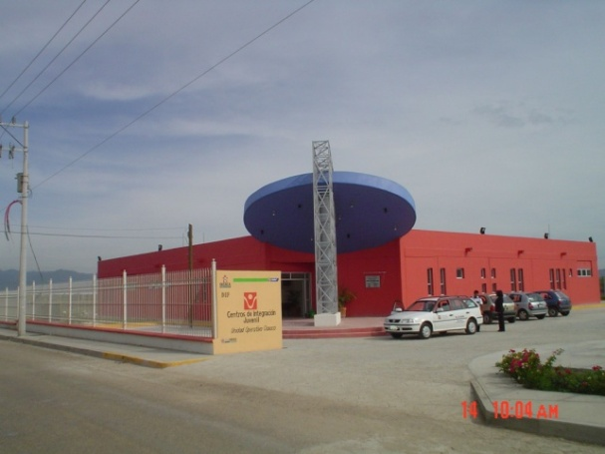
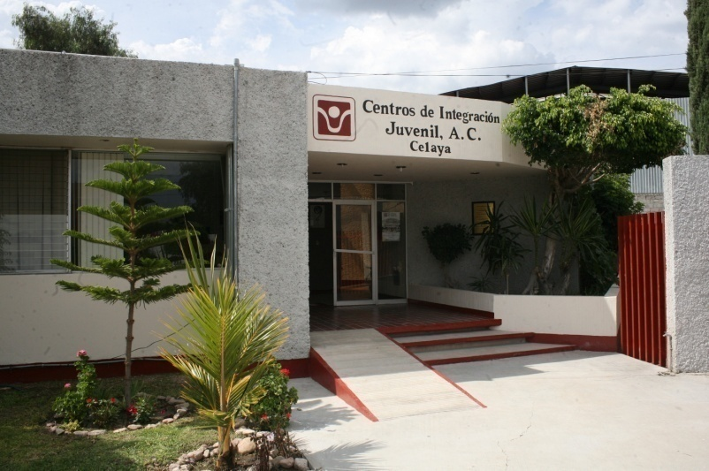
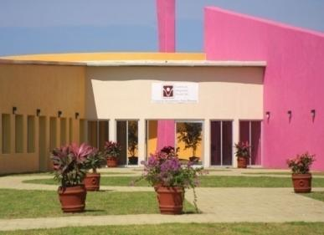
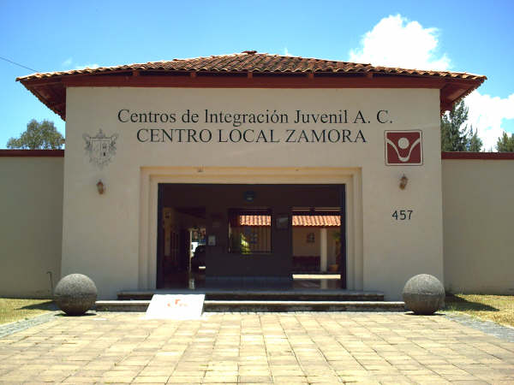
Centros de Integración Juvenil, A.C.
“To live without addictions”
CIJ provided prevention and treatment services and makes research in addiction since 1969
CIJ has an operative network of 114 Centers
During 2012 our coverage was for 7,846,000 people

Slide 56
Perception of Risk Associated with Consumption of Marijuana during Last Year
Drug Use in the Americas 2011 Report (CIDAD)
Uruguay
Prevalence of Use
Source: CICAD (2011) Informe del uso de drogas en las Américas 2011
Perception of Great Risk (%)
Greater perception of risk reduces consumption

Slide 57
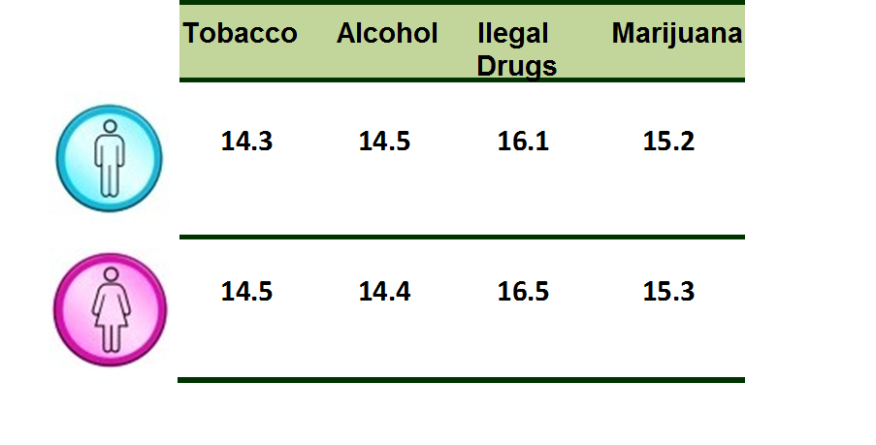
CIJ’s patients 2012
Age at first use of drugs
Age at first use of marijuana is between to 14 and 17 years old
Source: National Survey on Addictions 2011

Slide 58
Consequences of U.S. legalization of marijuana
Social
Tolerance
Increase use
Use in underage
(approval)
Users do not
seek treatment
Decrease risk perception
Promote discussion about legalizing
Disseminate wrong information about medical use
More availability
More use

Slide 59
Use of other drugs
Begin with marijuana
(12, 511 patients)
89.7% start using a 2nd drug
(11,218 patients)
71.9% start using a 3rd drug
(8,067 patients)
2nd DRUG
Alcohol | 24.2%
Cocaine | 20.2%
Inhalants | 15.1%
Crystal | 13.1%
Heroin | 6.1%
Tobacco | 6.0%
Sedatives | 5.3%
3rd DRUG
Cocaine | 19.4%
Alcohol | 15.5%
Heroin | 14.1%
Crystal | 13.4%
Inhalants | 11.2%
Crack | 8.3%
Sedatives | 5.6%
SISVEA, Centros de Tratamiento no Gubernamentales, 2009
Sample: 70,467 people (15-35 years or more) .
Mono-users
17.8%
SISVEA, 2009

Slide 60
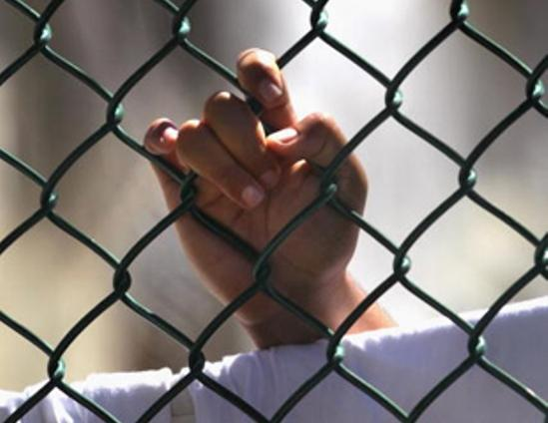
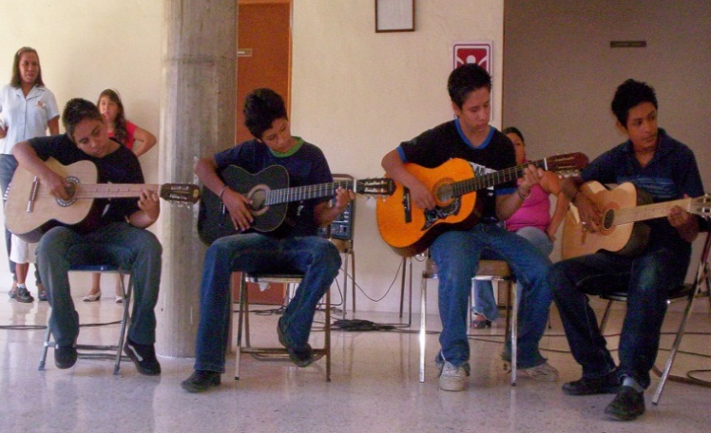
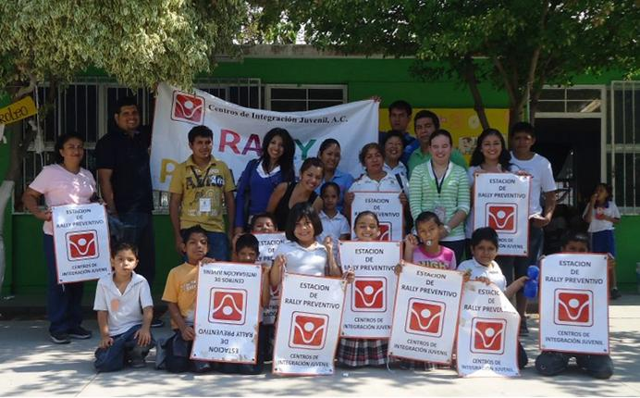
Alternatives
Treat addiction like a health issue
Personal use results in an intervention
Preventive education and access to treatment based on HR
Drug Courts – Therapeutic Justice
Mexican public policy

Slide 61
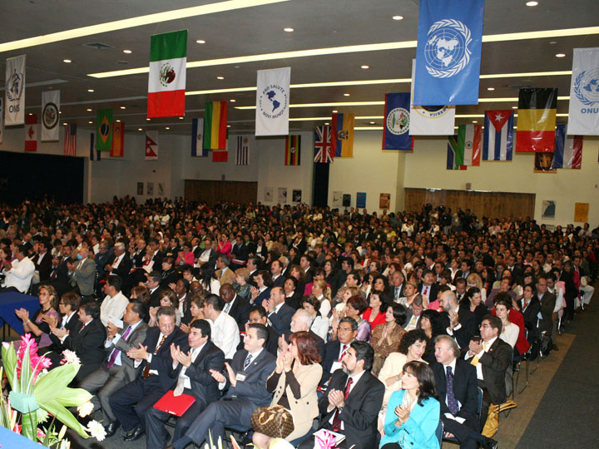
Petition: Call to Action in Favor of Prevention and Against marijuana Legalization
CIJ launched Call to Action in Favor of Prevention and Against Marijuana Legalization supported and signed by 8 networks from 50 countries
CIJ has 40,000 signatures against marijuana legalization.

Slide 62
Thank You!
Questions?
www.learnaboutsam.org
Email
info@learnaboutsam.org

