Slide 1
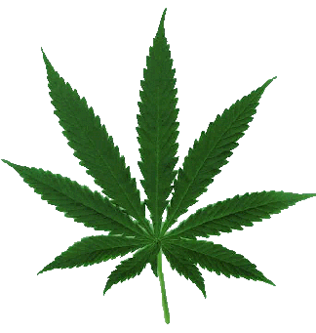


Marijuana:
The Highs and Lows
Nora D. Volkow, MD
Director

Slide 2
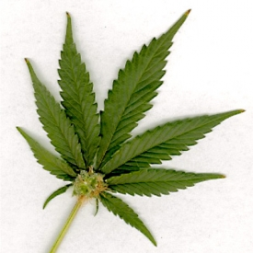
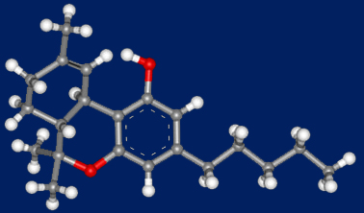
Marijuana is the Most Commonly Used Illicit Drug In the U.S.
Over 114 million Americans have tried it
at least once
An estimated
2.4 million Americans
used it for the first
time in 2013
Tetrahydrocannabinol (THC)
Active Ingredient in Marijuana
2013 National Survey on Drug Use and Health, SAMHSA, 2014.

Slide 3

ADDICTION IS A DEVELOPMENTAL DISEASE
it starts in adolescence and childhood
1.8%
TOBACCO
1.6%
THC
ALCOHOL
1.4%
1.2%
Percentage in each age group who
develop first-time dependence
1.0%
0.8%
0.6%
0.4%
0.2%
0.0%
5
10
15
21
25
30
35
40
45
50
55
60
65
Age
Age at tobacco, at alcohol and at cannabis use dependence as per DSM IV
NIAAA National Epidemiologic Survey on Alcohol and Related Conditions, 2003.

Slide 4

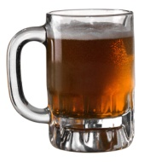
Percentage of U.S. 12th Grade Students
Reporting Past Month Use of
Cigarettes, Marijuana and Alcohol
Alcohol
Marijuana
Cigarettes

Slide 5
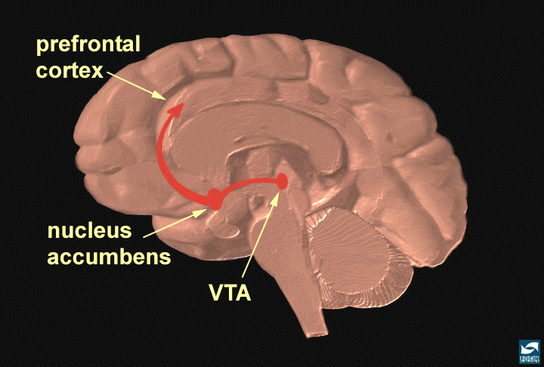
Natural and Drug Reinforcers
Increase Dopamine in NAc
1100
1000
AMPHETAMINE
900
800
700
600
% of Basal Release
500
400
300
200
frontal
cortex
100
0
0
1
2
3
4
5 hr
150
125
100
MARIJUANA
nucleus
accumbens
% of Basal Release
VTA/SN
0 20 40 60 80
Tanda, et al, Science 1997.
200
FOOD
150
100
Drugs of abuse increase DA in the Nucleus Accumbens, which is believed to trigger the neuroadaptions that result in addiction
% of Basal Release
Empty
50
Box
Feeding
0
0
60
120
180
Time (min)
Di Chiara et al.

Slide 6
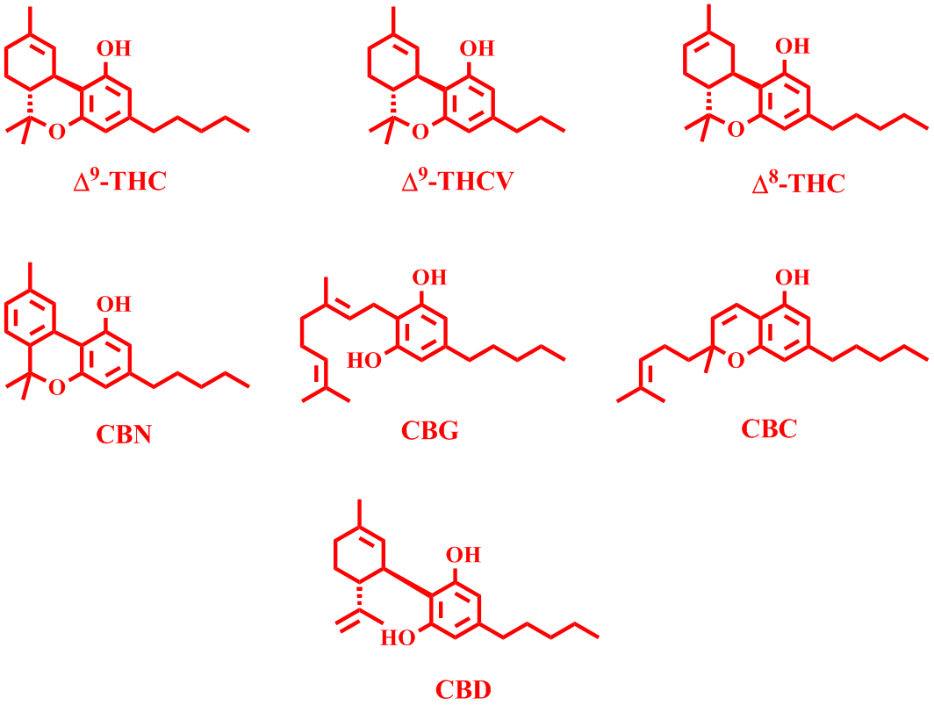
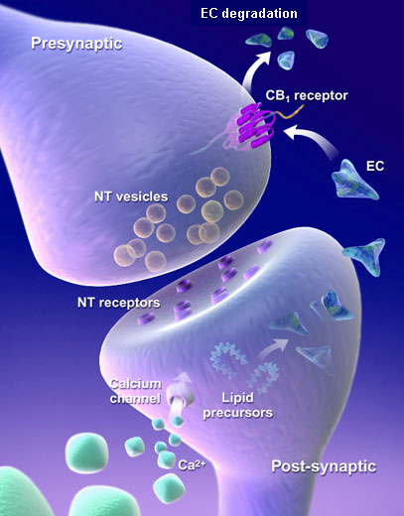
Constituents of MJ and the Cannabinoid System
delta-9-tetrahydrocannabinol
delta-9-tetrahydrocannabivarin
delta-8-tetrahydrocannabinol
cannabigerol
cannabinol
cannabichromene
cannabidiol
Notes:
Source?

Slide 7
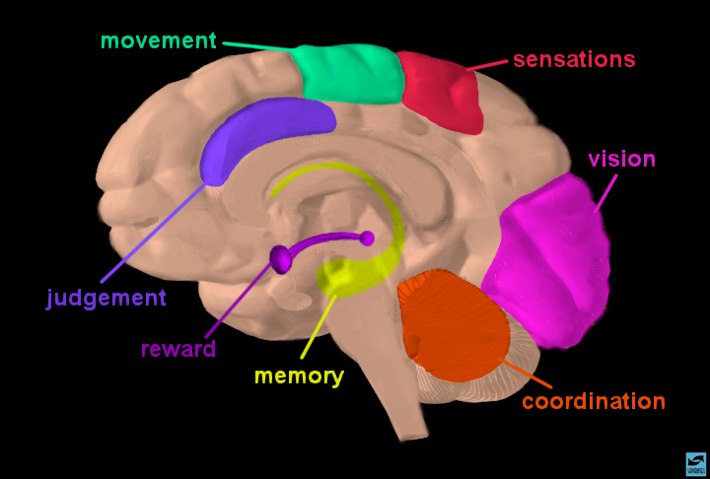
Cannabinoid Receptors Are Located Throughout the Brain and Regulate:
Brain Development
Memory & Cognition
Motivational Systems
& Reward
Appetite
Immunological Function
Reproduction
Movement Coordination
Pain Regulation
& Analgesia
.
.
.
.
.
.
.
.
.
.
.
.
.
.
.
.
.
.
.
.
.
.
.
.
.
.
.
.
.
.
.
.
.
.
.
.
.
.
.
.
.
.
.
.
.
.
.
.
.
.
.
.
.
.
.
.
.
.
.
.
.
.
.
.
.
.
.
.
.
.
.
.
.
.
.
.
.
.
.
.
.
.
.
.
.
.
.
.
.
.
.
.
.
.
.
.
.
.
.
.
.
.
.
.
.
.
.
.
.
.
.
.
.
.
.
.
.
.
.
.
.
.
.
.
.
.
.
.
.
.
.
.
.
.
.
.
.
.
.
.
.
.
.
.
.
.
.
.
.
.
.
.
.
.
.
.
.
.
.
.
.
.
.
.
.
.
.
.
.
.
.
.
.
.
.
.
.
.
.
.
.
.
.
.
.
.
.
.
.
.
.
.
.
.
.
.
.
.
.
.
.
.
.
.
.
.
.
.
.
.
.
.
.
.
.
.
.
.
.
.
.
.
.
.
.
.
.
.
.
.
.
.
.
.
.
.
.
.
.
.
.
.
.
.
.
.
.
.
.
.
.
.
.
.
.
.
.
.
.
.
.
.
.
.
.
.
.
.
.
.
.
.
.
.
.
.
.
.
.
.
.
.
.
.
.
.
.
.
.
.
.
.
.
.
.
.
.
.
.
.
.
.
.
.
.
.
.
.
.
.
.
.
.
.
.
.
.
.
.
.
.
.
.
.
.
.
.
.
.
.
.
.
.
.
.
.
.
.
.
.
.
.
.
.
.
.
.
.
.
.
.
.
.
.
.
.
.
.
.
.
.
.
.
.
.
.
.
.
.
.
.
.
.
.
.
.
.
.
.
.
.
.
.
.
.
.
.
.
.
.
.
.
.
.
.
.
.
.
.
.
.
.
.
.
.
.
.
.
.
.
.
.
.
.
.
.
.
.
.
.
.
.
.
.
.
.
.
.
.
.
.
.
.
.
.
.
.
.
.
.
.
.
.
.
.
.
.
.
.
.
.
.
.
.
.
.
.
.
.
.
.
.
.
.
.
.
.
.
.
.
.
.
.
.
.
.
.
.
.
.
.
.
.
.
.
.
.
.
.
.
.
.
.
.
.
.
.
.
.
.
.
.
.
.
.
.
.
.
.
.
.
.
.
.
.
.
.
.
.
.
.
.
.
.
.
.
.
.
.
.
.
.
.
.
.
.
.
.
.
.
.
.
.
.
.
.
.
.
.
.
.
.
.
.
.
.
.
.
.
.
.
.
.
.
.
.
.
.
.
.
.
.
.
.
.
.
.
.
.
.
.
.
.
.
.
.
.
.
.
.
.
.
.
.
.
.
.
.
.
.
.
.
.
.
.
.
.
.
.
.
.
.
.
.
.
.
.
.
.
.
.
.
.
.
.
.
.
.
.
.
.
.
.
.
.
.
.
.
.
.
.
.
.
.
.
.
.
.
.
.
.
.
.
.
.
.
.
.
.
.
.
.
.
.
.
.
.
.
.
.
.
.
.
.
.
.
.
.
.
.
.
.
.
.
.
.
.
.
.
.
.
.
.
.
.
.
.
.
.
.
.
.
.
.
.
.
.
.
.
.
.
.
.
.
.
.
.
.
.
.
.
.
.
.
.
.
.
.
.
.
.
.
.
.
.
.
.
.
.
.
.
.
.
.
.
.
.
.
.
.
.
.
.
.
.
.
.
.
.
.
.
.
.
.
.
.
.
.
.
.
.
.
.
.
.
.
.
.
.
.
.
.
.
.
.
.
.
.
.
.
.
.
.
.
.
.
.
.
.
.
.
.
.
.
.
.
.
.
.
.
.
.
.
.
.
.
.
.
.
.
.
.
.
.
.
.
.
.
.
.
.
.
.
.
.
.
.
.
.
.
.
.
.
.
.
.
.
.
.
.
.
.
.
.
.
.
.
.
.
.
.
.
.
.
.
.
.
.
.
.
.
.
.
.
.
.
.
.
.
.
.
.
.
.
.
.
.
.
.
.
.
.
.
.
.
.
.
.
.
.
.
.
.
.
.
.
.
.
.
.
.
.
.
.
.
.
.
.
.
.
.
.
.
.
.
.
.
.
.
.
.
.
.
.
.
.
.
.
.
.
.
.
.
.
.
.
.
.
.
.
.
.
.
.
.
.
.
.
.
.
.
.
.
Notes:
Slide 2: Brain regions and neuronal pathways
Certain parts of the brain govern specific functions. Point to sensory, motor, association and visual cortex to highlight specific functions. Point to the cerebellum for coordination and to the hippocampus for memory. Indicate that nerve cells or neurons travel from one area to another via pathways to send and integrate information. Show, for example, the reward pathway. Start at the ventral tegmental area (VTA) (in magenta), follow the neuron to the nucleus accumbens, and then on to prefrontal cortex. Explain that this pathway gets activated when a person receives positive reinforcement for certain behaviors ("reward"). Indicate that you will explain how this happens when a person takes an addictive drug.

Slide 8
Long Term Effects of Marijuana
Addiction: About 9% of users may become dependent, 1 in 6 who start use in adolescence, 25-50% of daily users
Estimated Prevalence of Dependence Among Users
*
*
* Nonmedical Use
Source: Anthony JC et al., 1994

Slide 9
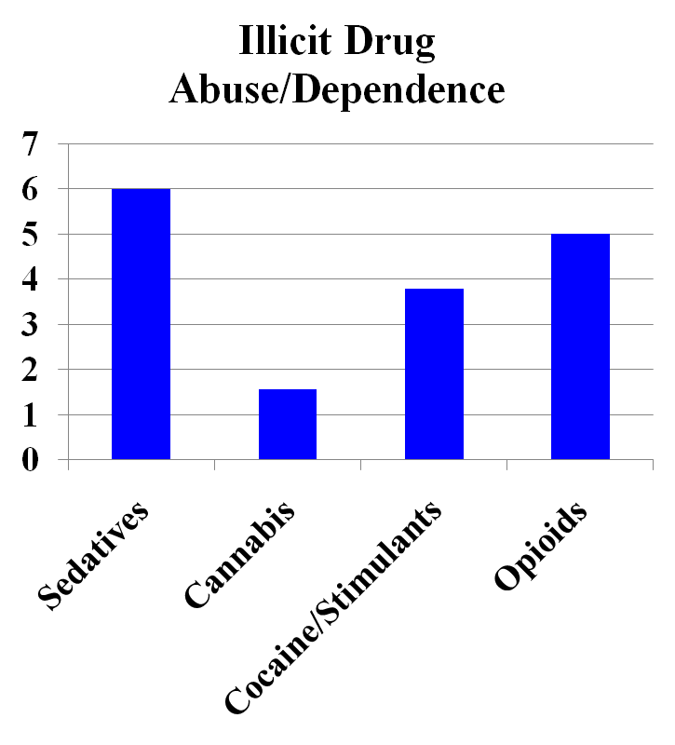
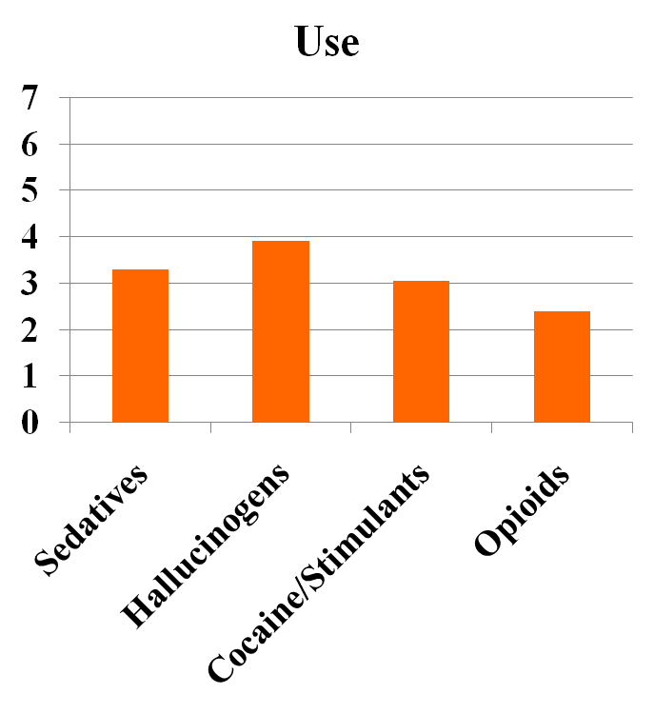
Drug Use Outcomes in Twin Pairs (n =234) Discordant for Cannabis Use Before Age 17
Odds Ratio
Source: Lynskey, MT et al., JAMA, 289, pp. 427-433, 2003.

Slide 10
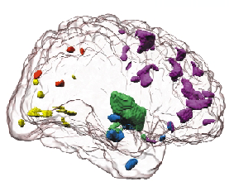
Does marijuana use negatively affect the developing brain and an individual’s
personal trajectory into adulthood?
Notes:
Does marijuana really damage the brain?
Research on how chronic marijuana use affects brain structure and function is still in its early stages. Some of its effects may be just at the threshold of current detection techniques. Thus, we do not have a full understanding of the extent to which long term marijuana use is associated with persistent deficits in brain performance.
However, the combined results of independent human studies so far, do suggest that marijuana can negatively influence the health of the brain, at least in some users.
Still, it is worth remembering that the effects seen in the following slides cannot be categorically linked to effects caused by marijuana exposure. The study of chronic effects of any drug in humans suffers from an unavoidable level of uncertainty that stems from important confounding factors, some of which may in fact be preexisting (before drug exposure) and associated with increased risk of initiating marijuana use.

Slide 11
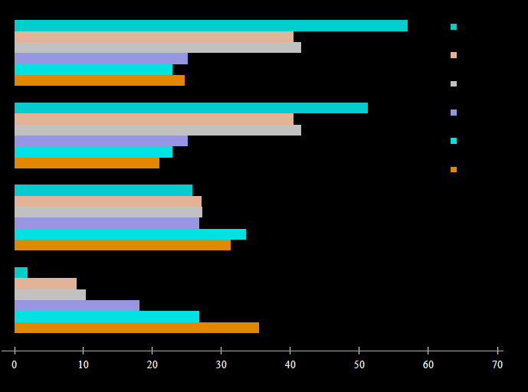
Cannabis Use and Later Life Outcomes
Are Dose Dependent
400+
300 to 399
200 to 299
100 to 199
1 to 99
Never
% welfare dependent
(ages 21-25)
% Unemployed
(ages 21-25)
mean personal income
in thousands of NZ $
at age 25
% gained university degree
by age 25
# of occasions using
Cannabis ages 14-21
Number of occasions using
Cannabis between ages 14-21
Source: Fergusson and Boden. Addiction, 103, pp. 969-976, 2008.
Notes:
Marijuana use is strongly linked to poorer outcomes later in life.
The relationship between marijuana use and poor life outcomes appears to be dose dependent. Illustrated are the results of a 25-year longitudinal study of a New Zealand birth cohort showing associations between increasing levels of cannabis use at ages 14-21 and: higher levels of welfare dependence; higher unemployment; lower income at age 25; and lower levels of academic degree attainment by age 25.
These results are consistent with an earlier study in the US showing poorer outcomes for chronic marijuana users in terms of education attained, household income, and overall life satisfaction. (Gruber, AJ et al., Psychological Medicine, 33, pp. 1415-1422, 2003.)

Slide 12
Frequency Of Cannabis Use Before Age 17 Years and Adverse Outcome (30years age) (n=2500-3700)
Consistent and dose-response association were found between frequency of adolescent cannabis use and advers outcomes
Adjusted Odds Ratios
Silins E et al., The Lancet September 2014.

Slide 13
Persistent Cannabis Users Show Neuropsychological
Decline from Childhood to Midlife
Adolescent Vulnerability
0.4
0.2
0
-0.2
-0.4
-0.6
-0.8
Dunedin prospective study of 1037 Ss born 1972/73,
Tested for IQ at age 13 and 38y.
Tested THC use ages 18, 21, 26, 32 and 38y
1 Diagnosis
2 Diagnoses
3 Diagnoses
Change in Full-Scale IQ
(in standard deviation units)
p=.44
p=.09
p=.02
Cannabis
Dependent
Before Age 18
(n=17)
Not Cannabis
Dependent
Before Age 18
(n=57)
Cannabis
Dependent
Before Age 18
(n=12)
Not Cannabis
Dependent
Before Age 18
(n=21)
Cannabis
Dependent
Before Age 18
(n=23)
Not Cannabis
Dependent
Before Age 18
(n=14)
Source: Meier MH et al., PNAS Early Edition 2012.

Slide 14
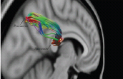
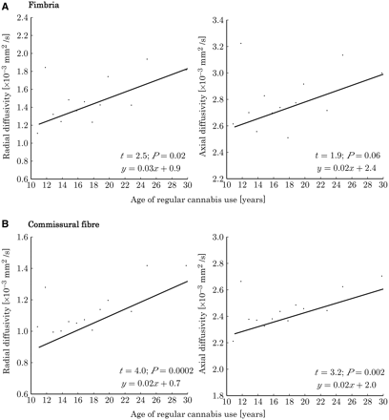
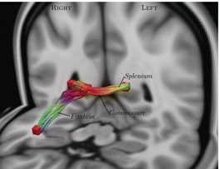
Early (<18y) Long-Term Cannabis Use Decreases Axonal Fiber Connectivity
Precuneus to splenium
Fimbria of hippocampus,
hippocampal
commissure and
Splenium
Axonal paths with reduced connectivity (measured with diffusion-weighted MRI) in cannabis users (n=59) than in controls (N=33).
Zalesky et al Brain 2012.

Slide 15

AMOTIVATION & THC

Slide 16
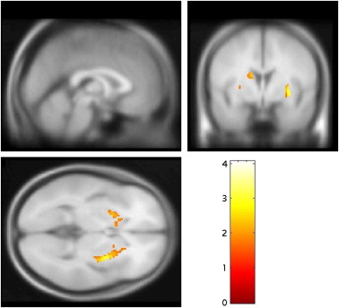
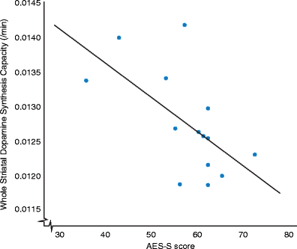
DA Synthesis Capacity in Cannabis Abusers
Reduced striatal DA synthesis capacity in cannabis users relative to controls
Striatal DA synthesis and apathy
(AES-S score)
¹⁸F DOPA
Bloomfield et al., Psychopharm 2014.

Slide 17
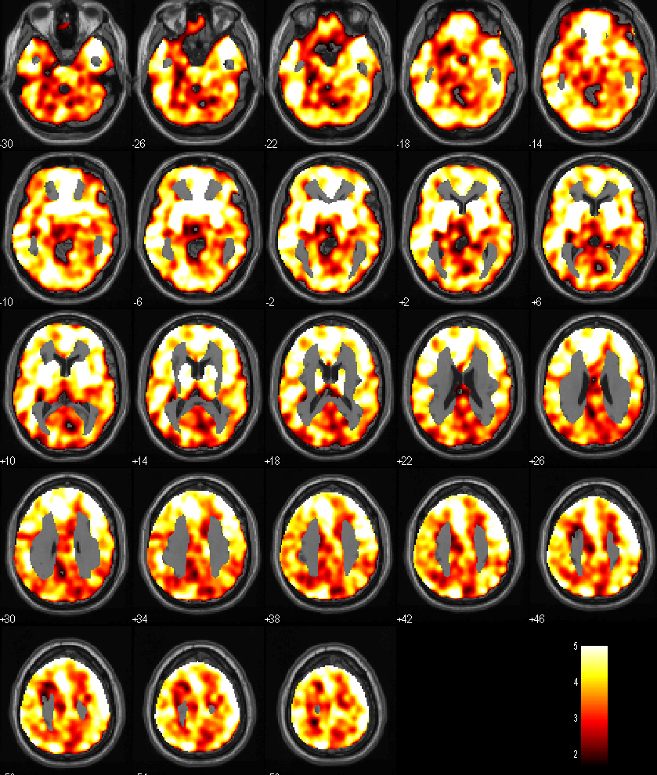
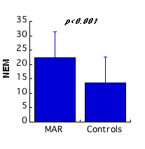
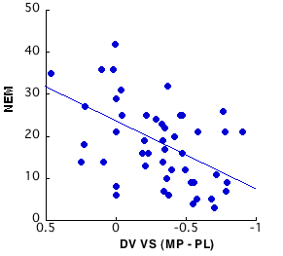
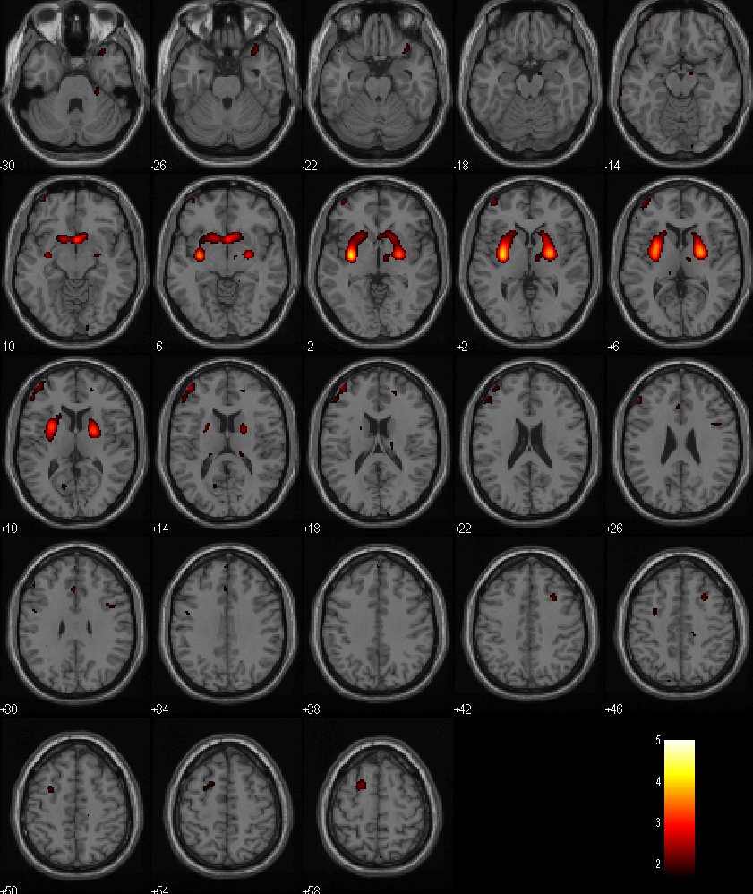
MP Induced Changes in [¹¹C]Raclopride (DA Marker) in Marijuana Abusers and Negative Emotionality
Healthy Controls (N=24) PL > MP
Marijuana Abusers (N=24) PL > MP
Reduced DA reactivity in VS in Marijuana abusers is associated with negative emotionality (NEM)
Volkow et al., PNAS 2014

Slide 18
Effects of THC on Mental Illness

Slide 19
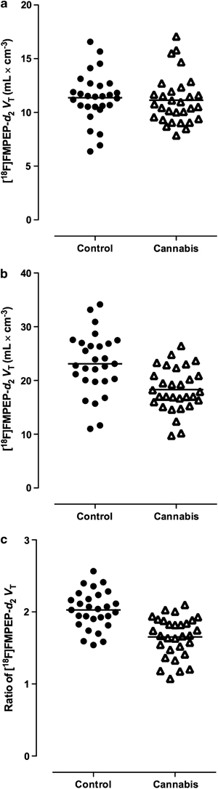
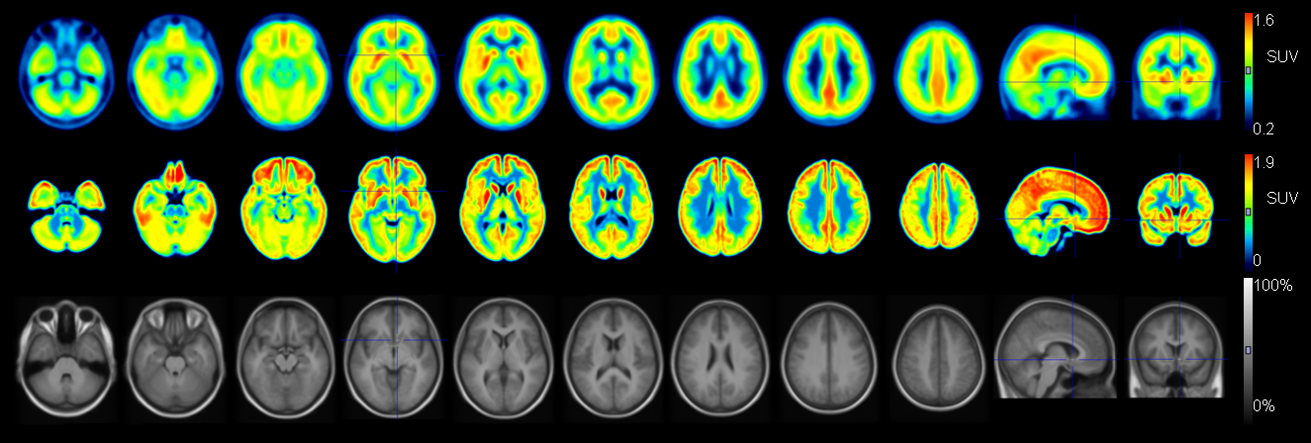
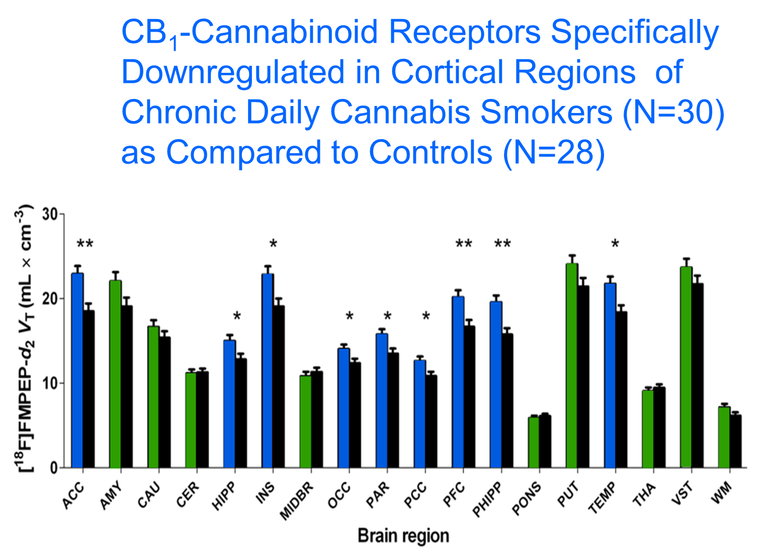
Cannabinoid CB1 Receptors in Human Brain are Downregulated in Marijuana Abusers
Marijuana Abusers
Controls
ACC/CBL
Van Loere et al., 2007.
Hirvonen et al., Mol Psychiatry 2013.

Slide 20
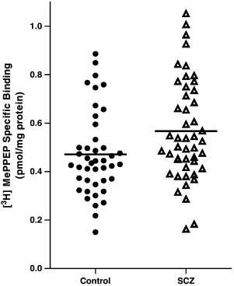
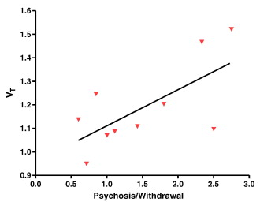
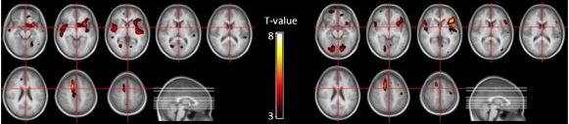
CB1R are Increased in Schizophrenics
CB1R (dlPFC) 20% higher in schizophrenics than controls
Increases in CB1R in schizophrenics were associated with psychosis severity
Jenko et al., Schizophr Res 2012
Wong et al., Neuroimage 2010
Treated
Schizophrenics > Controls
Not Treated
Ceccarini , et al., Neuroimage 2013

Slide 21
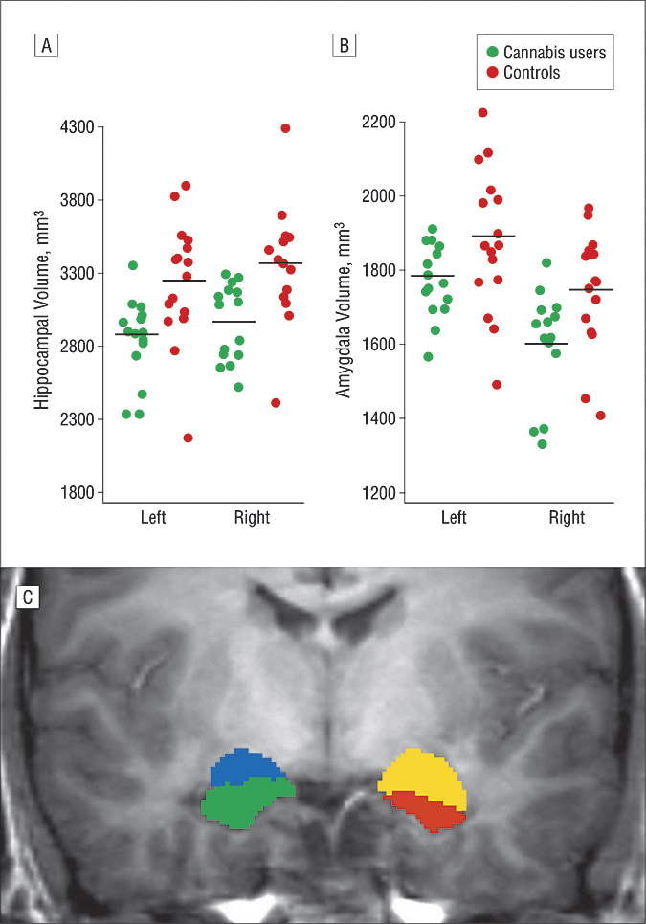
Brain abnormalities associated with long-term heavy cannabis use
Hippocampus
Amygdala
Yucel et al., Arch Gen Psychiatry. 2008
L (yellow) and R (blue) amygdala L(red) and R(green) hippocampus
Hippocampus and amygdala volumes smaller in cannabis users than controls and this has been linked with impaired memory perfprmance
Lorenzeti et al.., Biological Psychiatry 2015

Slide 22
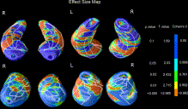
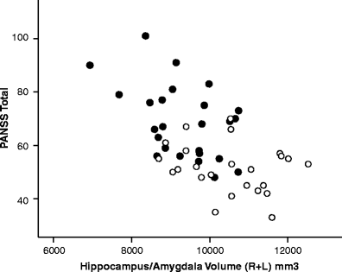
Schizophrenics have Smaller
Hippocampus and Amygdala
Areas in Hippocampus and Amygdala were volumes were smaller in schizophrenics than controls
Hippocampus/Amygdala
volumes correlated with
psychosis in schizophrenics (closed) and bipolar patients (open)
Prestia et al., Am J Geriatr Psychiatry 2015.
Watson et al., Brain Imaging Behav. 2012.

Slide 23
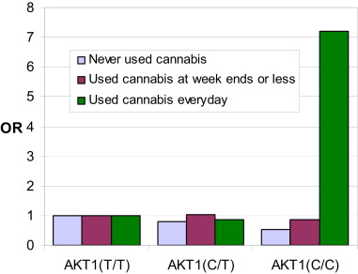
Cannabis-Associated Psychosis
Regular Cannabis Use Increases Schizophrenia Risk in those with AKT1 rs2494732 genotype
AKT1(T/T) AKT1(C/T) AKT1(C/C)
Study of Swedish Conscripts (n=45570)
Andréasson et al Lancet, 1987.
Never used cannabis
Used cannabis at week ends or less
Used cannabis everyday
30
Odds Ratio
20
Cases per 1,000
10
0
0
1
2
10
<50
>50
AKT1(T/T) AKT(C/T) AKT1(C/C)
No of times cannabis taken
Di Forti et al., Biological Psychiatry, 2012.
GXE model: p*=0.014
Prospective Dunedin study (n=1037)
Effect of High Potency Cannabis on
Risk of Psychosis
Risk of schizophrenia-like
psychosis at age 26 years
Odds ratio
Adjusted OR
Arseneault et al BMJ 2002
Di Forti M et al., The Lancet published online February 18, 2015.

Slide 24
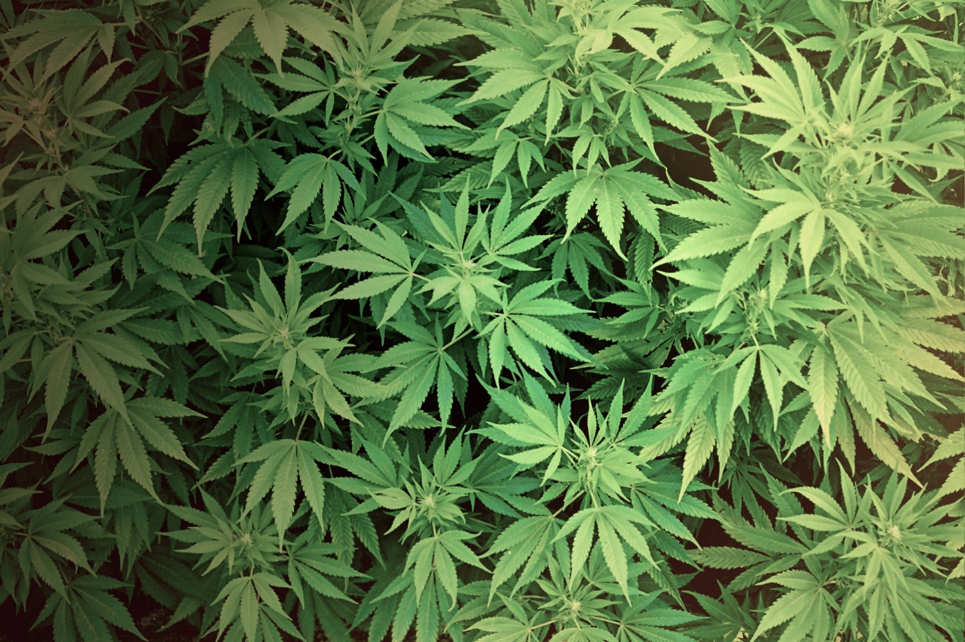



THC OF TODAY

Slide 25
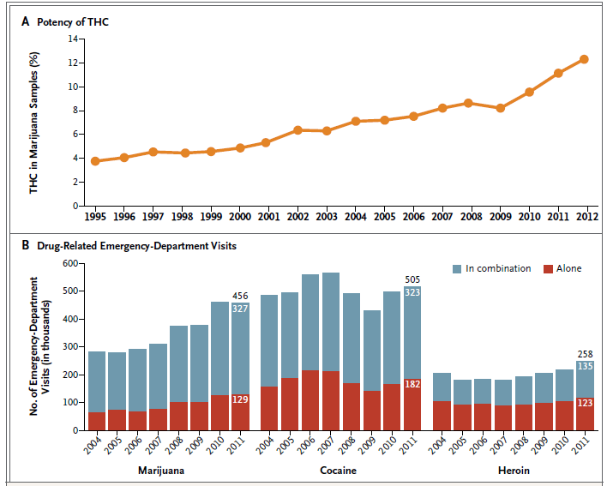
Increases over Time in the Potency of Tetrahydrocannabinol (THC)
in Marijuana and the Number of Emergency Department Visits Involving Marijuana, Cocaine, or Heroin
Volkow ND et al., NEJM 370(23), June 5, 2014.

Slide 26
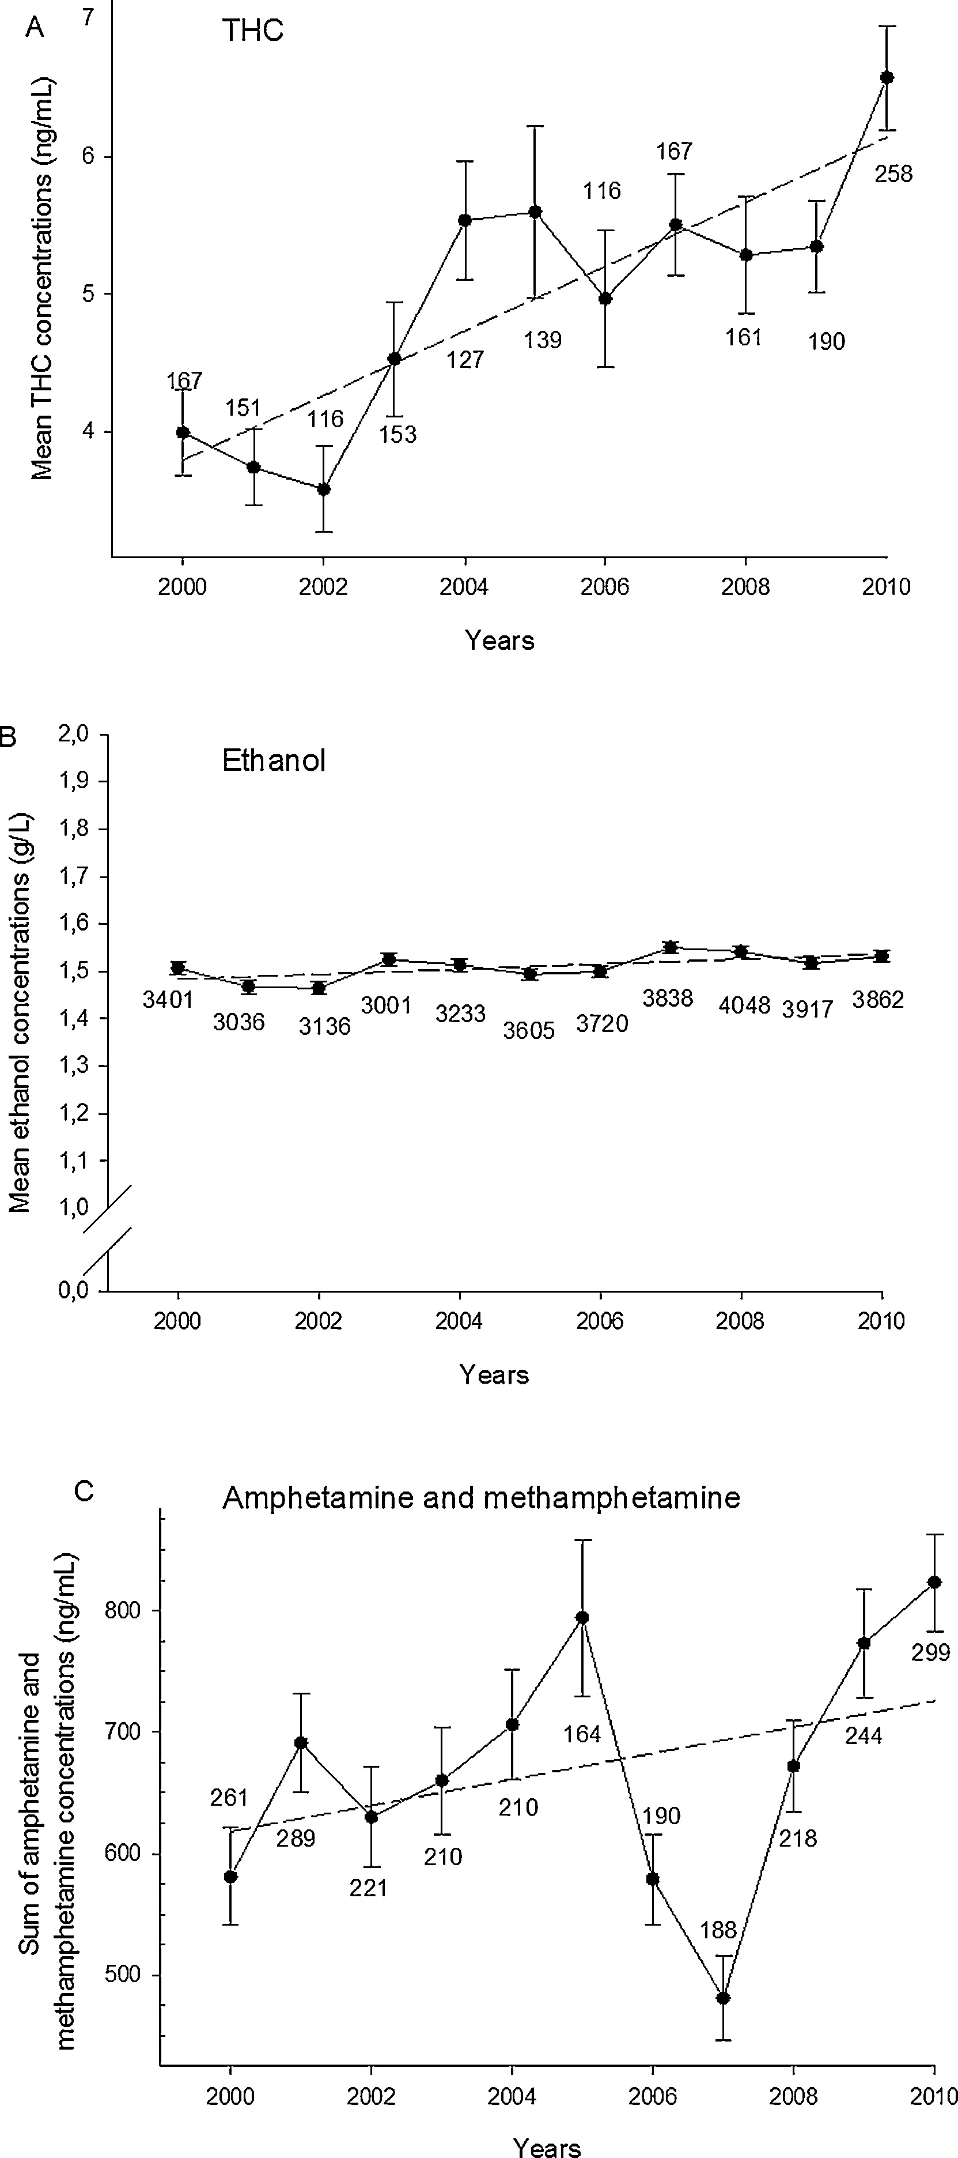
Mean Concentrations of THC, Ethanol & Amphetamines
In Whole Blood Samples From Drivers Apprehended By The Police Suspected Of Driving Under The Influence
Amphetamine &
Methamphetamine
THC
Ethanol
Vindenes V et al.,Forensic Sci Internati 2013; 226(1–3): 197-201.

Slide 27
SUBSTANCE ABUSE IS PREVENTABLE
12th Graders’ Past Year Marijuana Use vs.
Perceived Risk of Occasional Marijuana Use
Notes:
2012: non-sig dec in perceived risk.
Change in perceived risk precedes change in use by a year or so.
Inc in PY use and dec in perceived risk are NS here, but about 15% increase over 5 years.
More on MJ prevalence in other grades later in presentation.

Slide 28

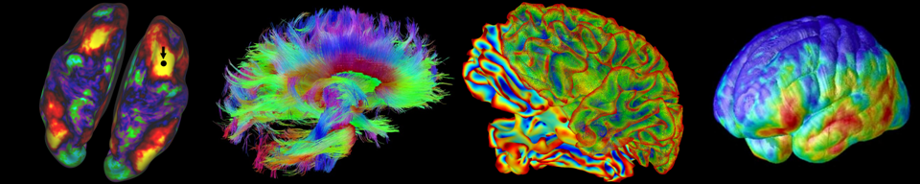

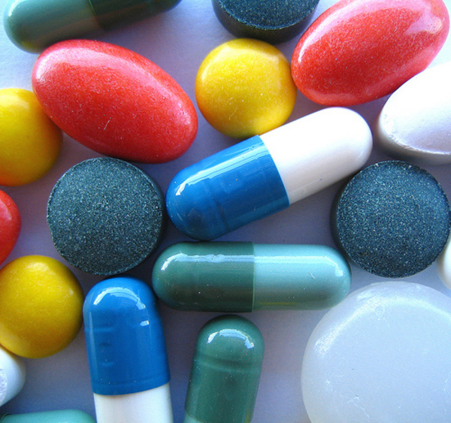


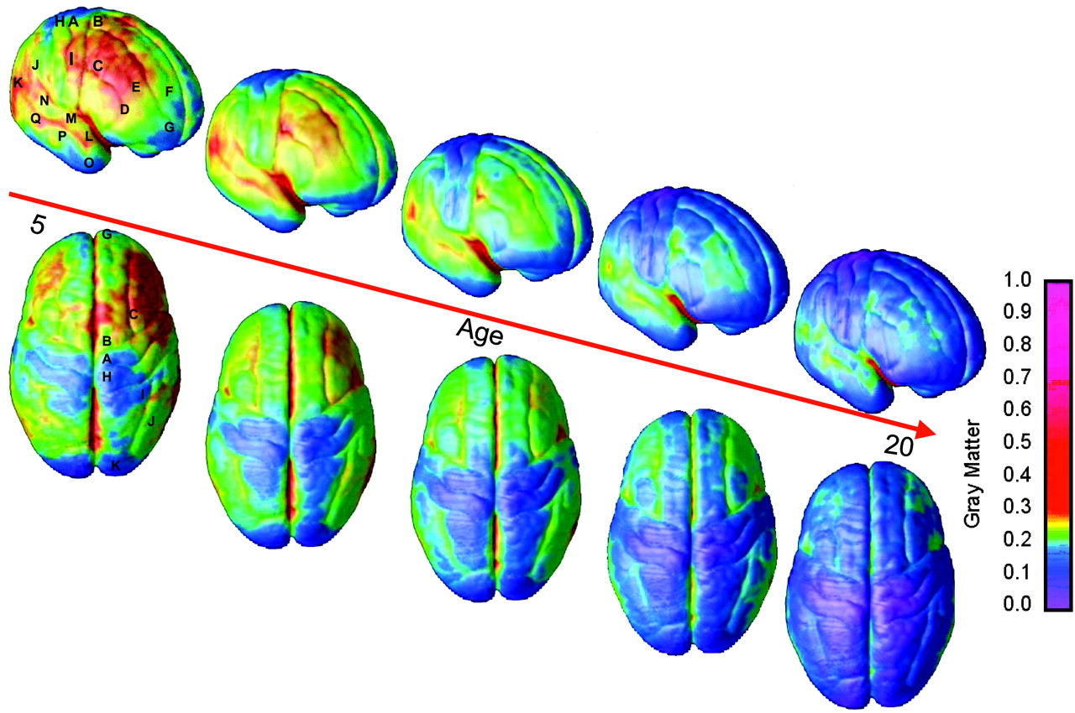
Adolescent Brain Cognitive Development
National Longitudinal Study
NIDA, NIAAA, NCI, NICHD, NIMHD, NIMH, NINDS, OBSSR
Ten year longitudinal study of 10,000 children from
age 10 to 20 years to assess effects of drugs on
individual brain development trajectories

Slide 29
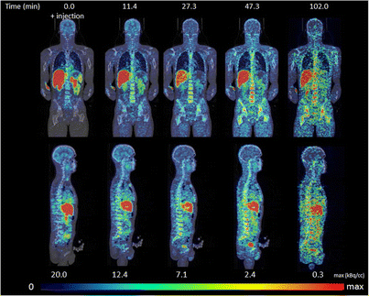
PET images of [11C]-NE40 (CB2R radioligand)
Ahmad et al., Mol Imaging Biol. 2013 A

Slide 30
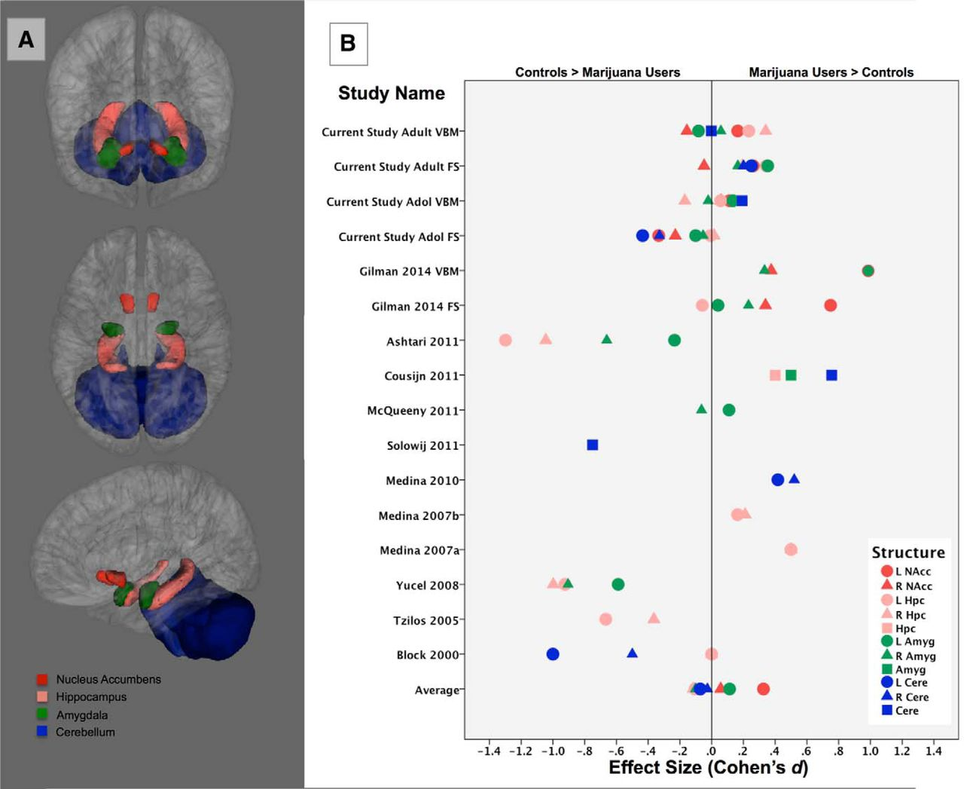
Subcortical Structures Differences Between Regular Marijuana Users and Nonusers
Weiland B J et al. J. Neurosci. 2015;35:1505-1512
Notes:
A, Depiction of subcortical structures evaluated for group differences between daily marijuana users and nonusers. B, Effect size of marijuana use on structure volumes from the current study and recent literature, presented as bilateral structures where available (circle/triangle) or as the entire structure (square). Average values are presented for right and left structures only. NAccFS, Freesurfer; VBM, voxel-based morphometry; L, left; R, right; NAcc, nucleus accumbens; Hpc, hippocampus; Amyg, amygdala.

