Slide 1
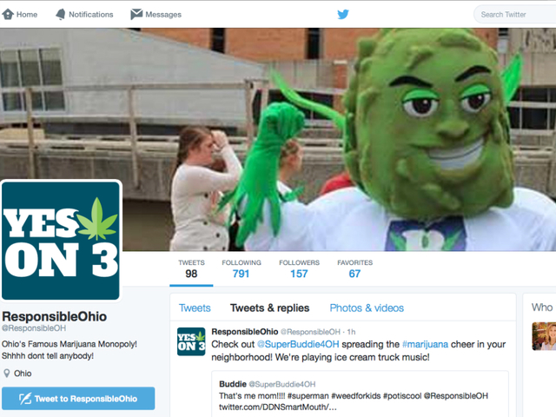
Beating Buddie and big marijuana
Ohio's plan to defeat legalization

Slide 2
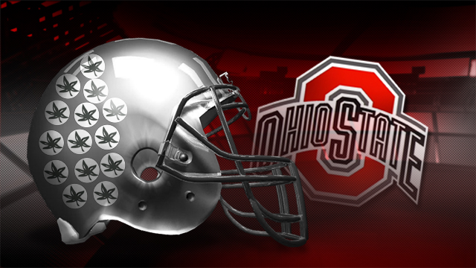
Ohio – what do you know
Bob Hope
Rock and Roll Hall of Fame
Steven Spielberg
Thomas Edison
Ohio State Buckeyes
Amish Community
Wright brothers
Birthplace of Presidents – 8 presidents have been born in Ohio

Slide 3
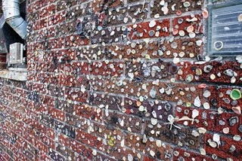
Ohio – What else are we known for
Charles Manson
Jeffrey Dahmer
Cleveland Browns
Cuyahoga River caught on fire
Maid-Rite Sandwich Shop’s Wall of Gum
Law – It is illegal to fish for whales in Ohio on a Sunday
Dittrick Museum of Medical History – largest collection of world contraceptives
Half of Ohio-born Presidents have died in office

Slide 4
Now We Have…

Slide 5
Who was responsible Ohio?
Investors made up of reps from real estate, entertainment and investment firms
Notable Investors
Oscar Robertson – The Big “O”
Ian James – Political Campaigner
Nick Lachey – former 98 Degrees member
Jimmy Gould – sports agent; former President of USFL New Jersey Generals

Slide 6
Who was responsible Ohio?
Recreational marijuana initiative – first to go without medical first
10 Investors for 10 grow sites
$554 million in tax revenue by 2020
250 tons of pot per year by 2020 (49 joints for every man, woman and child in our state
1140 marijuana stores in Ohio
Eliminate the black market

Slide 7
A little history
Started educating coalitions and groups in 2011
Traveling tour for businesses and community leaders
Monthly advocacy calls
Two Statewide conference for coalitions
One national conference
Linked them to SAM materials
Need for support in all communities

Slide 8
Vs.

Slide 9
Marathon
Longer race to win
Months and years of training
Winning and even finishing is much harder
Marijuana marathon – trying to change a person’s beliefs
Creates a vast understanding of the issue

Slide 10
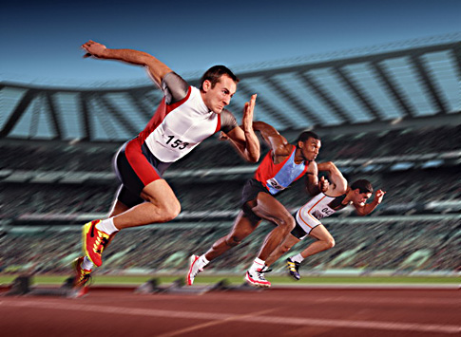
Sprint!
Shorter race
Go as fast as you can
Entirely different type of training
Have to get a great start
Marijuana – not trying to change minds
Different strategy
Trying to win votes as opposed to changing minds

Slide 11
“A Politician thinks of the next election; a statesman thinks of the next generation.”
James Freeman Clarke – Theologian and Author

Slide 12
Advocacy vs. lobbying
C3’s can lobby
No federal money
Use non-restricted funds
Government agencies cannot lobby
Letter of guidance from an attorney

Slide 13
Gather Your Friends

Slide 14
This is about politics and not public health
Influence others
Experience in fundraising, campaigning and media
Political support
Rules must be followed – c3 vs. c4/PAC

Slide 15
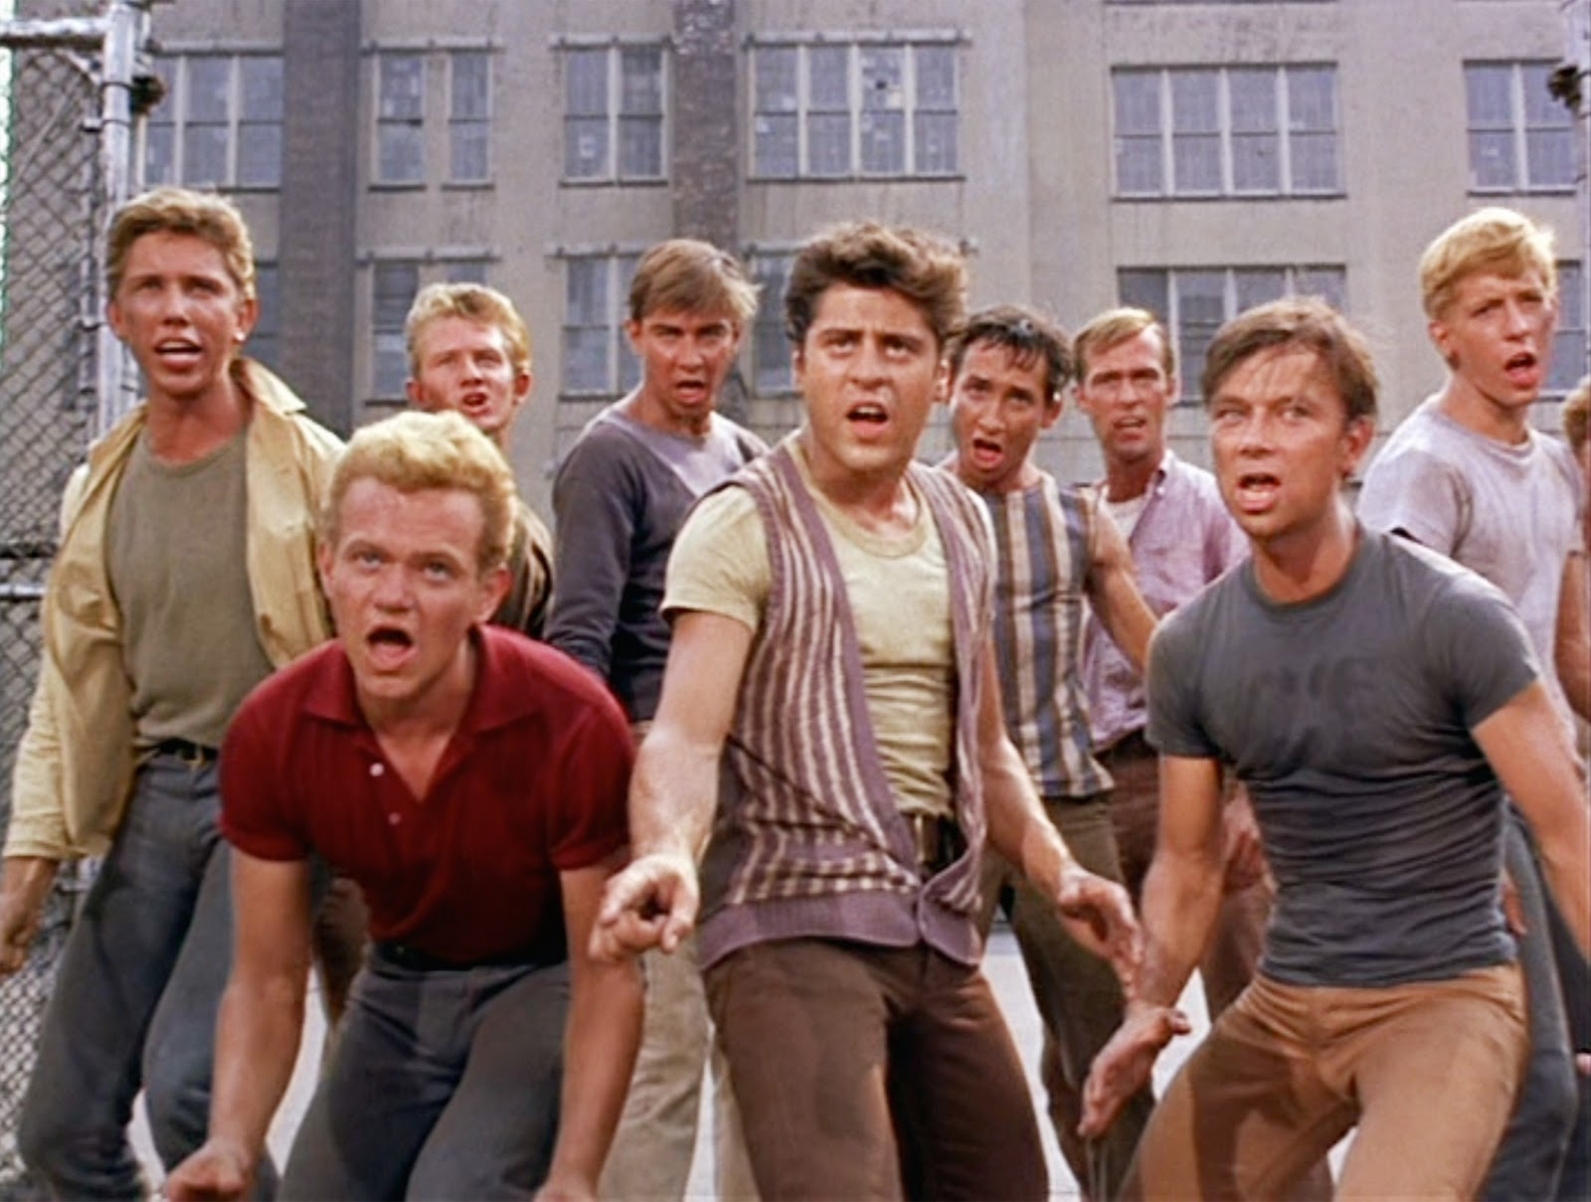
Gather your friends
Those who can win
Political figures
Power players
Community leaders
Influencers in media
Business leaders
Create a United Front!

Slide 16
The Business community
Legalization gives this group many problems
Three areas of focus
Workforce Readiness
Workplace Safety
Litigation

Slide 17
Employers worst nightmare

Slide 18
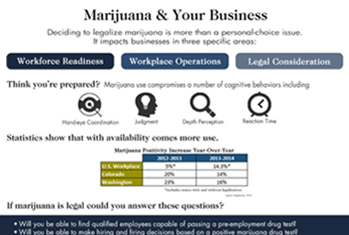
Information sheet
Asked questions of business
Increase in positive drug tests
Distributed statewide
Put in newsletters
Leave behind at speaking events

Slide 19
No On 3 Campaign
Ohio Children's Hospital Association
Ohio Chamber of Commerce
Ohio State Medical Association
Ohio Hospital Association
Cincinnati Children’s Hospital Medical Center
Nationwide Children's Hospital
Ohio Chapter, American Academy of Pediatrics
Ohio School Boards Association
Buckeye Association of School Administrators
Ohio Association of School Business Officials
ADAMHS Board of Cuyahoga County
ADAMHS Board of Hancock County
Buckeye State Sheriffs’ Association
County Auditors' Association of Ohio
Columbus Chamber of Commerce
Greater Cleveland Partnership
Council of Smaller Enterprises (COSE)
Cincinnati USA Regional Chamber
Toledo Regional Chamber of Commerce
Dayton Area Chamber of Commerce
Dayton Regional Employers Against Marijuana (DREAM)
Canton Chamber of Commerce
Tuscarawas County Chamber of Commerce
Youngstown-Warren Regional Chamber of Commerce
Drug Free Action Alliance
NFIB/Ohio
Ohio Association of County Behavioral Health Authorities
Ohio Council of Behavioral Healthcare Providers
Ohio Council of Retail Merchants
Ohio Business Roundtable
Ohio Farm Bureau Federation
Ohio Grocers Association
Ohio Manufacturers' Association
Ohio Prosecuting Attorneys Association
Ohio State Coroners Association
Ohio Township Association
Ohio Trucking Association
Prevent Blindness Ohio Affiliate

Slide 20
The Importance of Polling
Messaging Makes the Difference

Slide 21
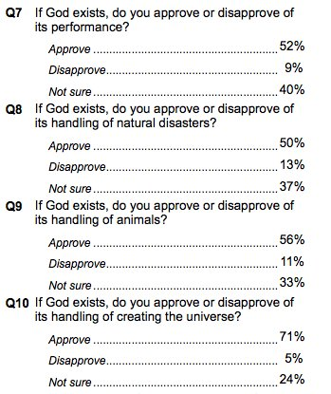
Polling will…
Help develop messages
Give a clearer vision for strategy
Determine voters concerns
What are the weakest messages?
Be scientific about messages for potential funders

Slide 22
WHY: Spending not aligned with what influences our health status?
What influences our health status
Where our nation spends its health care dollars (~$3+ Trillion)
10%
Access to Care
Environment
Genetics
Lifestyle & Behavior
Access to Care
Other
Health Behaviors
20%
20%
88%
50%
8%
4%
Centers for Disease Control and Prevention, University of California at San Francisco, Institute for the Future

Slide 23
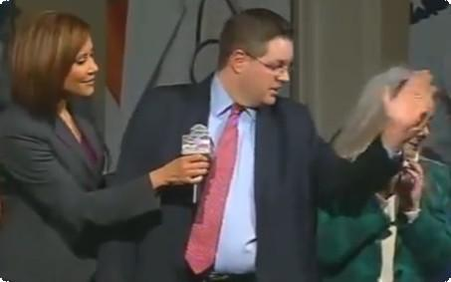
Tony’s Messages
Drugged Driving
2. Mental Health and marijuana
3. System abuse in colorado

Slide 24
Marijuana Monopoly
Number of Stores – more than starbucks and mcdonalds
edibles
Ohio’s Messages

Slide 25
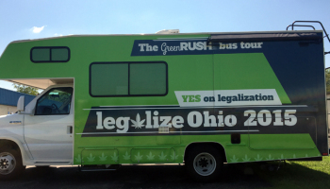
Obstacles
Outspent 12:1 ($30 million to $2.5 million)
Slick television ads – based on social justice and tax revenue
Celebrities
High paid consultants
Mailing pieces
“Green Rush” bus

Slide 26
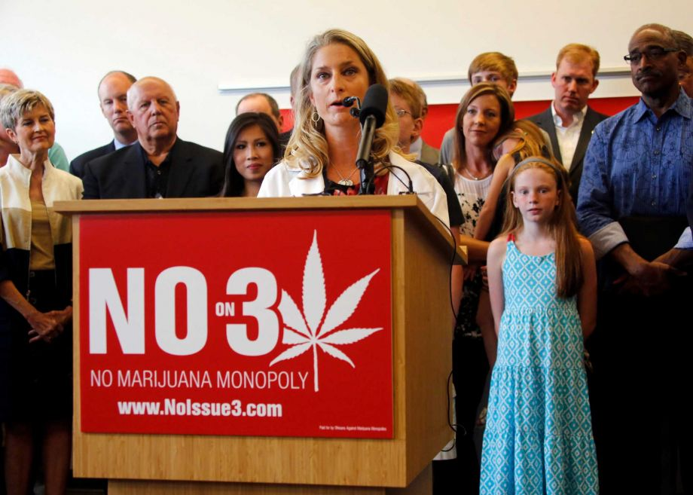
Earned Media through press conferences
Experienced team of campaigners
Grassroots efforts
Partners contributed through information distribution
Wide network
Most important – the right message
Overcoming Obstacles

Slide 27
Mistakes

Slide 28
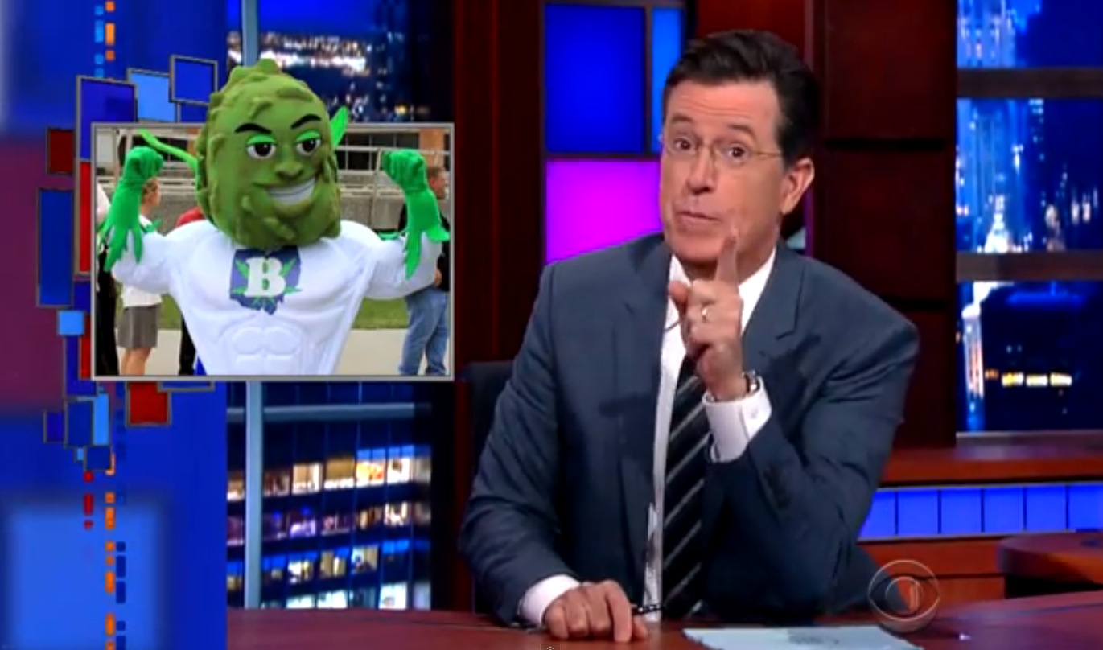
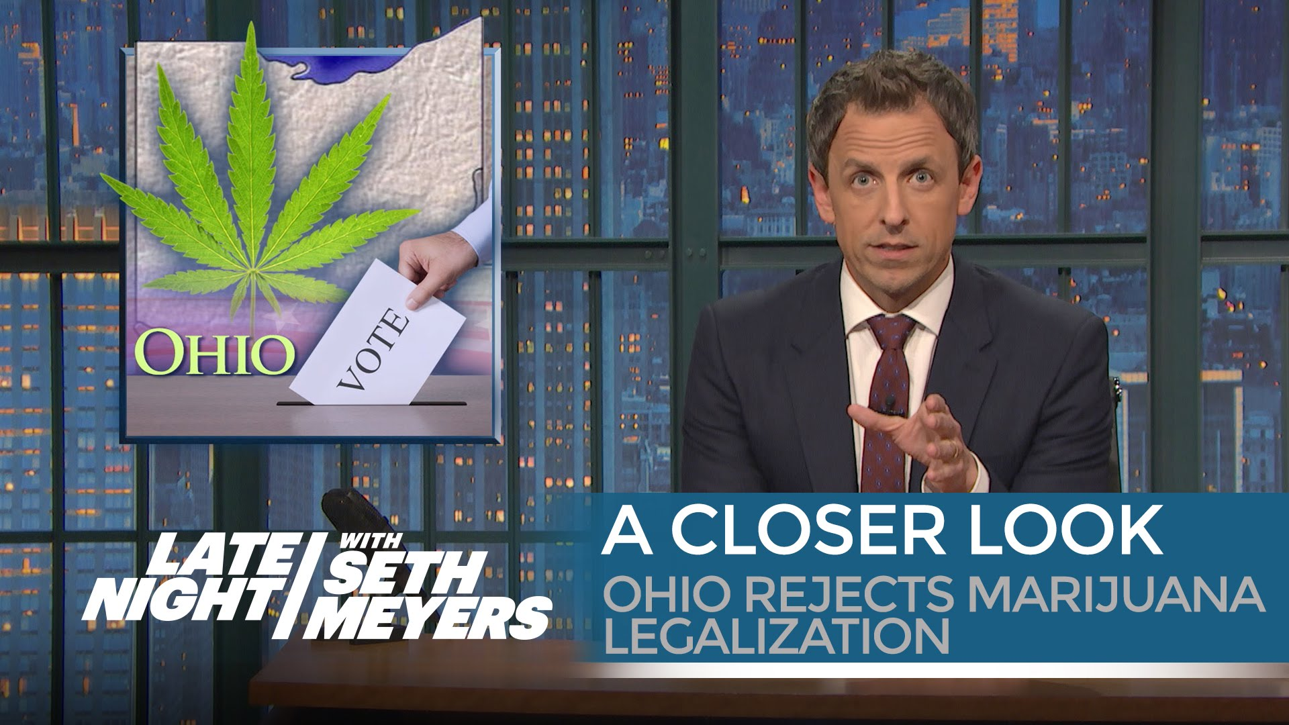
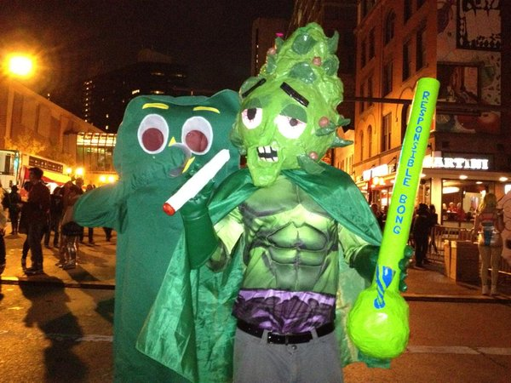
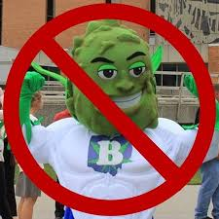

Slide 29
In the End
Responsible Ohio defeated by 64-36 margin!
Due to:
Political support
Widespread grassroots efforts
Messages based on polling
Smart Approaches to Marijuana

Slide 30
We have many avenues for education, SAM provides a strategy
The real threat to legalization
Don’t just present on problems, but offer solutions
Big Marijuana=Big Tobacco 2.0
Credibility to the field

Slide 31
Tony Coder Chairman – Ohio SAM tonycoder86@gmail.com

