Slide 1
www.prium.com
The Five Things You Need to Know About
Marijuana & the Workplace

Slide 2
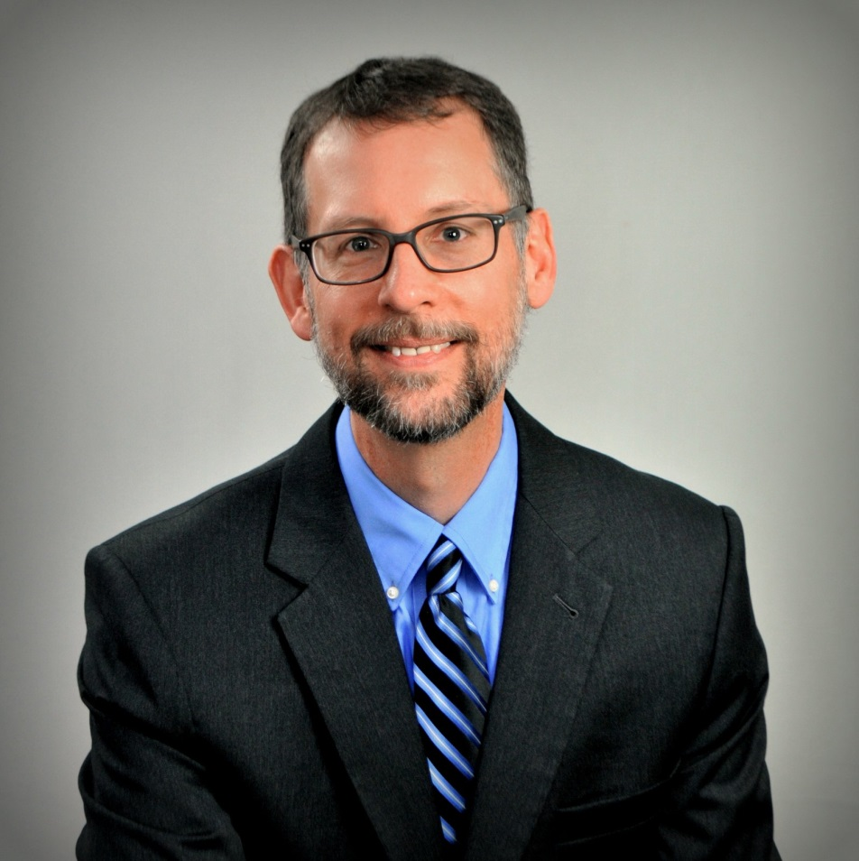
Mark Pew, Senior VP, PRIUM
35+ years in P&C, 20+ years in Work Comp
Created PRIUM’s Medical Intervention Program in 2003, Intervention Triage in 2010, Texas Closed Formulary turnkey in 2011, Centers with Standards in 2012, TaperRx in 2014
From March 2012 thru February 2016 …
317 presentations, 19,645 people, 39 states
Published and quoted in CLM Magazine, Risk & Insurance, Business Insurance, WorkCompCentral, WorkCompWire, Insurance Thought Leadership and others
IAIABC Medical Issues Committee, SAWCA Medical / Rehab Committee, SIIA Work Comp Committee, CompSense pharmacy & UR groups
LinkedIn: markpew
Twitter: @RxProfessor

Slide 3
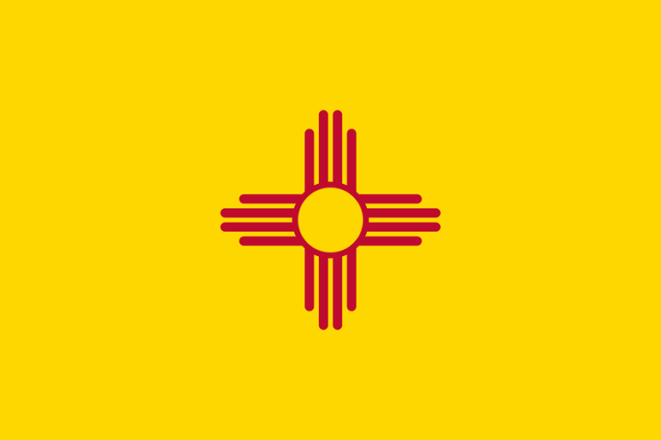
1. New Mexico requires reimbursement of medical marijuana by Workers’ Compensation
Three Court of Appeals decisions established precedent
HB 195 to exclude reimbursement died in the Senate
Prediction: This will not be limited to just Work Comp
Prediction: If somebody else pays, use and quantity increase
Prediction: Other states will be targeted

Slide 4
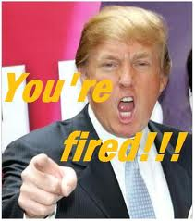
2. Employers retain the ability to terminate for-cause (but check your state)
Colorado – Brandon Coats v. Dish Network, LLC
New Mexico – Rojerio Garcia v. Tractor Supply Company
Michigan – Joseph Casias v. Wal-Mart Stores, Inc.
OSHA (safe work environment) v. ADA (accommodate disabilities)
Prediction: Even following the rules doesn’t reduce the chances of unemployment

Slide 5
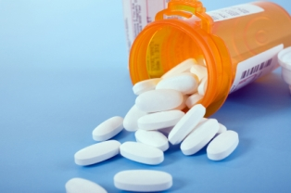
3. Marijuana is the solution to our opioid epidemic
An argument that is being made … constantly
Is marijuana is less dangerous than opioids?
Marijuana is not as benign as advocates promote
Very little research on this matter, much of it not positive
Prediction: This is a politically successful, non-factual argument

Slide 6
4. Presence <> Impairment
THC (Willie Nelson) v. CBD (Jake Plummer)
Tolerance levels, metabolizing variances
Positive urine drug test – Up to 7 days for single use, up to 100 days for regular use
3.1-4.5ng/mL (oral) or 3.3-4.5 ng/mL (smoked) = BAC of 0.05
Prediction: Proving causal relatedness is difficult

Slide 7
5. Ballot Initiatives to legalize recreational use makes November 8 even more interesting
Likely: Arizona, California, Nevada, Vermont
Maybe: Connecticut, Michigan, Rhode Island
Probably not: Delaware, Maryland, Massachusetts, Missouri, New York, Ohio
This doesn’t count efforts underway to decriminalize
Prediction: More workplace accidents, higher absenteeism/presenteeism, impact to hiring and return-to-work

Slide 8
We need common sense
But it’s not in abundant supply

Slide 10
Mark Pew
Senior Vice President
(678) 735-7309 Office
mpew@prium.net
LinkedIn: markpew
Twitter: @RxProfessor
Our Evidence Based blog
www.priumevidencebased.com
Notes:
For more information on the PPR program, please contact us at this toll free number or visit our website.

