Slide 1
Cannabis Legalization Issues
Kevin A. Sabet, Ph.D.
President, SAM

Slide 2
SAM promotes an evidence-based approach to marijuana policy that prioritizes public health
SAM takes an evidence-based, scientific approach to marijuana policy that rejects the false dichotomy that we must either lock up marijuana users OR legalize pot
We are non-partisan, and work with Democrats, Republicans, and independents
Groups We Collaborate With include:
American Society of Addiction Medicine
American Academy of Pediatrics
American Academy of Child and Adolescent Psychiatry
Over 30 state affiliates

Slide 3
Two Organizations, One Mission
SAM Action is dedicated to promoting healthy marijuana policies that do not legalize drugs.
Active at all levels of national, state, and local policy-making
Invests in and starts organizations to promote smart marijuana policies
SAM’s mission is to educate citizens on the science of marijuana and to promote health-first, smart policies and attitudes that decrease marijuana use and its consequences.
Brings light to and conducts research into marijuana’s negative effects

Slide 4
Focusing on just one drug?
Opioids today, meth/cocaine tomorrow? (History)
More people died from cocaine cut with fentanyl than pure opioids last
Month in Ohio
Marijuana a constant issue

Slide 5
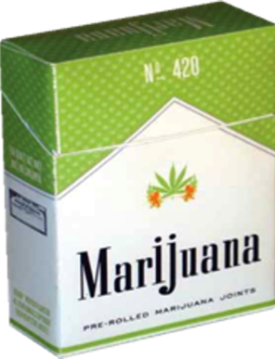

Slide 6
This isn’t your Woodstock Weed
Source: Marijuana Business Journal; other open source media

Slide 9
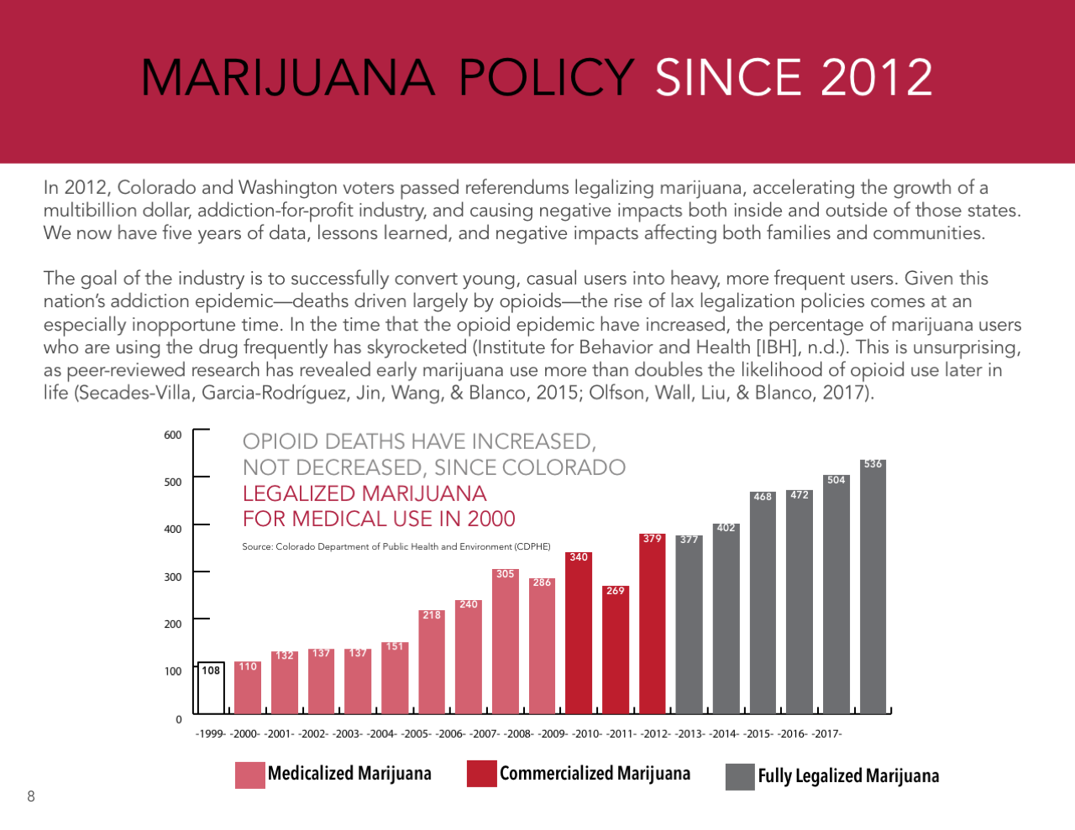

Slide 12
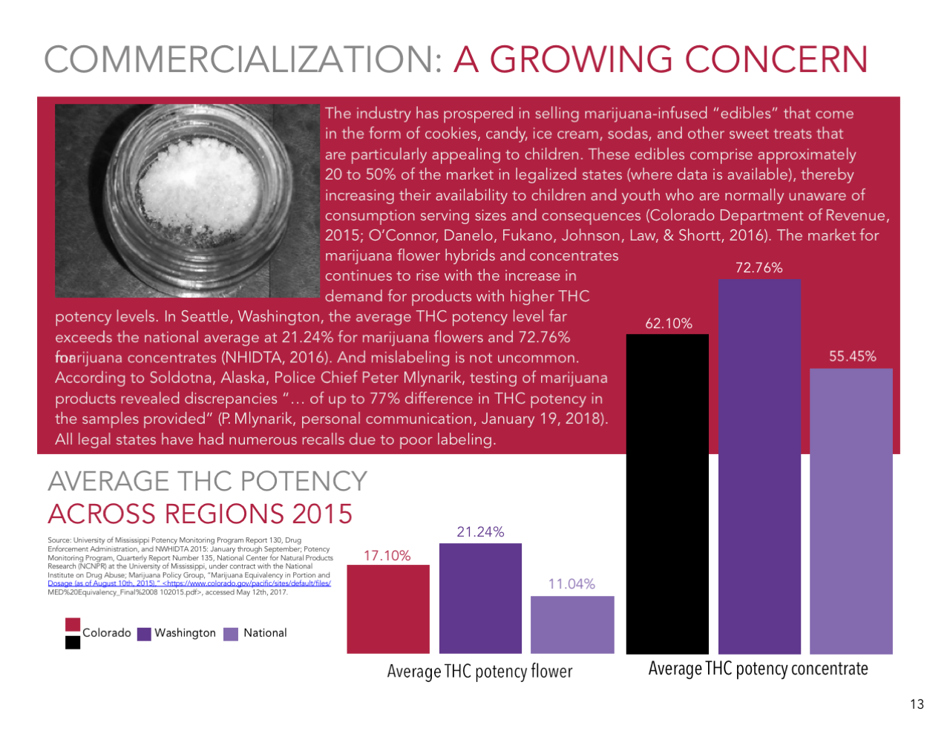

Slide 15
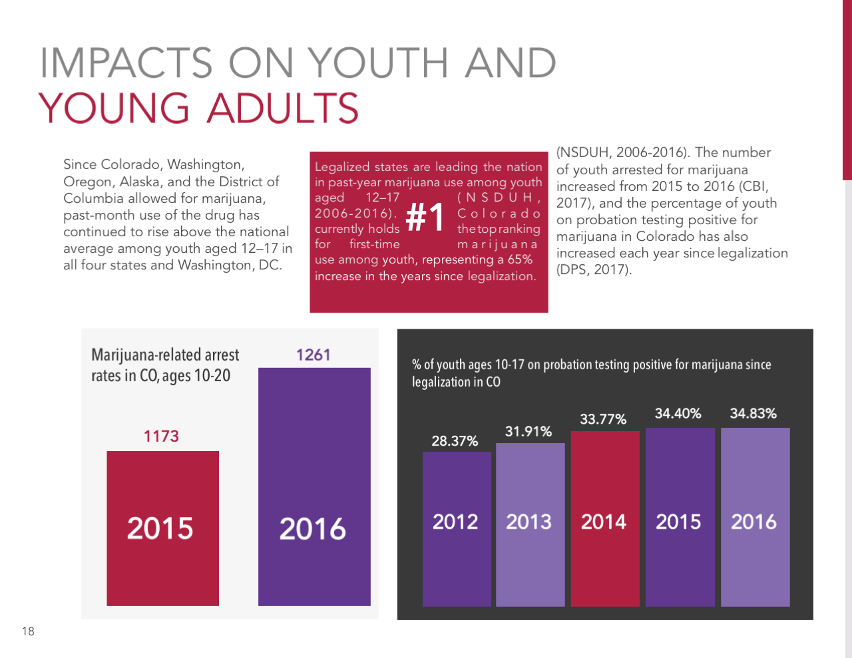

Slide 16
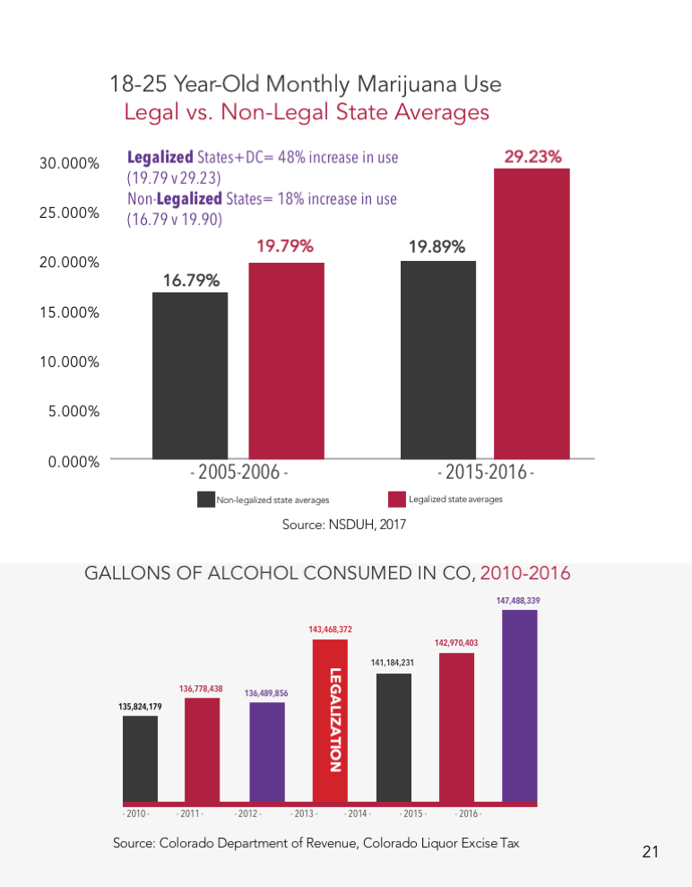

Slide 18
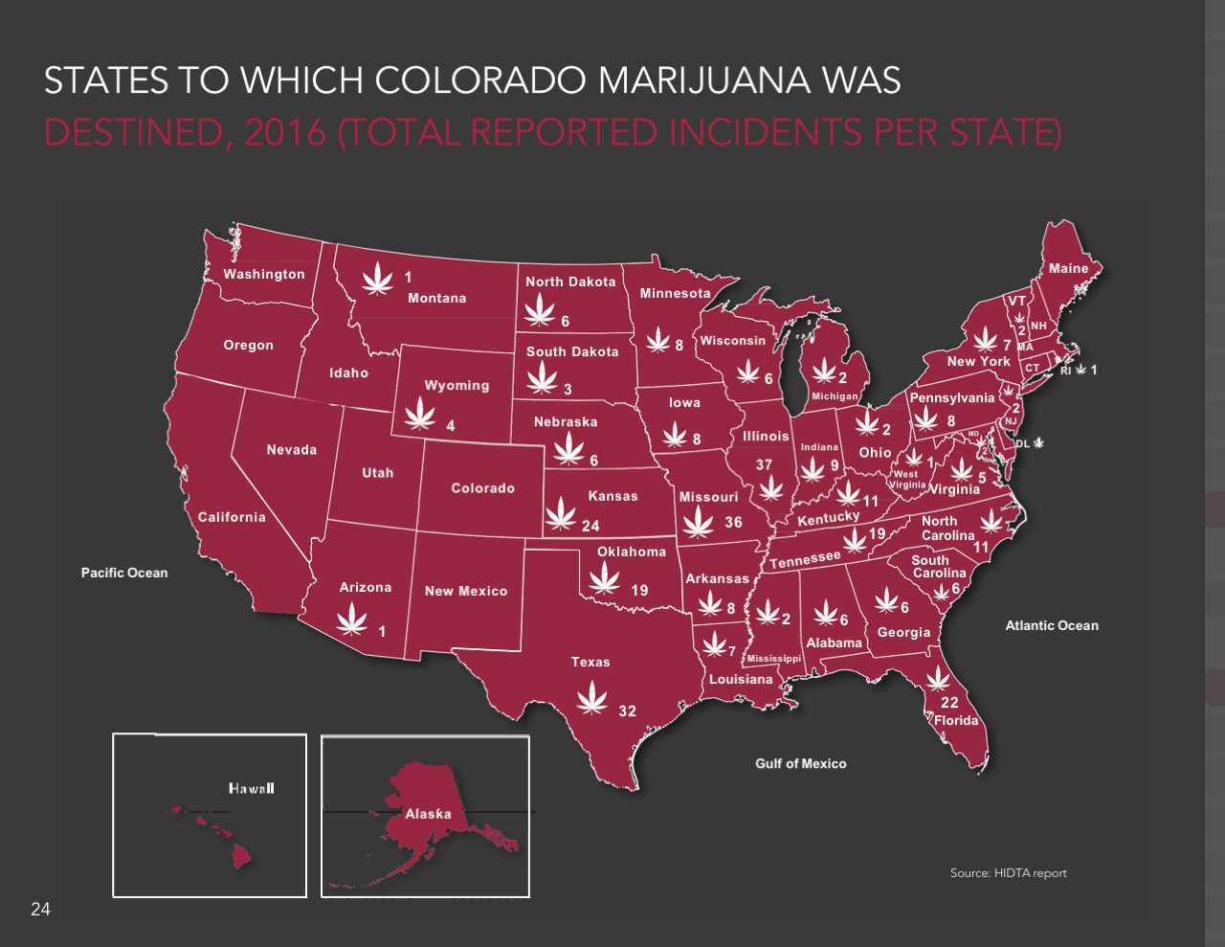

Slide 20
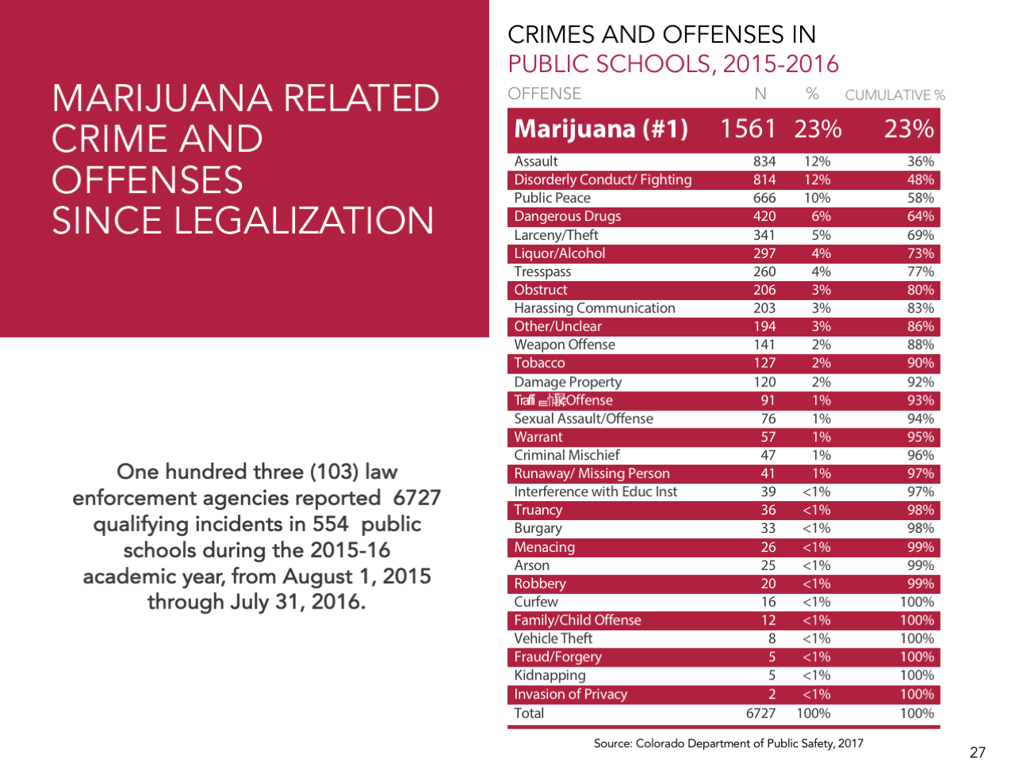

Slide 30
A final word from Volkow et al in the NEJM:
“Repeated marijuana use during adolescence may result in long-lasting changes in brain function that can jeopardize educational, professional, and social achievements.
“However, the effects of a drug (legal or illegal) on individual health are determined not only by its pharmacologic properties but also by its availability and social acceptability.
“In this respect, legal drugs (alcohol and tobacco) offer a sobering perspective, accounting for the greatest burden of disease associated with drugs not because they are more dangerous than illegal drugs but because their legal status allows for more widespread exposure.”
Source:

