Slide 1

European lessons from
cannabis legalization in US states

Slide 2
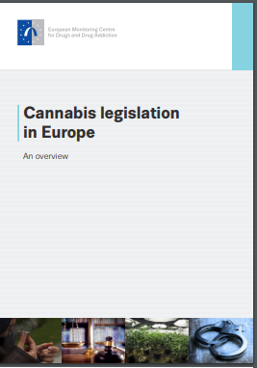
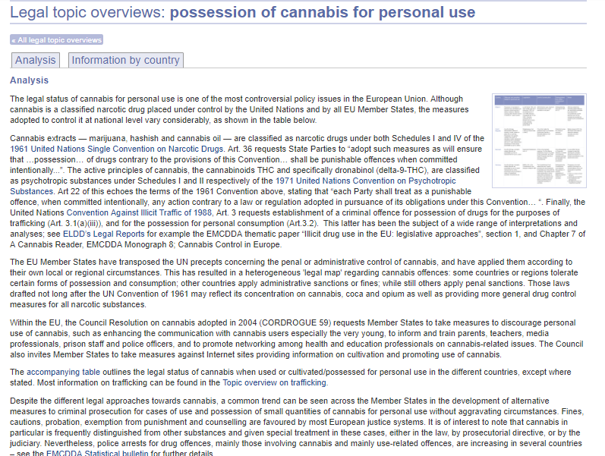
Cannabis situation in Europe
No country has legalized cannabis
Trend towards reducing penalities for use/possession
  Fines, cautions, probabation, councelling (EMCDDA 2012)
  Decriminalisation, depenalisation, or diversion measures (EMCDDA 2017)

Slide 3
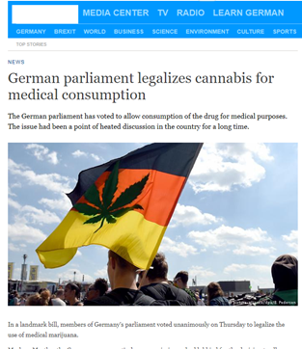
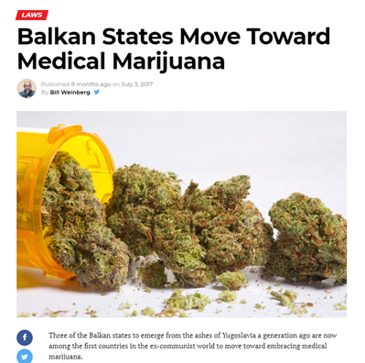
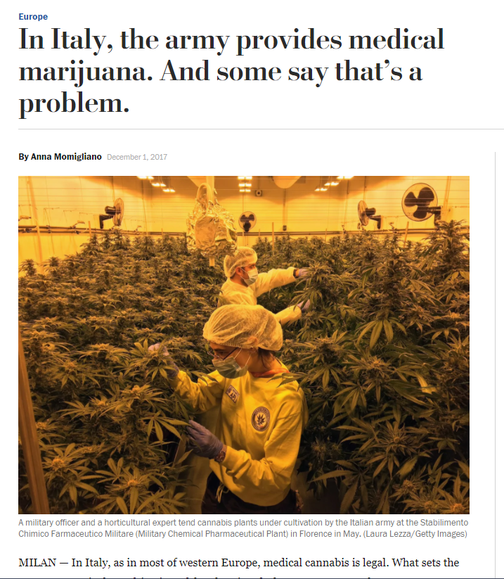
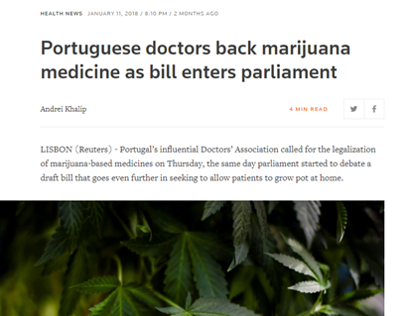
Spread of medical use of cannabis
Medical cannabis has been introduced in several countries in the past years
Medical cannabis strictly regulated – requires prescription and cultivated under govt control
(EMCDDA 2017)

Slide 4
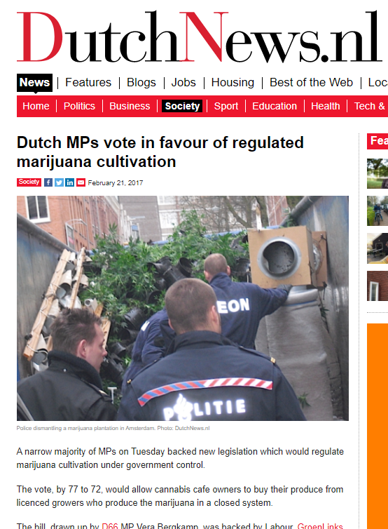
Legalization in Europe?
Uphill battle for legal supply of recreational cannabis
  Fewer coffeshops, tighter control
  Social clubs have not achieved even semi-legal status (EMCDDA 2017)
Loyal to the drug conventions
  No national government has expressed support for legalization of cannabis
  … but some opposition parties have
  Some proposals have been discussed in national parliaments

Slide 5
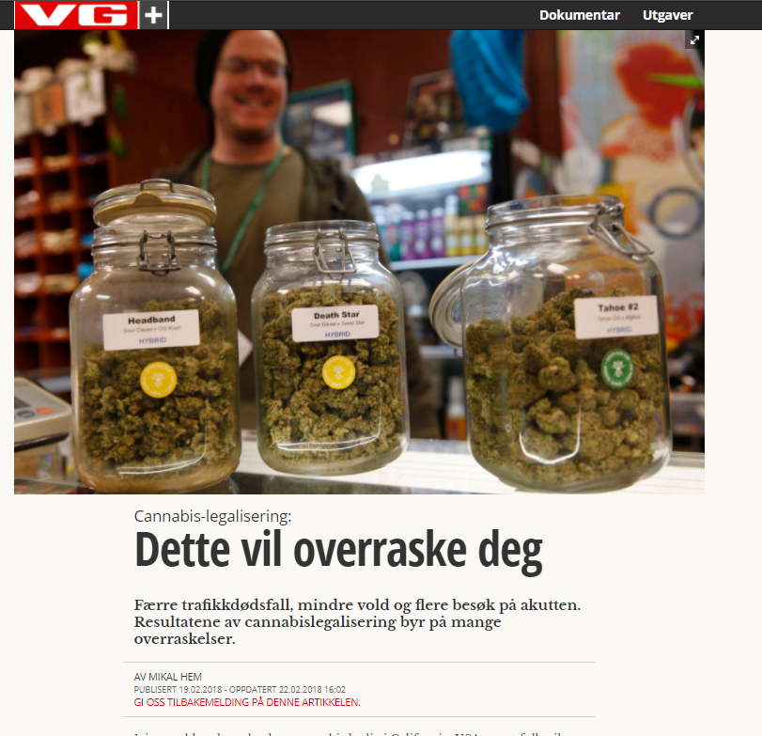
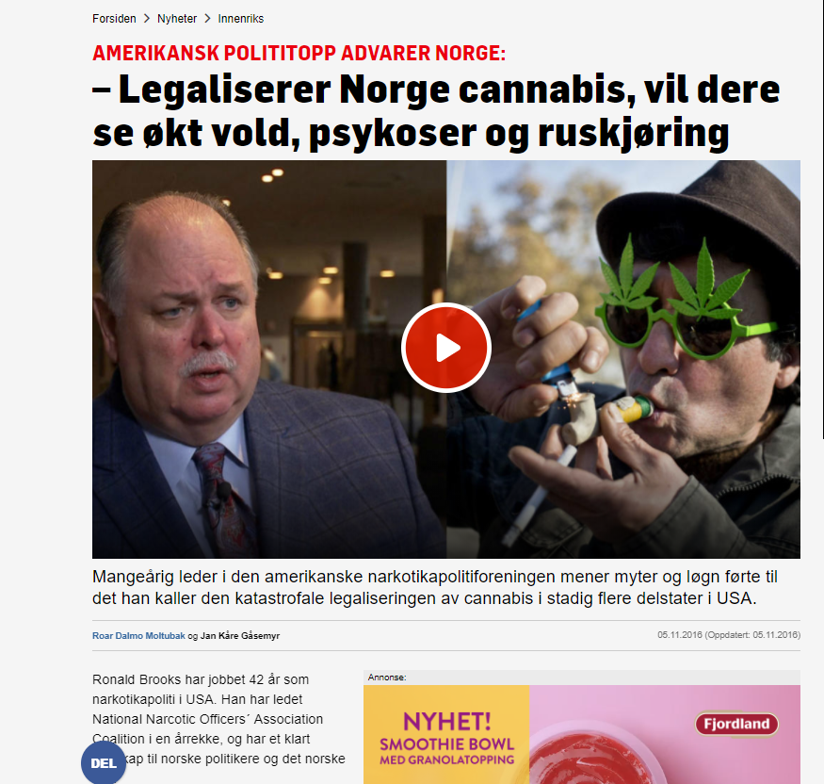
Impact of US legalization
Puts the issue on the agenda
  New boost to a political cause
  Renewed media interest
  Shows that «it’s possible»
Arguments from the US debate echoed in Europe
  From social justice to tax revenues
  Influences harm perception and prevention efforts
  Claims about effects of legalization used in debate
Undermines global conventions
  Opens a window of opportunity - or Pandora’s box
A sense of inevitability?
«All eyes on Colorado»
  A limit to how much information we can process

Slide 6

Lack of rigorous evaluation:
A battle for control over the narrative
Notes:
Theoretical benefit of legalization: real-world experience with regulated cannabis market
- effects on consumption, harm, youth, crime etc
In reality – not well evaluated, no baseline →
A battle for control over the narrative – some very vocal claims
The lack of rigorous evaluation means that the data are up for debate. The interpretation of the data reflects people’s views. Some will emphasise traffic deaths, some will question the data. Some will emphasise the tax revenues, others will focus on costs, some will say youth consumption increases, others say it doesn’t.

Slide 7

Legalization is not the end
Commercialization
  An emerging industry with vested interests in policy and regulation
  Competitive → product innovation, more effective, lower prices
Challenging the regulations
  Industry and consumer interests vs health and social issues
  Political influence
  Impacts on other states
  A new dynamic
Cultural acceptance
  What is «Acceptable use»
  Balancing prevention/health messages and stigma
  Presence in public space, culture, communities

