Slide 1

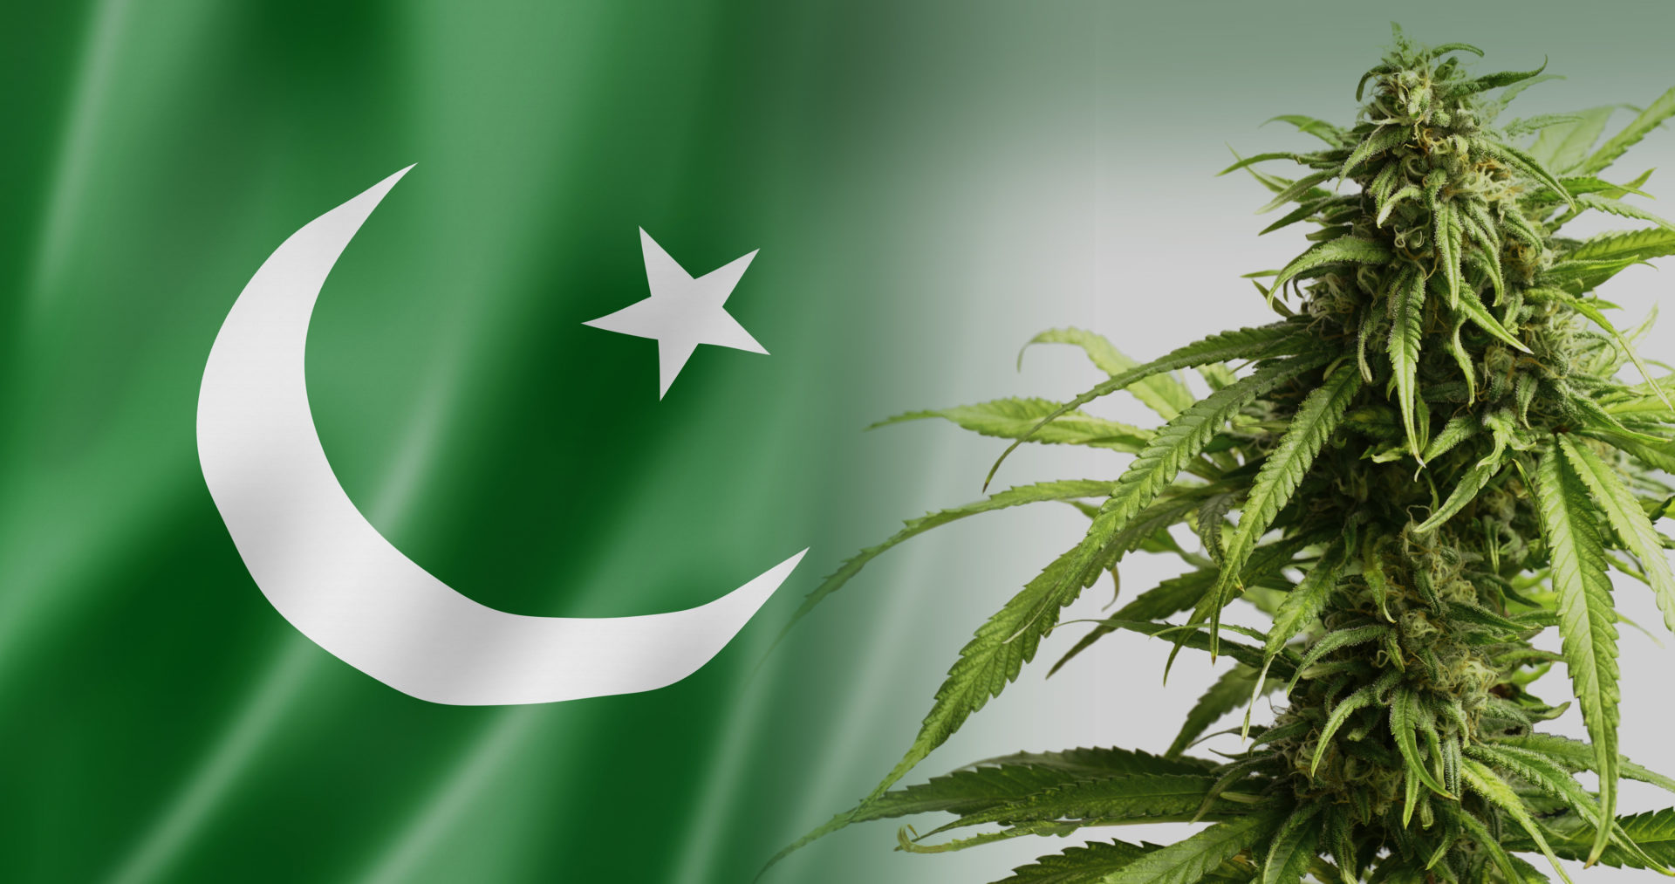
Cannabis Legalization Debate in US:
Impact on Pakistan & South Asia
Side Event: Cannabis Legalization
Five Years Later:
What Have We Learned?
61st Session of CND
Vienna, 15th March, 2018
Asia Ashraf
Director Rehabilitation &
Head of the Psychology Department,
Sunny Trust
Hubert H. Humphrey Fellow, USA.
Sunny Trust
Drugs – No – Never – Ever
Notes:
Good Afternoon Ladies & Gentleman,
Thank you Kevin for giving me this opportunity.
I am going to speak about Cannabis legalization debate in US and its impact on Pakistan and South Asia.

Slide 2

Pakistan: Illicit Drug Use and Trafficking
Sunny Trust
UNODC Report, 2013
Notes:
Pak. Is a country with over 200 million population. It shares a long, porous, border with Afghanistan , which produces 60-70% of world's illicit opium.40% of which is transited through Pak .

Slide 3
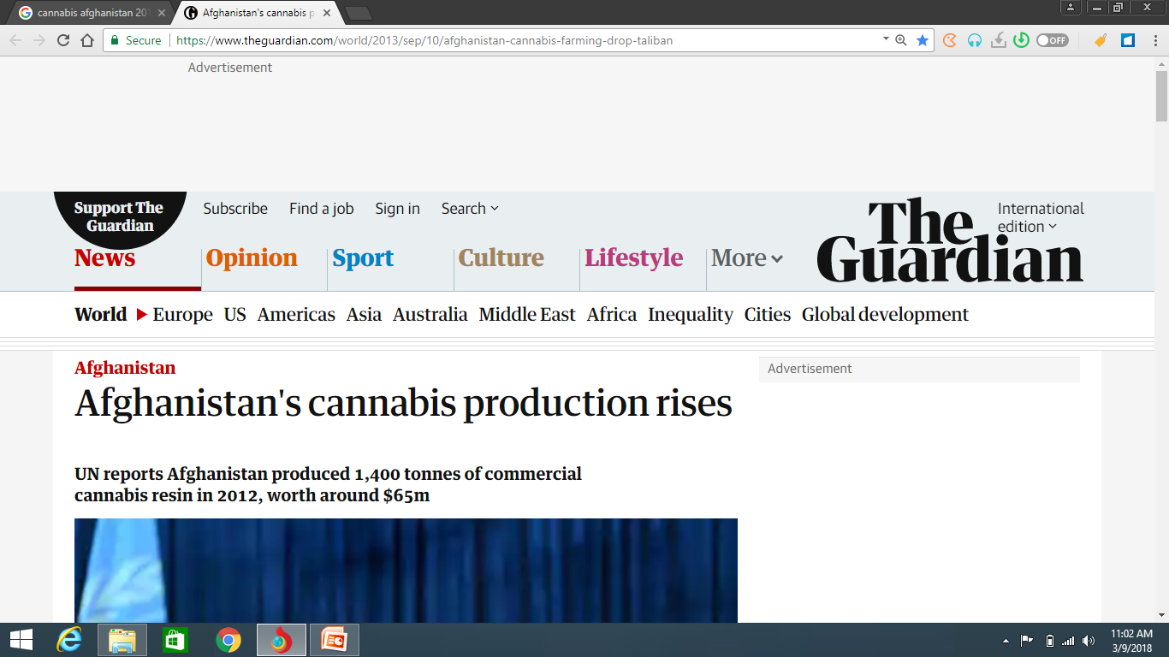
Notes:
UN reports Afghanistan produced 1400 hectare tons of Cannabis in 2012. So unfortunately Pak. Is transit corridor as well as consumer of illicit Afghan drugs.

Slide 4
Drug Situation
6.7 million illicit drug-users (4.25 million substance use disorder).
5.2 million are men & 1.5 million are women.
Cannabis users are 4 million nationwide.
2.7 million opiate users (Heroin, Opium, Prescription painkiller).
76% regular opiate users reported cannabis as the first drug they ever used
One in five of 6.7 million illicit drug users reports to use more than one substance
Sunny Trust
UNODC Report, 2013
Notes:
According to this report there are 6.7 million illicit drug users of which 4.25 million are with SUD.
Cannabis is most widely used illicit drug in Pakistan (UNODC: 2013). There are 4 million cannabis users.
2.7 million are opiate users.
In the UNODC report, 76% regular opiate users reported cannabis as the first drug they ever used.
One in five of 6.7 million illicit drug users reports to use more than one substance...Poly drug abuse. Common combination is heroin, cannabis and tranquilizers.

Slide 5
Focus On Heroin Eclipsed Cannabis
War in Afghanistan in late 1970s and early 1980s spread Heroin in Pakistan
Focus shifted more on Heroin and opium and eclipsed cannabis
Cannabis remains an under-studied subject
Sunny Trust
Drugs – No – Never – Ever
Notes:
War in Afghanistan in late 1970s and early 1980s spread Heroin in Pakistan.
Unprecedented and unmanageable crisis.
Focus shifted more on Heroin and opium and eclipsed cannabis.
Cannabis remains an under-studied subject

Slide 6
Cannabis not so “soft”?
Almost 10% of truck drivers use alcohol while driving on Pakistani roads. Marijuana use is almost 30% (Mir et.al, Feb 2015)
Schizophrenic patients with comorbid cannabis abuse exhibited more positive symptoms and violent behavior, and may be more likely to lead to dependence in persons with schizophrenia (Farooq S. 2007).
Heroin was ranked by 88 per cent of key informants to cause major social problems. The next most problematic drug was cannabis charas, with three-quarters (75%) rating it to cause major social problems (UNODC, 2013).
Sunny Trust
Drugs – No – Never – Ever
Notes:
This is the only available research data.

Slide 7
Robust policy structure: strong on opium but weak on cannabis
Pakistan has done well in becoming “poppy-free” in 2010 through effective policies and actions
Pakistan’s Drug Policy 2010 and the Master Plan envisaging “drug-free” Pakistan by 2020
Policy goals remain deficient in both documents in not addressing cannabis
State also has a lax attitude towards cannabis use, there is law but not implemented properly.
Sunny Trust
Drugs – No – Never – Ever
Notes:
Pakistan has done well in becoming “poppy-free” in 2010 through effective policies and actions in eliminating poppy cultivation which it tries hard to maintain despite attempts at very low-level production.
Pakistan’s Drug Policy 2010 and the Master Plan envisaging “drug-free” Pakistan by 2020 inspires credibility to the extent that Pakistan can eradicate poppy cultivation to almost zero level through innovative policies and resolve despite existence of drug-infested Afghanistan next door
But policy goals remain deficient in both documents in not addressing cannabis which grows unchecked in many parts of Pakistan including wild cannabis growth in all over Islamabad

Slide 8
Societal tolerance, casualness & dislike towards Cannabis
Cannabis often seen as “soft” versus heroin as “hard” drug?
Perceived less harmful and user remaining functional
Myths about benefits and wonders of cannabis
Cannabis used by ‘devotees’ at shrines
Sunny Trust
Drugs – No – Never – Ever
Notes:
Unlike liquor unquestionably forbidden in Islam, some confusion regarding status of cannabis as forbidden and intoxicant thus sinful in Islam

Slide 9
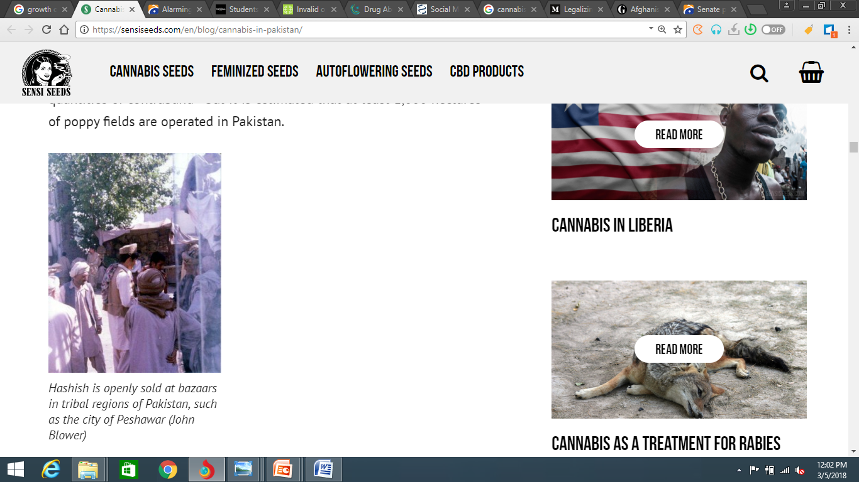
Sunny Trust
Drugs – No – Never – Ever

Slide 10
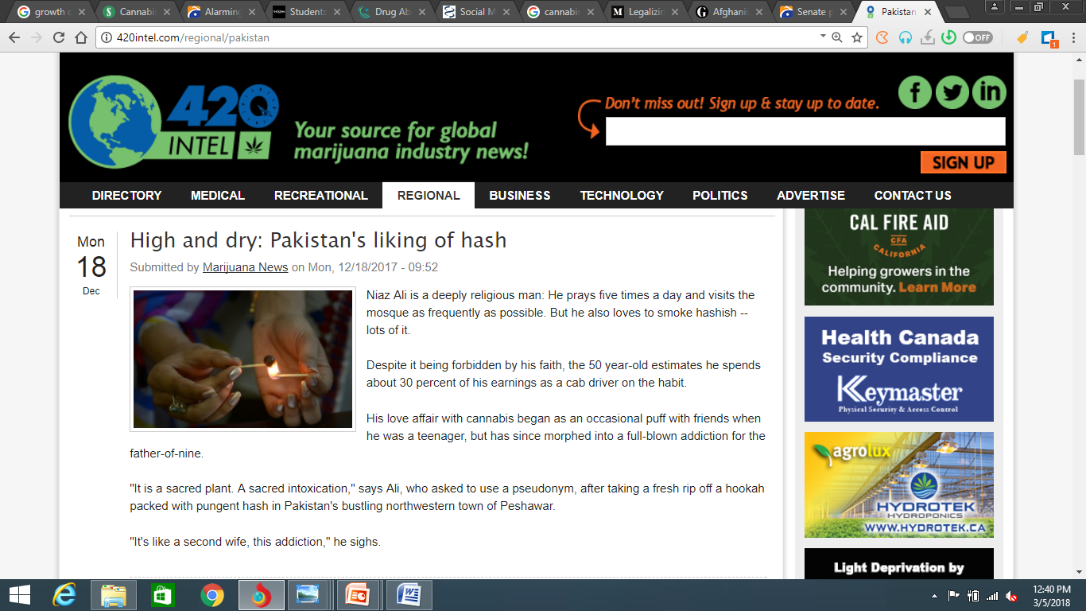
Sunny Trust
Drugs – No – Never – Ever
Notes:
You can see how spiritual aspects has used to influence perception of the user. It says that person is very spiritual, prays five times a day , visits regularly mosque. Meaning that it has positive influence and there is no harm in using it.

Slide 11
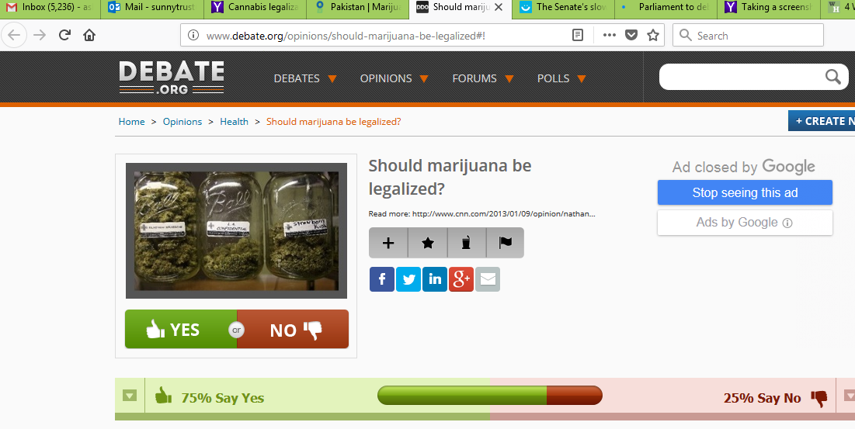
Sunny Trust
Drugs – No – Never – Ever
Notes:
What is very important is how polls like this are affecting our region.

Slide 12
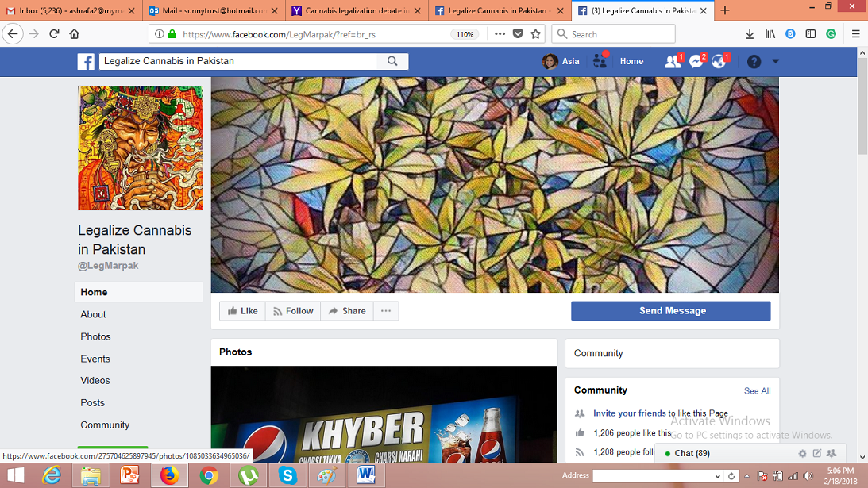
Sunny Trust
Drugs – No – Never – Ever
Notes:
I was astonished to see this page. Because when Kevin asked me to speak about Cannabis legalization debate and I said its not an open debate like this. But I believe that if something is out of sight, it doesn't mean that it has no existence. It exist powerfully.

Slide 13
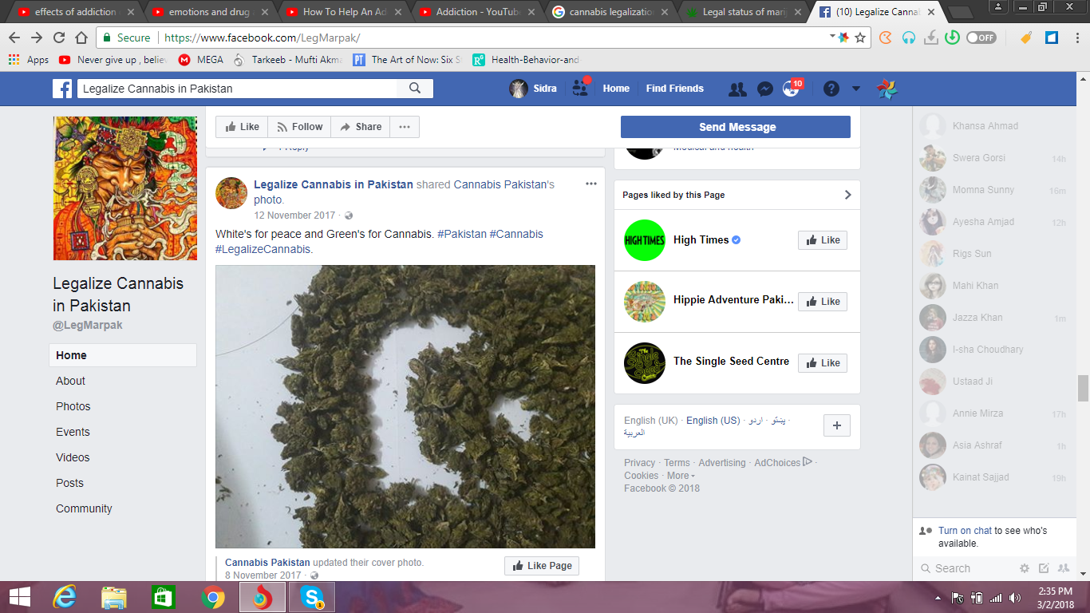
Sunny Trust
Drugs – No – Never – Ever
Notes:
The page says that white in our flag is Peace and Green is for cannabis.

Slide 14
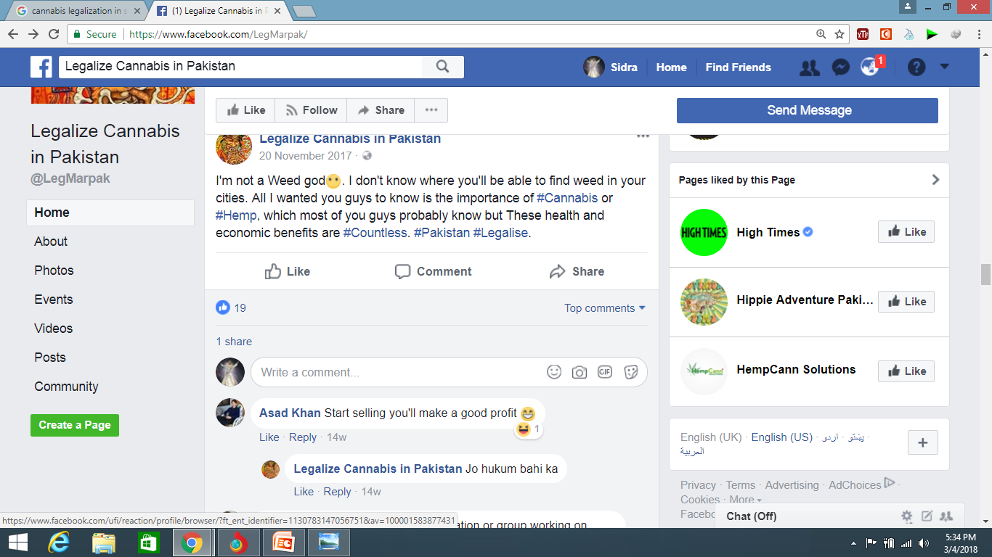
Sunny Trust
Drugs – No – Never – Ever
Notes:
How persuasive this message is.

Slide 15
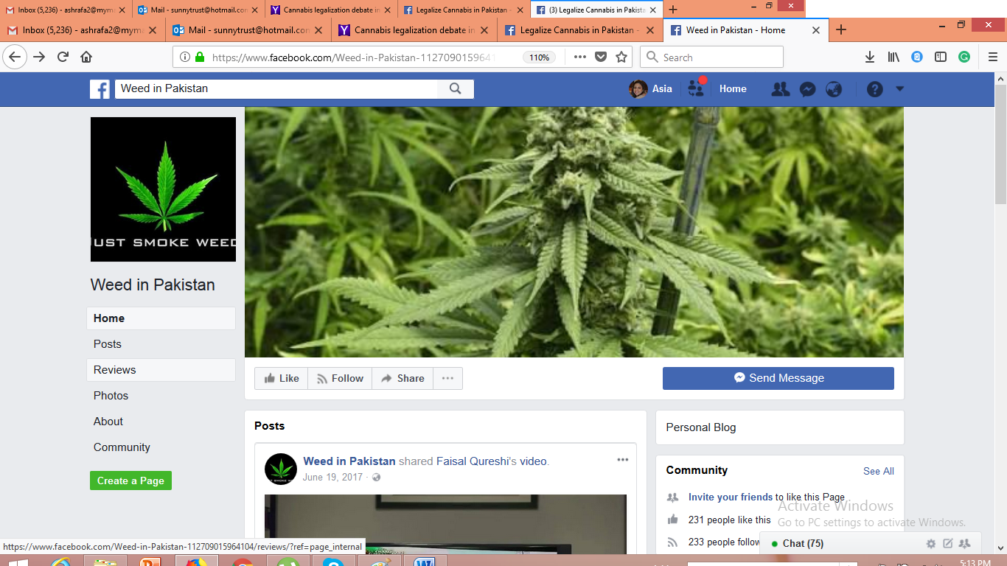
Sunny Trust
Drugs – No – Never – Ever
Notes:
There is another page.

Slide 16
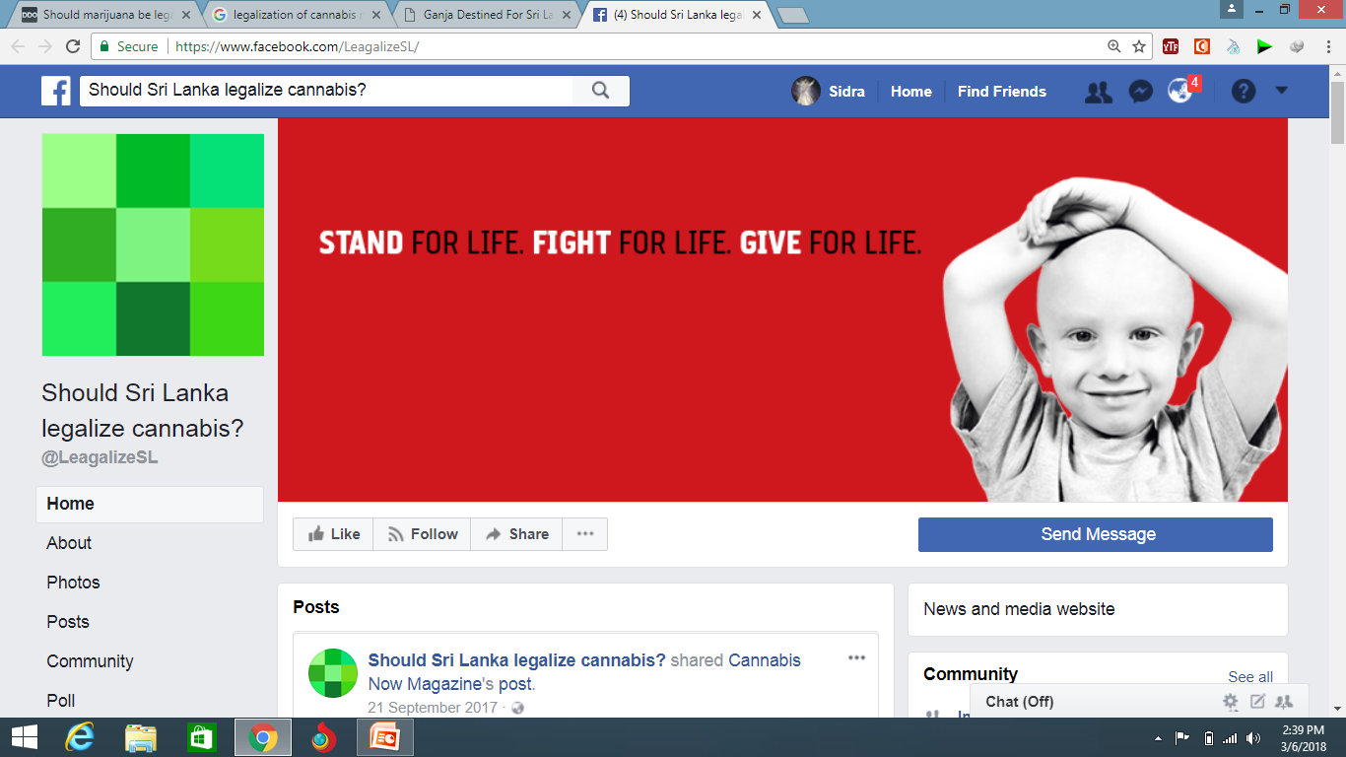
Sunny Trust
Drugs – No – Never – Ever
Notes:
Similar Social media page is in Srilanka.

Slide 17
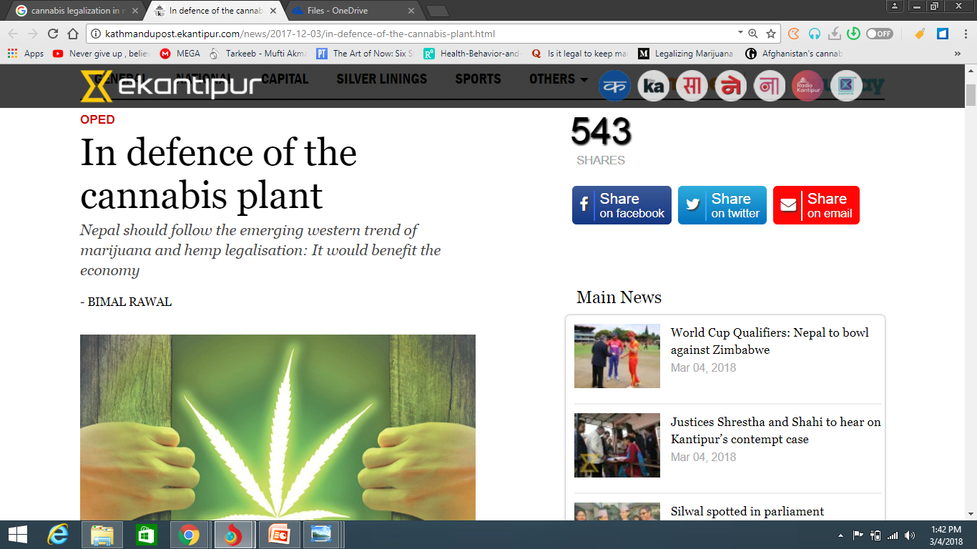
s
Sunny Trust
Drugs – No – Never – Ever
Notes:
Nepal also has started debates in defense of Cannabis Plant.

Slide 18
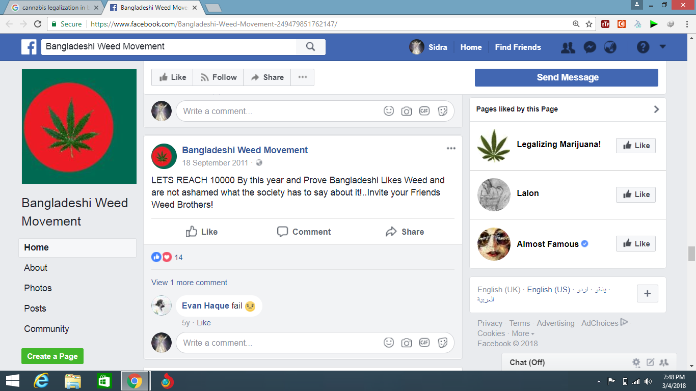
Sunny Trust
Drugs – No – Never – Ever
Notes:
Bangladesh has also Weed Movement

Slide 19
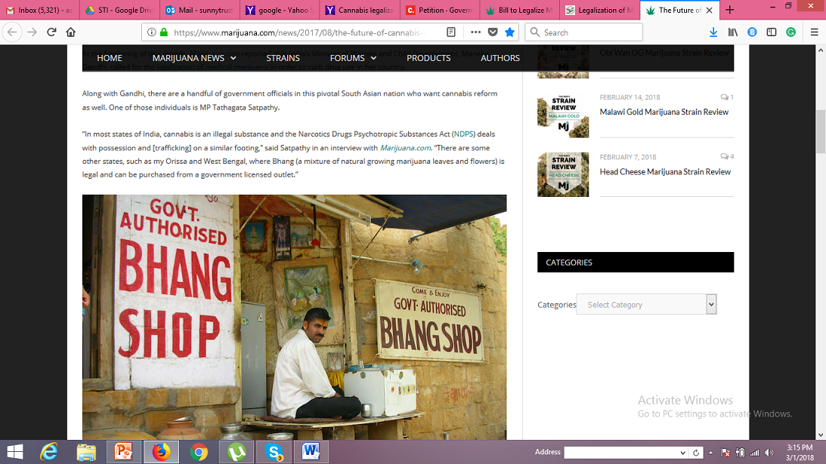
Sunny Trust
Drugs – No – Never – Ever
Notes:
In India, Bhang raw form of Cannabis is commonly used in ceremonies, and have also Govt. authorized bhang shops

Slide 20
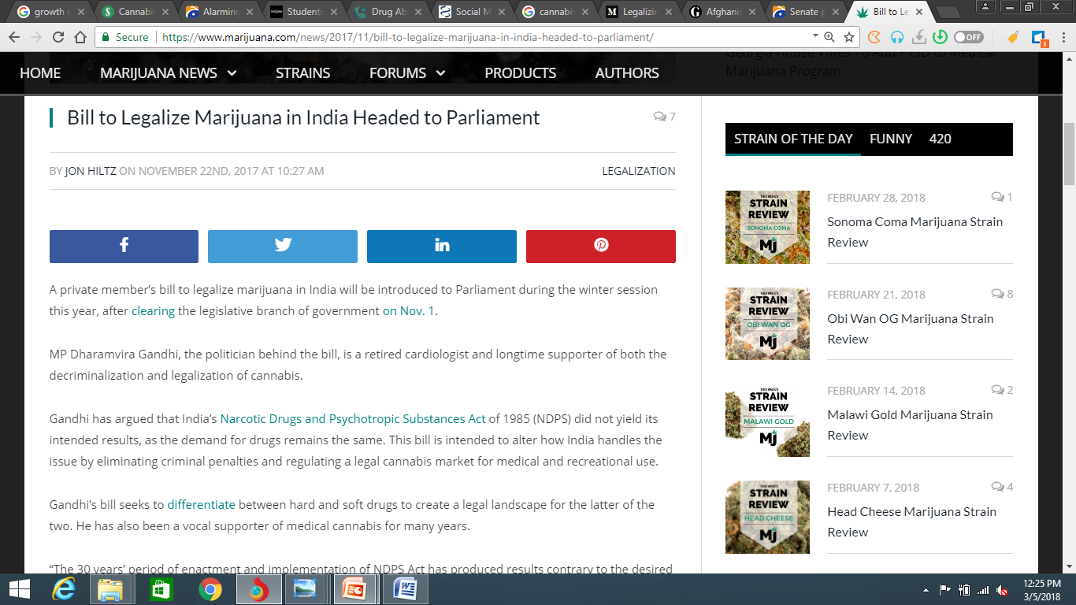
Sunny Trust
Drugs – No – Never – Ever
Notes:
A private member’s bill to legalize marijuana in India will be introduced to Parliament during the winter session this year, after clearing the legislative branch of government on Nov. 1.
MP Dharamvira Gandhi, the politician behind the bill, is a retired cardiologist and longtime supporter of both the decriminalization and legalization of cannabis.
Gandhi has argued that India’s Narcotic Drugs and Psychotropic Substances Act of 1985 (NDPS) did not yield its intended results, as the demand for drugs remains the same. This bill is intended to alter how India handles the issue by eliminating criminal penalties and regulating a legal cannabis market for medical and recreational use.

Slide 21
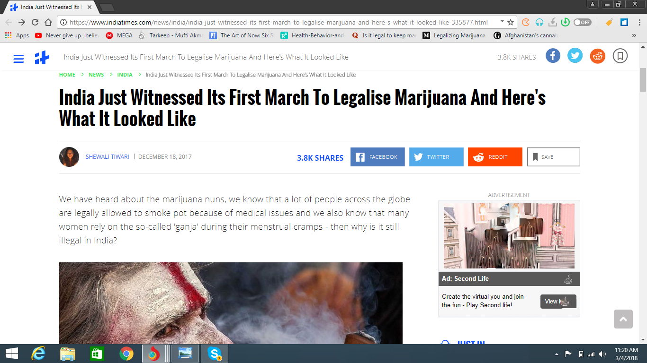
Sunny Trust
Drugs – No – Never – Ever
Notes:
India had its first march with an attempt to legalize the "greatest plant on earth" - marijuana and the credit goes to The Great Legalization Movement - India. December
They went outside on the roads to educate doctors, individuals, authorities, government and everyone else about the benefits of marijuana and India's long association with it.
The group is trying to establish the reality that our own vedas have identified it as the most sacred plant to have existed on this Indian Sub-continent, then what is the reason behind it being illegal in our country

Slide 22
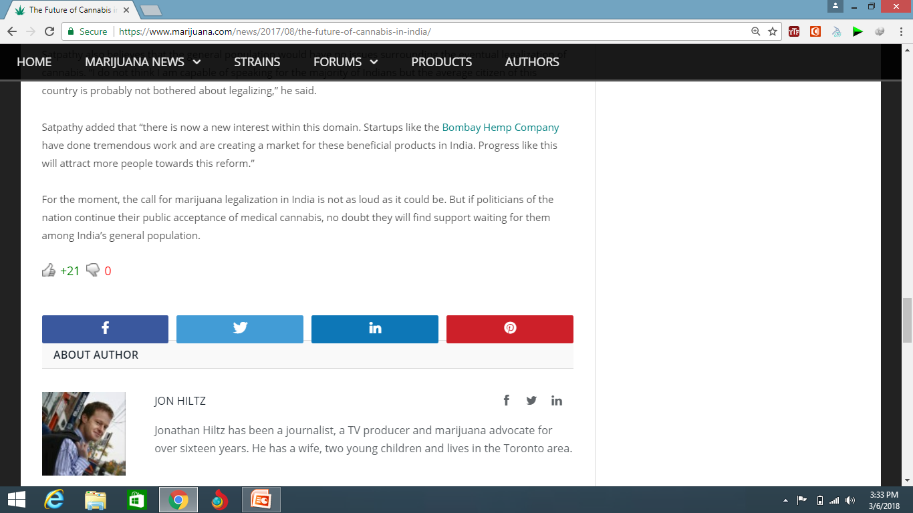
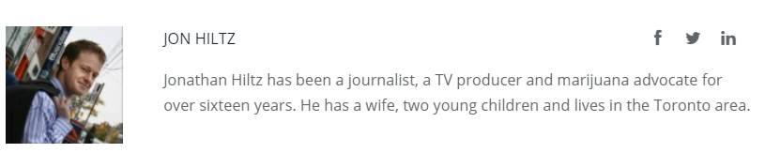
Sunny Trust
Drugs – No – Never – Ever
Notes:
Jonathan Hiltz has been a journalist, a TV producer and marijuana advocate for over sixteen years. He has a wife, two young children and lives in the Toronto area.

Slide 23
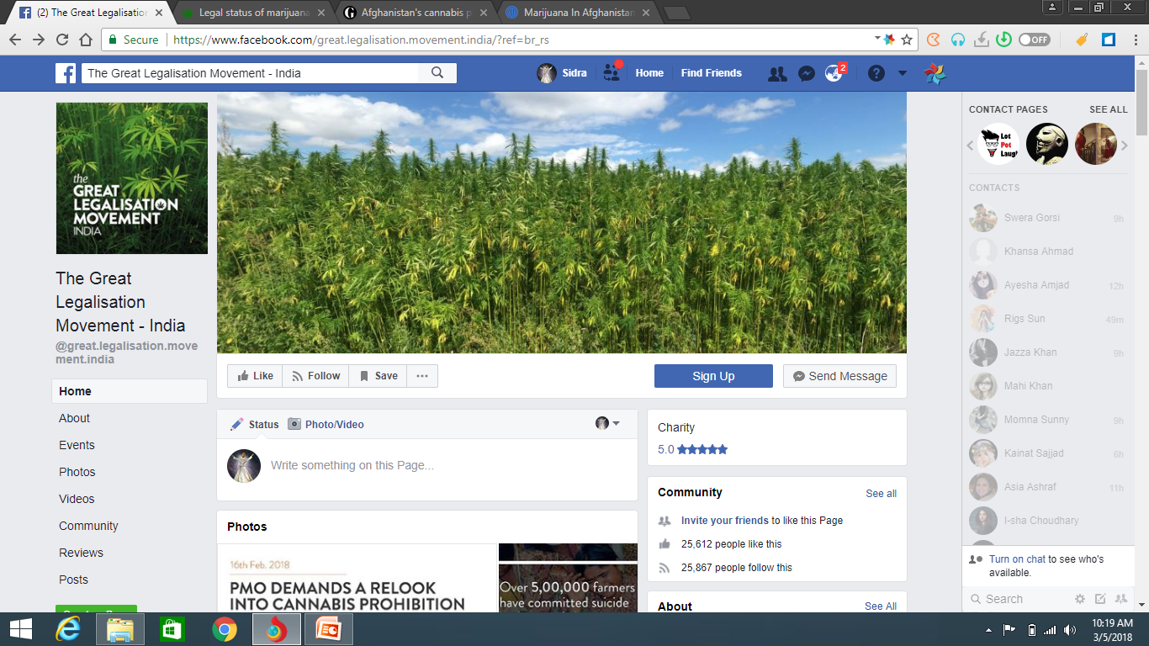
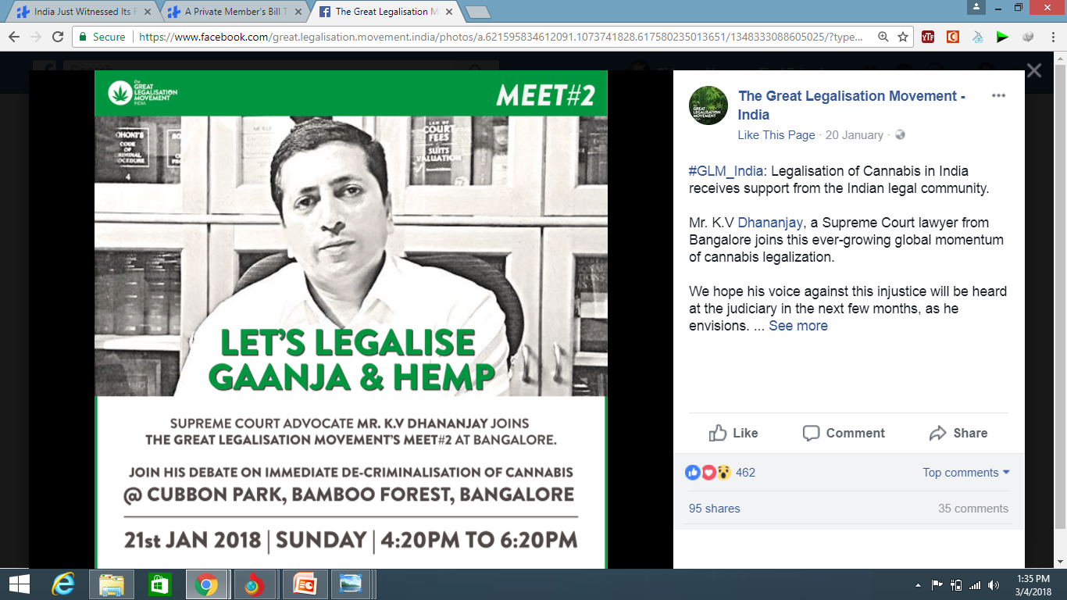
Sunny Trust
Drugs – No – Never – Ever
Notes:
Its rapidly progressing. You can see they are organizing more events and marketing them on social media as well.

Slide 24

Total population of Pakistan is over 200 million People.
After Yemen, Pakistan has second highest youth population.
63% of the total population.
Sunny Trust
CIA World Fact Book, UNICEF, Fried Ebert Stiftung Organization
Notes:
Here I want to highlight very important information, Pakistan is 6th most populous country in the world. Our total population is over 200 million. After yemen Pakistan has highest youth bulge. Youth under the age of 25 constitutes the 63% of total population exposed to the risk of substance abuse.

Slide 25
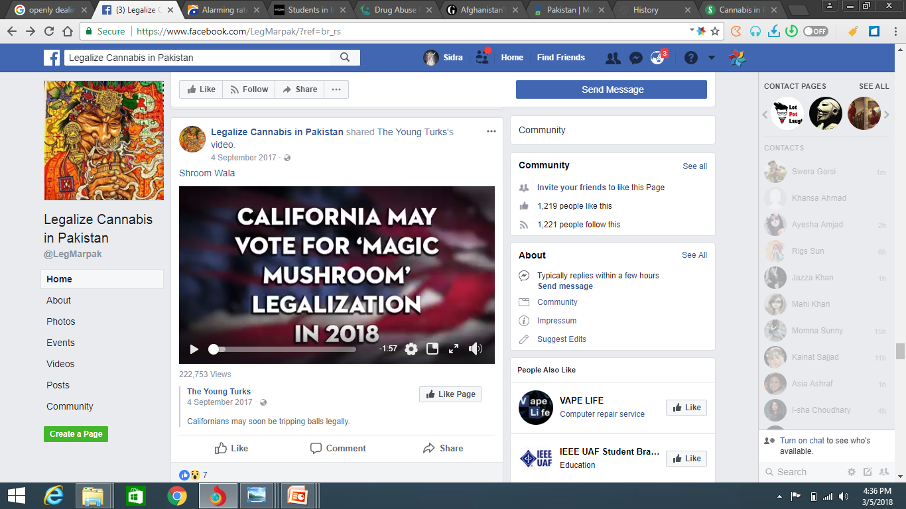
Sunny Trust
Drugs – No – Never – Ever
Notes:
And the polls and information like this are affecting very much our youth. They are very active social media user.

Slide 26
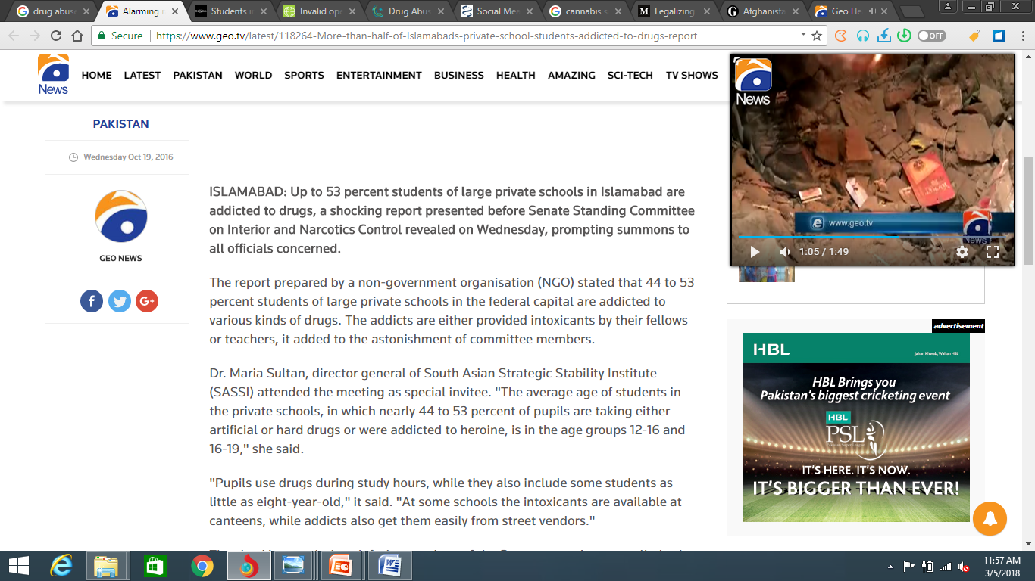
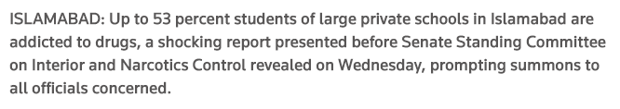
Sunny Trust
Drugs – No – Never – Ever
Notes:
This is the most recent and shocking report presented to Senate Standing committee. Up to 53% students in private schools of Islamabad were found addicted / dependent to hard core drugs.
This kind of debate is floodgate of drugs and we simply cannot afford that---allowing future generations to perish at the hands of drug mafias.
Being a developing country, constrained by indoor and outdoor security threats, poverty, unemployment, geographical location, lack of political will, lack of strict monitoring for legalization… increase in cannabis use, mental health issues, poly drug use, cannabis as a gateway drug, trafficking from Afghanistan, doesn’t make Pakistan suitable country for legalization or even decriminalization.

Slide 27
Way Forward
Need for a full-fledged national survey on state of cannabis in Pakistan
Cannabis related perceptions need to be explored
Proper leadership and policy planning with focus on implementation
Effective prevention programs targeting risk and protective factors
Sunny Trust
Drugs – No – Never – Ever
Notes:
The present situation (i.e. high level of cannabis use) cannot be allowed to further aggravate but can be arrested and reversed and progress towards drug-free (including tobacco-free) Pakistan realistically made despite many odds and that's our only option. Making Pakistan poppy-free has at least arrested level of heroin. Opiate use in Pakistan and likewise, a cannabis-free Pakistan will most likely arrest & reverse level of cannabis use, even while Afghan cannabis (like opium) continue to traffic across and into Pakistan---yet out efforts to make Pakistan drug-free go on and hope Afghans do the same too.
Need for a full-fledged national survey on state of cannabis in Pakistan and several sub-studies addressing different aspects of cannabis use, being the biggest drug use type with 4 million users, to formulate more informed drug control policies.
Cannabis related perceptions need to be explored.
Proper leadership and policy planningwith focus on implementationwill make a difference.

Slide 28
Way Forward
A community coalition targeting students, families, teachers etc. will make the difference.
It is necessary to enhance evidence based treatment and rehabilitation service treating cannabis and co-occurring mental disorders.
Strict monitoring and evaluation mechanism
Sunny Trust
Drugs – No – Never – Ever
Notes:
Effective prevention programs targeting risk and protective factors are necessary to be developed and implemented.
A community coalition targeting students, families, faith based healers, teachers and, media will make the difference.
It is necessary to enhance evidence based treatment and rehabilitation service treating cannabis and co-occurring mental disorders.
Strict monitoring and evaluation mechanism is necessary to regulate services provided.
International cooperation to improve border control, increase prevention and treatment services is dire need of time like US state department, INL in collaboration with Colombo Plan are taking a lot of initiatives in Pakistan. Work force is prepared through giving knowledge and training in substance use disorder treatment and prevention.
Drugs is an ongoing challenge, generation to generation, and part of our national survival and existence, so we cannot afford to give up the struggle

Slide 29


