Slide 1
Marijuana And Kids
Dr. Karen Randall, FAAEM
VP Case Management

Slide 2
5 years in Napa valley of cannabis

Slide 3
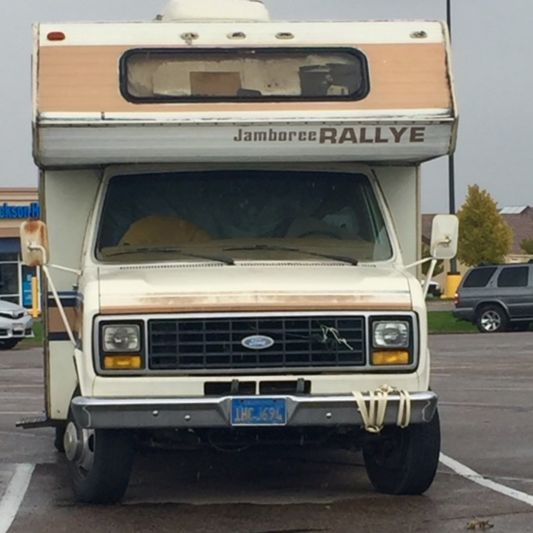
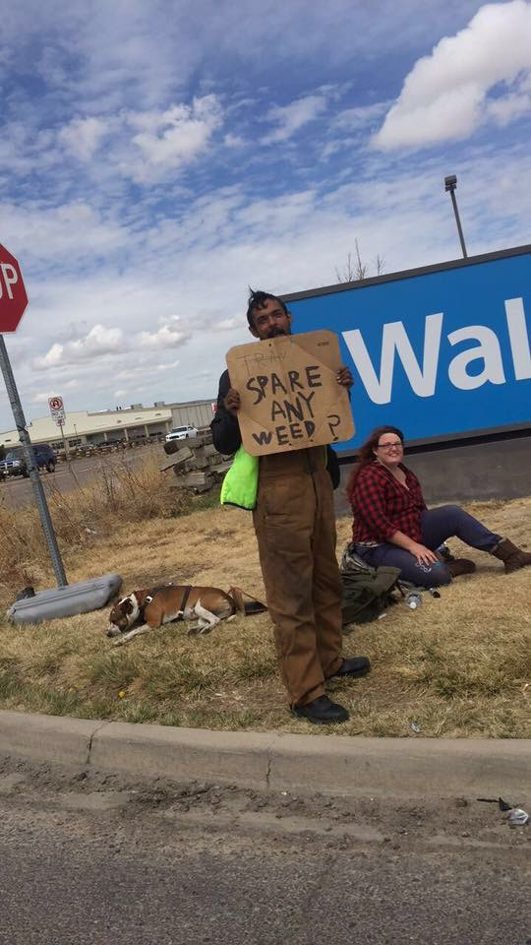
District 60 absenteeism rates
2016 – Chronic absenteeism – missing 18 days or more a year
32% total, but that year 47% of 8th graders.
2017 – 27.6%
Some schools in the small southern towns of Colorado report that their classrooms are over 50% homeless children. These schools and teachers often times have to feed, clothe, bathe and educate these children.
This is happening in communities that were not financially well off prior to the marijuana migration.

Slide 4
19 year old with seizures
19 y/o male consuming 1500 mg THC a day (had been cutting down)
Recurrent seizure like activity.

Slide 5
Some stories from “the Valley”
8 week old infant
9 y/o child with dermatitis
16 y/o male with acute psychosis

Slide 6
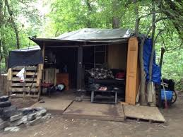
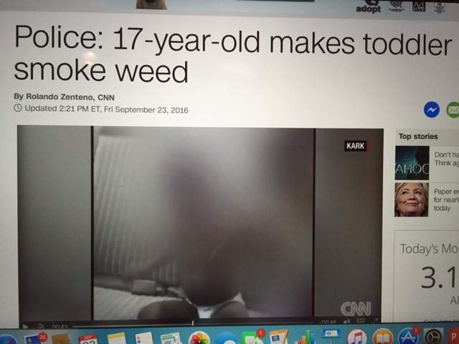
Not in my backyard
In states where counties are allowed to opt out, a different type of trafficking starts.
New illegal grows
New types of drug pushers:
https://www.cml.org/issues.aspx?taxid=11076

Slide 7
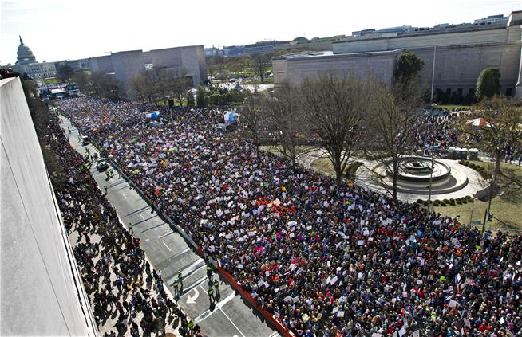
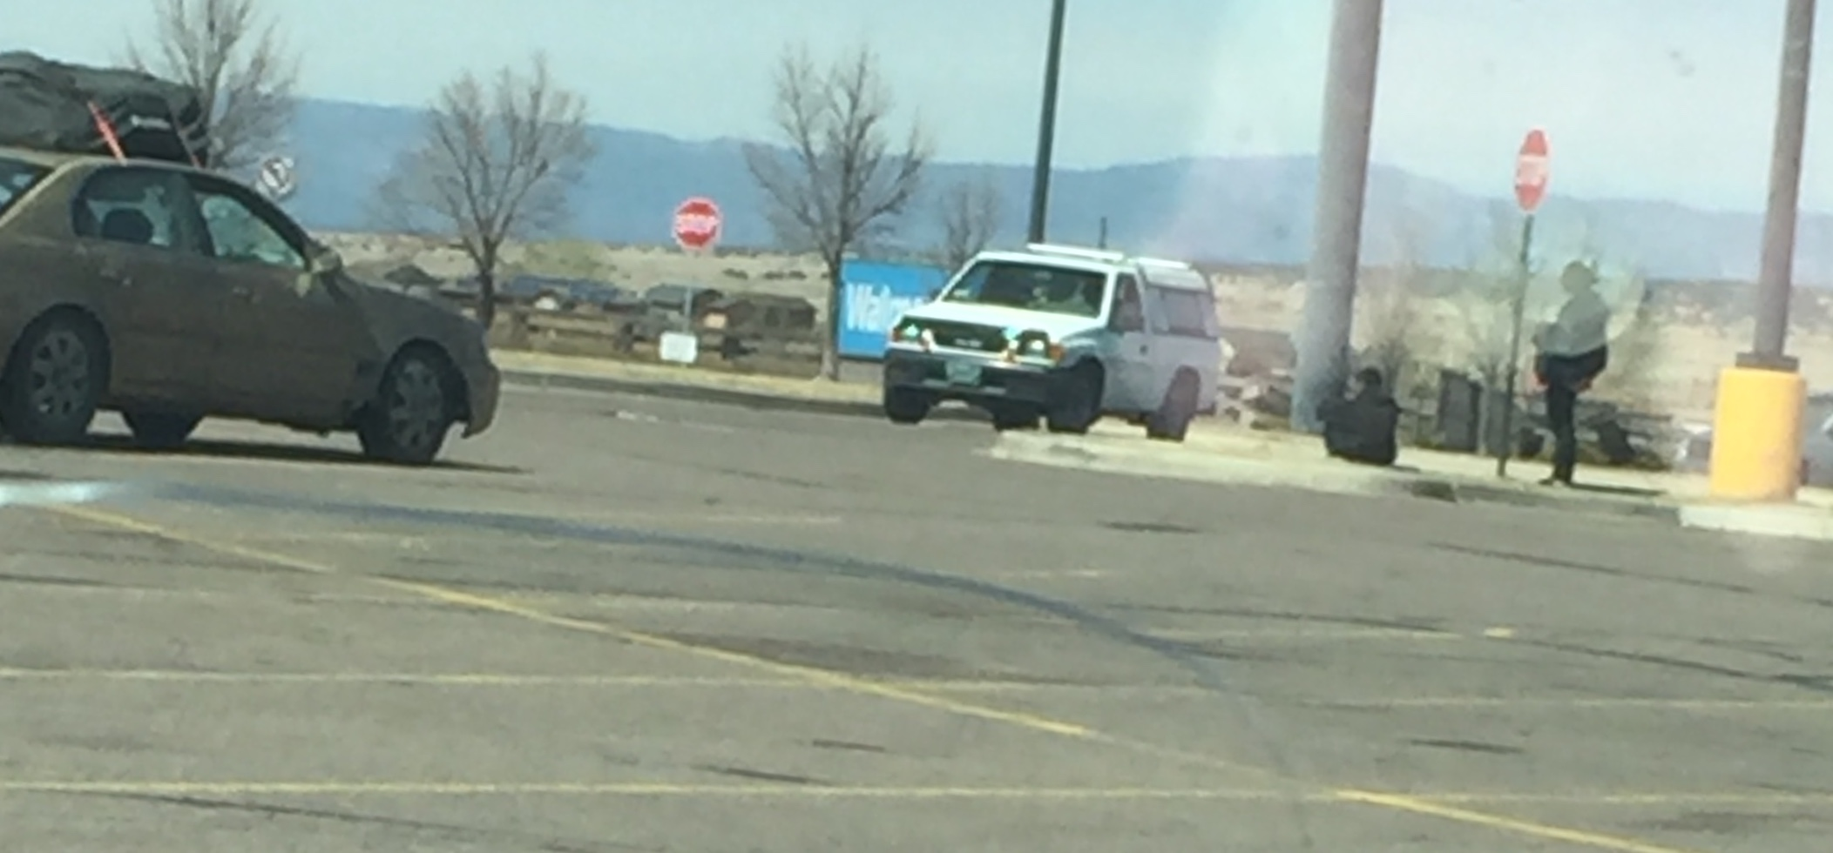
3/24

