Slide 1


SAM Action is dedicated to promoting healthy marijuana policies that do not legalize drugs.
Active at all levels of national, state, and local policy-making
Invests in and starts organizations to promote smart marijuana policies
Polling
Advocacy
SAM’s mission is to educate citizens on the science of marijuana and to promote health-first, smart policies and attitudes that decrease marijuana use and its consequences.
Brings light to and conducts research into marijuana’s negative effects

Slide 2
Groups we collaborate with
American Society of Addiction Medicine
American Academy of Pediatrics
American Academy of Child and Adolescent Psychiatry
Other leading public health authorities
Over 30 state affiliates, including:
  Treatment centers
  Recovery groups
  Prevention organizations
  Law enforcement
  Leading medical authorities
  Volunteer citizens

Slide 3


The false dichotomy:
“Legalization OR Incarceration?”
vs
Icons: Ddigital Innovation, FR; Iconathon; Edward Boatman (The Noun Project)
Icons: Milky – Digital Innovation;

Slide 4
Not This…
Source: 3CCannabis

Slide 5
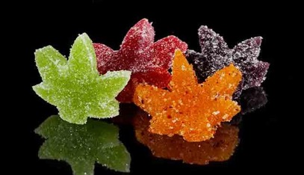


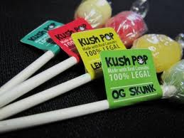
…But This
Source: Marijuana Business Journal; other open source media

Slide 6

Three separate issues that often get conflated
1
2
3
Medicinal use of compounds derived from marijuana/other drugs
Legalization of marijuana or other drugs for “non-medical” use
Penalizing drug users/ ”decriminalization”

Slide 7
Example: Support for Legalization Drops 20 Points When Respondents Have Choices
NY state poll, 600 voted in 2016 election, Emerson College (Nov 30-Dec 2, 2017)
Question: Do you think the use of marijuana should be made legal for adults aged 21 and older?
Yes: 60% No: 29% Unsure: 11%
Question: Knowing that personal marijuana possession is already decriminalized and medicalized in New York, which one of the following marijuana policies do you prefer?
Keep current policy: 26%
Keep medical, repeal decriminalization: 22%
Legalize marijuana: 40%
Repeal both, make marijuana completely illegal: 11%

Slide 8
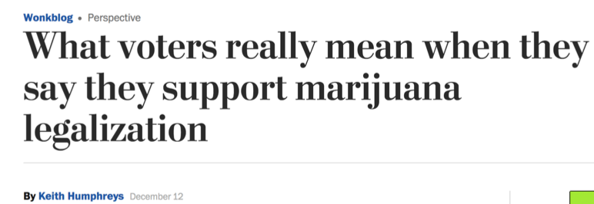
Nationwide Emerson Poll: 43% support for legalization when given choices.
Nationwide Mason-Dixon Poll: 49% support for legalization when given choices; also found 50% support for federal laws if individual users aren't targeted (only 43% opposed)
Illinois Mason-Dixon Poll: 23% support for legalization when given choices.
New York State Emerson Poll: 40% support legalization, down from 60%, when given choices.

Slide 9
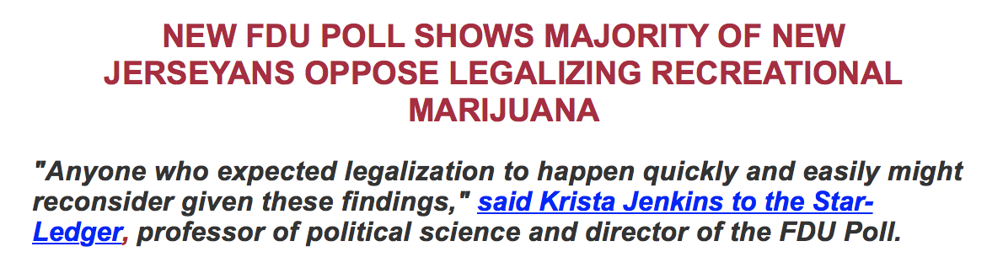
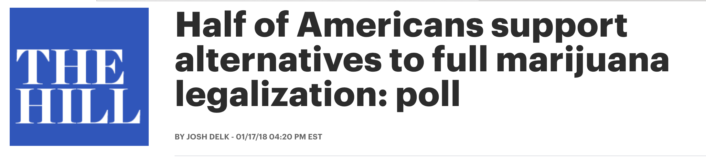

Slide 10
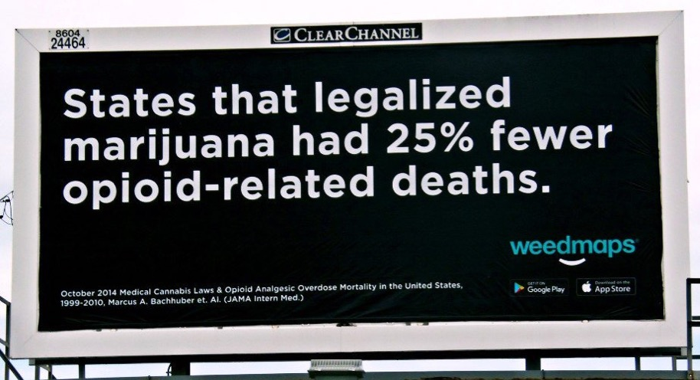
You may have seen this…
https://media.jamanetwork.com/news-item/lower-opioid-overdose-death-rates-associated-with-state-medical-marijuana-laws/

Slide 11
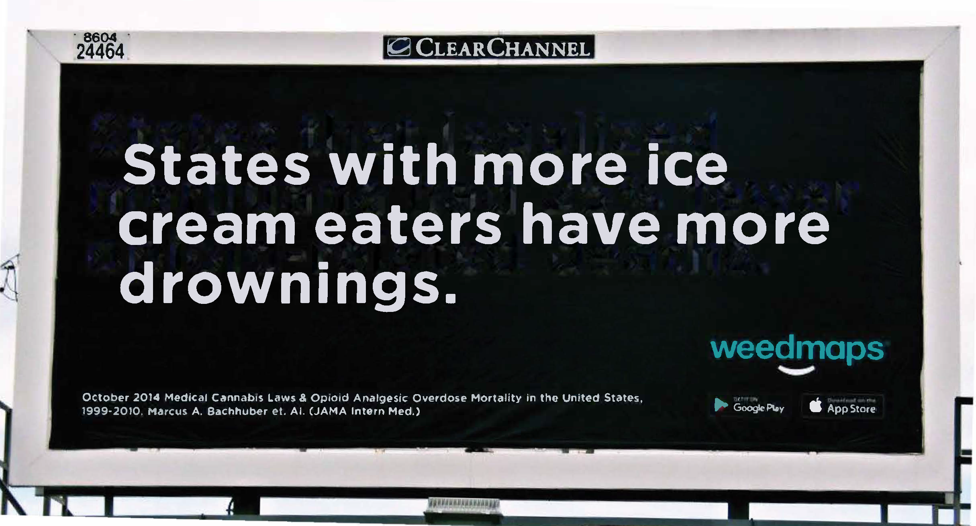

Slide 12
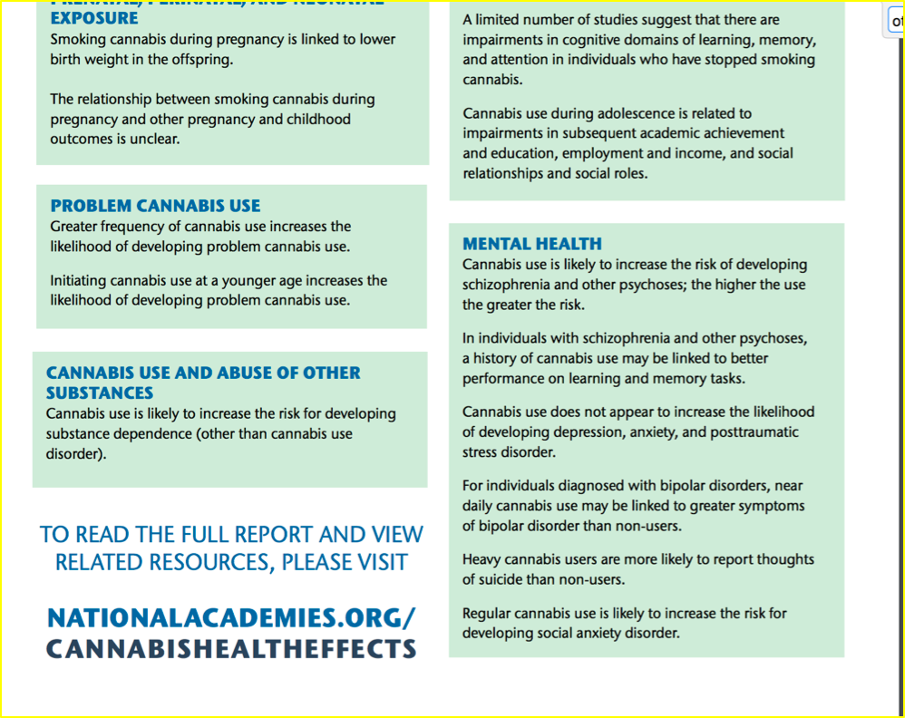
National Academy of Sciences report

Slide 13
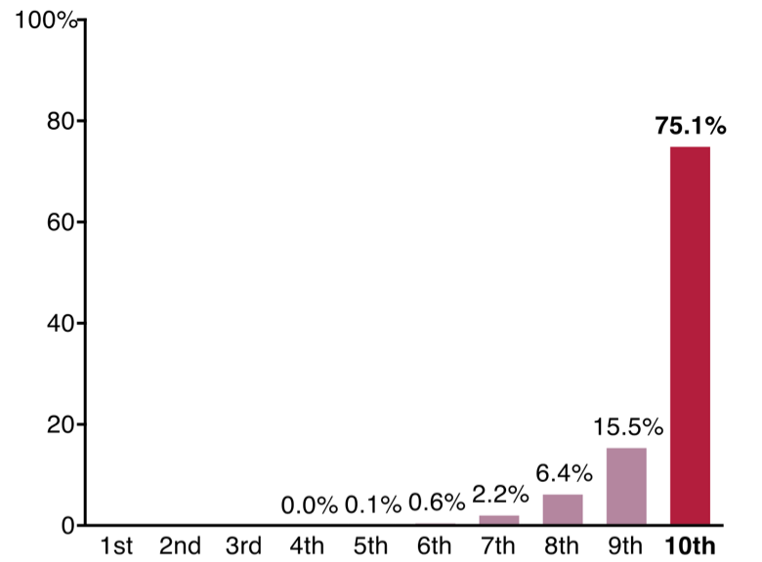
The top 10% of the population make up 75% of the alcohol industry’s U.S. sales
Avg. 10 drinks a day
Source: Cook, P. J. (2007). Paying the tab: The economics of alcohol policy. Princeton, NJ: Princeton University Press

Slide 14
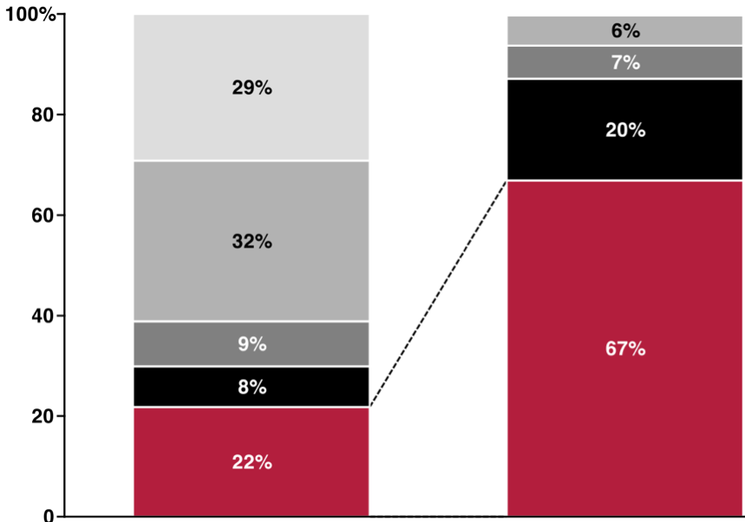
Amount
Consumed
# of MJ users
Source: Colorado Department of Revenue: Market Size and Demand for Marijuana in Colorado

Slide 15
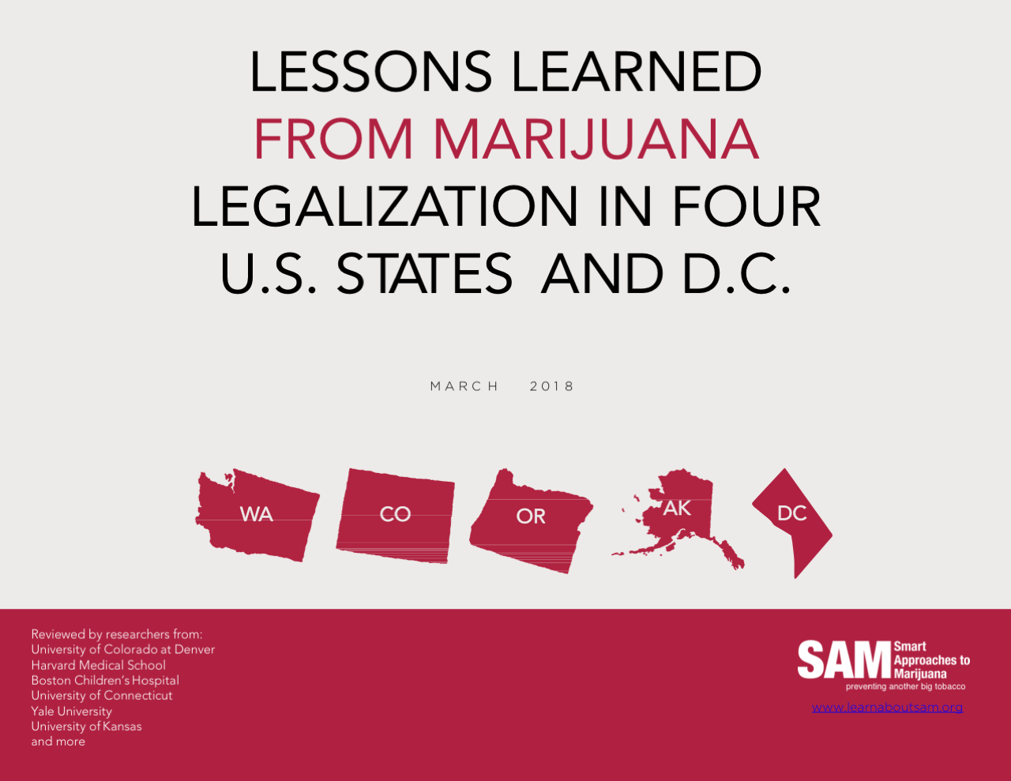

Slide 16
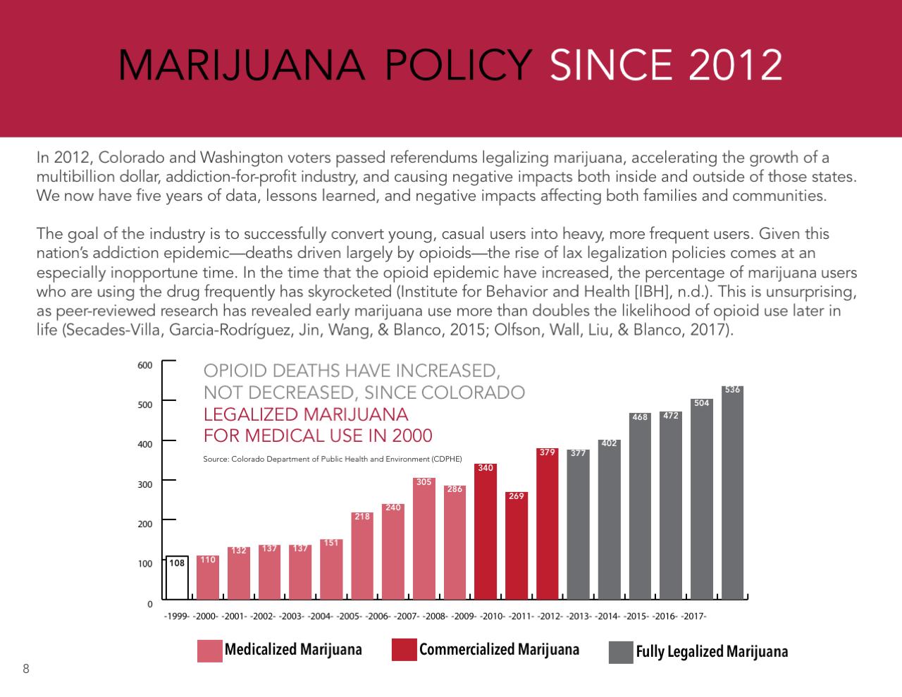

Slide 17
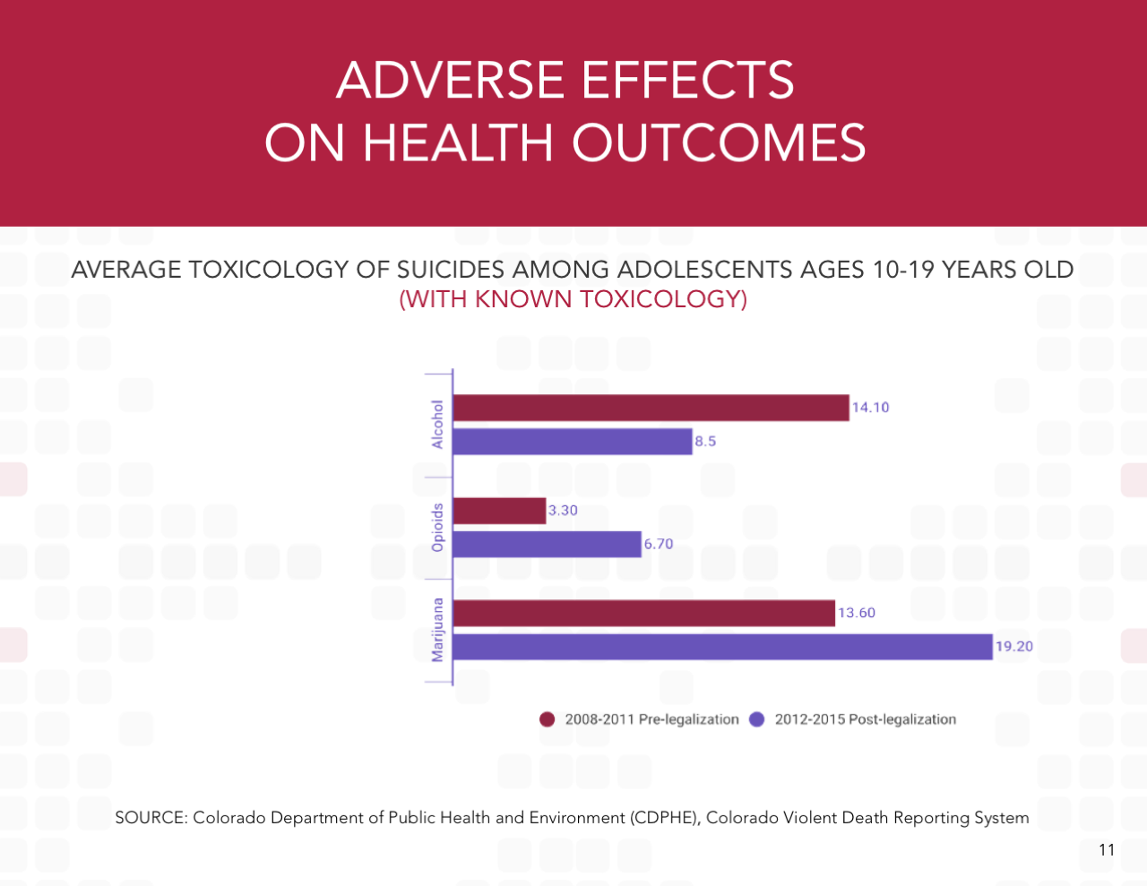

Slide 18
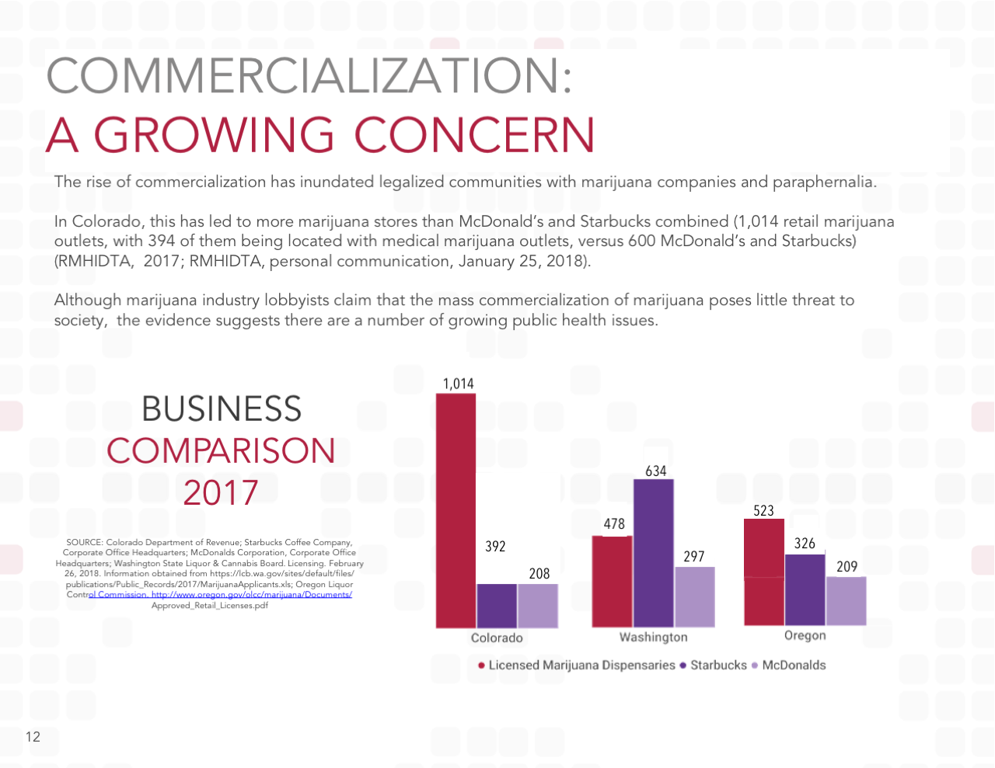

Slide 19
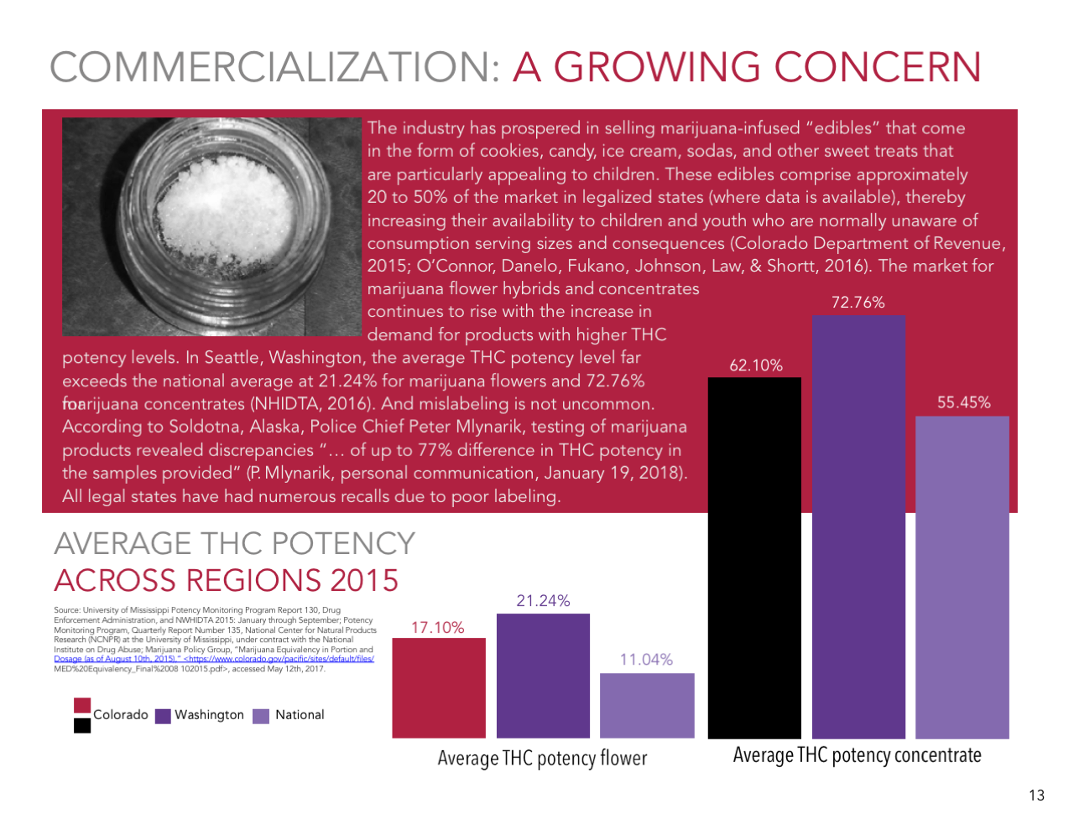

Slide 20
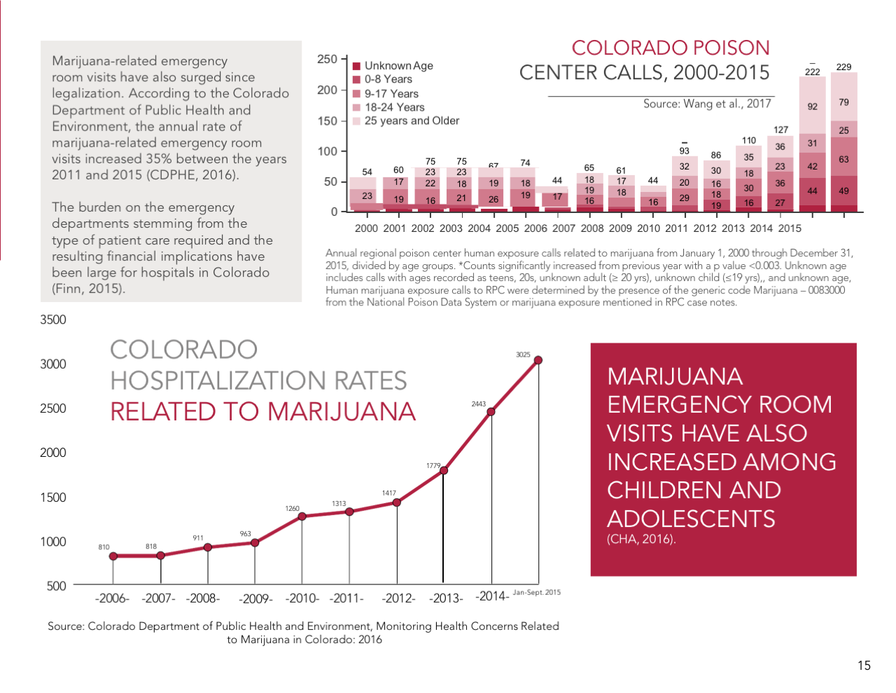

Slide 21
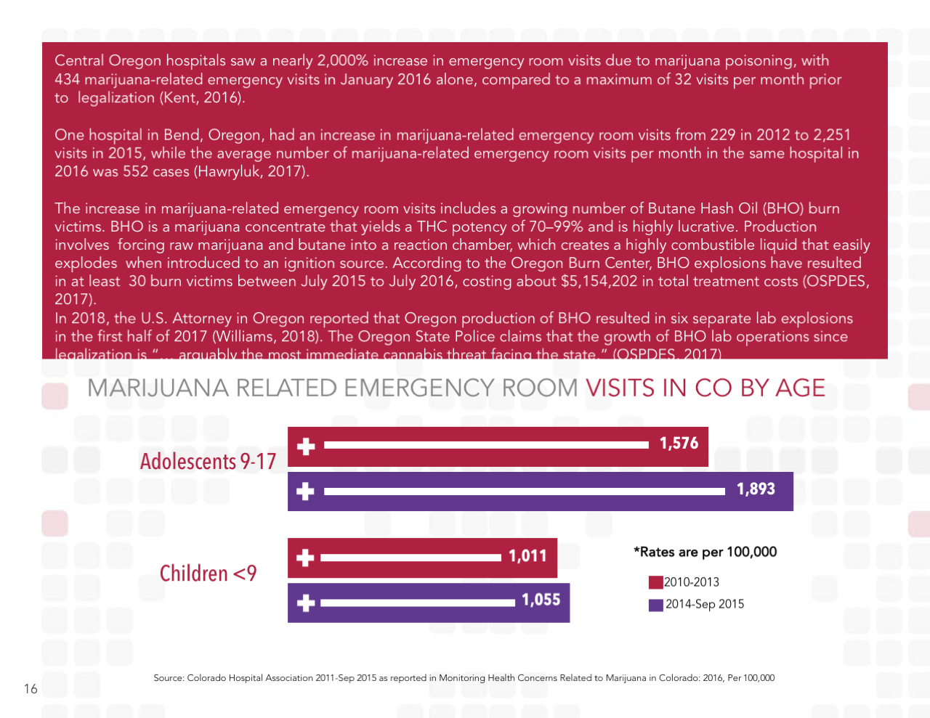

Slide 22
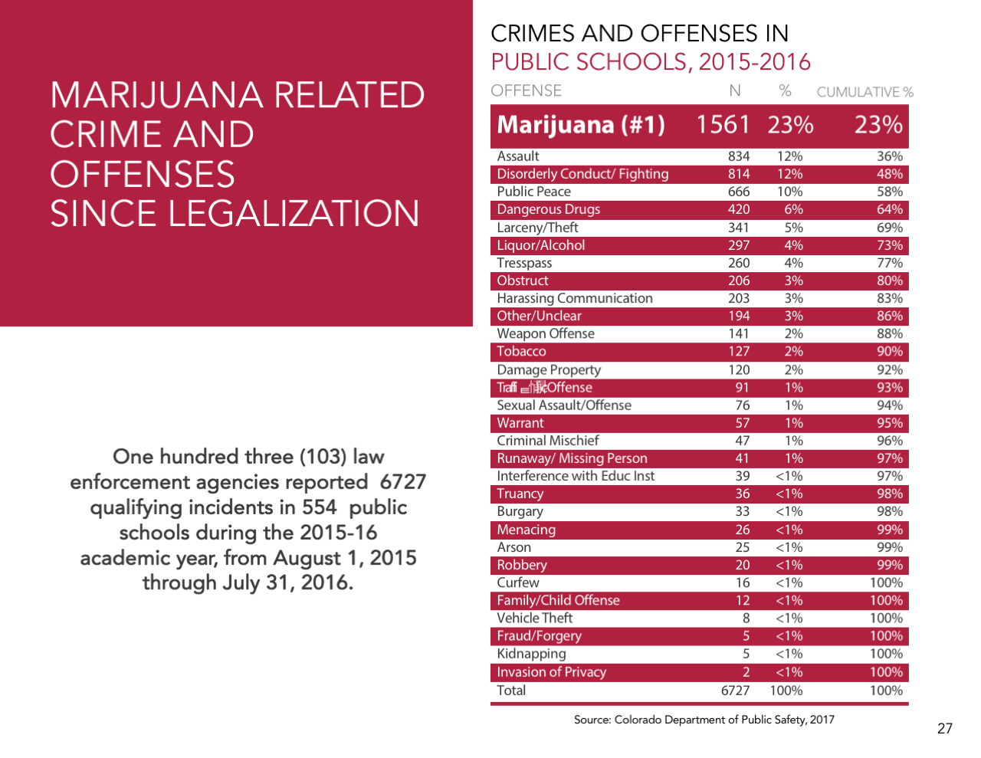

Slide 23
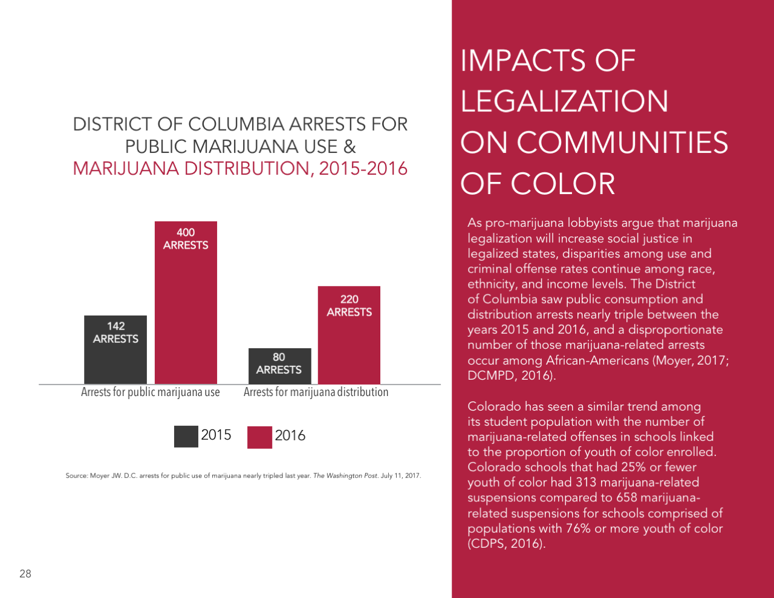

Slide 24
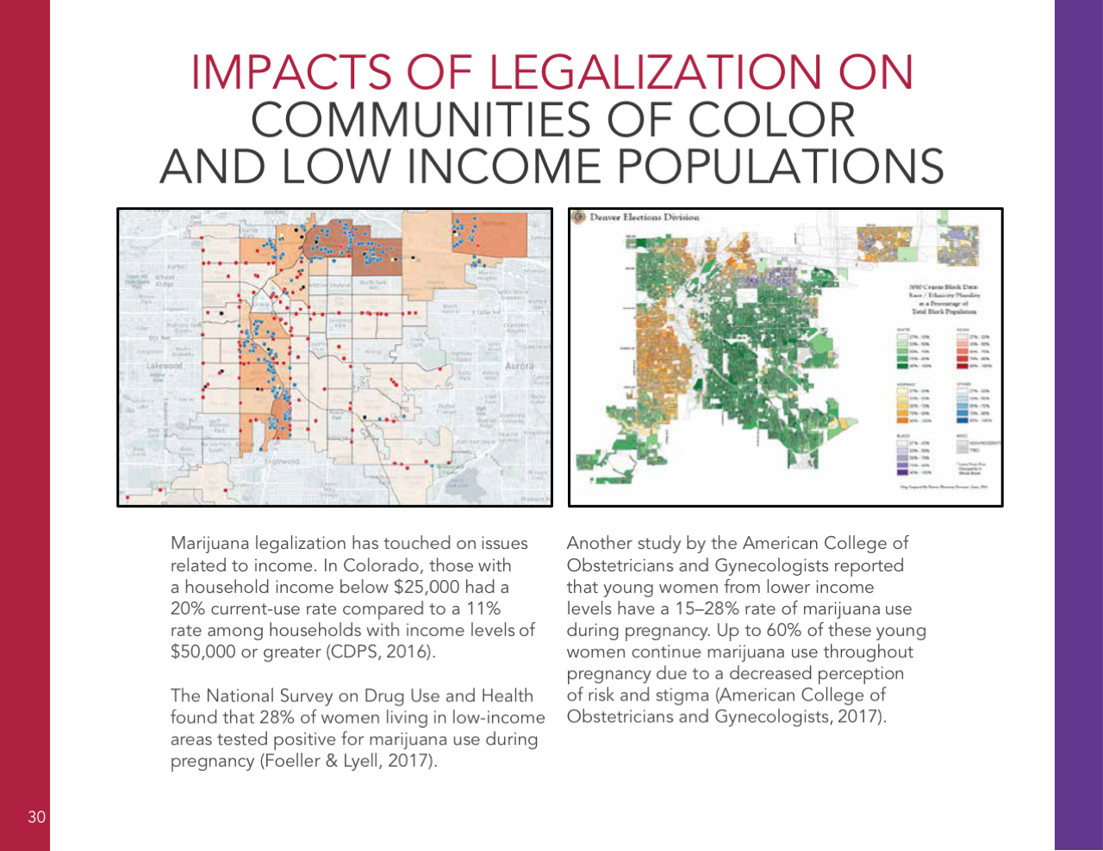

Slide 25
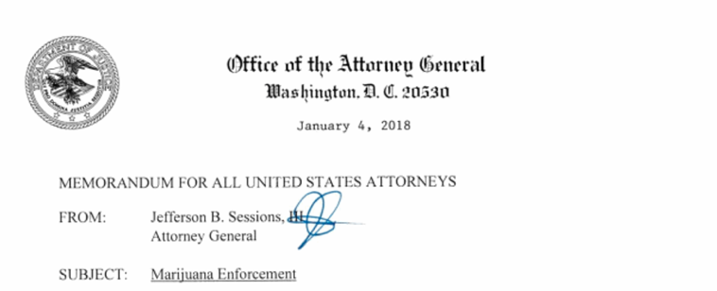
Where are we now?

Slide 26

Does the Replacement Guidance Mean Arresting Marijuana Users?
"We have never historically seen the federal government prosecute people for small possession of marijuana. I think it's highly unlikely the federal government will be using their scarce federal resources to hone in on marijuana users."
Brian Vicente
One of the primary authors of Colorado Amendment 64, legalizing pot, and co-director of the successful ‘Yes on 64’ campaign

Slide 27

So What Will The New Guidance Do?
Institutional
Investment

Slide 28
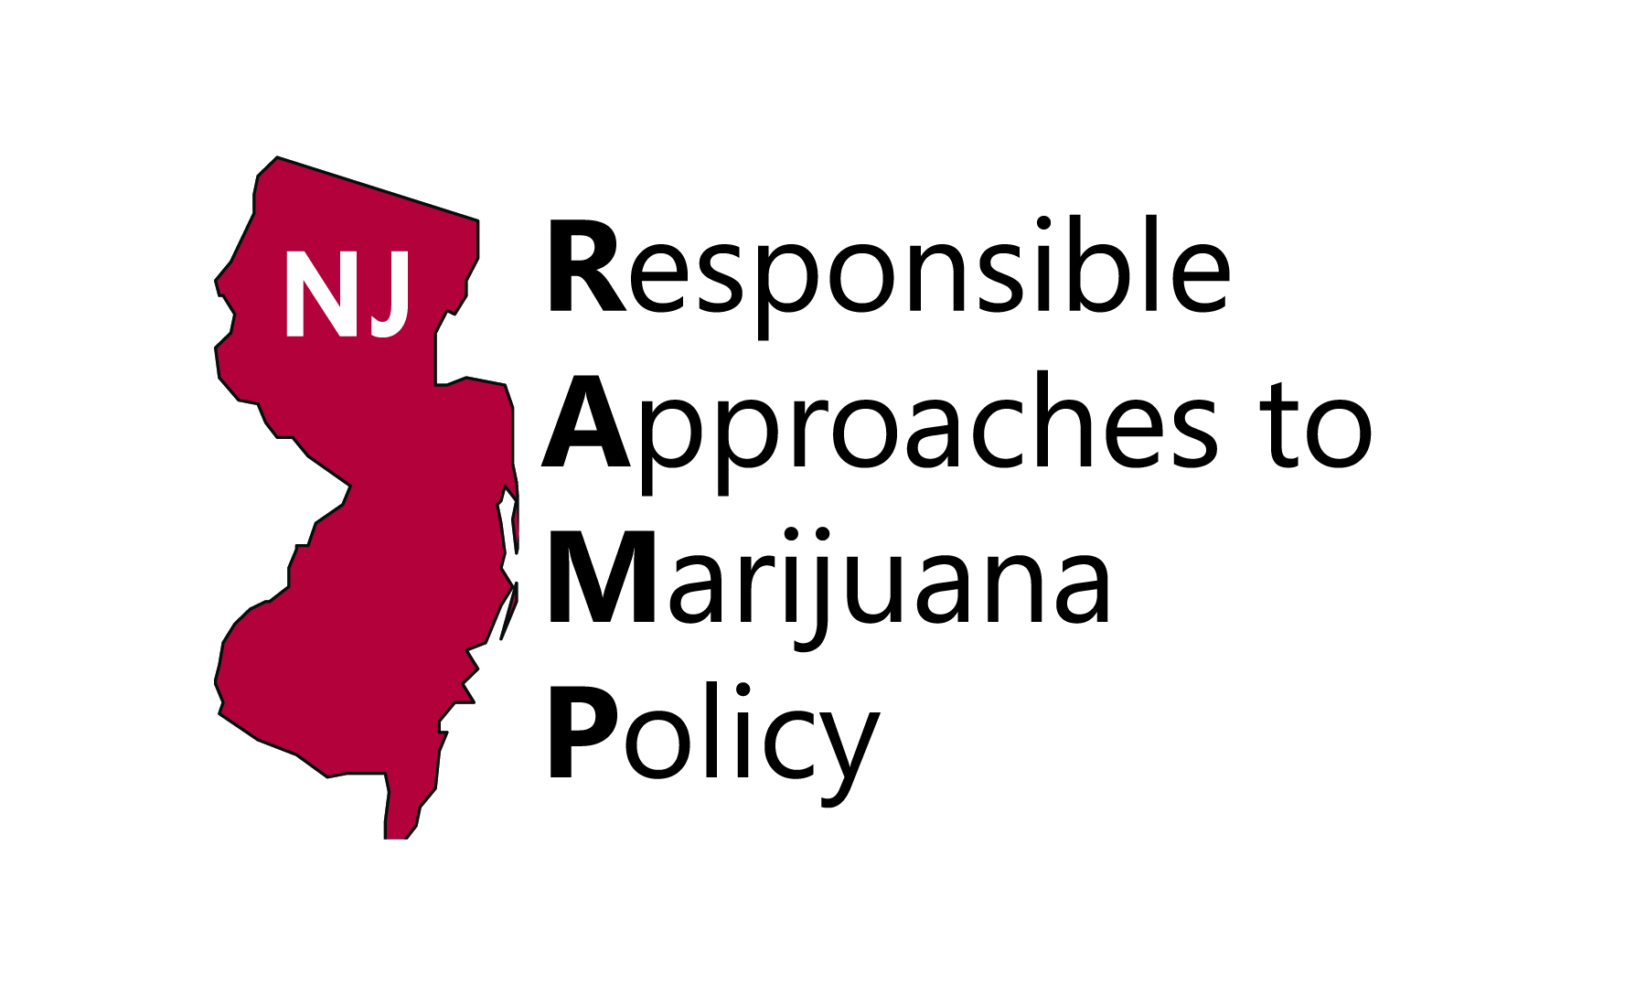

Multiple hearings
Showing Gov this will be very hard to do
Created big coalition
State Contact: Grace Hanlon
grace@learnaboutsam.org

Slide 29

In process of hiring
Political Dynamics make this a priority state for 2018-19

Slide 30

Funding PAC
Scott Greenlee
Ballot Initiative

Slide 31
Vermont compromise
State Contact: Grace Hanlon
grace@learnaboutsam.org

Slide 32

Other Projects Started in 2018

Slide 34
What can we do?

Slide 35
SAM Resources
One-pagers & educational briefs
Working paper on projected costs of marijuana legalization in Rhode Island and Connecticut (and IL soon)
SAM testimony
Reefer Sanity PowerPoint Slides
SAM report on 5 Years of Legalization

Slide 36

Tools Available
SAM partnered with Communities for Alcohol- and Drug-free Youth (CADY) to create a comprehensive resource for marijuana-targeted media campaigns. Copies available for purchase by contacting CADY or SAM.

Slide 37






Get Involved!
Connect with us via email at info@learnaboutsam.org
&
Follow us:
@learnaboutsam
Facebook.com/learnaboutsam
Sign up for alerts and news, also donate to the cause at learnaboutsam.org
Grassroots organizing through SAM Action App
(text SAM to 797-979 or find in App Store)
“We were gaining momentum. But now that's flipped and we're more on the defensive.” – Rep. Dina Titus (D-NV), one of the biggest marijuana supporters in Congress.

