Slide 1
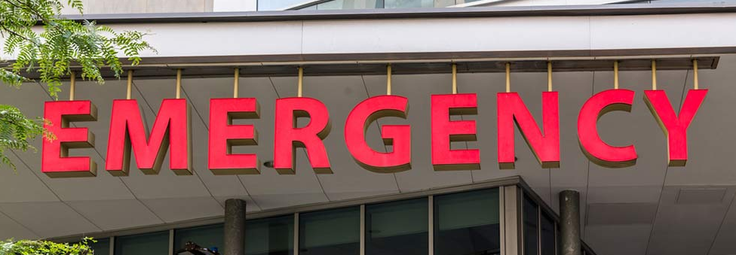
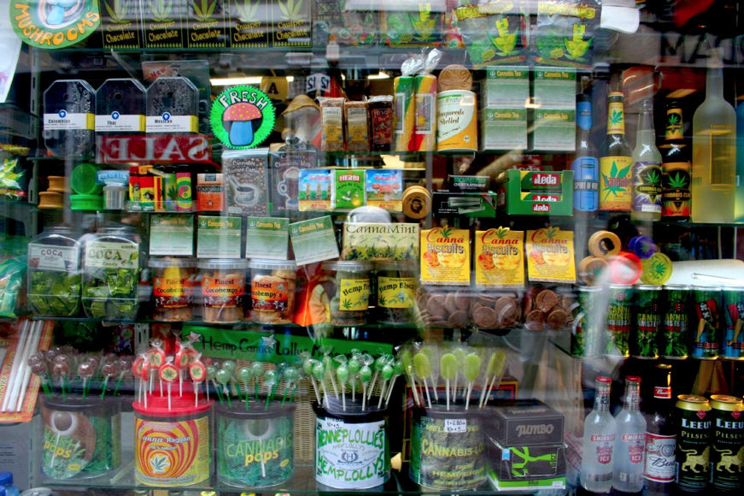
Marijuana –
Cases from the Front Lines
Roneet Lev, MD FACEP
Chief, Scripps Mercy Hospital San Diego Emergency Department
Chair, San Diego Prescription Drug Abuse Medical Task Force
President, Independent Emergency Physicians Consortium, iepc.org

Slide 2


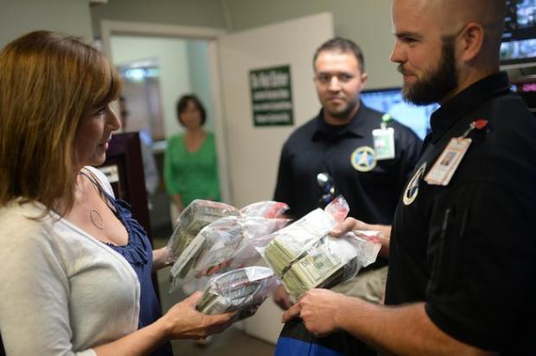
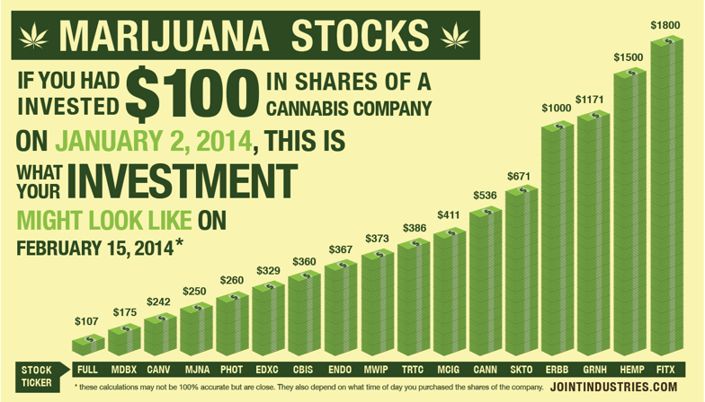
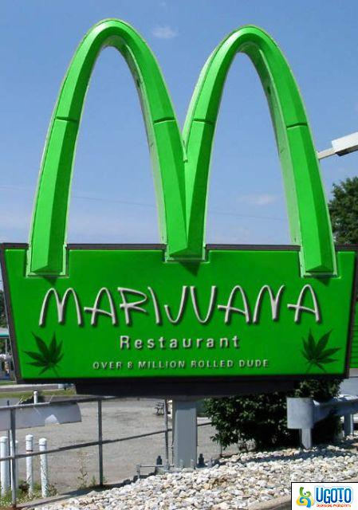
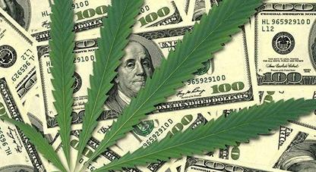

$$$$$$

Slide 3
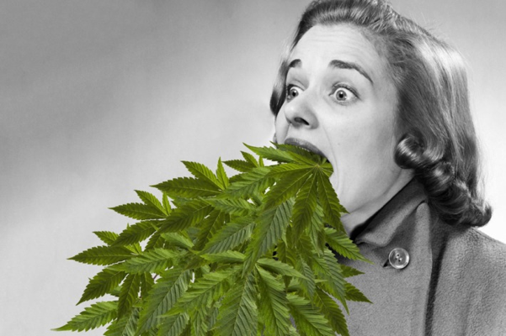
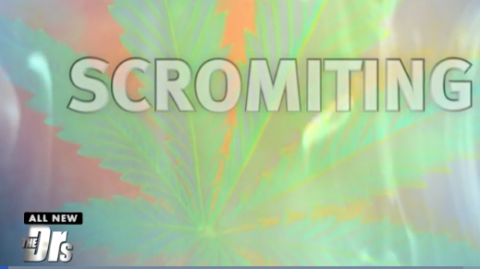
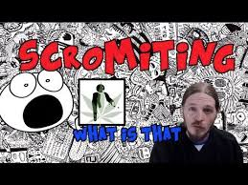



Scromiting
Cannabis Hyperemesis Syndrome

Slide 4
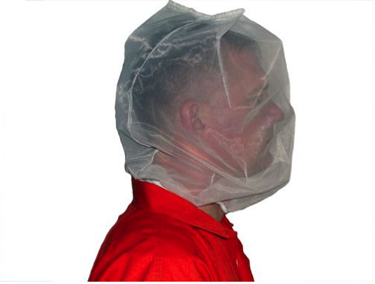
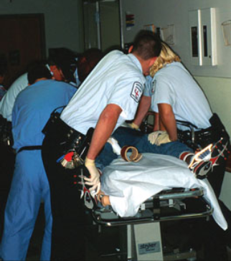
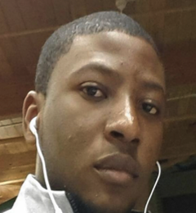
Excited Delirium
Marijuana induced psychosis
19 year old ate cookie and jumped off 4th floor
47 year old ate candy and killed wife
31 year old ate face off homeless man
No reporting
  Autopsy, Hospitals
Levy Thamba Pongi 1995 - 2014

Slide 5


Psychiatric ED Boarding
How many are positive for THC?
Living in the ER for over a week
5o% of all ER patients at 6 am

Slide 6

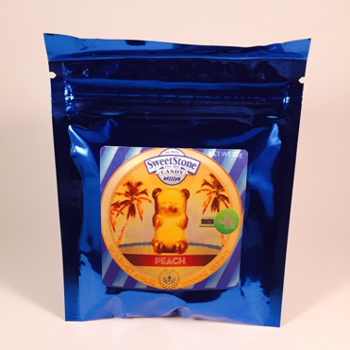
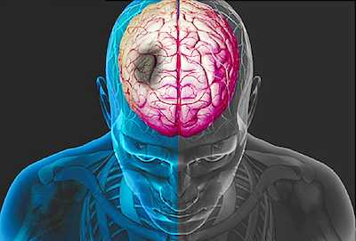

I can’t talk right or move my arm
Hangover Remedy
10 x increase likelihood to miss work if using marijuana
3.6 x more likely to have on-the-job incidents
5 x more likely to file a work comp claim
6,000 companies, industries and profession conduct drug testing
American Council for Drug Education in New York

Slide 7
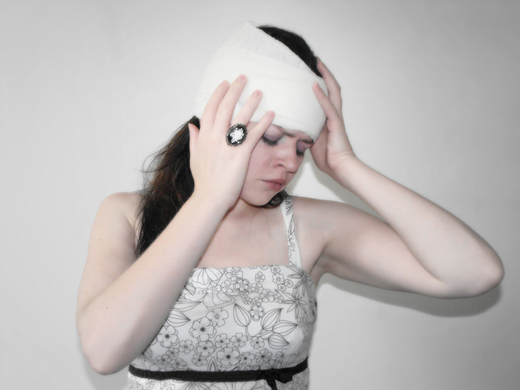
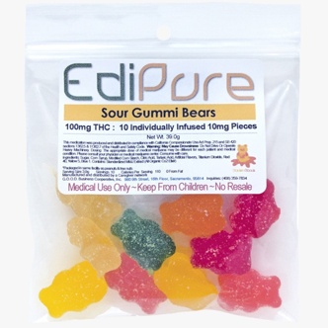
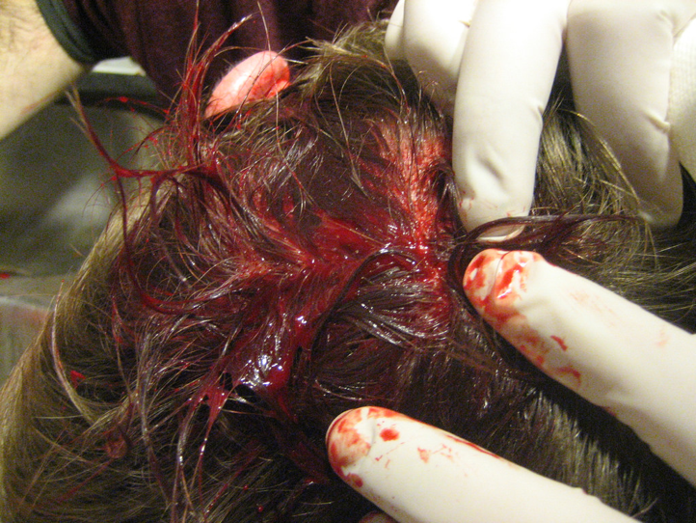

Passed out and hit head
Chronic pain accounts for 90% of qualifying conditions for use of medicinal marijuana
Majority of white males age 30-40 self diagnosed with pain
JAMA - only 17 percent accurate label on 75 products from 45 brands
Notes:
THE CASE
54 year old passed out and hit her head. Husband and teenage kids. Kid had apple watch.
Why passed out? Heart? Electrolyte?
Head – internal bleeding
THE DIAGNOSIS
Using marijuana for 2 years for migraines and fibromyalgia
MYTH
No quality control, taking for 2 years and nothing…
Package says milligram
DISCHARGE INSTRUCTION
wound care, head injury precautions
don’t use marijuana for pain

Slide 8
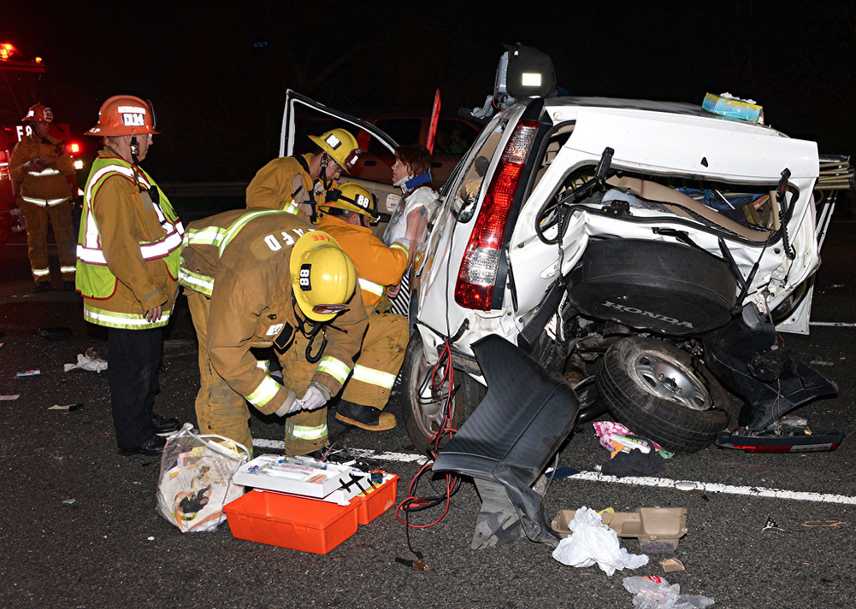
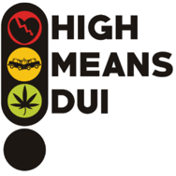

Code Trauma Code Trauma
Grossly under reported
#1 drug detected in impaired drivers
Percent of fatally injured impaired drivers detected with marijuana 3x up in past 10 years
3 x as many high school students reported driving after marijuana compared to alcohol (8.6% to 2.9%)

Slide 9
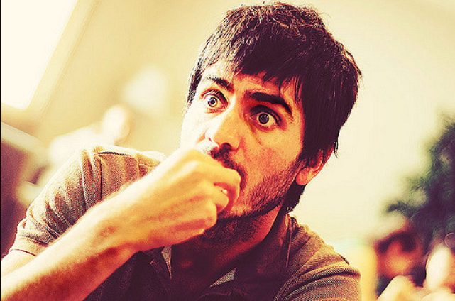

911 - I’m Dying
How to self treat anxiety with cannabis

Slide 10
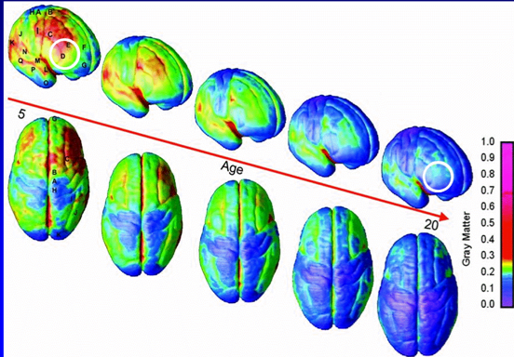

I don’t feel well
Frontal Lobe developing until age 25
Loss of 8 IQ points
Heavy use in teen and continued to adulthood had a permanent drop in IQ points
Meir et al. “Persistent cannabis users show neuropsychological decline from childhood to midlife.” Proceeding of the National Academy of Sciences. 2012

Slide 11
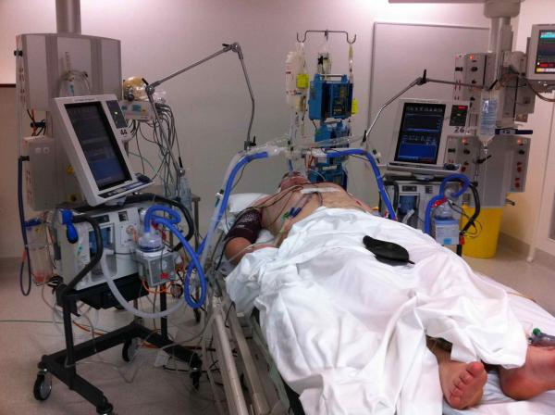
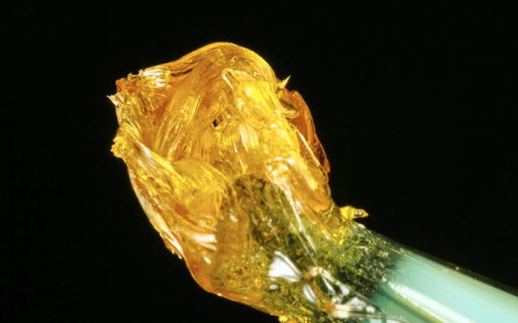

Intubated, on ventilator
Wax
Notes:
CASE
35 year old short of breath, poorly responsive
Oxygen, Blood Gas, Intubation, Blood pressure support
DIAGNOSIS
Wax – 99% concentrate
MYTH
Marijuana doesn’t kill

Slide 12

I have Morning Sickness
THC crosses the placenta
In Breast Milk
Notes:
Talk to Obs …

Slide 13
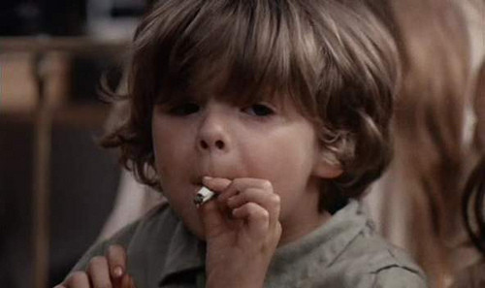

Children Exposed
2015: 14% of California Poison Center Calls are for kids < 5 years
1 in 6 Colorado Kids hospitalized with lung issue test positive for marijuana
“The AAP opposes legalization of marijuana because of the potential harms to children and adolescents”.
Charlotte Figi (Charlie) –300 seizures a day, Dravet Syndrome treated with strain with low THC and more Cannabidiol CBD olive oil
Wang et al. Pediatric Marijuana Exposures in a Medicinal State. JAMA Pediatrics 2013
California Poison Center Data
KM Wilson.Marijuana Exposure in Children Hospitalized for Bronchiolitis
1-48 month old, Jan 2013 – April 2014
Urine sent to CDC for THC metabolite
AAP

Slide 14

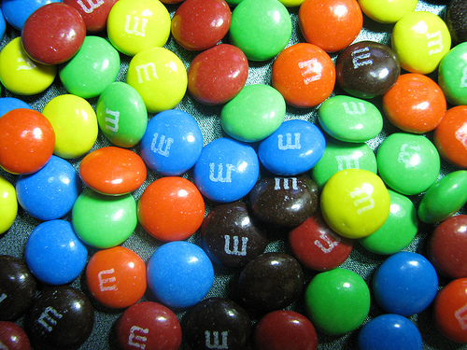

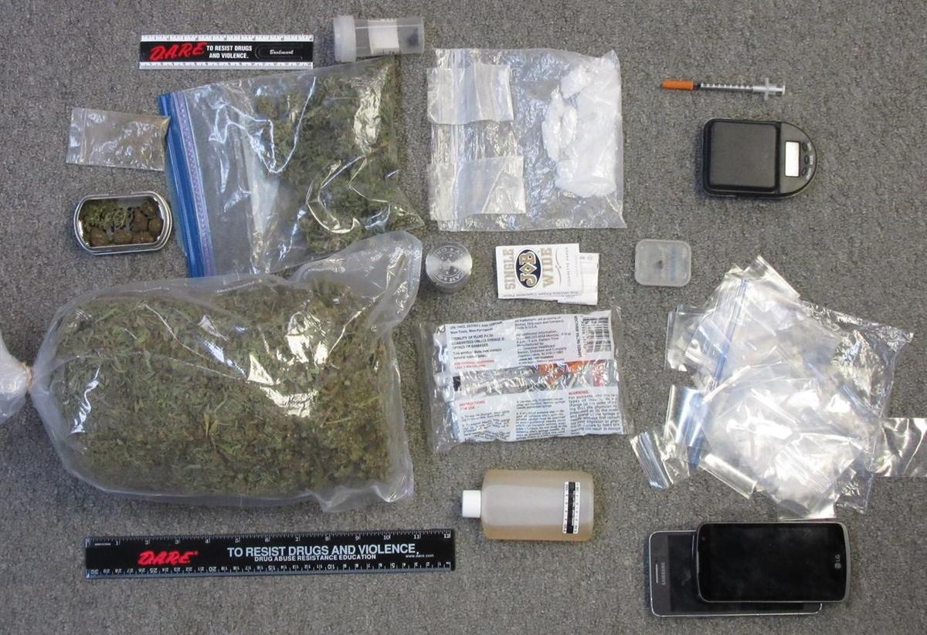
M&Ms

Slide 15
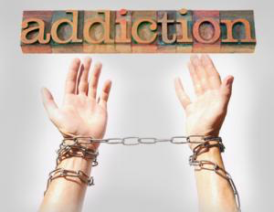
Addiction
10% develop addiction, 17% if start in adolescence
42.4% of heavy users experience withdrawal symptoms
10 – 20% of daily users are dependent

Slide 16
Understanding Addiction
SURVIVAL
Addiction affects about 10% of population
Only 10% are receiving treatment
Genetic component ** Take a Family History
Starts in middle school
Dopamine receptors depleted = increased circulating dopamine, the new “normal” requirement for dopamine is increased
DOPAMINE
WATER
FOOD
best day ever
100
THC
600
Heroin
800
Meth
1000
Baseline
15-40
From lecture by Dr. Corey Waller

Slide 17
Cannabis Use Disorder – DMS 5
Affects 6 million Americans, 2.5% of adults
Problematic pattern of cannabis use leading to clinically significant impairment or distress, as manifested by 2 or more of the following within 12 month period
  Taken in larger amounts or time than intended use
  Persistent desire or unsuccessful efforts to cut down or control use
  Great deal of time spent in obtaining or recover from its effects (65%)
  Craving
  Failure to fulfill obligations in work., school, or home
  Continued use in physically hazardous situation
  Continued use despite knowledge of health problem (72%)
  Tolerance (83%)
  Withdrawal (91%)
  Hasin DS, et al. Prevalence and Correlates of DSM-5 Cannabis Use Disorder.
  The American Journal of Psychiatry. Dec 2015
  http://ajp.psychiatryonline.org/doi/abs/10.1176/appi.ajp.2015.15070907

Slide 18
Cannabis Withdrawal
44% of frequent users reported 2 or more withdrawal symptoms upon cessation
34% reported 3 or more symptoms
Onset: 1-2 days of abstinence, peaks at 2-6 days, resolve 7-14 days, sleep disturbance, irritability, and physical tension may persist for weeks.
  Fatigue (31%)
  Yawning (27%)
  Hypersomnia (26%)
  Psychomotor retardation (25%)
  Anxiety (19%)
  Depression (16%)
  Anorexia, weight loss, anger, irritability, strange dreams, chills, tremor, diaphoresis, stomach pain

Slide 19

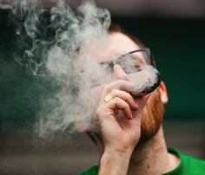
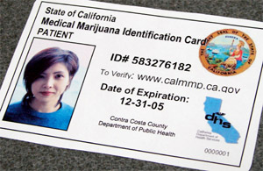

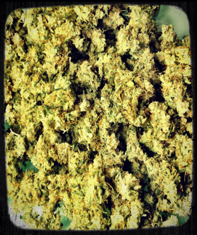
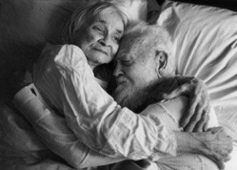
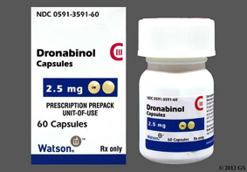
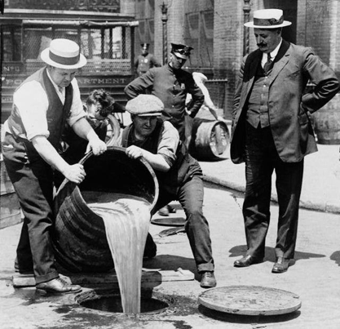
What Americans Want
Don’t want to go to jail
Medicinal use
Recreational use

Slide 20

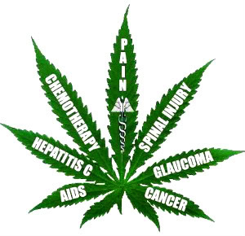
Analyzing Research
How many people in study?
What was dose of THC used?
Opioid Epidemic based on NEJM letter to the editor on 38 patients

Slide 21
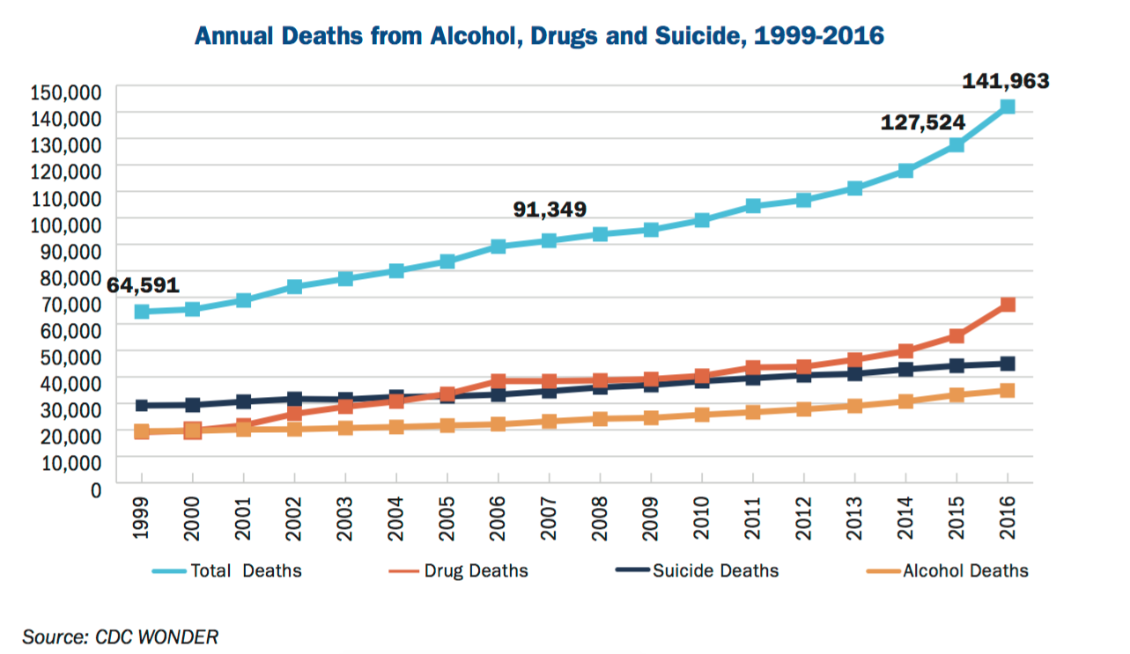
Annual Deaths

Slide 22
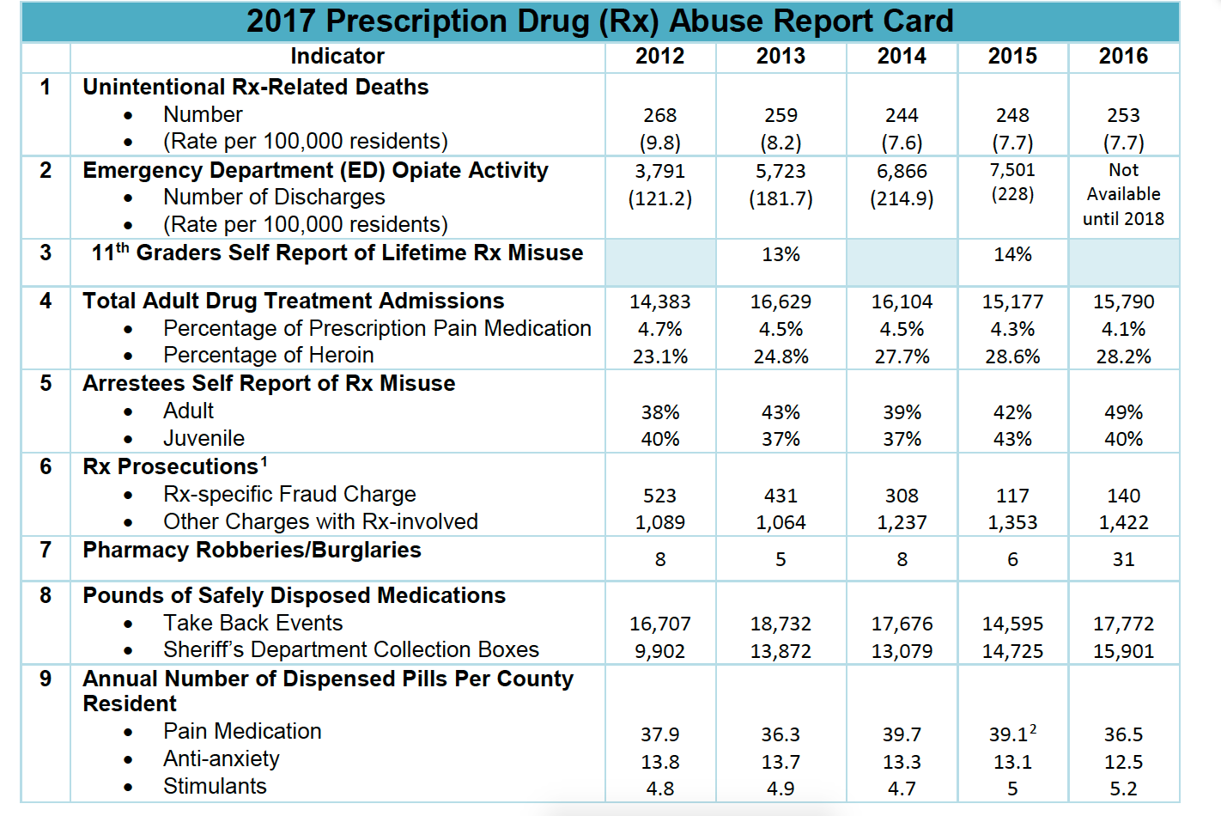
Rx Abuse Report Card

Slide 23
ED Visits for Cannabis
Up 830%
The Center for Community Research prepared this analysis for the San Diego County Marijuana Prevention Initiative with data from the California Department of Public Health, March 2016. mpisdcounty.net

Slide 24

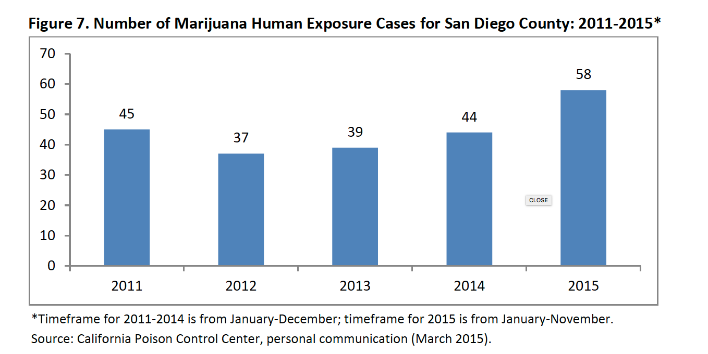
Poison Center Calls for Marijuana

Slide 25


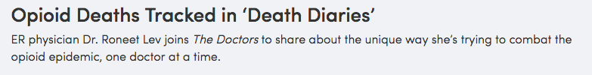
San Diego Death Diaries - 2013
283 deaths; 33 Medications; 4366 Rx

Slide 26
Drug Deaths 2006 - 2016
San Diego ME Data 2016: All Drug Related Deaths and All THC Related Deaths

Slide 27
Gender of Drug Deaths
San Diego ME Data 2016: All Drug Related Deaths and All THC Related Deaths

Slide 28
Ethnicity of Drug Deaths
San Diego ME Data 2016: All Drug Related Deaths and All THC Related Deaths

Slide 29
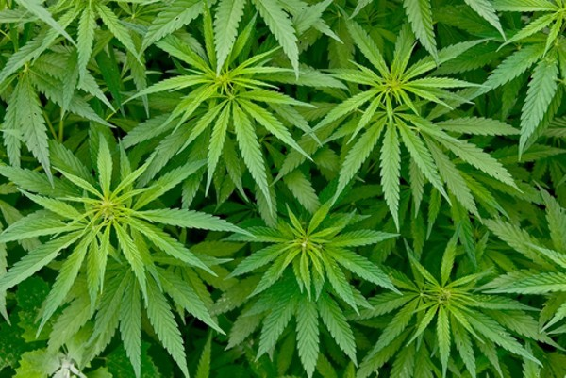
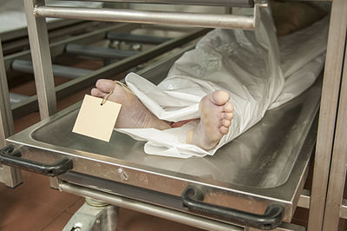
Marijuana Death Diaries - 2016
1 year old “undetermined”
15 year old “undetermined”
19 year old lost control of vehicle, struck tree (32 Drivers)
21 year old jump off bridge in suicide – “suicide” (76 suicides)
34 year old fall while hiking – “accident”
55 year motorcycle driver struck embankment, (9 MCA)
23 year old with pneumonia – “natural”
50 year old struck by car (pedestrians) – “accident”
69 year old with heart disease – “natural”
24 year old with seizure – “natural”
38 year old electrocuted – “accident”
54 year old with hypertension – “natural”
34 year old stabbed to death – “”homicide” (23 homicides)
52 year old with COPD/emphysema ‘ “natural”
33 year old sudden cardiac death, history of diabetes, “natural”
42 year old riding bicycle, hit a car, “accident”
47 year old with diabetic ketoacidosis, “natural”
22 year old skateboard into car, “accident”
61 year old hemopericardium, “natural”

Slide 30
2016 San Diego Medical Examiner Investigations
3071 ME investigated deaths in 2016
841 involved drugs ( illicit, Rx, alcohol)
462 involved THC
54.9% of all Drugs involved THC
Source: Thank you to Dr. Stephen Campman, Deputy Medical Examiner, San Diego County, who pulled hair and teeth to obtain data

Slide 31
Marijuana Cause of Death
30.1%
23.4%
18.2%
15% of all
3071 ME investigations in 2016
16.5%
6.9%
5%
San Diego ME Data 2016: 462 autopsies positive for THC

Slide 32
THC positive Drug Overdoses
30.3% of all 317 ME illicit deaths
30.1% of all 84 ME Rx deaths
30.3% of all 246 ME alcohol deaths
Of the 518 Drug related overdose deaths, 139 = 27% tested positive for THC
San Diego ME Data 2016
*total not equal 139, 518 due to combinations

Slide 33
THC positive “Natural Deaths”
10.6% of all 1018 Natural ME deaths involved THC in 2016
San Diego ME Data 2016

Slide 34
THC positive “Accidents”
9.1% of all 919 Accident ME deaths involved THC in 2016
San Diego ME Data 2016

Slide 35
THC positive Suicides
17.7 % of all 430 Suicide ME deaths involved THC in 2016
San Diego ME Data 2016

Slide 36
THC positive Homicides
29.1% of all 79 Homicide deaths involved THC in 2016
San Diego ME Data 2016

Slide 37
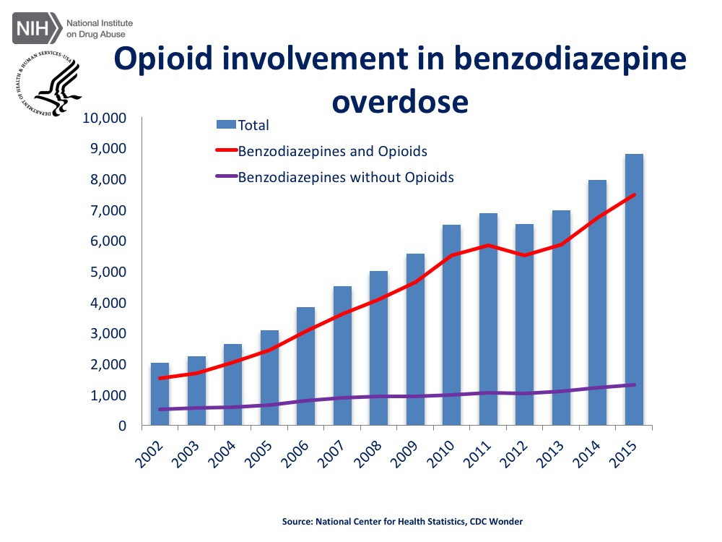

FDA Black Box Warning

Slide 38
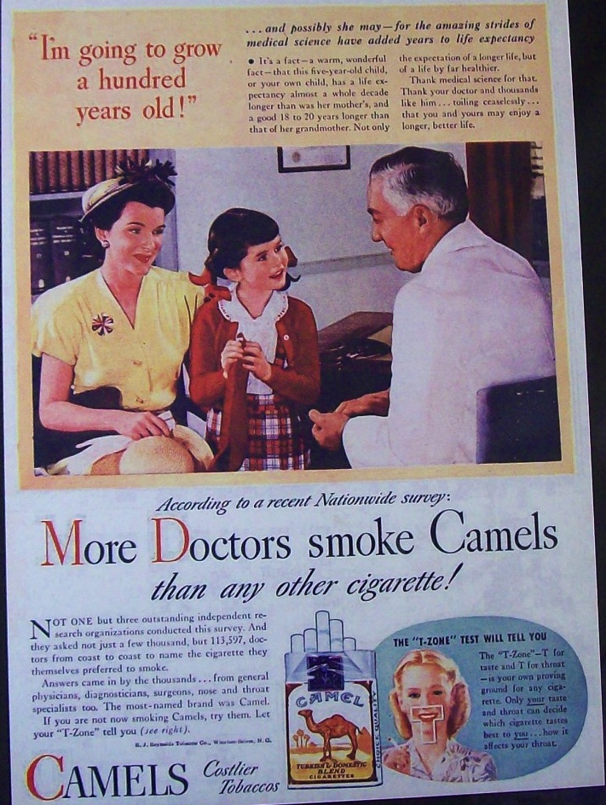
Big Tobacco Lessons
1920 German scientists link tobacco and cancer
1931 Hoffman, Cancer and Tobacco Habits
1950s Many publications
1964 Surgeon General warning based on 7,000 articles
1980 Tobacco Law suits
1990 Ban on Flights

Slide 39
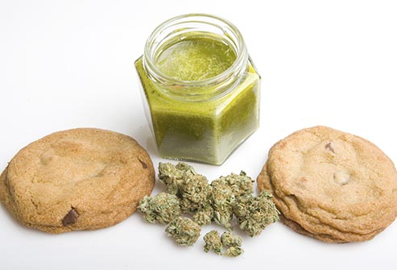
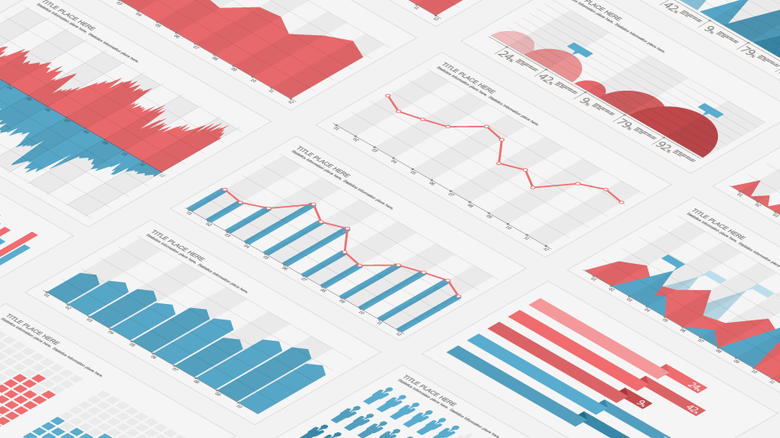
Where is the data?
Prescription fatalities associated with marijuana
Motor vehicle fatalities associated with marijuana
Cardiovascular fatalities
Motor vehicle collisions associated with marijuana
Pregnant women using marijuana
Newborns testing positive for marijuana
Babies and Children testing positive for marijuana
ED visits with marijuana poisoning
Psychiatric admission testing positive for marijuana
Marijuana exacerbating psychosis
Marijuana and suicides

