Slide 1
From Victims to Advocates: Leading the Way as Change Agents
An initiative of
Notes:
Presentation Title:
From Victims to Advocates: Leading the Way as Change Agents
Description:
Engaging people whose lives have been impacted by marijuana is delicate business! Today’s panelists have been called to turn their grief into hope and their hope into action. They have suffered unimaginable pain as a result of something that current social norms treat as benign; a substance that is being normalized and glorified; a product that is marketed as though it were a health-food. Our panelists are speaking out to advocate for change. They will share their journey with you. They will describe how their stories have helped influence policy-based solutions, change communities, and save lives. Workshop attendees will gain tools they can employ in their own communities as effective change agents.
Three learning Objectives:
Strategies to empower people whose lives have been impacted by marijuana to advocate for policy change.
Developing an effective message for change.
Communication strategies to carry voices across multiple media platforms.

Slide 2
From Victims to Advocates: Leading the Way as Change Agents
Strategies to empower people whose lives have been impacted by marijuana to advocate for policy change.
Developing an effective message for change.
Communication strategies to carry voices across multiple media platforms.
Notes:
90 Minute Panel Discussion
Panel: Darryl Rogers, Aubree Adams, Sally Schindel, Corinne Gasper
Moderator: Dana Stevens
Draft Questions:
What brings you to Marijuana work?
What policy changes or laws do you think could have changed the situation that led to your loss? Strategies to empower people whose lives have been impacted by marijuana to advocate for policy change.
Audience Questions
Closing thoughts - What is the most important lesson or action--take away-- for the people in the audience? Are there steps or actions they could take to change the environment/conditions, policies, laws?

Slide 3
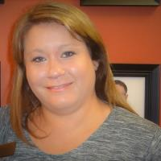
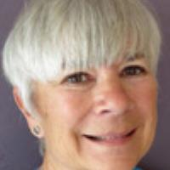
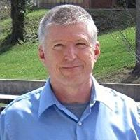
Corinne Gasper, Aubree Adams, Darryl Rogers, Sally Schindel,

Slide 4
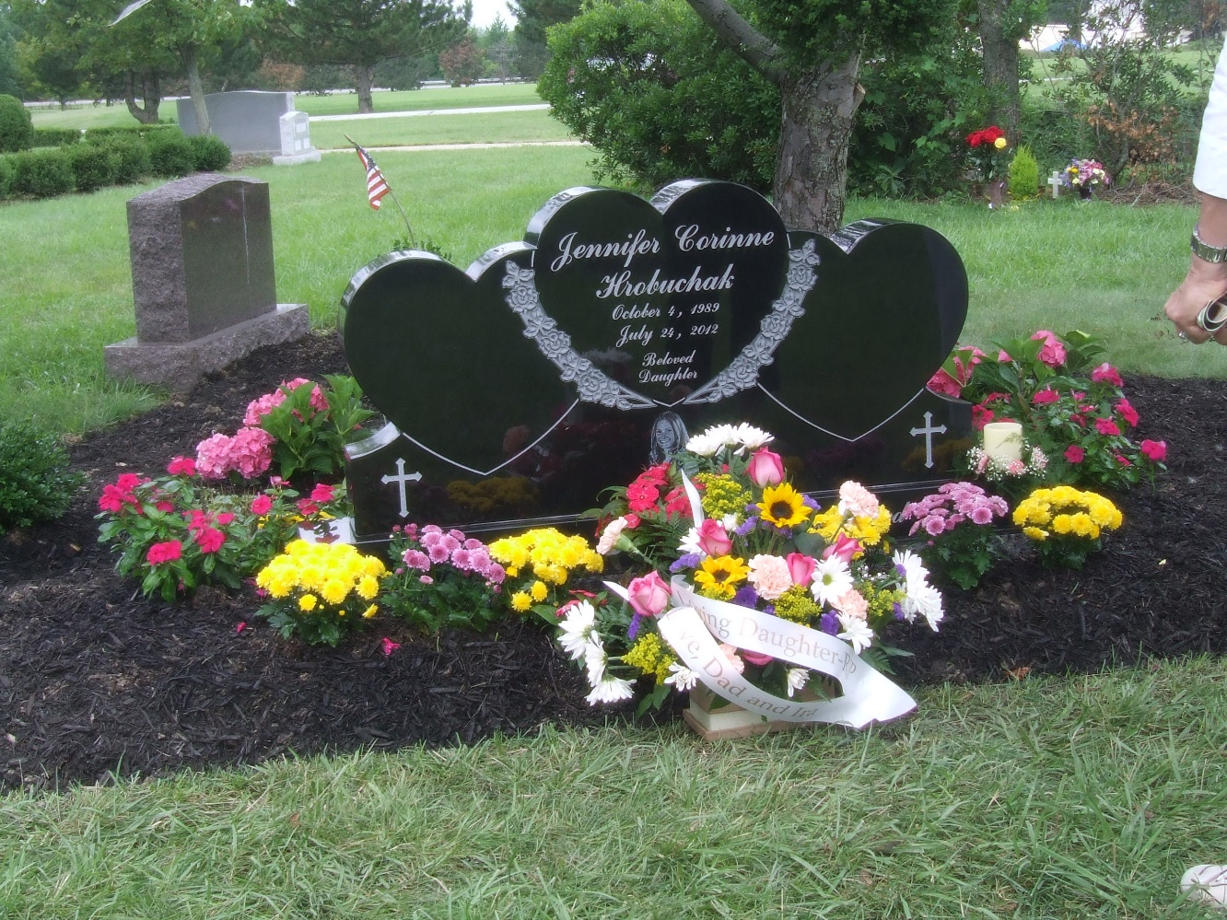
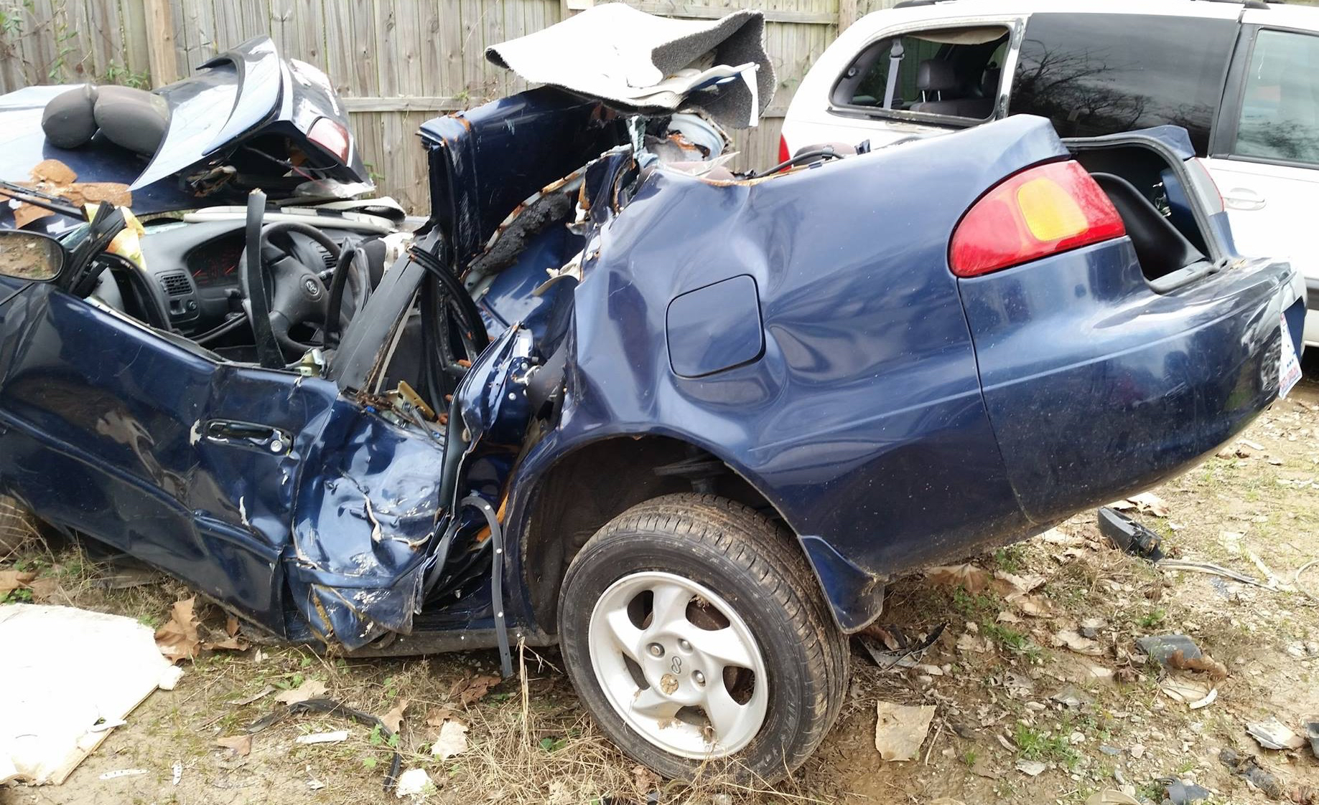
What brings you to marijuana work?

Slide 5
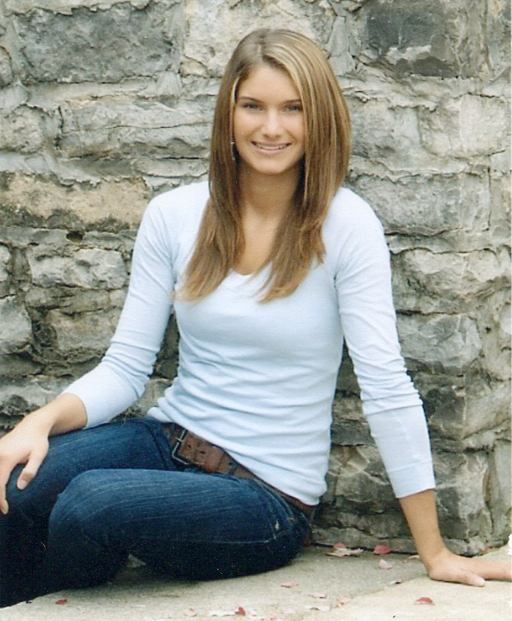
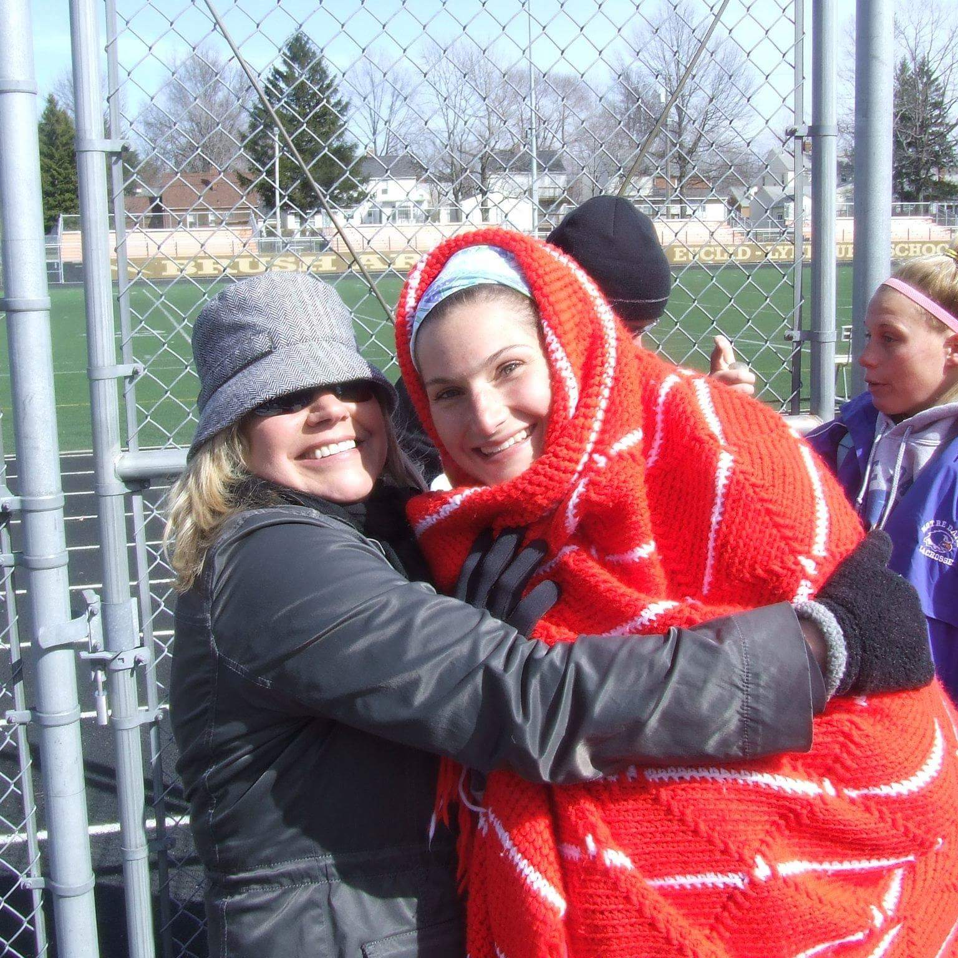
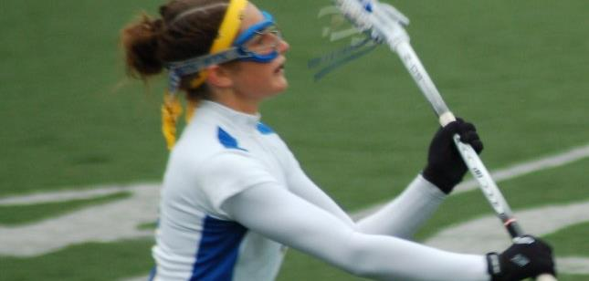
Corinne Gaspar
https://www.nbcsandiego.com/news/local/Marijuana-Safety-Summit-Held-in-San-Diego---455961823.html
Notes:
Timing:
Introduction
5 min
Question 1
2-3 min each
15 min
Question 2
2-3 min each
15 min
Audience Questions
1-3 min each
30 min
Final Question
2-3 min each
15 min
Wrap up
5 min

Slide 6
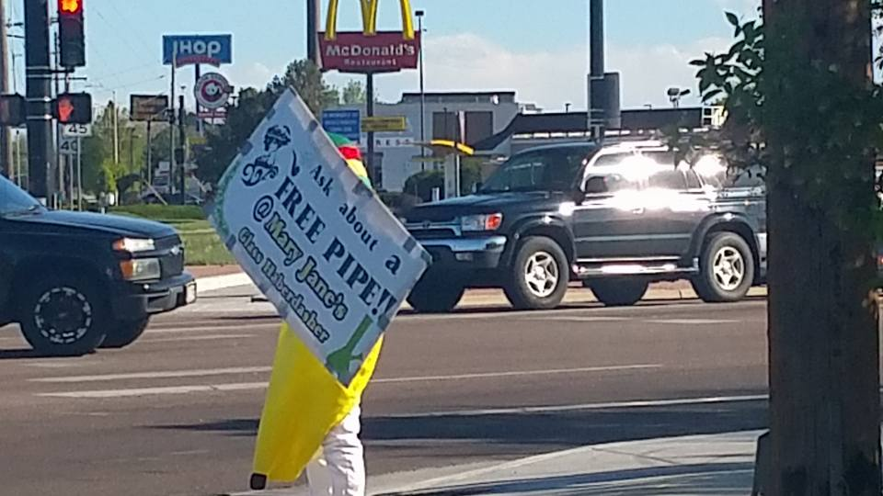
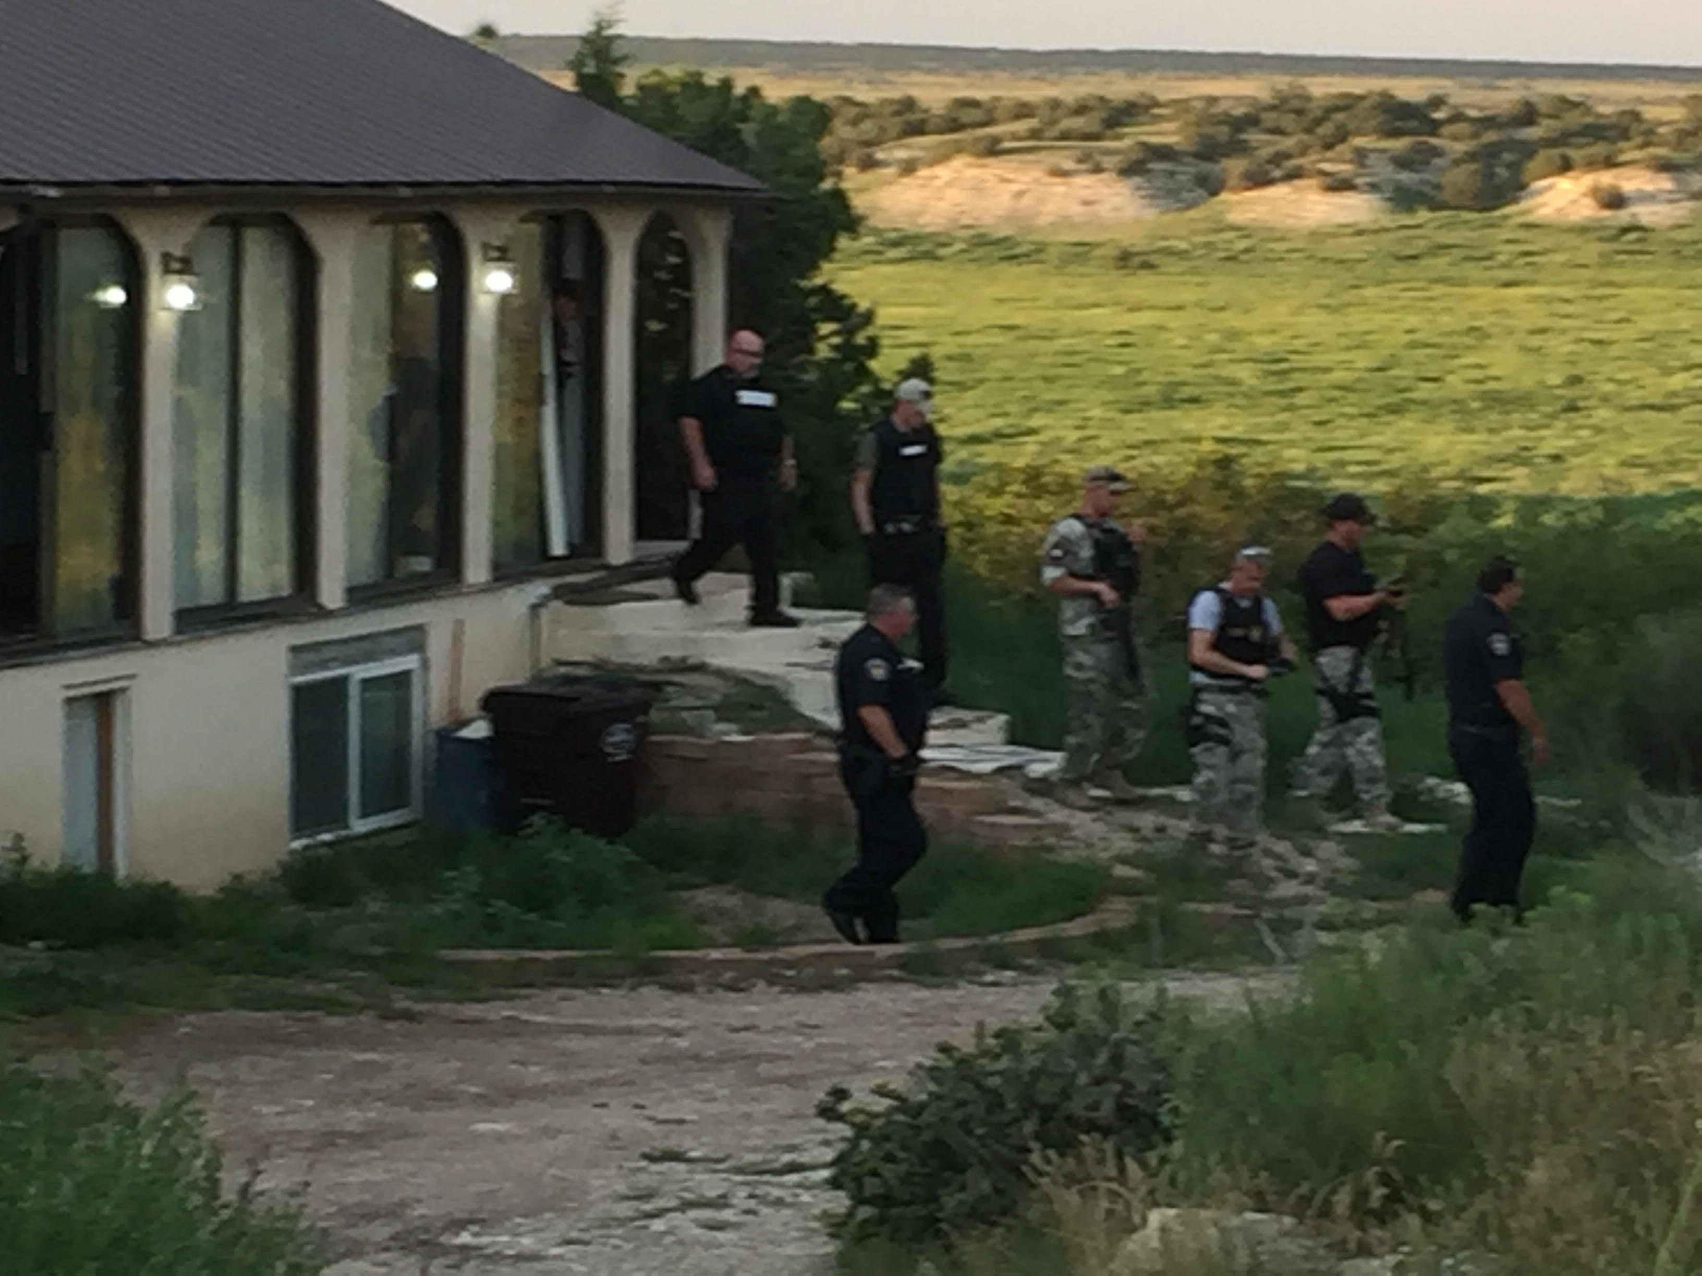
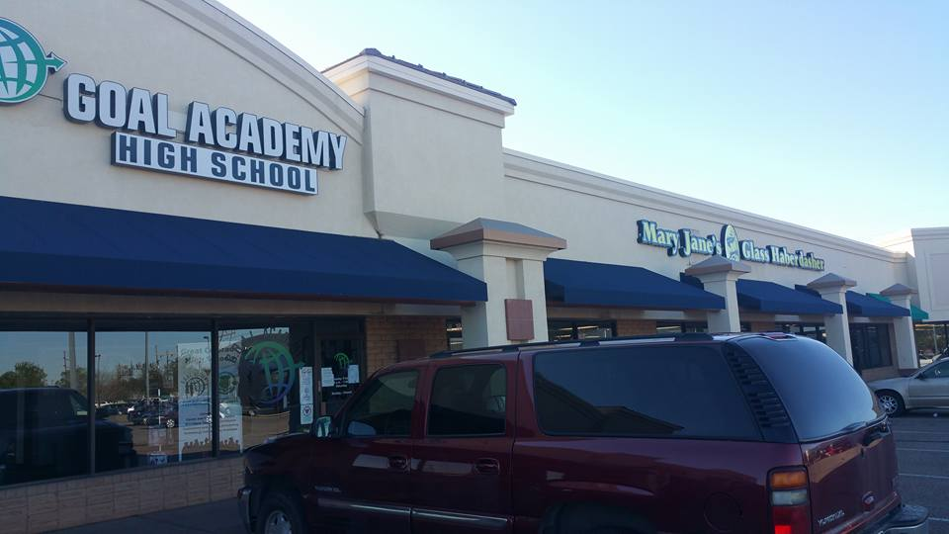
Aubree Adams

Slide 7
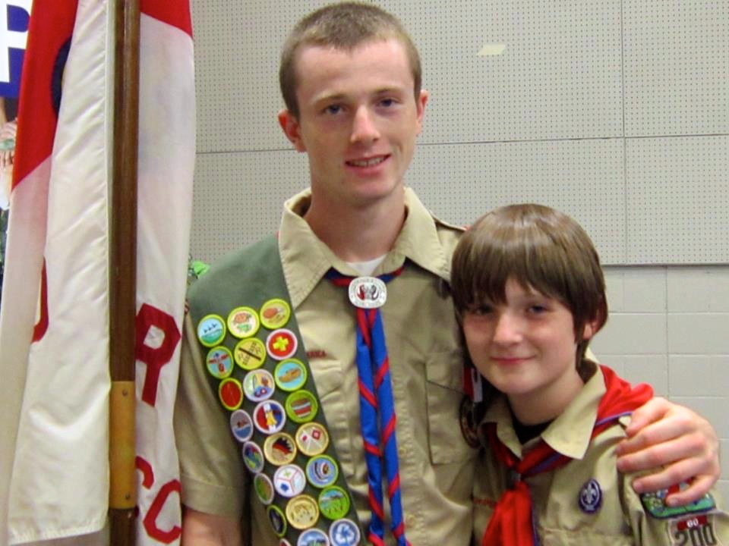
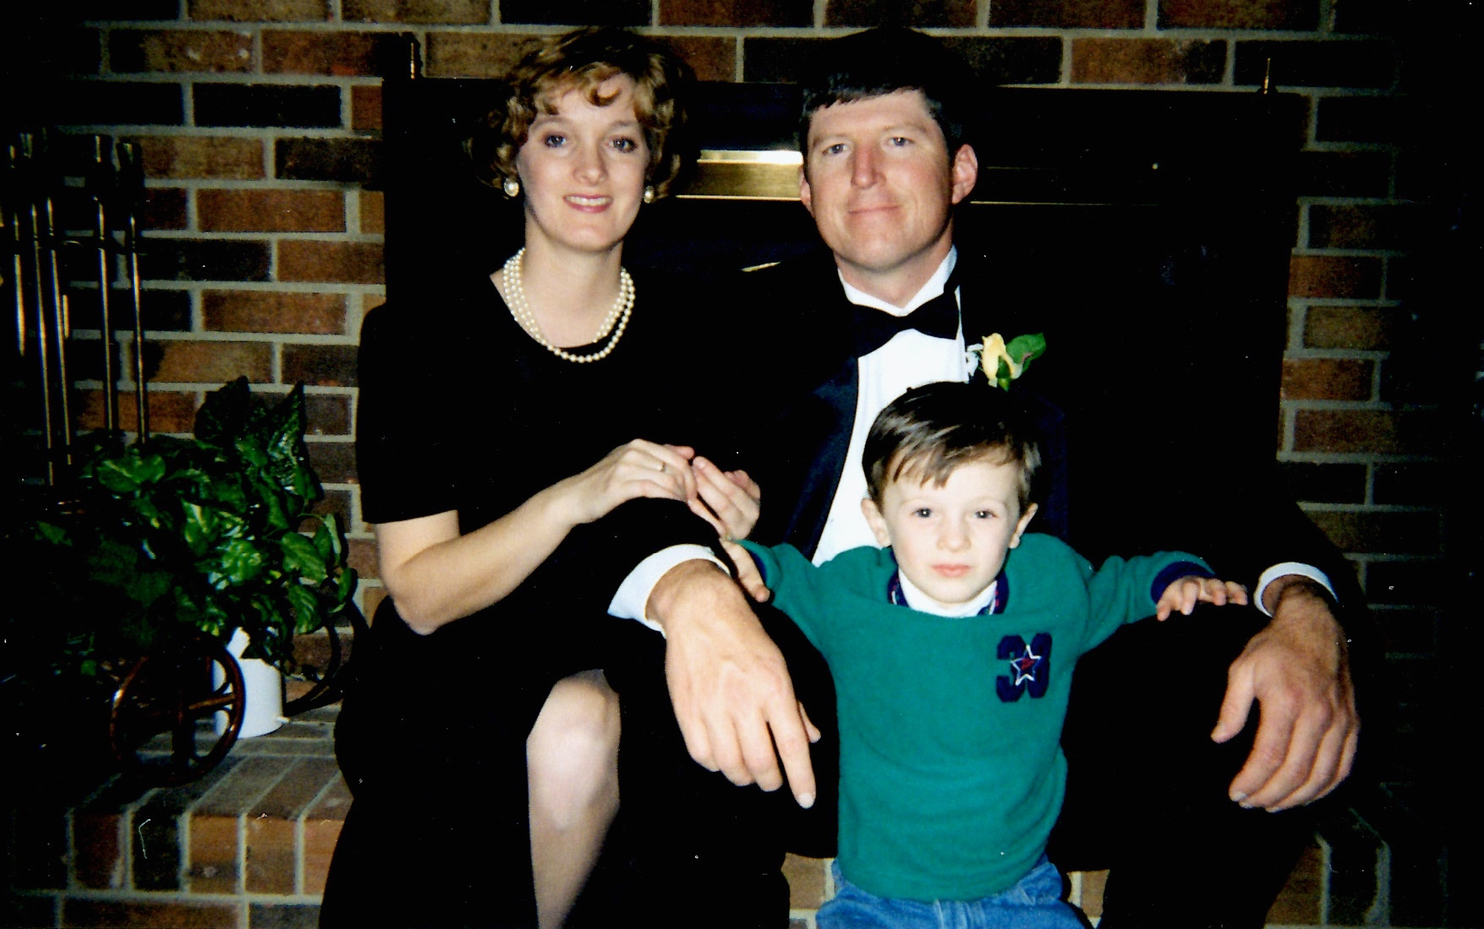
Darryl Rogers

Slide 8
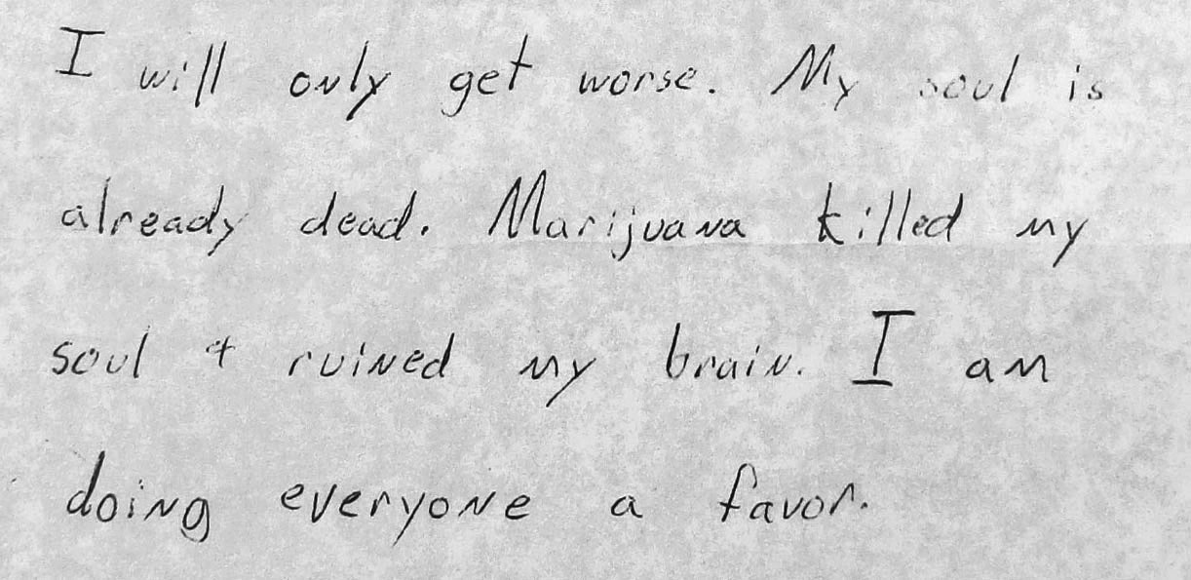
Sally Schindel

Slide 9
What policy changes or laws do you think could have changed the situation that led to your loss?
What strategies will empower people whose lives have been impacted by marijuana to advocate for policy change?

Slide 10
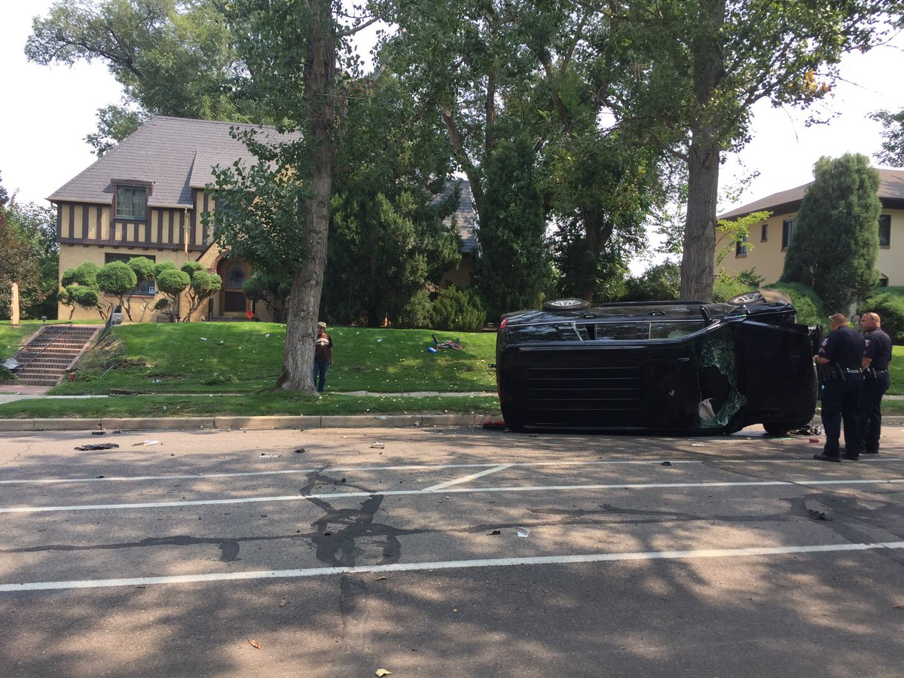
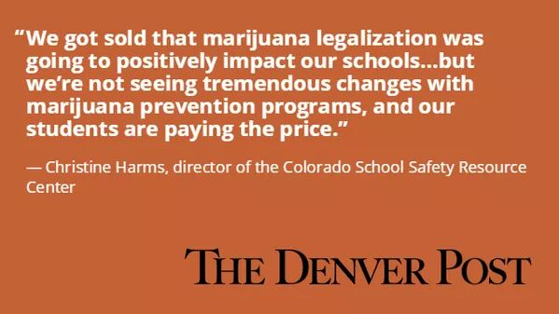
Aubree Adams

Slide 11
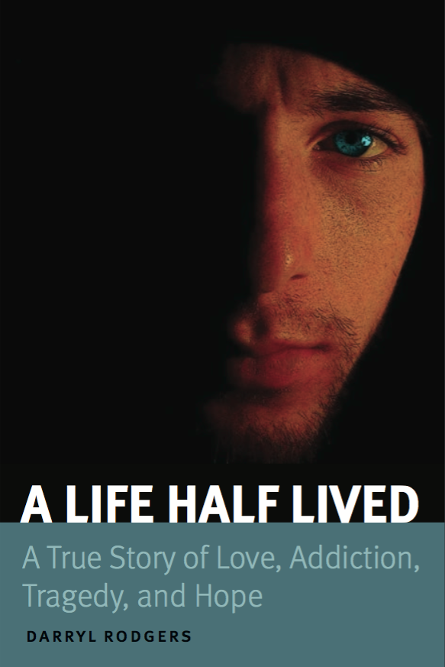
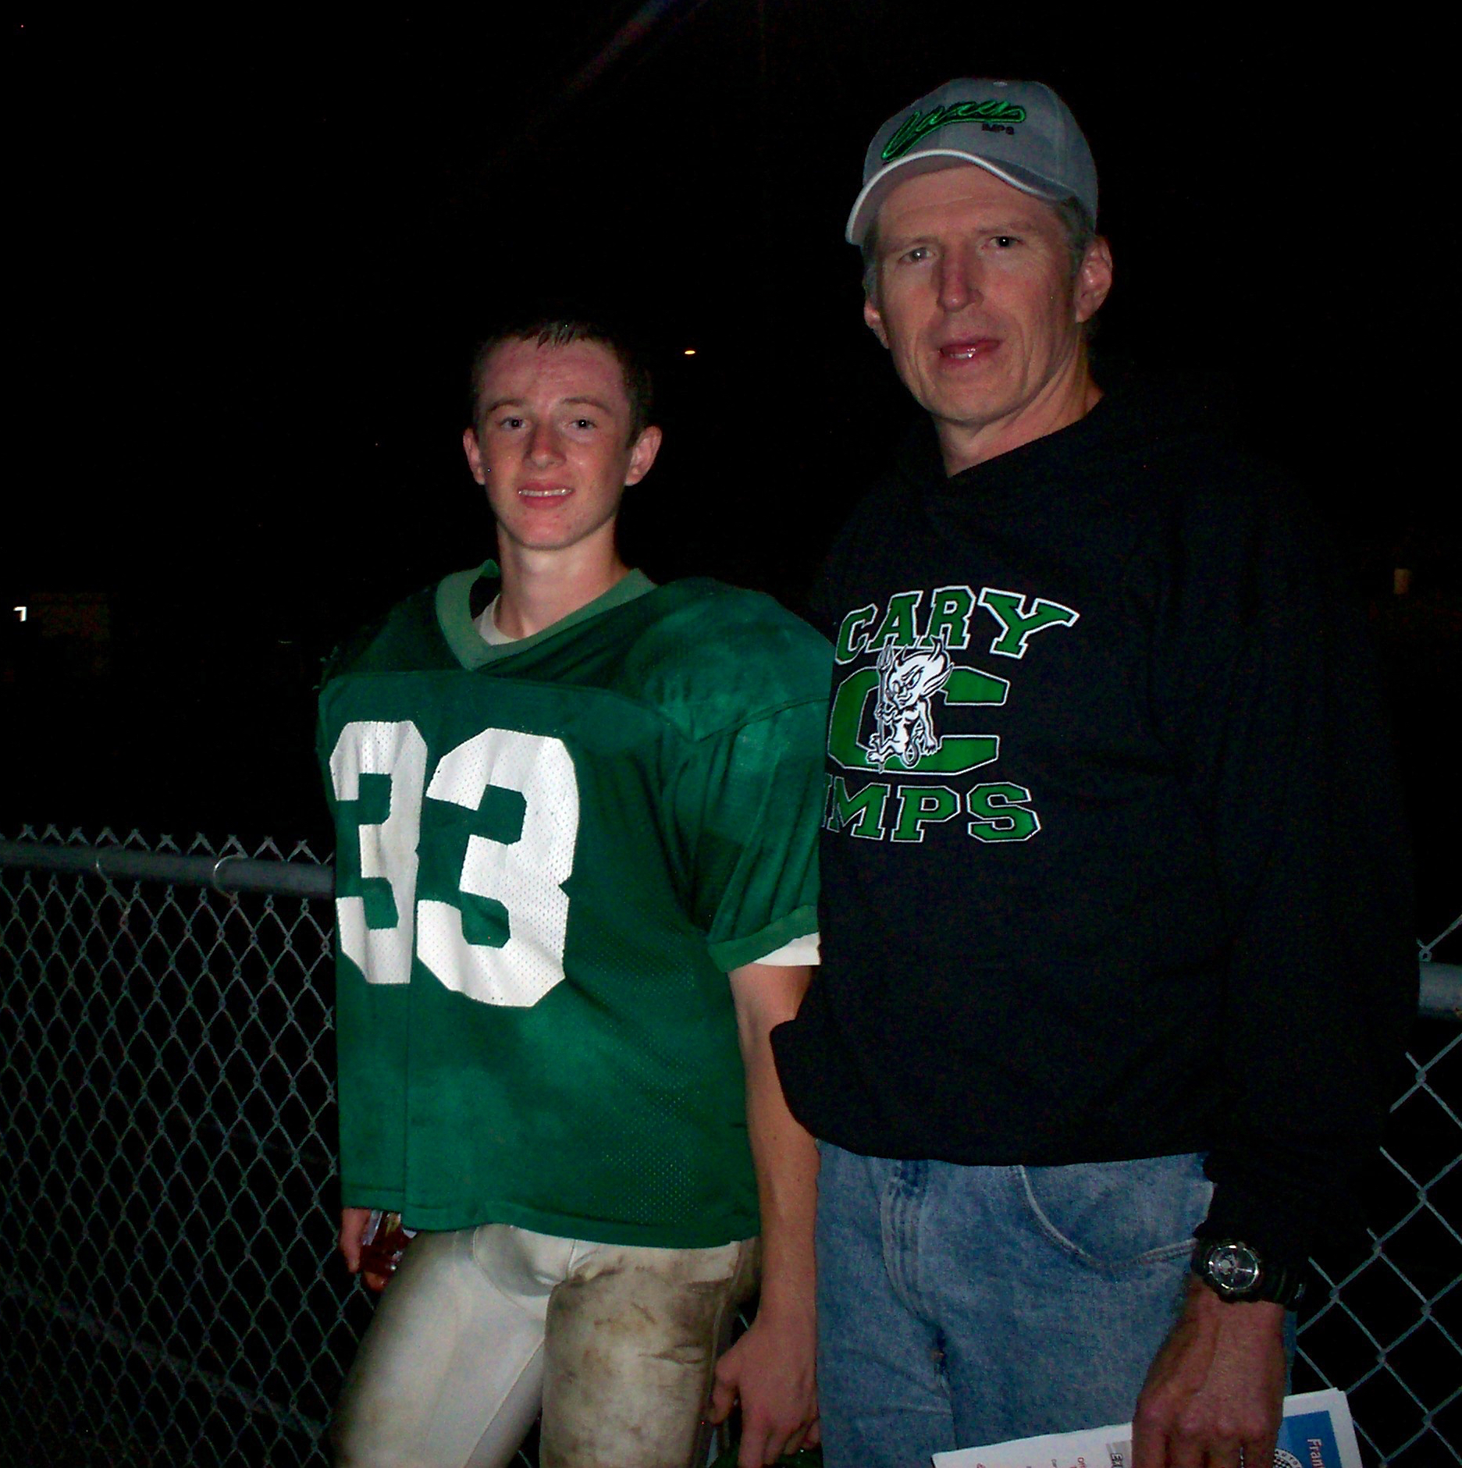
Darryl Rogers

Slide 12
Sally Schindel

Slide 13
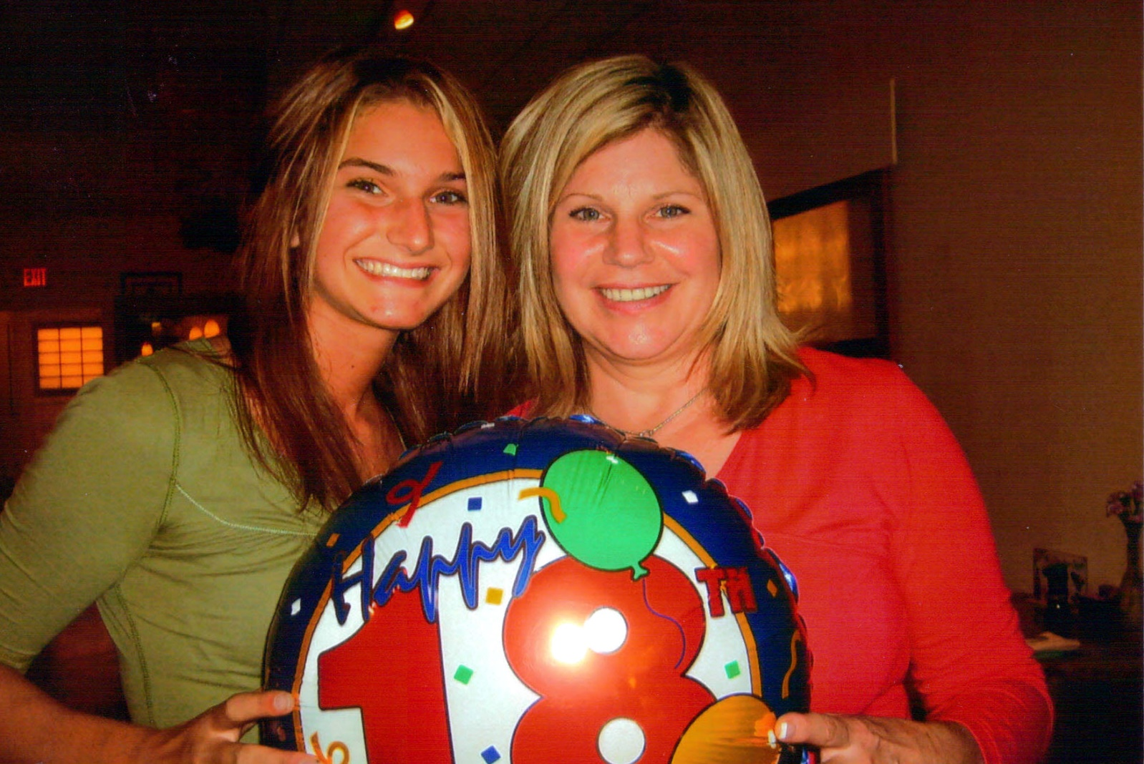
Corinne Gaspar

Slide 14
What is the most important lesson?
Are there steps or actions we can take to change the:
environment,
policies,
laws

Slide 15
Darryl Rogers

Slide 16
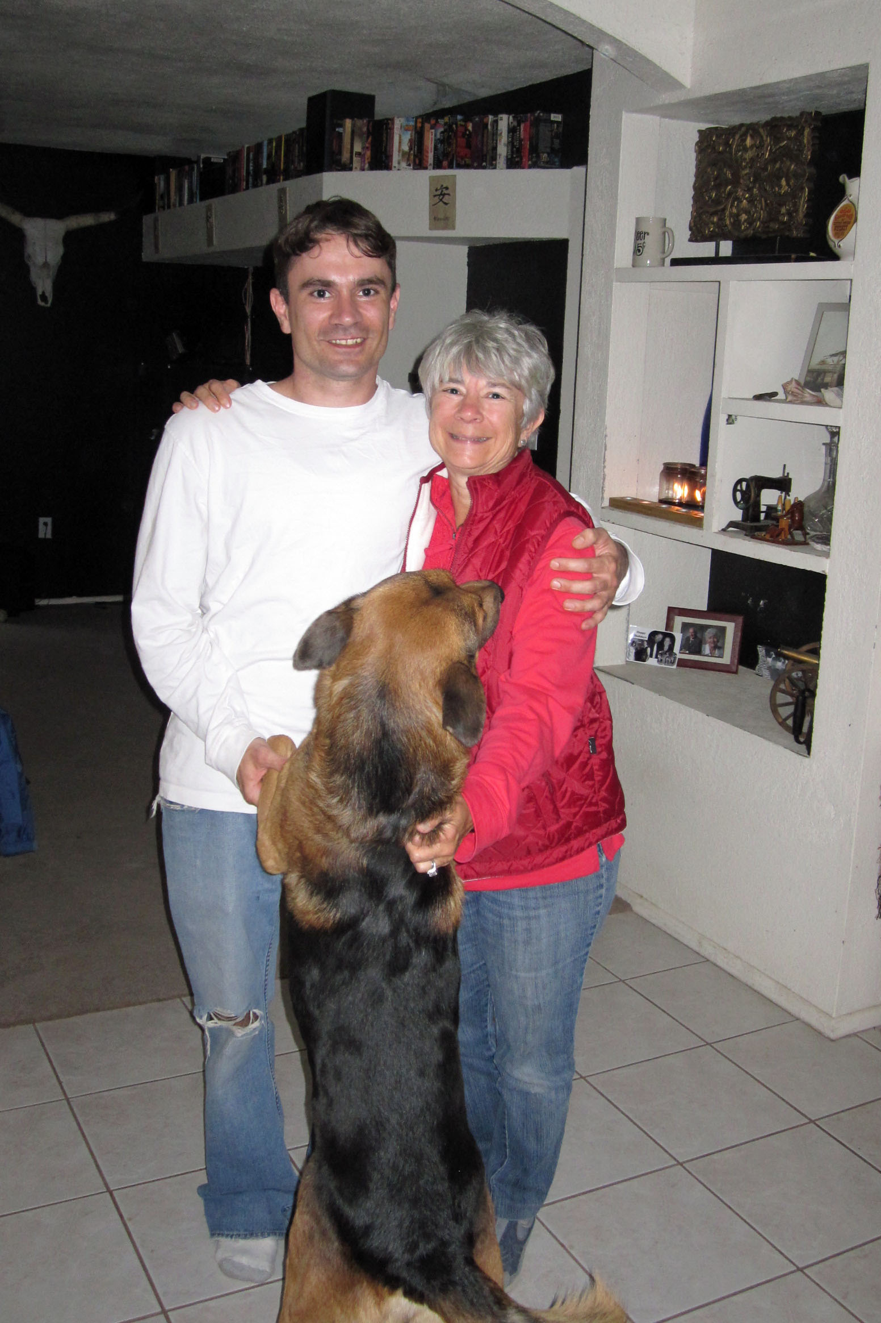
Sally Schindel

Slide 17
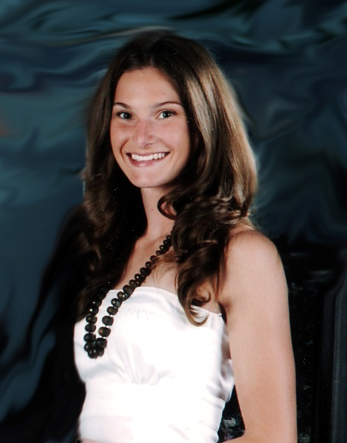
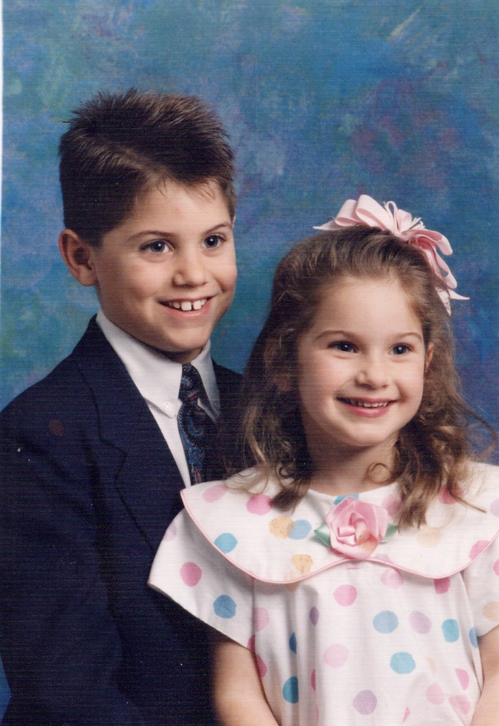
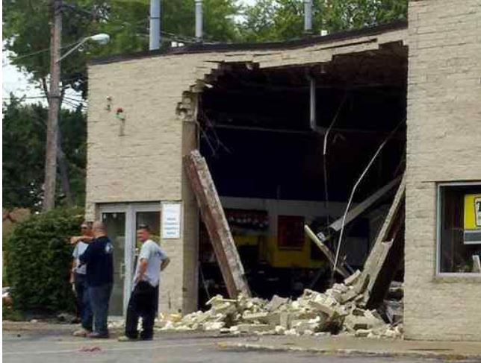
Corinne Gaspar

Slide 18
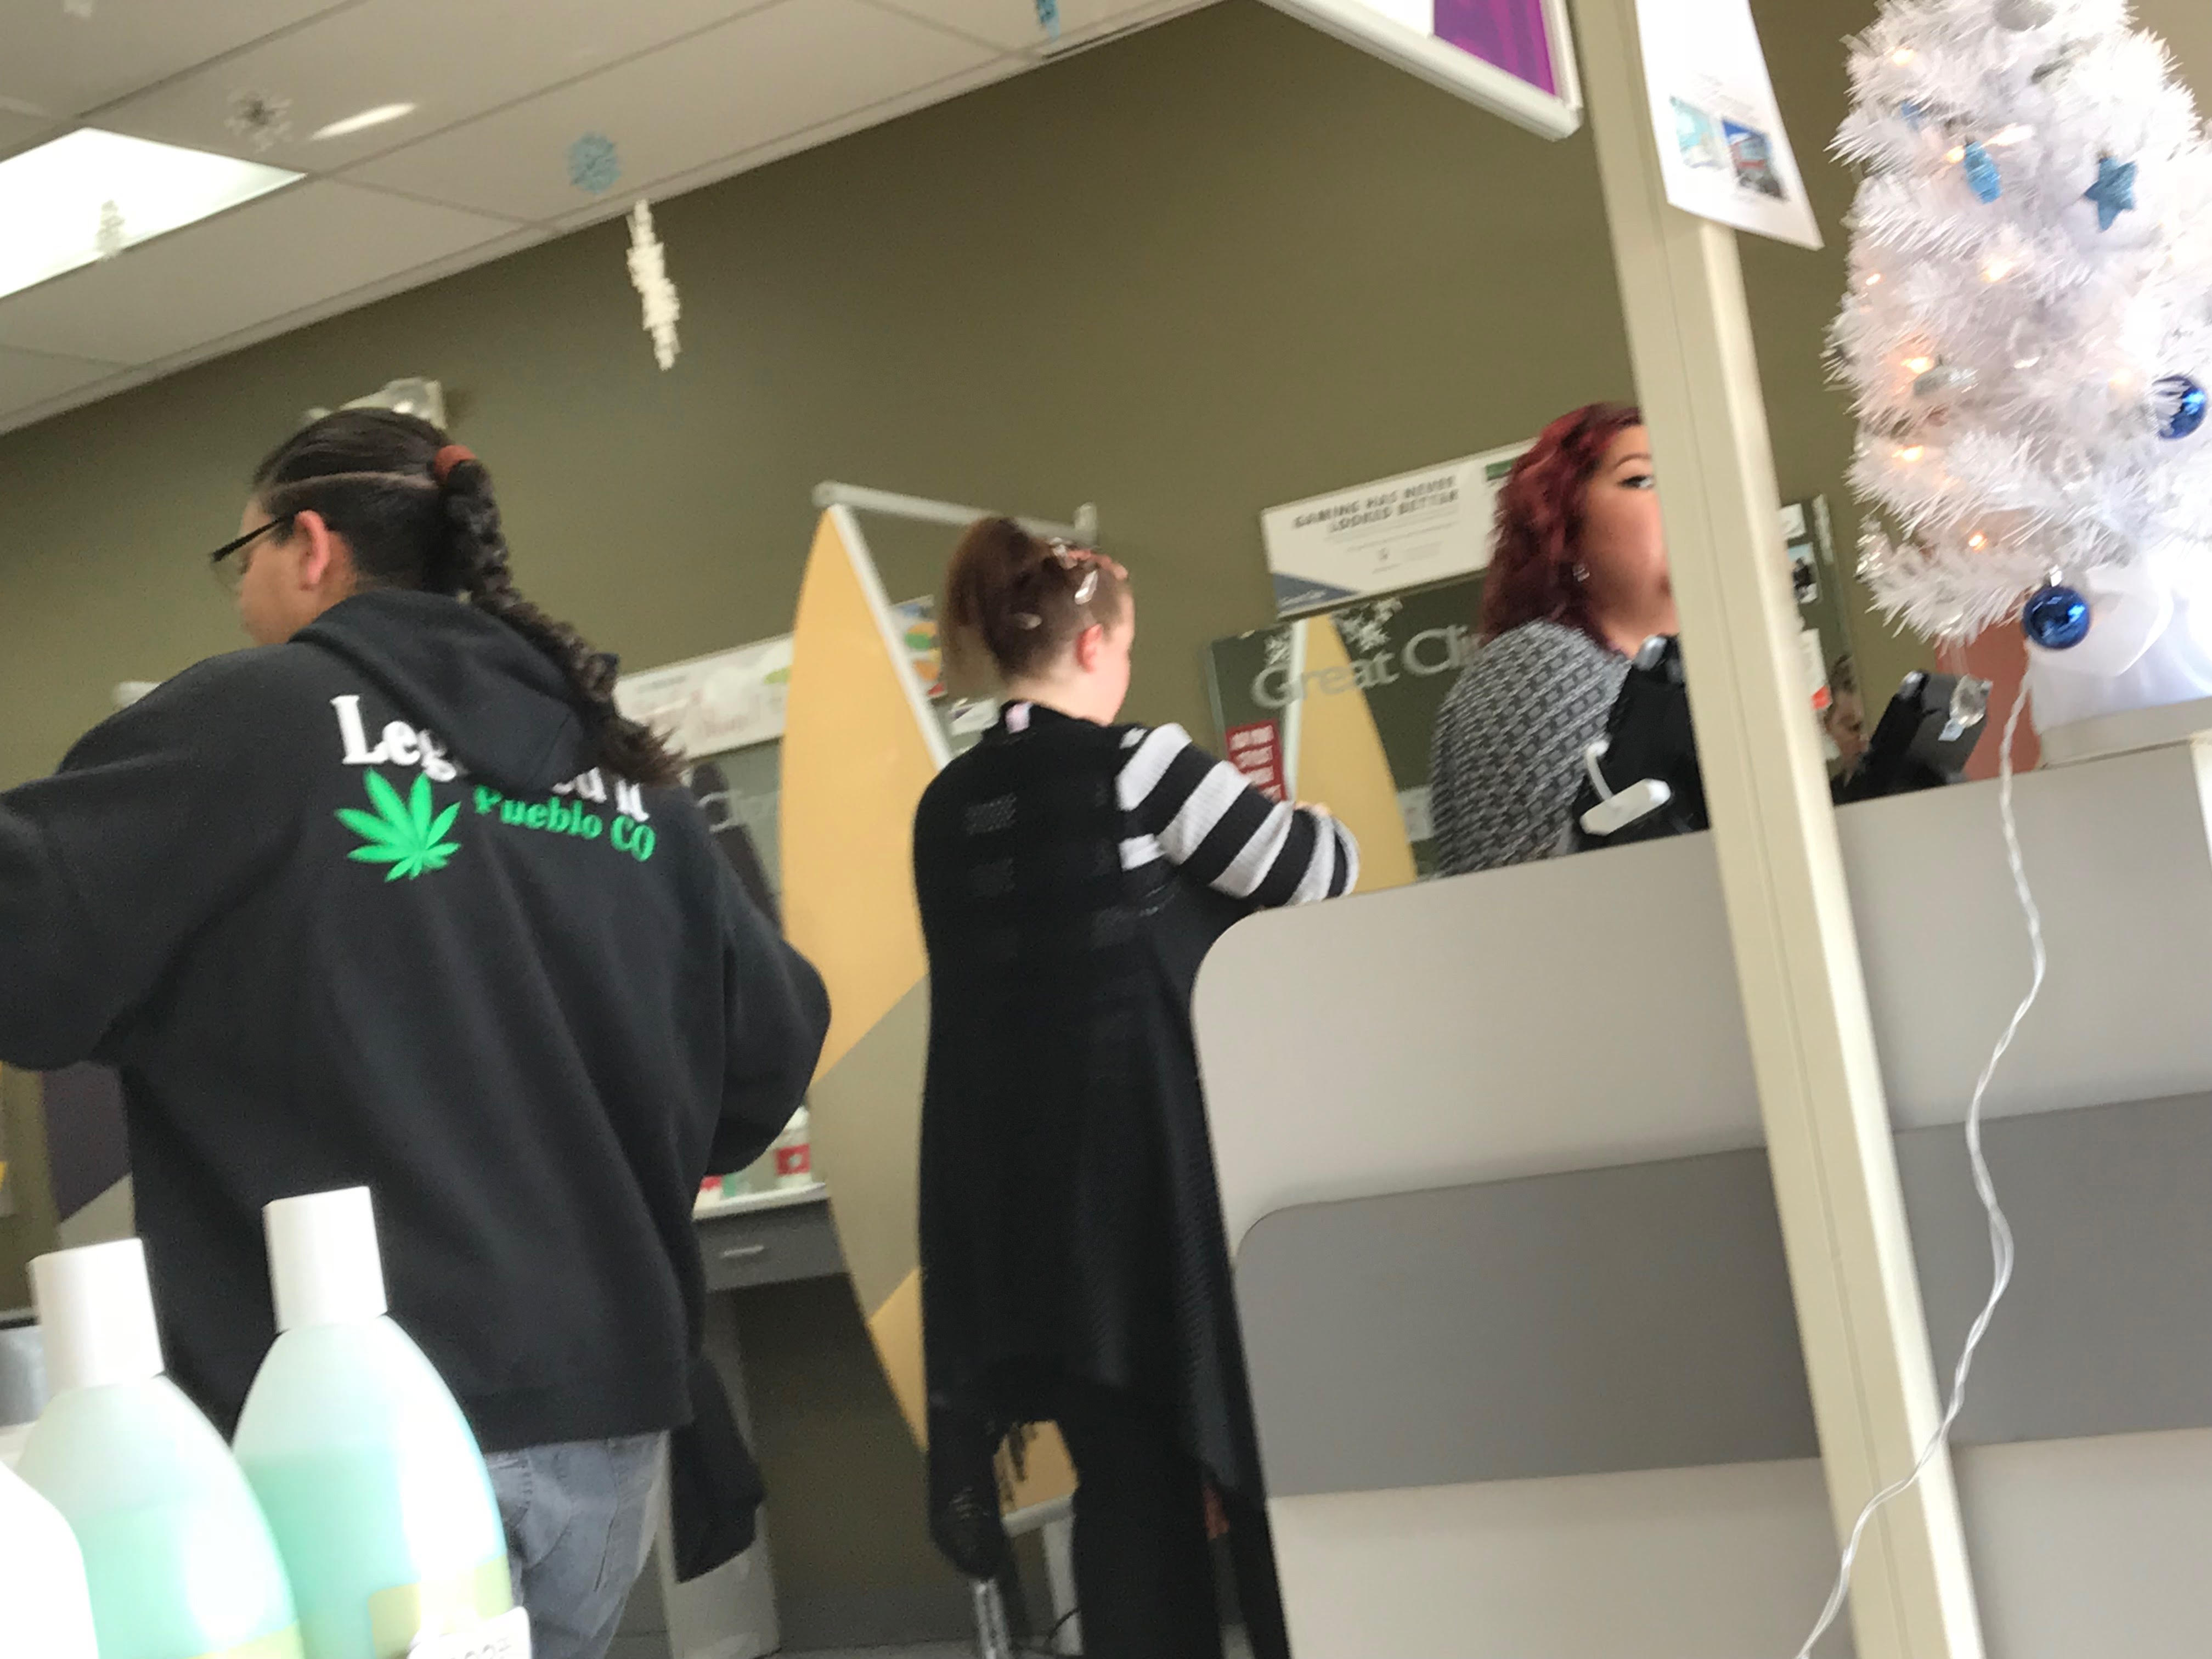
Aubree Adams

Slide 19
Audience Questions

Slide 20
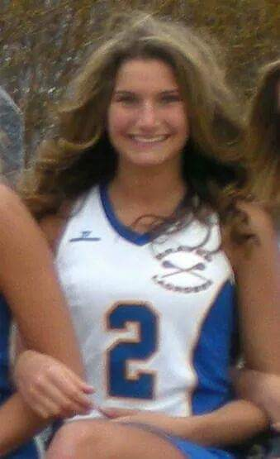
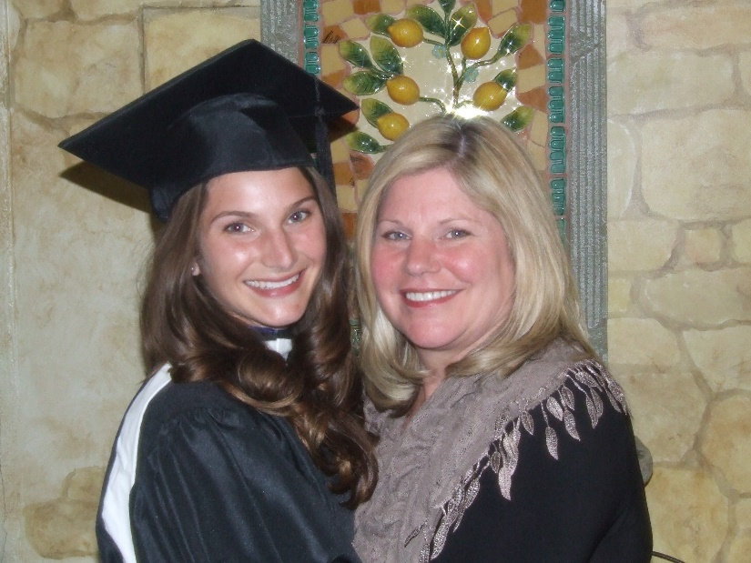
Corinne Gaspar

Slide 21
Sally Schindel

Slide 22
Darryl Rogers

Slide 23
Aubree Adams

Slide 24
Closing thoughts
What is the most important lesson or action--take away-- for the people in the audience?
Are there steps or actions they could take to change the environment/conditions, policies, laws?

Slide 25
Learn more & get involved!
www.highmeansdui.org www.learnaboutsam.org
Dana Stevens 760.317.6716 dana@learnaboutsam.org

