Slide 1
States to Watch in 2018
Mervyn L. Jones II

Slide 2
NEW JERSEY - Governor’s Promise
NJ-RAMP
LEADERSHIP
ADVOCATES
WHAT HAS BEEN DONE?

Slide 3
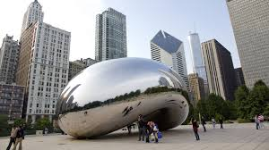
ILLINOIS – Ballot Push
Healthy & Productive Illinois
Leadership
What’s ahead

Slide 4
MICHIGAN – Ballot Push
Healthy Michigan
Leadership
Troops on the ground and Boot camps

Slide 5
NEW HAMPSHIRE – LEGISLATIVE PUSH
New Futures
Victory
Future

Slide 6
Vermont – Legislative
Passed Decriminalization.
1-2 ounces will not be ticketed or charged.

